Slide 1
📡
AI-Powered Telecom Network Operations Assistant
Hybrid RAG · multi-agent troubleshooting · fault-risk prediction · LLM-as-judge
Jerom Santhiyagu
PU Bootcamp GenAI Capstone — Project 4 · Prodapt
Notes:
Introduce yourself and the project: Project 4 of the PU Bootcamp GenAI capstone. One sentence: we turn 100K historical 5G network records into an assistant that finds similar incidents, explains them and recommends validated fixes.

Slide 2
NOC engineers lose time searching history
Thousands of records, recurring problems, no fast way to reuse past fixes
▸ Recurring issues: congestion, poor signal, high latency, packet loss, call drops, handover failures, faults
▸ Rich history: KPIs, alarms, config changes, users, security events, weather
▸ But: finding similar incidents, causes and corrective actions by hand is slow and inconsistent
▸ Goal: ask in plain English → similar cases, analysis, risk score and recommended actions
“A cell is experiencing high latency, packet loss and reduced throughput. What similar conditions occurred before?”
?
“Multiple cells show poor service quality and increasing alarm counts. What factors could contribute?”
?
“A region has increasing fault occurrence and declining handover success. What corrective actions?”
?
2
Notes:
Engineers in the NOC deal with recurring congestion, latency, call drops and faults. Searching history manually is slow. These three questions come straight from the brief and are what the system is built to answer.

Slide 3
The solution at a glance
One microservice, one question, one grounded and validated answer
100K
7
13
100%
0.5s
incidents indexed
FAISS + BM25
agents with a
judge loop
REST endpoints
FastAPI + Swagger
category accuracy
golden queries
mean analysis time
offline mode
What an engineer gets back
🔎
🏷️
📈
🔬
🛠️
⚖️
Similar cases
Priority P1–P4
Forecasts
Root cause
Action plan
Judge verdict
hybrid search + filters
category + confidence
fault risk + KPIs
impact, SLA, MTTR
cited, approval-flagged
5 quality criteria
3
Notes:
The solution at a glance. Every number here is produced by the code in the repo.

Slide 4
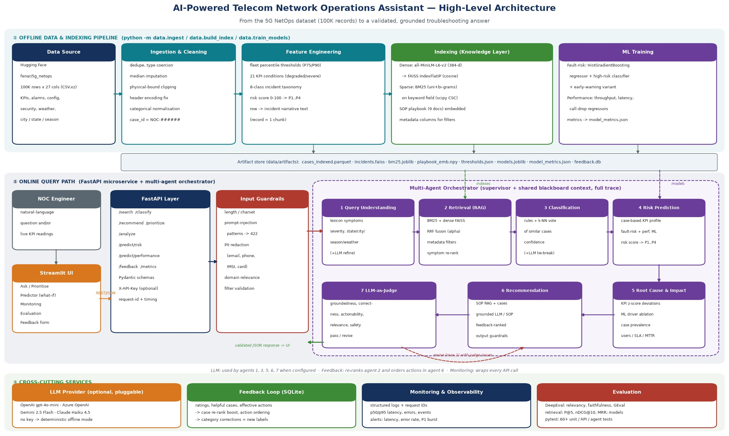
Architecture: build offline, answer online
4
Notes:
Walk the diagram left to right. Top: the offline pipeline that turns the CSV into indexes and models. Middle: the online path through FastAPI, guardrails and the seven agents, with the judge able to send the plan back once. Bottom: LLM, feedback, monitoring and evaluation.

Slide 5
From 100K KPI rows to searchable incidents
5G NetOps dataset (Hugging Face fenar/5g_netops) · 27 fields · one record = one chunk
1
Ingest & clean
2
21 KPI conditions
3
Taxonomy & risk
4
Narrative + index
download, dedupe, impute, clip bounds, fix encoding
degraded ≥ fleet P75, severe ≥ P90 (data-driven)
8 incident classes · risk 0–100 · priority P1–P4
summary → MiniLM/FAISS · keywords → BM25
Data findings that shaped the design
▸ Fault rate is near-deterministic (R² 1.000; critical alarms r = 0.93) → added an early-warning model on leading indicators (R² 0.64)
▸ 'Issue Reported' is label noise (identical KPI means for yes/no) → used only as a filter
▸ No free text → narratives generated from conditions; numbers kept out of BM25 to avoid vocabulary noise
5
Notes:
The dataset is numbers only, so the key design step is turning KPIs into the language engineers use. Thresholds are percentiles of the fleet, so they adapt to the data. Mention the two honest findings: the fault rate is near-deterministic and Issue Reported is noise.

Slide 6
Hybrid + symptom re-rank wins retrieval
Fusion alone does not beat BM25; re-ranking the fused pool on symptoms does
▸ Dense: all-MiniLM-L6-v2 → FAISS exact cosine
▸ Sparse: vectorised BM25 (uni+bi-grams) on location, season, weather, conditions, category
▸ Fusion: Reciprocal Rank Fusion, semantic weight α = 0.6 (tunable per request)
▸ Re-rank: + symptom overlap with query, + feedback boost. This is where the gain comes from
▸ Filters: state, city, season, weather, category, priority, risk, required conditions; auto-detected from text
6
Notes:
Hybrid retrieval: BM25 on a keyword field plus dense MiniLM vectors in FAISS, fused with Reciprocal Rank Fusion and re-ranked by symptom overlap and feedback. Metadata filters are applied before search, so top-k is always inside the filter. The chart compares strategies on paraphrased queries.

Slide 7
Seven agents collaborate on every analysis
Supervisor + shared blackboard · full trace · deterministic fallback for every LLM step
1
2
3
4
5
6
7
Query understanding
Retrieval
Classification
Risk prediction
Root cause & impact
Recommendation
LLM-as-judge
symptoms, severity, location
hybrid RAG + filters
rules + k-NN vote (+LLM)
case-based KPI profile → ML
deviations, drivers, users, SLA
SOP RAG, cited plan
5 criteria → pass / revise
Collaboration loop
▸ Judge → Recommendation: if groundedness ≤ 3 or any score ≤ 2, the issues are sent back and the plan is rebuilt (e.g. adds SOPs for uncovered symptoms); at most one revision bounds cost
▸ Why plain Python, not LangGraph: a fixed DAG plus one loop gives deterministic, testable, fast control flow
7
Notes:
Seven agents share one context object. Each leaves a trace entry. The judge scores the plan on five criteria; if it says revise, its issues go back to the recommendation agent once. Every agent has a deterministic fallback, so the system works without an LLM.

Slide 8
Predicting risk, explaining the root cause
HistGradientBoosting models with local driver explanations
Root cause = three independent signals
σ
KPI deviation
direction-aware z-scores vs fleet baseline
ƒ
Model drivers
median-substitution ablation on the fault model
≈
Historical evidence
condition prevalence in the top-k similar cases
Impact: users affected, data at risk, availability gap, expected MTTR, SLA breach risk, services affected, pattern prevalence
8
Notes:
Fault-risk models: the full model is used for what-if analysis, and the early-warning model is the honest forecast. The performance models beat the baseline but are modest, and we show R² in the UI. Root cause triangulates statistics, model drivers and history.

Slide 9
Safe by design, better with every rating
Guardrails on input and output · feedback flows back into ranking and actions
🛡️
Input guardrails
✅
Output guardrails
🔁
Feedback loop
▸ Pydantic ranges & enums on every field
▸ 13 prompt-injection / SQL / script patterns → 422
▸ PII redaction: email, phone, IMSI, card
▸ domain-relevance check (off-topic → 422)
▸ citations must be retrieved case IDs or SOPs
▸ unsafe steps removed (e.g. disable alarms)
▸ service-affecting steps need approval
▸ optional X-API-Key, request-ID audit trail
▸ 1–5 rating, helpful cases, effective actions
▸ case boost/penalty in re-ranking (±0.15)
▸ actions re-ordered per category
▸ category corrections → new labelled examples
9
Notes:
Security and compliance: validate everything at the edge, redact PII before any LLM call, and sanitise outputs. The feedback loop makes the system better with use, and a test proves the ranking changes.

Slide 10
Measured, not assumed
pytest suite · retrieval benchmark · golden-set evaluation · DeepEval when an LLM is configured
0.95
100%
symptom-extraction F1
SOP coverage
100%
4.9/5
valid citations
judge score
DeepEval metrics: AnswerRelevancy · Faithfulness · ContextualRelevancy · GEval Recommendation Quality · GEval Diagnosis Correctness (judge = configured LLM)
10
Notes:
Evaluation at three levels: unit, API and agent tests; retrieval metrics; and recommendation quality on golden queries with the heuristic judge and, when a key is set, DeepEval metrics. Note the embedding comparison that justified MiniLM.

Slide 11
Live demo
Streamlit UI on top of the FastAPI microservice
1
Ask
2
Filter
3
Guardrails
brief question 1 → full multi-agent analysis
hybrid vs keyword vs semantic; Winter, P1/P2, TX
prompt injection blocked, PII redacted
4
Prioritise
5
What-if
6
Feedback
batch of incidents ranked P1 → P4
risk and performance predictor with drivers
rate → monitoring and feedback dashboard
11
Notes:
Switch to the live demo now and follow 07_Demo_Script.md.

Slide 12
Trade-offs we chose, and what comes next
Deliberate trade-offs
Next steps
▸ Deterministic core, LLM for language: always available and cheap; less fluent offline
▸ Exact FAISS at 100K: no recall loss; move to ANN / managed vector DB beyond about 5M vectors
▸ Small LLMs (4o-mini / Flash / Haiku): evidence-bound prompts do not need large models
▸ Percentile thresholds: adapt to the fleet, but are relative rather than 3GPP targets
▸ Real data: retrain on live KPIs with timestamps and cell topology
▸ Retrieval: cross-encoder re-ranker, LLM query rewriting
▸ Ops: Azure Container Apps, Azure AI Search, Prometheus / Azure Monitor
▸ Learning: A/B tests on feedback ranking, retrain the classifier on corrections
Thank you — questions?
12
Notes:
Close with the trade-offs we chose deliberately, and what we would do next with real network data. Then open for questions.

