Slide 1
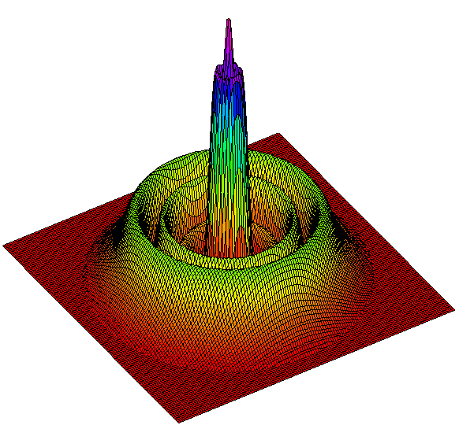
OSCAR
A matlab based optical FFT code
Jerome Degallaix

