Slide 1
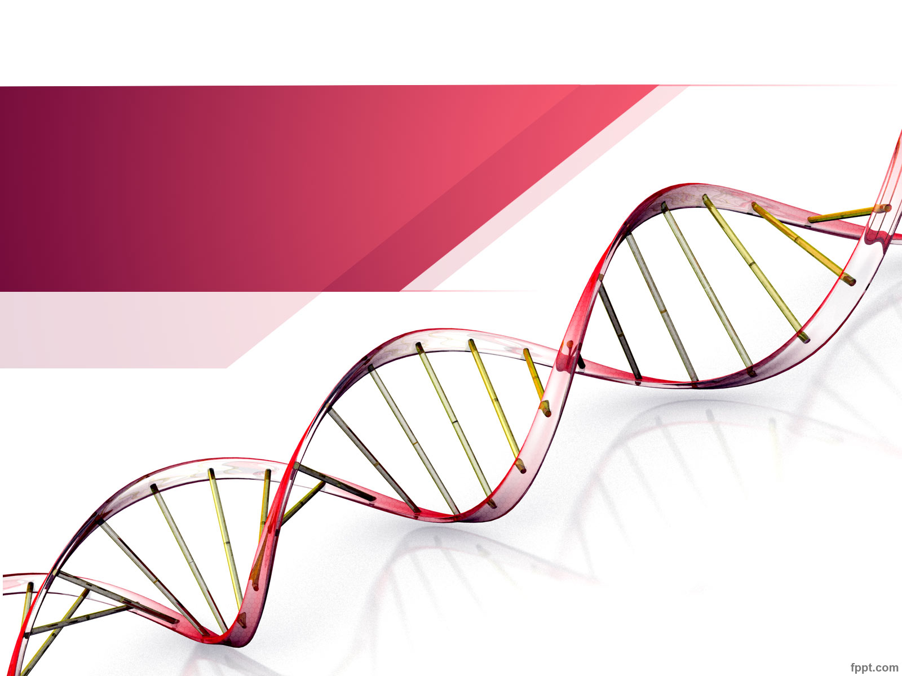
Analyse de données Métagénomique
Jérôme Ambroise
ULC / IREC / CTMA

Slide 2

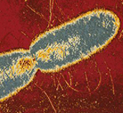
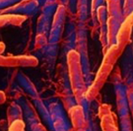
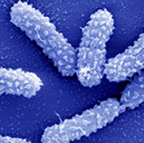
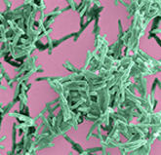
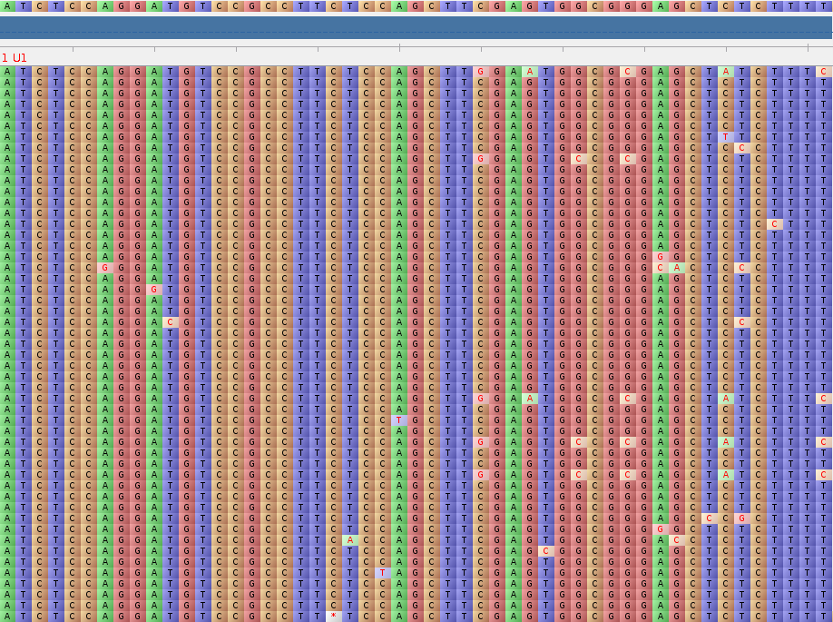
Contexte biologique:
Objective:
Identify the microbial community
Method:
Deep amplicon sequencing of 16s rRNA gene
16s gene sequences allows to differentiate most bacteria
Challenge:
Huge amount of data
=> Bioinformatics and Biostatistics
16s rRNA

Slide 3
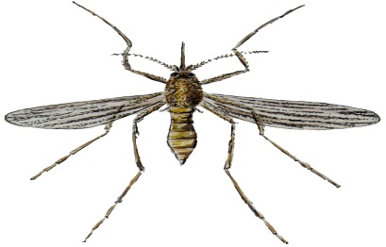
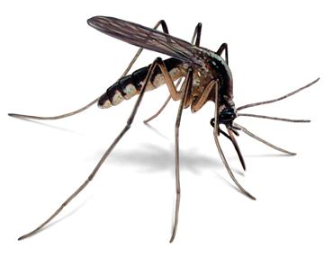
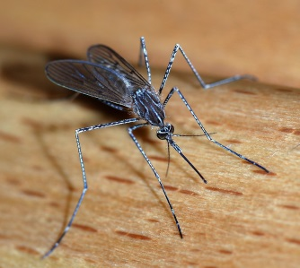
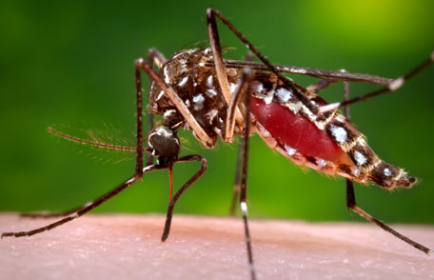
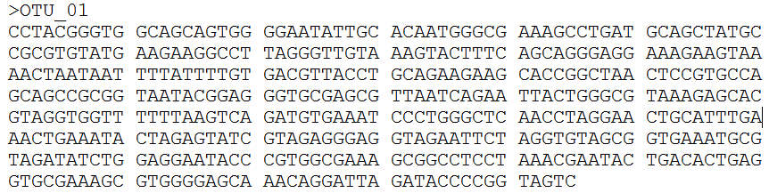
OTUs et identification taxonomique
100.000 Seq.
=> Generate an OTU Table
=> Taxonomic identification for each OTU using database (Greengenes)

Slide 4

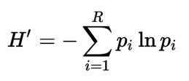


Analyse bio-statistique
1: Alpha diversity
Richness = Number of OTUs
Shannon diversity
H’ = 1.38
H’ = 0.56

Slide 5
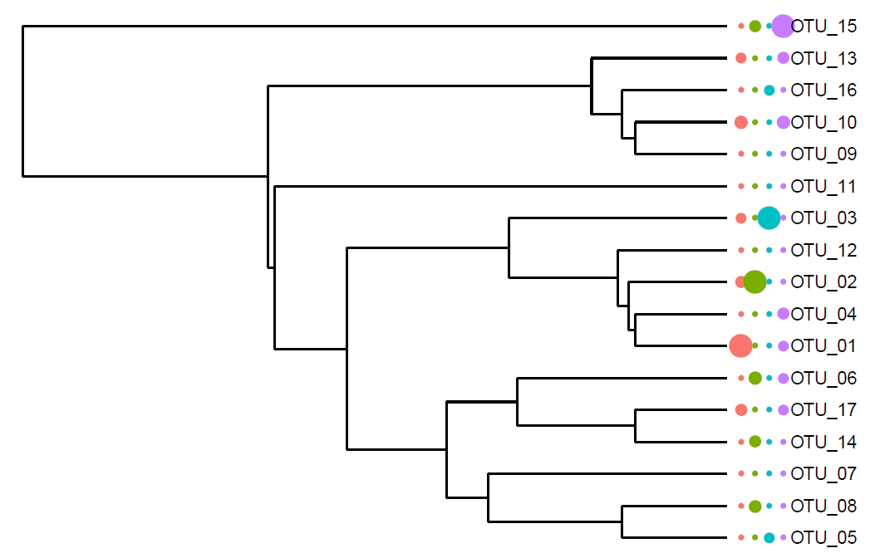
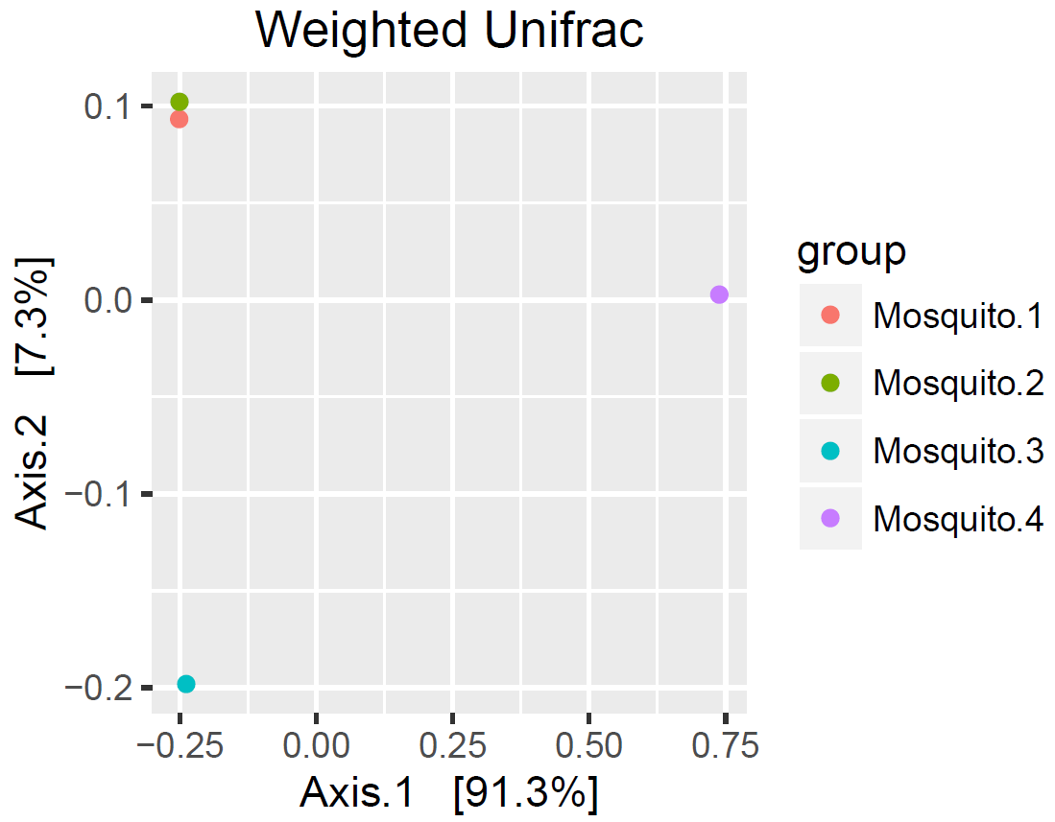
Analyse bio-statistique
2: Beta diversity (Unifrac analysis)

