Slide 1

DEPARTMENT OF ARTIFICIAL INTELLIGENCE
20AM5203 - DESIGN PROJECT - 1
Batch - 12
Presented by :
Guided by :
JEROME CHRISTOPHER J - 811722001019
NUEMON KUMAR K R - 811722001037
SATHYA PRAKASH A - 811722001044
Mr. R. ROSHAN JOSHUA,
Assistant Professor / AI

Slide 2
PROJECT TOPIC
HANDWRITTEN DIGIT RECOGNITION USING WEBCAM

Slide 3
OBJECTIVE
The primary objective of this project is to create a model capable of accurately identifying handwritten digits. By leveraging machine learning techniques and image processing.

Slide 4
EXISTING SYSTEM
The existing system for handwritten digit recognition relies on capturing images using a webcam in real-time.
The image undergoes basic preprocessing steps such as resizing, grayscale conversion, binarization, and noise reduction to enhance clarity and improve recognition accuracy.

Slide 5
PROPOSED SYSTEM
The proposed system addresses the shortcomings of the existing approach by incorporating advanced image preprocessing techniques, such as adaptive thresholding, contrast enhancement, and background subtraction.
These improvements result in higher recognition accuracy, even in challenging environments, and greater adaptability to various handwriting styles.

Slide 6
LITERATURE SURVEY
S.No | TITLE | AUTHOR | YEAR | TECHNIQUES USED | DEMERITS
1 | A Financial Handwritten Digit Recognition Model Based on Artificial Intelligence | Qisheng Jiang | 2022 | Artificial intelligence; Machine learning; Deep learning; Financial applications. | Data security and privacy.
2 | Handwritten Digit Recognition for Banking System | V. Gopalakrishan, R. Arun | 2022 | Convolutional neural networks, MNIST database | Leading to errors in recognition.

Slide 7
LITERATURE SURVEY
S.No | TITLE | AUTHOR | YEAR | TECHNIQUES USED | DEMERITS
3 | A survey on Recognition of Handwritten ZIP Codes in a Postal Sorting System | K S Naga Sai Nischal, Guvvala Nithin Sai | 2023 | Handwritten recognition, ZIP codes, API, Convolution neural network, MNIST database. | Leading to incorrect ZIP codes.
4 | Automatic Number Plate Recognition System (ANPR) | Chirag Patel, Dipti Shah | 2023 | Automatic Number Plate Recognition (ANPR), Artificial Neural Network (ANN), Number Plate, Optical Character Recognition | Leading to false positives.

Slide 8
LITERATURE SURVEY
S.No | TITLE | AUTHOR | YEAR | TECHNIQUES USED | DEMERITS
5 | A deep learning approach for forensic handwriting analysis | Adeyinka Oluwabusayo Abiodun | 2024 | CNN; SVM; DNN; Bayesian inference; forensic handwriting analysis | Ethical questions regarding its admissibility in court.

Slide 9
FLOW DIAGRAM
Input Image
Classification on Using KNN, SVM
Pre-Processing
User
MNIST Data
Result and Accuracy
Train and Evaluate

Slide 10
SYSTEM & SOFTWARE SPECIFICATION
SOFTWARE SPECIFICATION
Windows 10/11
MNIST
Visual Studio
Python 3.6 or above
HARDWARE SPECIFICATION
Multicore Processor
Webcam
RAM 8GB

Slide 11
MODULES
Pre-Processing Module
Creating Module
Training Module
Evaluate Module
Prediction Module

Slide 12
PRE-PROCESSING
Purpose
The Preprocessing module handles the conversion and transformation of image data so that it can be used by machine learning models.
Function Used
preprocess_train_data(self, X):
preprocess_input_image(self, frame):

Slide 13
Function Purpose
This functions is used to converts it to grayscale, resizes it to 8x8 pixels, inverts the pixel values (making the background black and digits white), and flattens it into a 1D array.

Slide 14
CREATE MODULE
Purpose
The Model Creation module is responsible for defining and creating machine learning models that will be used for digit recognition. It combines different classifiers into an ensemble model using a Voting Classifier.
Function Used
create_model(self):
Function Purpose
This function defines and creates the ensemble machine learning model.

Slide 15
Algorithms Used
MLPClassifier (Multi-Layer Perceptron)
Program
model = MLPClassifier(hidden_layer_sizes=(100,), max_iter=10, random_state=42)
Algorithm Purpose
The hidden_layer_sizes=(100,) specifies a single hidden layer with 100 neurons.
The model is trained on the digits dataset provided by scikit-learn.

Slide 16
TRAINING MODULE
Purpose
The Training module handles the process of training the machine learning model using labeled data (in this case, the Digits dataset from sklearn).
Function Used
train_model(self):
Function Purpose
This function trains the model using the Digits dataset, which is a set of 8x8 pixel images of handwritten digits.

Slide 17
Steps in Training
Forward pass: Compute predictions.
Loss calculation: Use categorical cross-entropy.
Backpropagation: Update weights via gradient descent.

Slide 18
EVALUATE MODULE
Purpose
The Evaluation module is responsible for testing the trained model to see how well it performs on unseen data (i.e., test data). It calculates performance metrics such as accuracy.
Function Used
evaluate_model(self):
Function Purpose
This function evaluates the trained model's performance on the test set. It first scales the data, splits it into training and test sets, and then makes predictions using the trained model.

Slide 19
Evaluation Metrics
Accuracy: Proportion of correct predictions.
Confusion Matrix: Class-wise performance analysis.
Importance of testing on unseen data to avoid overfitting.

Slide 20
PREDICTION MODULE
Purpose
The Prediction module makes predictions using the trained model. It takes an image as input, processes it, and uses the model to predict the digit represented by the image.
Function Used
make_prediction(self, frame):
Function Purpose
This function processes the input image (frame), which could be captured by the webcam or loaded from a file, and makes a prediction using the trained model. It also calculates the confidence level of the prediction.

Slide 21
ADVANTAGES
Instant Feedback
Responsiveness
Integration
Error-Correction
Accessibility
Efficiency

Slide 22
CONCLUSION
These improvements enhance accuracy, adaptability, and responsiveness, making the system suitable for various practical applications across different environments and handwriting styles.

Slide 23
REFERENCES
LeCun, Y., Bengio, Y., & Hinton, G. (2015). Deep learning. Nature, 521(7553), 436-444.
Krizhevsky, A., Sutskever, I., & Hinton, G. E. (2016). ImageNet classification with deep convolutional neural networks, 236-241.
M. Abadi, A. Agarwal, P. Barham, et al. (2018). TensorFlow: Large-scale machine learning on heterogeneous systems, 661-669.

Slide 24
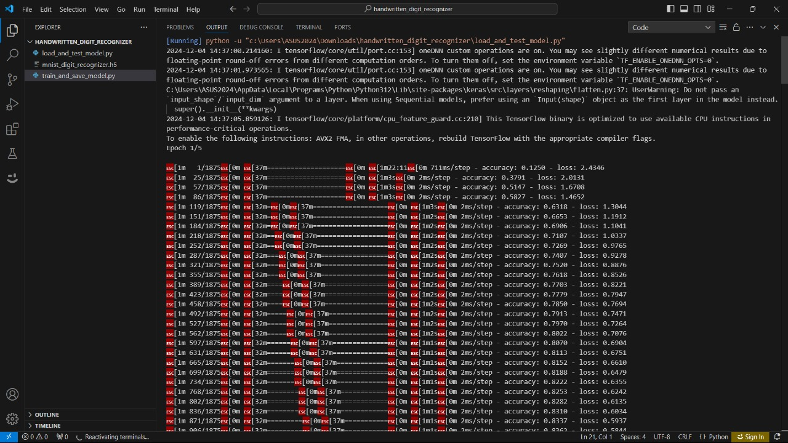
Output Screenshot
Loading Images

Slide 25
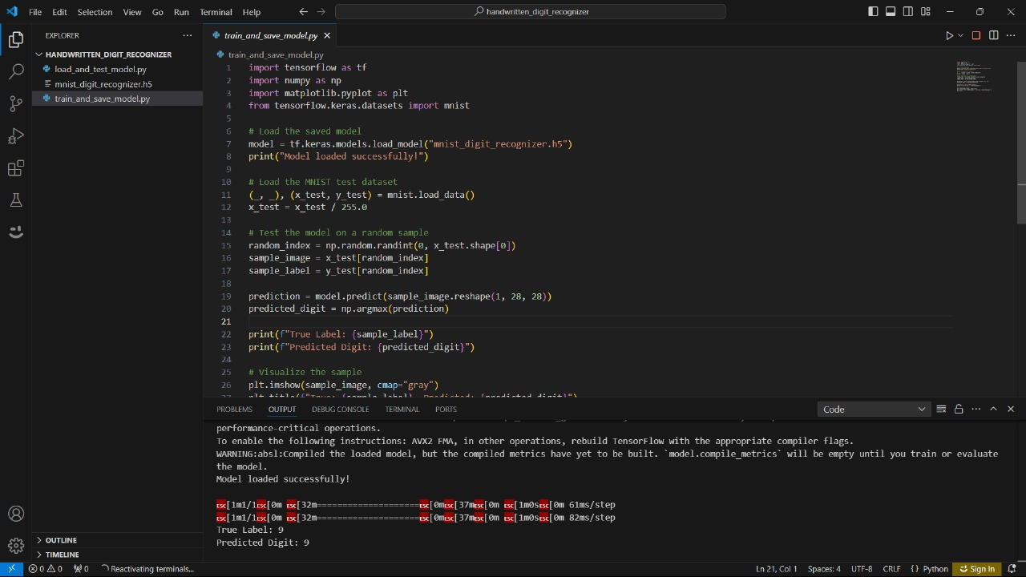
Output Screenshot
Training Data

Slide 26
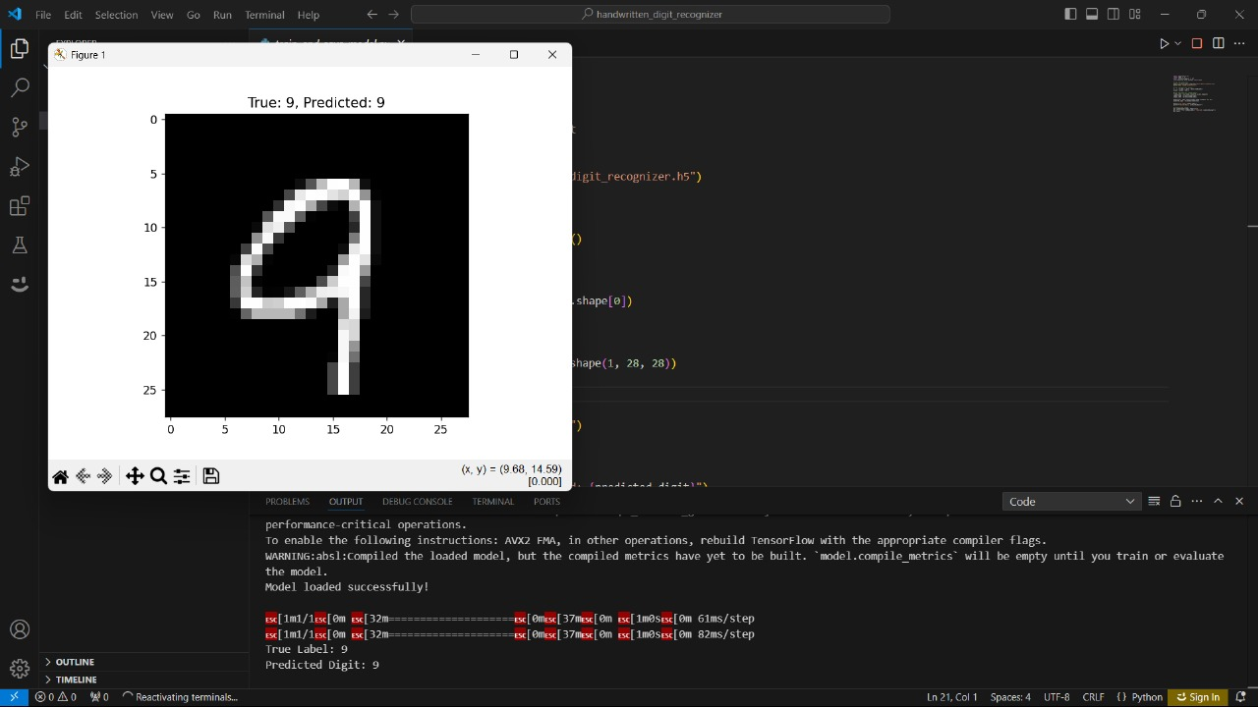
Output Screenshot
Predicted Output

