Slide 1
OpenWeather
Add weather data to you factory

Slide 2
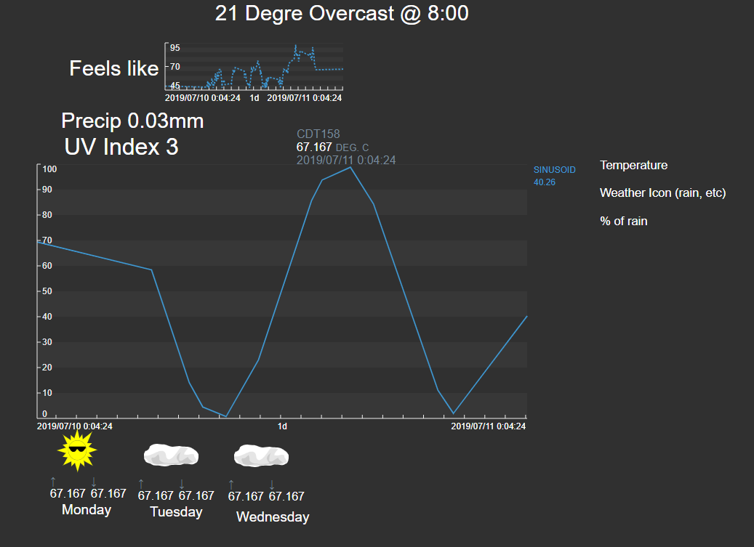
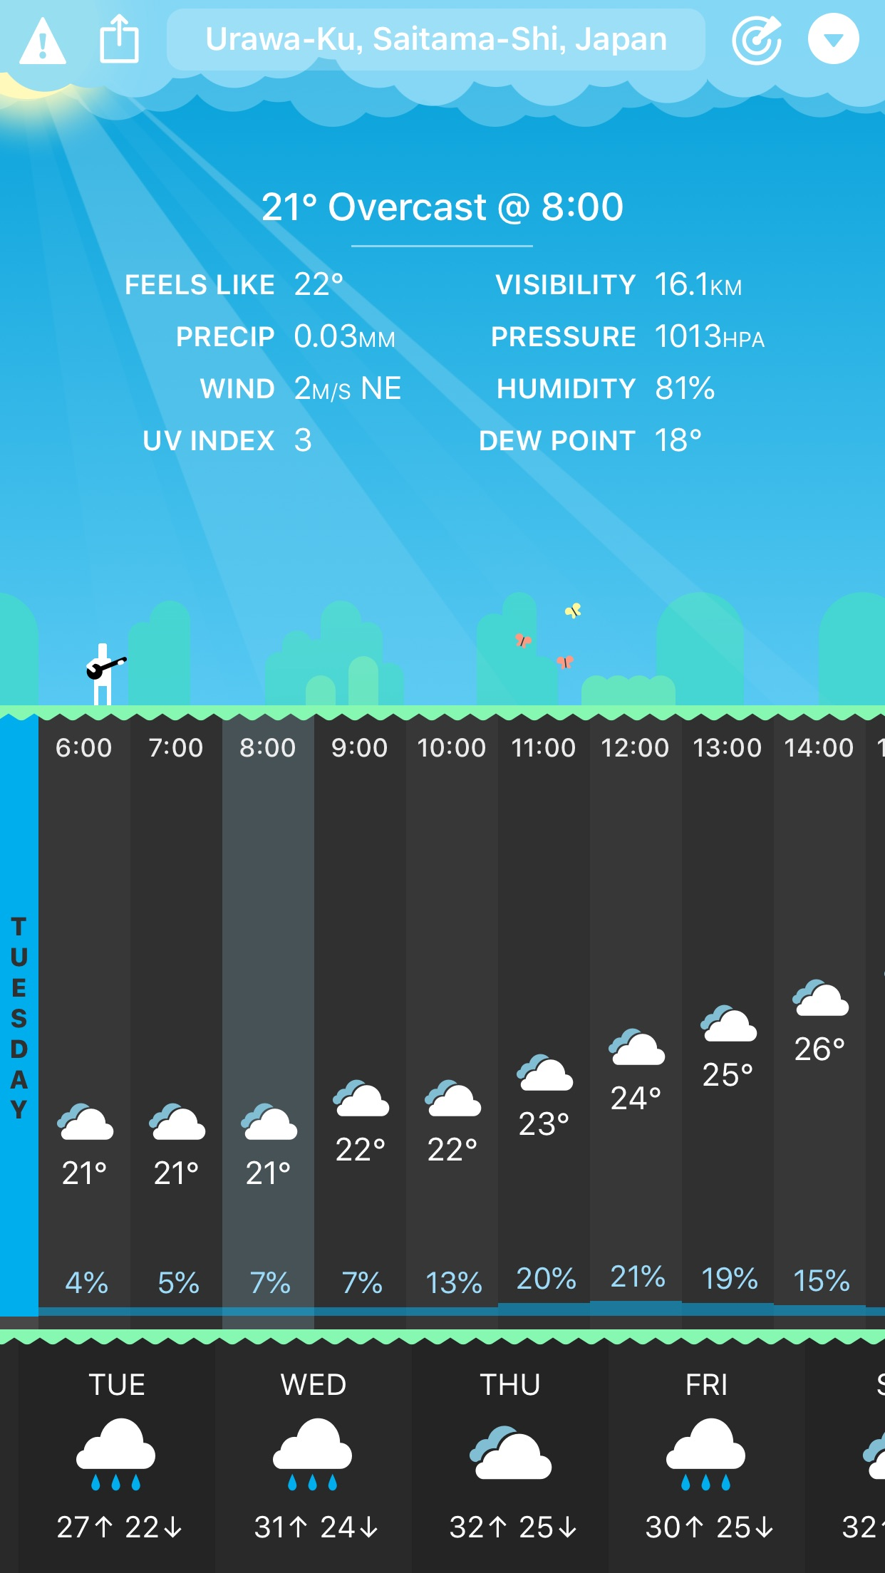
Design doc 1
Inspiration

Slide 3
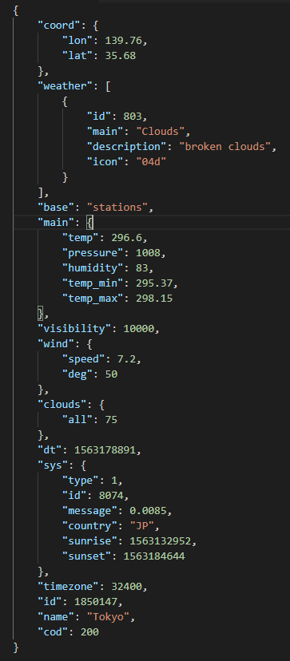

CURRENT DATA
Store as Static Data using traits
Tagname:
OpenWeather + Id + API + path
Example:
Id = 1850147
Path = weather.id
Thus tag is:
1850147.weather.id
Historize only id, others are enumeration sets
Internal, store nothing
Historize all data
Timestamp
Historize sunrise and sunset (change too much due to leap years to be a lookup)
Type,id, message are internal. Use country for AF structure
Timezone static data, id -> tagname, name -> element, cod is internal

Slide 4
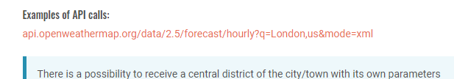
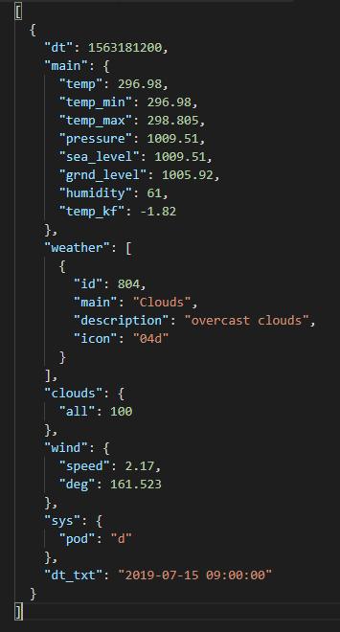
OpenWeather.ID.API CALL.JSON data
OpenWeather.ID.forecast.hourly.main.temp
No info on city name, need to grab id for URL call

