Slide 1
Kubernetes Clusters at scale on AWS @ Intuit
Shri Javadekar (@shrinandj)

Slide 2
Journey so far ...
Design and development started in Jan ‘18
First application was running Kafka on Kubernetes
Running clusters in dev/test, pre-prod and prod environments since Apr ‘18.
Over 150 Kubernetes clusters and 3000 namespaces today…

Slide 3
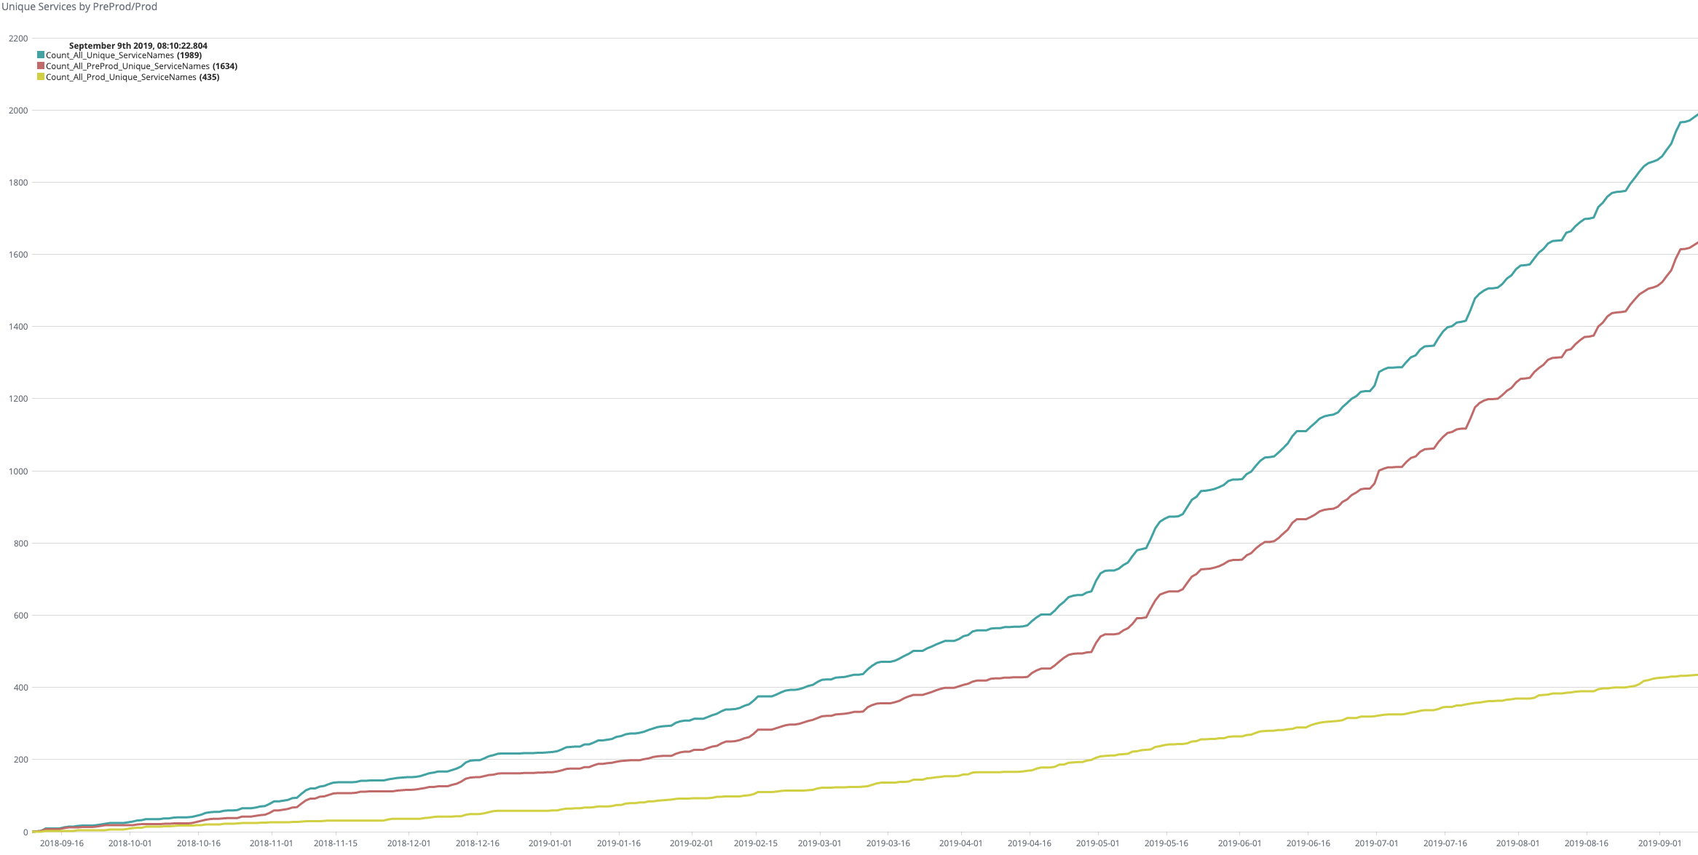
Journey so far ...
1989
Total Services
1634
Preprod Services
435
Prod Services

Slide 4
Modern SaaS platform today ...
Intuit Kubernetes Service
Using Kops today
Moving to EKS
Intuit Kubernetes Service Manager (may open source)
Custom Resources for cluster lifecycle management (aka. Keiko)

Slide 5

Each Kubernetes cluster today ...
User namespace 1
User namespace 2
User namespace 3
User namespace n
Applications
alb-ingress
kube-dns
fluentd
metrics
prometheus
autoscaler
Addons
etcd
kube-scheduler
kube-apiserver
kube-controller
kube-proxy
K8s Control Plane

Slide 6
Each Kubernetes cluster today ...
alb-ingress
kiam
eventrouter
metrics
kube-dns
autoscaler
Addons
etcd
kube-scheduler
kube-apiserver
kube-controller
kube-proxy
K8s Control Plane
Master Nodes

Slide 7
The Problems

Slide 8
Addons
Common functionality needed by all apps on a cluster
DNS, log forwarding, metrics, identity, etc.
Integrate with other AWS services such as ALB.

Slide 9
Multi-tenancy
What does each tenant mean?
Namespace?
Kubernetes objects with the same label?
Some CRD?
We decided to go with Kubernetes Namespaces

Slide 10
More Multi-tenancy issues
Noisy neighbour
Customized setup
Tenant specific AMIs
Tenant specific instance types
Cost accounting

Slide 11
Multi-tenancy solutions
We decided to go with ...
Instance Group per Namespace
Customized labels
Centralized upgrades

Slide 12
Resilience and hardening ...
Pods stuck in terminating state ...
EC2 instance networking broken ...

Slide 13
Deep monitoring
Not enough to simply check if components are “up”
Deep monitoring
Actually exercise the functionality
Periodically
Preferably automatic remediation

Slide 14
Cost efficiency
How do we reduce costs?

Slide 15

Keiko
“Keiko provides a set of independent open-source tools for orchestration and management of multi-tenant, reliable, secure and efficient Kubernetes clusters at scale.”
github.com/keikoproj
Instance manager
Kube forensics
Upgrade
manager
Active monitor
Addon manager
Governor
Minion manager

Slide 16
Keiko
github.com/keikoproj
twitter.com/keikoproj
github.com/keikoproj
Instance manager
Kube forensics
Upgrade
manager
Active monitor
Addon manager
Governor
Minion manager

Slide 17
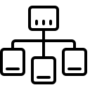
Instance-manager
Declaratively provision and manage ASGs (nodes)
Number and type of nodes
Labels and taints
Subnets and security groups
$ kubectl create -f /tmp/hello_world.yaml
instancegroup.instancemgr.keikoproj.io/hello-world created
$ kubectl get igs
NAME STATE MIN MAX GROUP NAME PROVISIONER STRATEGY AGE
hello-world Ready 2 3 shri-east-2-instance-manager-hello-world-NodeGroup-16Y8ZA1ZJW8JK eks-cf crd 3m
nodes Ready 2 3 shri-east-2-instance-manager-nodes-NodeGroup-1K1T3YSXCCCK9 eks-cf crd 1d

Slide 18
Upgrade-manager
Upgrade Manager provides RollingUpgrade, a Kubernetes native mechanism for doing rolling-updates of instances in an AutoScaling group using a CRD and a controller.

Slide 19
Addon-Manager
Addons are critical components within a Kubernetes cluster that provide basic services needed by applications like DNS, Ingress, Metrics, Logging, etc. Addon Manager provides a CRD for lifecycle management of such addons using Argo Workflows.

Slide 20
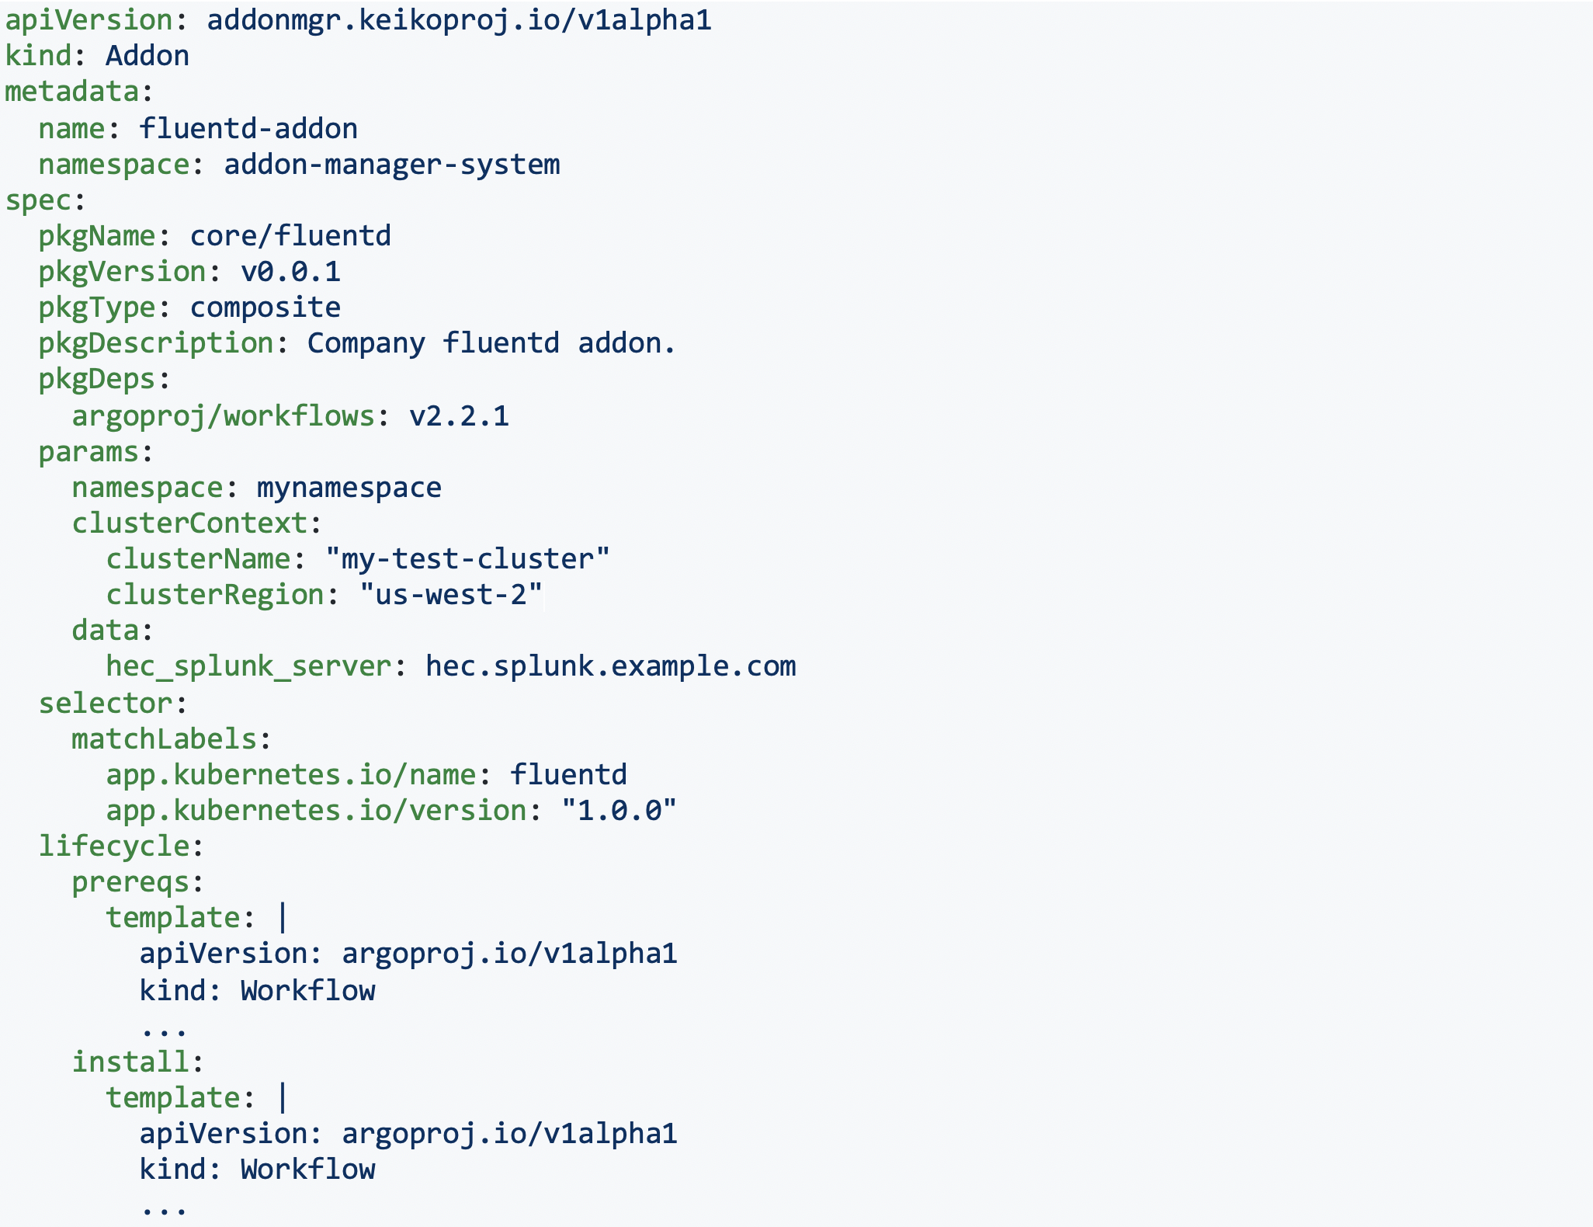
Addon-Manager

Slide 21
Governor
Governor improves the stability of large Kubernetes clusters by proactively terminating failed but stuck pods and misbehaving nodes.

Slide 22
Minion-manager
Minion-manager enables the intelligent use of Spot Instances in Kubernetes clusters on AWS. This is done by factoring in on-demand prices, spot-instance prices and current state of the AutoScalingGroups.

Slide 23
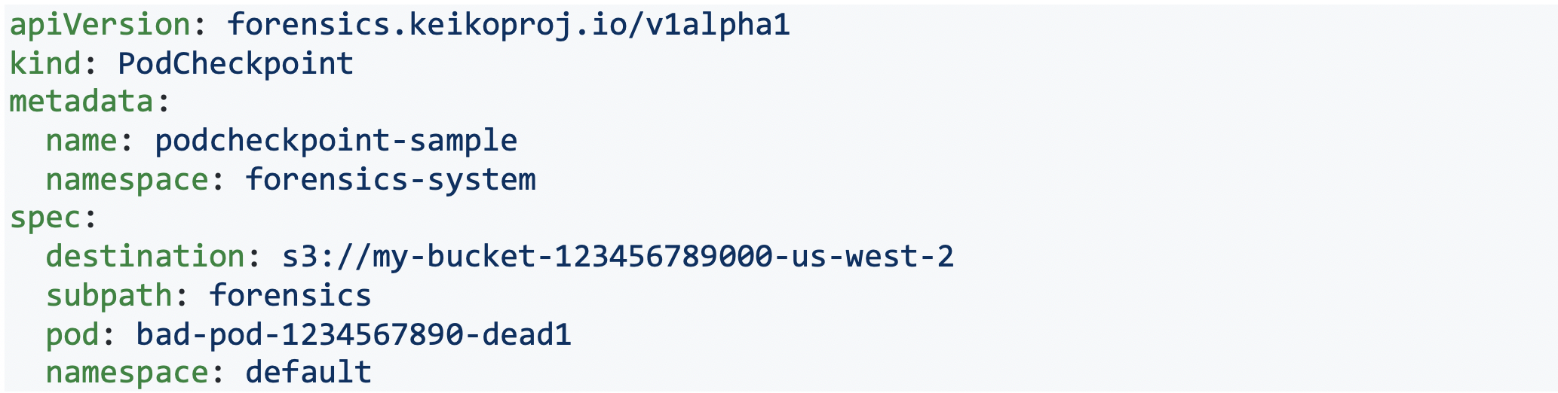
Kube-forensics
Kube-forensics allows a cluster administrator to dump the current state of a running pod and all its containers so that security professionals can perform offline forensic analysis.

Slide 24
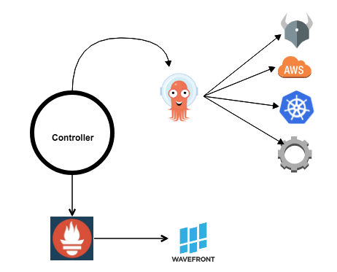
Active-monitor
Active-Monitor is a Kubernetes custom resource controller which uses Argo Workflows for deep cluster monitoring.

Slide 25
Keiko
Security
Monitoring
Kube-Forensics
Active-monitor
Reliability
Cost Eff
Governor
Minion Manager
Orchestration
Instance-manager
Upgrade-manager
Addon Manager

Slide 26
Keiko Demo

Slide 27
Coming up ...
Kubernetes control plane using EKS
Multi-cluster Service Mesh using Istio
OpenTelemetry
GitOps for AWS resources
Experimentation platform
And more ...

Slide 28
There’s a lot happening ...
<Shameless plug about hiring (referrals) …>

Slide 29
Thank you

