Slide 1
CAPSTONE PROJECT · TELECOM
AI-Powered Telecom Network
Operations Assistant
Evidence-grounded RAG with agents: similar past cases, risk, ranked root-cause hypotheses and next steps — nothing invented.
[Your name] · Repository Jerom_Telecom · [Date]
Notes:
Good morning. My project is an AI assistant for telecom network operations. An engineer describes a network problem in plain words; the assistant finds similar historical cases in 100,000 records, classifies the case, predicts fault risk, ranks likely causes and suggests what to check — and every statement it makes is traceable to evidence. [about 20 seconds]

Slide 2
PROBLEM STATEMENT
Engineers diagnose network degradations under time pressure
Too many signals
Past cases are hard to use
Generic AI is unsafe here
KPIs such as latency, packet loss, handover success and alarms change constantly; each degradation needs a quick, correct decision.
Similar incidents happened before, but finding them and their pattern takes manual search and experience.
Chatbots invent measurements, incident IDs and confident root causes — a wrong 'fact' costs outage time.
Question: how can an assistant help an engineer decide faster while never presenting a guess as a fact?
Telecom NetOps Assistant · 2 / 12
Notes:
The problem. NOC engineers face constant KPI degradations and alarms and must decide quickly what is wrong and what to do. Past incidents hold the answer but are hard to search. And a general chatbot is dangerous here, because it invents numbers and causes. So the question was: how do we help engineers decide faster without ever presenting a guess as a fact? [45 s]

Slide 3
BUSINESS NEED
Faster, consistent and trustworthy triage
Need | What the solution provides
Shorter time to a first diagnosis | similar cases, category, severity and priority in seconds
Consistent decisions | the same documented rules for every case (YAML), not individual judgement
Reuse of historical knowledge | hybrid search over 100,000 past records as evidence
Trust and auditability | every statement tagged with its source; LLM output checked by code
Safe, local operation | runs on a laptop; works offline; refuses requests to act on the network
Decision support only: recommendations are options to evaluate, never guaranteed KPI improvements.
Telecom NetOps Assistant · 3 / 12
Notes:
What the business needs: shorter time to a first diagnosis, consistent decisions across engineers, reuse of historical knowledge, and above all trust — every claim auditable. It must also be safe: it supports decisions, it never acts on the network, and it never promises KPI improvements. [45 s]

Slide 4
SOLUTION OVERVIEW
One question in, an evidence-backed assessment out
Similar cases
Labels
Fault risk
Ranked hypotheses
Checks and actions
hybrid retrieval from 100,000 records
category, severity and priority by documented rules, labelled as derived
ML prediction next to the rate observed in similar cases
with confidence, evidence for and against
what to verify, what to do, what to monitor
How it stays honest
Facts come from the data and from rules · estimates come from ML models with measured error · the LLM only explains, and a grounding gate rejects any number, ID or claim that is not in the evidence.
Telecom NetOps Assistant · 4 / 12
Notes:
The solution: one plain-language question in, and out comes similar historical cases; a derived category, severity and priority; a fault-risk prediction shown next to the rate actually observed in similar cases; ranked root-cause hypotheses; and concrete checks and actions. The principle: facts from data and rules, estimates from ML with measured error, and the LLM only explains — code checks every number it writes. [50 s]

Slide 5
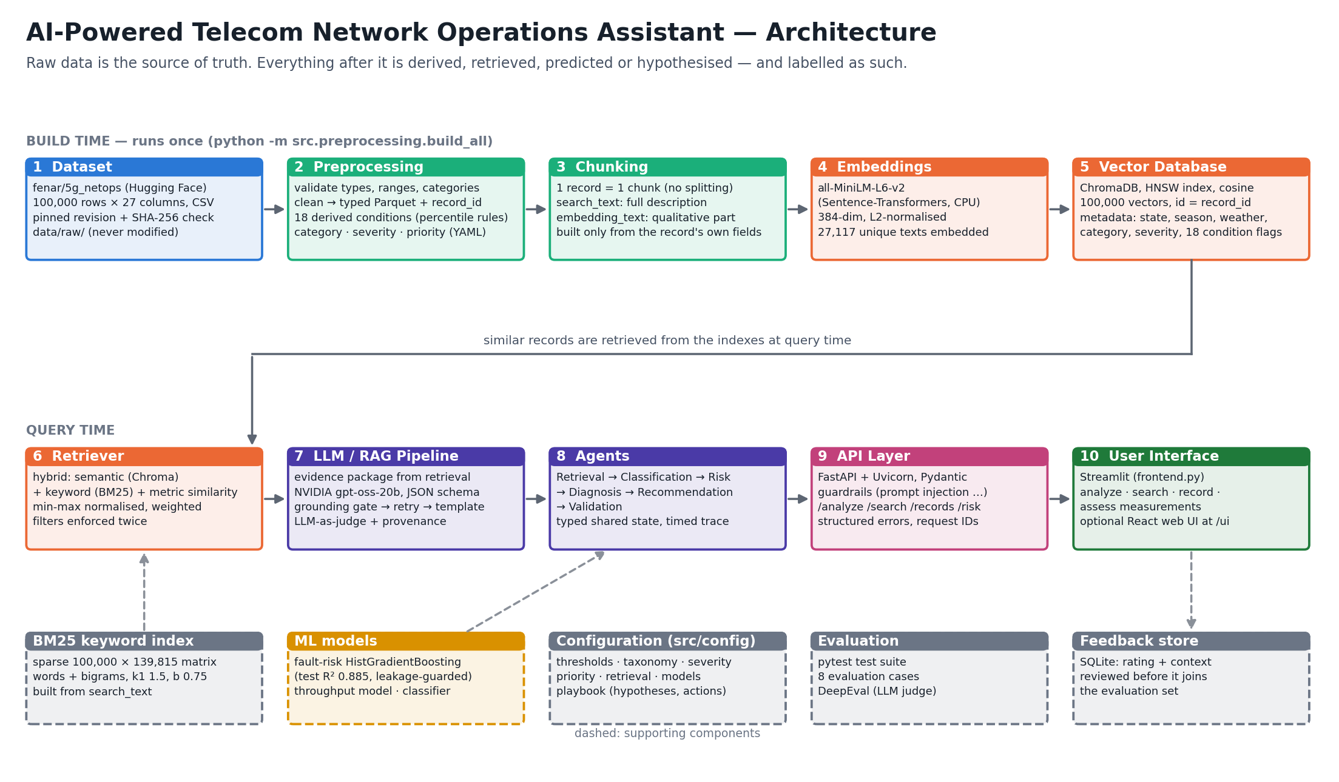
ARCHITECTURE
Ten stages, one direction of trust
Telecom NetOps Assistant · 5 / 12
Notes:
The architecture follows the required chain. At build time: the pinned dataset is validated and cleaned, conditions and labels are derived by rules, each record becomes one chunk, chunks are embedded with MiniLM into ChromaDB and also indexed by BM25. At query time: the Streamlit UI calls FastAPI, guardrails check the input, the retriever combines semantic, keyword and metric similarity, six agents build the answer, and the LLM writes the explanation behind a grounding gate. [60 s]

Slide 6
DATA FLOW
Following one real record and one real question
Raw row
Preprocessed
Derived
Chunk
Indexed
ROW-033707: latency 168.408 ms, packet loss 13.702 %, Snow, Cochranville MN
typed values + record_id; nothing altered
high_latency (>129.92 ms), high_packet_loss (>11.88 %) → Service Degradation, HIGH, P3
embedding_text (qualitative) + search_text (full, with numbers)
ChromaDB: 384-number vector + metadata · BM25: 164 weighted terms
Query: “High latency and packet loss during snow”
Embedding search alone ranks latency-only records high; BM25 alone has nothing to match 'packet loss' on (it appears in every record, IDF 0) and its top hit has packet loss 5.98 %.
Hybrid result: the top 5 all have high latency and high packet loss, in snow — metric similarity reads the actual values and fixes what each search misses.
Telecom NetOps Assistant · 6 / 12
Notes:
Here is a real record's journey. Record 33707 starts as a raw CSV line, becomes typed data, gets two derived conditions and the labels Service Degradation, HIGH, P3, becomes a text chunk, and is stored both as a vector in ChromaDB and as a weighted row in BM25. For the question 'high latency and packet loss during snow', each search alone makes mistakes; the hybrid ranking returns five records that all show both conditions in snow. [60 s]

Slide 7
TECHNOLOGY STACK
Small, local, explainable components
Layer | Technology | Why
Language | Python 3.12 | data, ML and API in one language
LLM | NVIDIA API Catalog · openai/gpt-oss-20b | JSON-schema output; Claude also supported
Embedding model | sentence-transformers all-MiniLM-L6-v2 | fast on CPU, 384 dimensions
Vector database | ChromaDB (HNSW, cosine) | local, metadata filters, id = record_id
Keyword search | BM25 (own sparse implementation) | exact names, places, conditions
ML | scikit-learn HistGradientBoosting | accurate; handles missing inputs
API / UI | FastAPI + Uvicorn + Pydantic / Streamlit | validated REST API; Python UI (+ React)
Evaluation | pytest · DeepEval | proofs and LLM-judged RAG metrics
Telecom NetOps Assistant · 7 / 12
Notes:
The stack is deliberately small and local. Python throughout. The LLM is gpt-oss-20b from NVIDIA's API catalog with JSON-schema outputs. MiniLM embeddings in ChromaDB, plus my own BM25 implementation. scikit-learn gradient boosting for risk. FastAPI for the API, Streamlit for the UI, and pytest plus DeepEval for evaluation. [40 s]

Slide 8
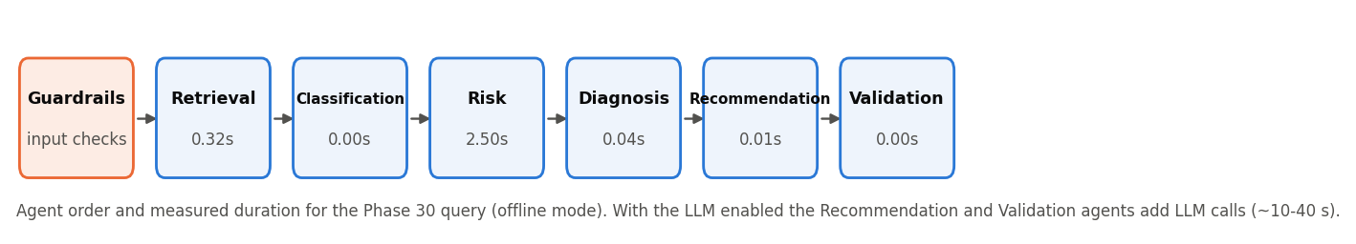
AGENT WORKFLOW
Six agents, one shared state, no loops
Retrieval
Classification
Risk
Diagnosis
Recommendation
Validation
evidence
category, severity
prediction, priority
hypotheses
actions + LLM explanation
checks, judge, provenance
Agents communicate only through a typed shared state; each step is timed and traced. A test proves the agents return exactly the single pipeline's result.
Telecom NetOps Assistant · 8 / 12
Notes:
The analysis runs as six agents in a fixed order: retrieval, classification, risk, diagnosis, recommendation and validation. They share one typed state, each declares the inputs it needs and writes a timed trace entry. There are no autonomous loops — a linear workflow is easier to test, and a test proves the agents give exactly the same result as the plain pipeline. [45 s]

Slide 9
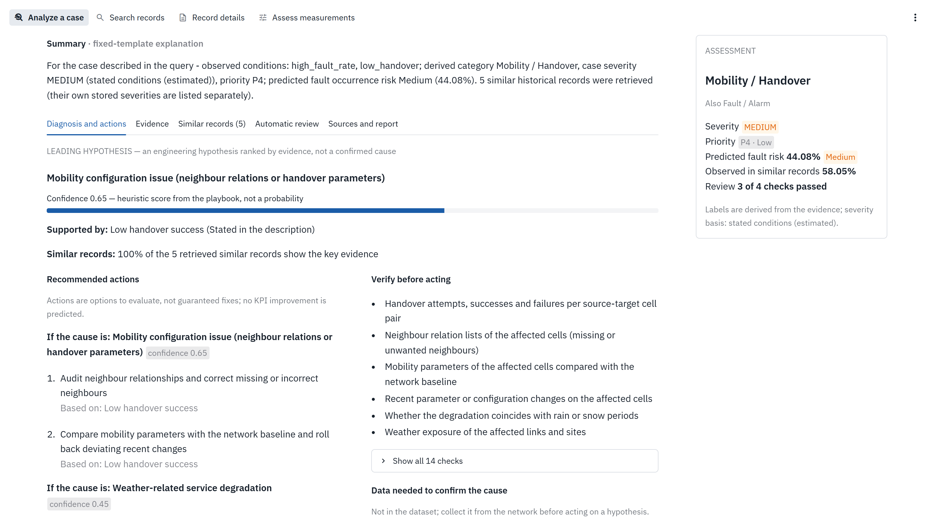
DEMO
Fault occurrence up, handover success down — what now?
Run locally
uvicorn src.main:app --reload
streamlit run frontend.py
Point out
Category Mobility / Handover; severity 'estimated' — values were only described
Predicted risk 44.08 % next to 58.05 % observed — never mixed
Leading hypothesis 0.65 — heuristic, not a probability
Every action states its basis; review checks shown
Telecom NetOps Assistant · 9 / 12
Notes:
[Switch to the live app: streamlit run frontend.py, with the API running.] I choose the example 'Faults rising, handover falling' and press Analyze case. Point out: the category is Mobility and Handover; severity is marked estimated because I only described the problem; the ML prediction of 44 percent is shown next to the 58 percent actually observed in similar records; the leading hypothesis scores 0.65, a documented heuristic; and every action says which condition it is based on. If the live demo fails, this screenshot is the real output. [90 s]

Slide 10
EVALUATION RESULTS
Measured, not assumed
222
1.00
0.93
0.885
automated tests, all passing
retrieval precision, 8 evaluation cases
DeepEval faithfulness (LLM judge)
fault-risk R² on unseen data (MAE 3.7 pts)
Metric | Score
Condition recall · category match · hypothesis in top 2 · grounded | 1.00 · 1.00 · 1.00 · 0.75
DeepEval answer relevancy · contextual precision · contextual relevancy | 0.89 · 1.00 · 0.28
Category classifier (agreement with the rules, not real accuracy) | 97.4%
Judge: nvidia openai/gpt-oss-20b. Development scores — one retrieval weight was tuned on these 8 cases.
Telecom NetOps Assistant · 10 / 12
Notes:
Quality was measured. All automated tests pass, including the five proofs the specification asked for, such as comparing every processed value with the raw file. On the eight evaluation cases, retrieval precision, category, hypothesis and grounding are all at the top. DeepEval, using the NVIDIA model as an independent judge, gives the faithfulness shown. The served fault-risk model explains 88 percent of the variation on unseen data. Two honest caveats: these are development scores, and the classifier figure is agreement with my own rules. [60 s]

Slide 11
CHALLENGES AND LEARNINGS
Real problems found by testing — and what they taught
Challenge | What I did | Learning
No labels in the data | derived labels with documented rules | say 'derived', never 'ground truth'
R² 0.9998 was leakage (target is a formula) | excluded formula columns → honest 0.885 | a perfect score is a warning sign
LLM computed new numbers | grounding gate, retry, template | never trust fluent text — check it
'normal user load' retrieved high-load records | strip good/normal phrases + penalty | embeddings miss negation
pandas altered ~15 % of floats in the last digit | exact float() parsing + equality test | test the data, not only the code
Small LLM as judge raises false alarms | code checks + judge must agree | layer cheap checks with judgement
Limitations: synthetic data, no timestamps, cell IDs or transport counters, so causes remain hypotheses. Next: real operator data, confidence calibrated from feedback.
Telecom NetOps Assistant · 11 / 12
Notes:
The most valuable part was what testing found. The data has no labels, so labels are derived and always called derived. A near-perfect R-squared turned out to be leakage. The LLM computed numbers that were not in the evidence, so code now checks every number. Embeddings confused 'normal load' with high load. Even pandas changed values in the last decimal place. The lesson: test the data and check the AI. Limits: the data is synthetic, so causes stay hypotheses. [60 s]

Slide 12
Thank you — questions?
Evidence first
Honest ML
Safe LLM
every statement carries its source
leakage removed; derived labels named as derived
the model explains, code checks, a judge reviews
Repository Jerom_Telecom · design/Design_Document.pdf · docs/API_Documentation.pdf · API docs at /docs
Notes:
To close: evidence first, honest machine learning, and a safely constrained LLM. Thank you — I'm happy to take questions or show any part live.

