Slide 1





Introduction to Robotic Process Automation
LINKEDIN POST AUTOMATION BOT
220701106
JEROM SANTHIYAGU A
Mrs. J. Jinu Sophia, M.E., (Ph.D.),
Assistant Professor (SG),
Department of Computer Science and Engineering.

Slide 2
Abstract
The "LinkedIn Post Automation Bot" is a Robotic Process Automation (RPA) solution developed using UiPath to simplify and streamline LinkedIn post management. Social media engagement on platforms like LinkedIn often demands consistent effort, which can be time-consuming and prone to errors when done manually. This bot automates the workflow by retrieving post content from an Excel file, securely logging into LinkedIn, and posting content at scheduled intervals using a delay-based mechanism. Additionally, it sends email notifications to inform users of successful posting, ensuring efficiency and reliability. By automating repetitive tasks, this bot allows users to focus on crafting impactful content while ensuring consistent and timely posting, making it a valuable tool for professionals and businesses.

Slide 3
Need for the Proposed System
Manually managing LinkedIn posts is time-consuming, inconsistent, and prone to errors. The proposed system eliminates these challenges by automating content scheduling, posting, and notifying users upon successful execution.
This ensures timely and efficient content delivery, enabling users to focus on creating impactful posts rather than managing posting schedules.
It reduces human errors with features like email integration and dynamic data storage.

Slide 4
Advantages of the Proposed System
Time-Saving: Automates repetitive tasks, freeing up valuable time.
Accuracy: Ensures precise and consistent posting without errors.
Efficiency: Retrieves, posts, and confirms content seamlessly.
User-Friendly: Simple interface and workflow for easy operation.
Scalability: Can manage multiple posts and adapt to varying schedules.
Notification Feature: Provides real-time updates via email.
Reliability: Handles tasks without interruptions or inconsistencies.

Slide 5
Main Objective
The primary objective of this project is to automate the scheduling, posting, and notification process for LinkedIn content. The bot retrieves posts from an Excel file, automates login and posting tasks, and notifies the user via email, providing a seamless solution for LinkedIn content management. It doesn’t needs the user to be always available in the social media , it reduces the users distractions by frequently logging into LinkedIn for posting each time. Also It helps the user to keep his/her profile engaged in the LinkedIn.

Slide 6
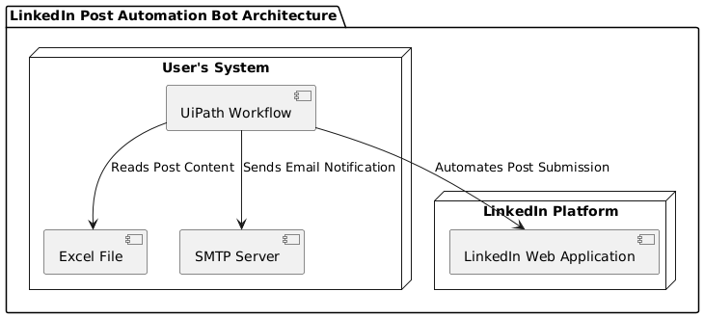
Architecture

Slide 7
System Requirements
HARDWARE:
Processor: Minimum Dual-Core, Recommended Quad-Core or higher
RAM: Minimum 4GB, Recommended 8GB or higher
Storage: At least 10GB free space
System: Windows-compatible desktop or laptop
SOFTWARE:
UiPath Studio and Orchestrator: For developing and deploying the bot
Microsoft Excel: For managing input and output data
Web Browser: Google Chrome or Microsoft Edge for web automation
Email Client: SMTP-supported email service (e.g., Gmail, Outlook)
Operating System: Windows 10 or higher

Slide 8
Functional Description
Module 1: Input Handling and Initialization
This module reads the input from the excel file and stores them in a data table variable. It also configures the necessary credentials.
Module 2: Content Posting
This module first automates the process of LinkedIn login. After this, It starts reading the post content from the variable to initiate the posting function.
Module 2: Email Notification
This module send a confirmation mail to the user to acknowledge him that the post has been posted successfully.

Slide 9
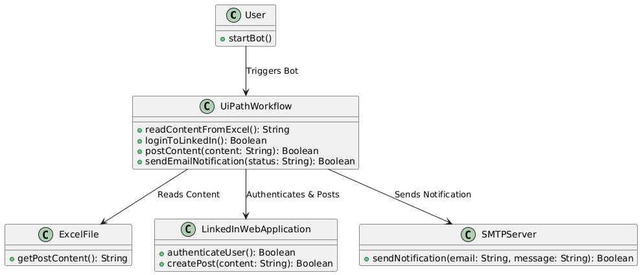
Table Design

Slide 10
Process Design
Main Process:
Automate LinkedIn post scheduling and notifications..
Retrieve post content from Excel.
Log into LinkedIn and post content.
Wait for a fixed interval before the next post.
Send email notification after posting.
Sub-Processes:
Input Handling
Content Posting
Email Notification

Slide 11
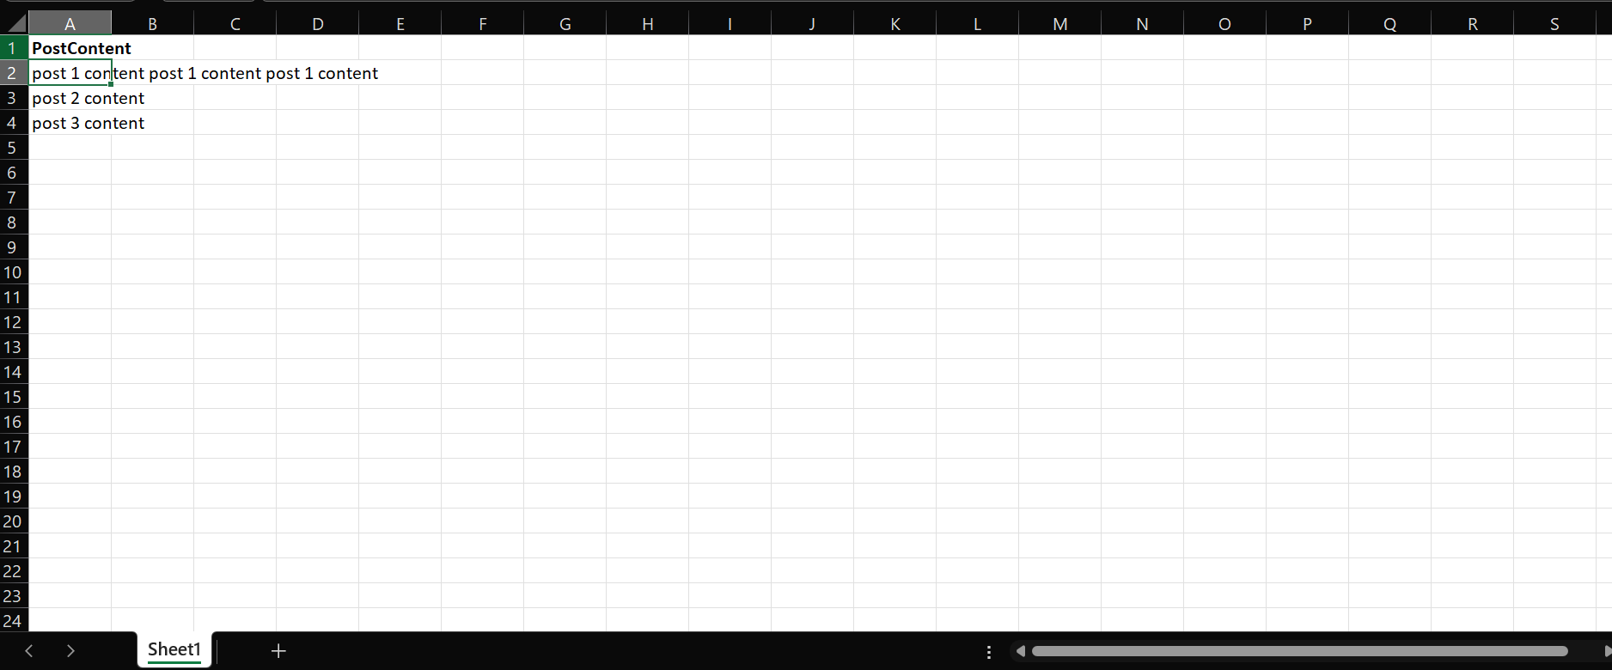
Implementation
Implementation of Module 1: Input Handling and Initialization

Slide 12
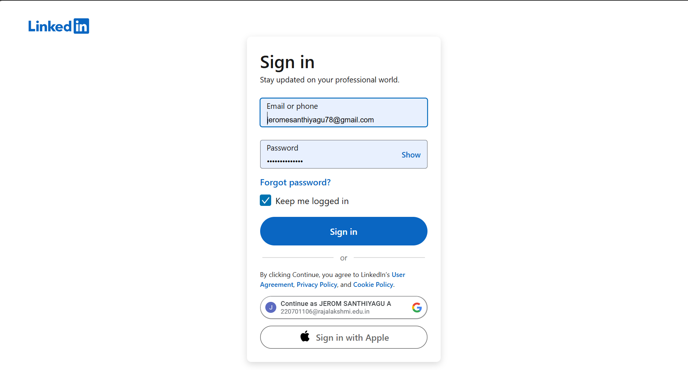
Implementation
Implementation of Module 2: Content Posting

Slide 13
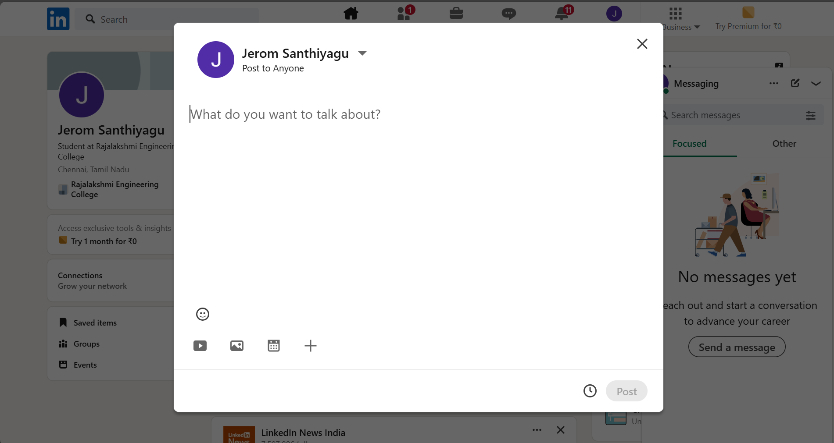
Implementation
Implementation of Module 2: Content Posting

Slide 14
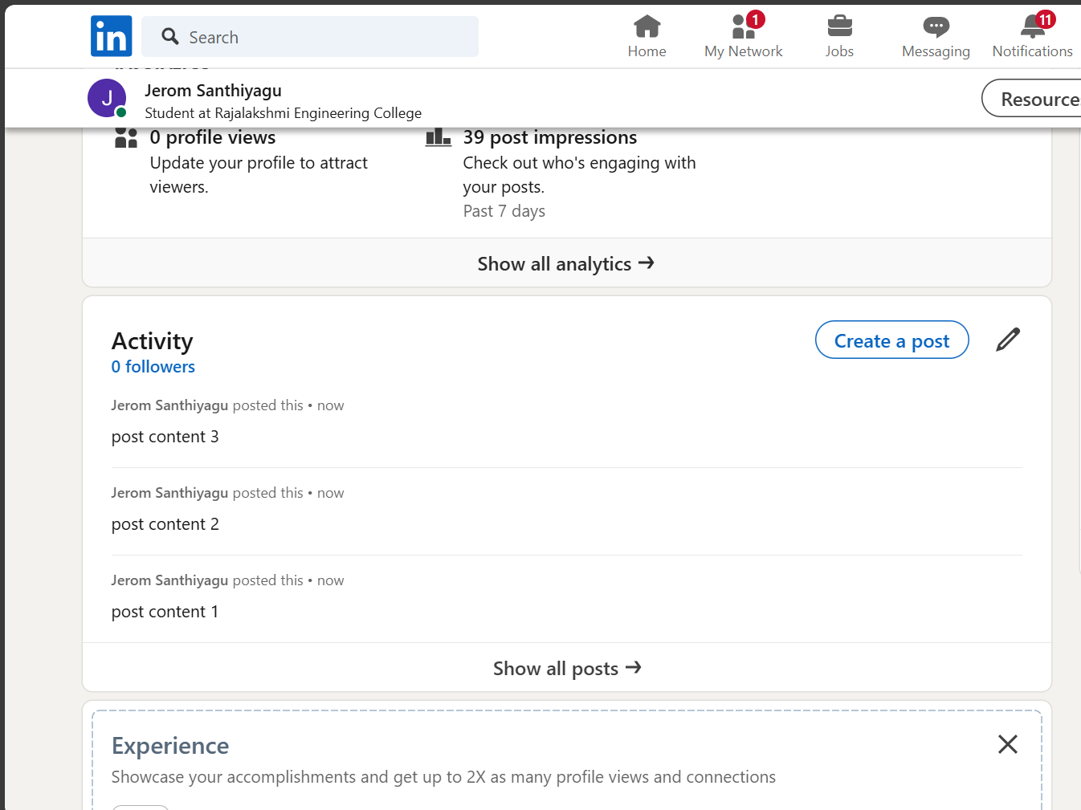
Implementation
Implementation of Module 2: Content Posting

Slide 15
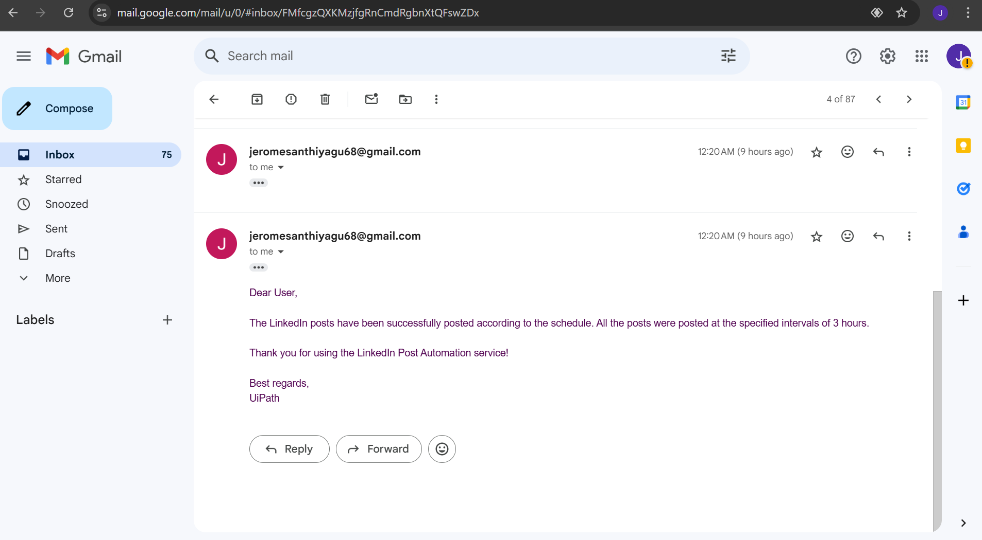
Implementation
Implementation of Module 3: Email Notification

Slide 16
Conclusion
The "LinkedIn Post Automation Bot" is a powerful tool designed to simplify and automate the process of managing LinkedIn posts. By handling content scheduling, automated posting, and notifications, it significantly reduces manual effort while ensuring consistency and reliability in content delivery. The bot's ability to operate seamlessly ensures users can focus on strategy rather than execution. Although challenges such as adapting to platform updates or handling login errors may occur, implementing regular updates and robust error-handling mechanisms will maintain its efficiency and effectiveness. This solution exemplifies the potential of automation in revolutionizing professional social media management.

Slide 17
Future Enhancement
Future advancements in the LinkedIn Post Automation Bot could involve integrating advanced AI technologies such as Natural Language Processing (NLP) for generating more engaging and personalized content recommendations. Incorporating machine learning algorithms could optimize posting times by analyzing user engagement trends, ensuring maximum visibility and interaction. Additionally, sentiment analysis could be leveraged to tailor posts based on audience preferences, creating a more targeted and impactful outreach strategy. These enhancements would not only improve automation but also enable users to achieve more strategic and data-driven LinkedIn engagement.

Slide 18
References
Flowcharts: Studio - Flowcharts (uipath.com)
Email activity: Activities - Send SMTP Mail Message (uipath.com)
Email activity: https://youtu.be/8vlLvsyCO3Q

Slide 19
Queries

Slide 20
Demonstration

Slide 21
Thank You

