Slide 1
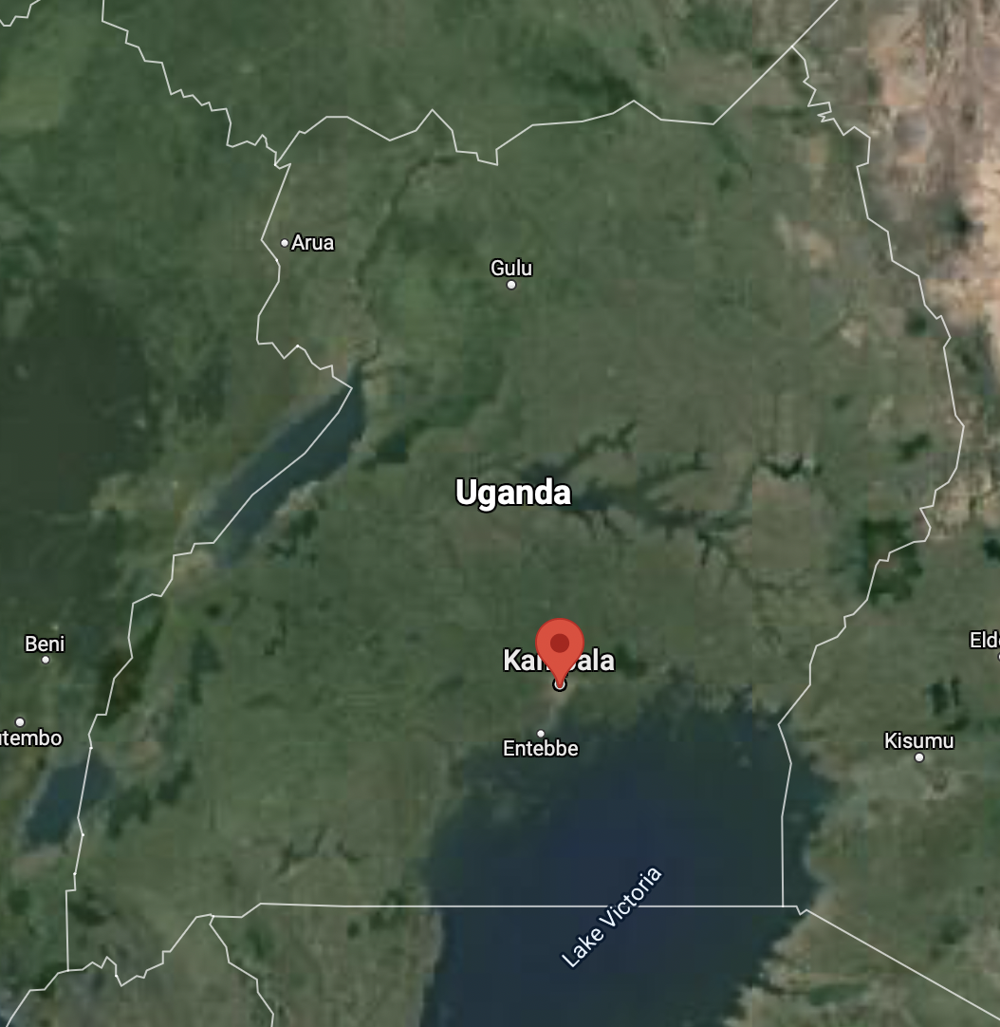
Predicting air quality using meteorological observations
in Kampala, Uganda
Konstanze, Paulos, Jerome

Slide 2
Value & Stakeholder
Value
Predicting particulate matter concentration based on meteorological measurements
Protect community health by warning population in case of expected high particulate matter load
Stakeholder
Ministry of Health, which makes the predictions available to various stakeholders and to the population

Slide 3
Dataset
Dataset result of AirQo research initiative of Makerere University, Kampala, Uganda
ca. 15000 weather and particulate matter observation sets at five locations in Kampala
per observation set:
-> five days of hourly meteorological measurements (e.g. temperature, precipitation)
-> one particulate matter measurement 24 hours after last weather observation

Slide 4
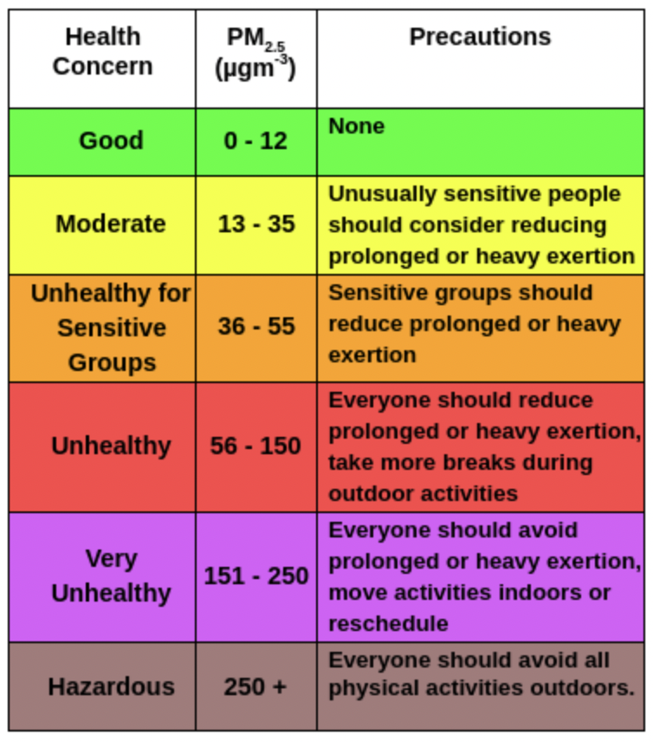
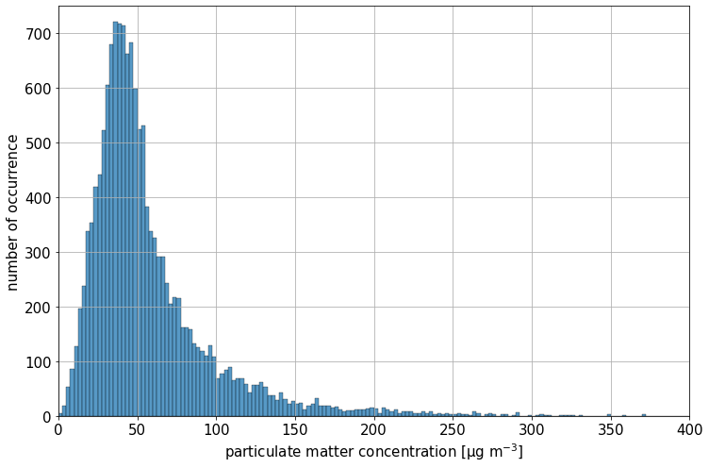
Target variable: particulate matter concentration
PM2.5 concentration [µg m⁻³] (particles with a diameter smaller than 2.5 µm)

Slide 5
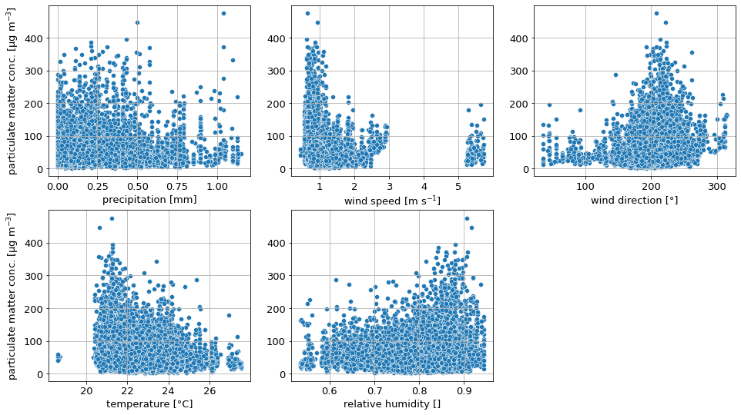
Features
precipitation, wind speed and direction, temperature, relative humidity
average over five days of weather observations used
non-linear relationships between target and features...

Slide 6
RMSE score & baseline model
RMSE (Root Mean Squared Error) score
measure for the mean deviation between the predicted and the observed values
answers the question: “How erroneous do we expect our model to be on average?”
baseline model
always predict the mean particulate matter load of 58 µg m⁻³
score: RMSE = 42 µg m⁻³ ~ 72 % of the mean particulate matter load
Notes:
RMSE can be thought of a kind of distance between the predicted and the observed values

Slide 7
Models to predict particulate matter concentration
Model | RMSE [µg m⁻³] | Percentage of the mean particulate matter load [%]
Baseline model | 42 | 72
Multivariate linear regression | 41 | 71
Decision tree | 36 | 62
Random Forest | 28 | 48
linear regression model here not suitable due to non-linear target-feature relationships
best prediction by Random Forest Regression
Notes:
linear regression model here not suitable due to non-linear target-feature relationships
Since there is an improvement of the RMSE between the models, i.e. it gets smaller, we can tell that the Random Forest model yields the best prediction so far

Slide 8
Summary
ca. 15000 meteorological measurements used to train and test models to predict particulate matter load 24 hours ahead
features: precipitation, wind speed and direction, temperature, relative humidity
linear regression not suitable due to non-linear target-feature relationships
best performance by Random Forest Regression with RMSE of 28 µg m⁻³
~ 48 % of mean particulate matter load
~ error of at most one category in the guideline on hazardous levels
Notes:
With a final RMSE of ca. 28 and comparing the table for categorizing the air quality, the model can be off in predicting lower particulate matter loads by two categories.

Slide 9
Outlook
model underestimates large particulate matter concentrations
separate model formulation for extreme and thus the most dangerous particulate matter concentrations required?
further feature engineering
model analysis for the five locations separately and more sophisticated analysis for different averaging periods
better averaging of wind direction

Slide 10
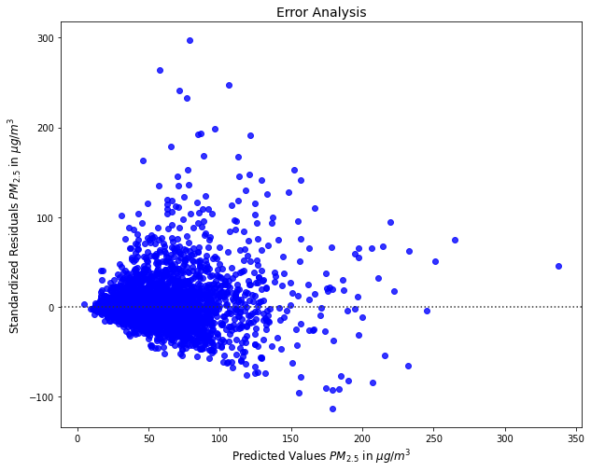
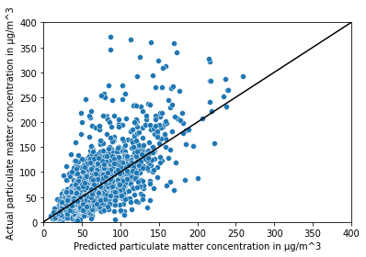
Appendix

Slide 11
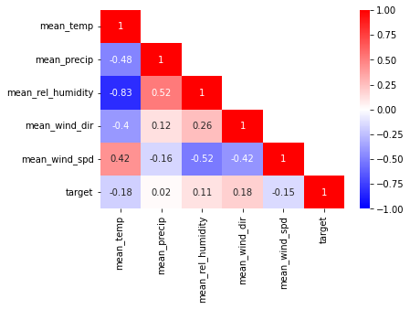
Appendix

Slide 12
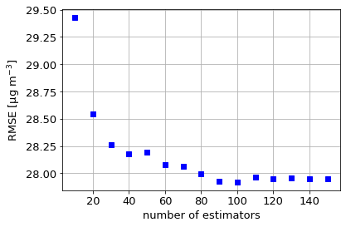
Appendix

Slide 13
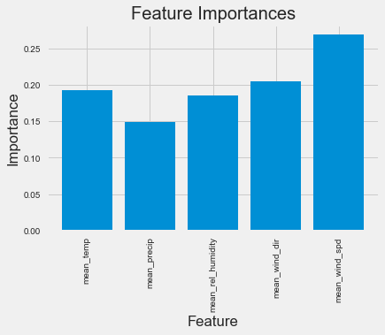
Appendix

Slide 14
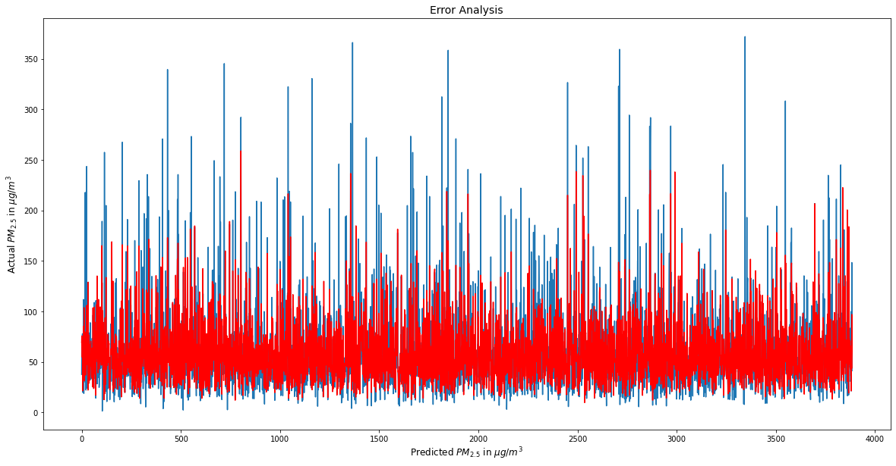
Appendix

Slide 15
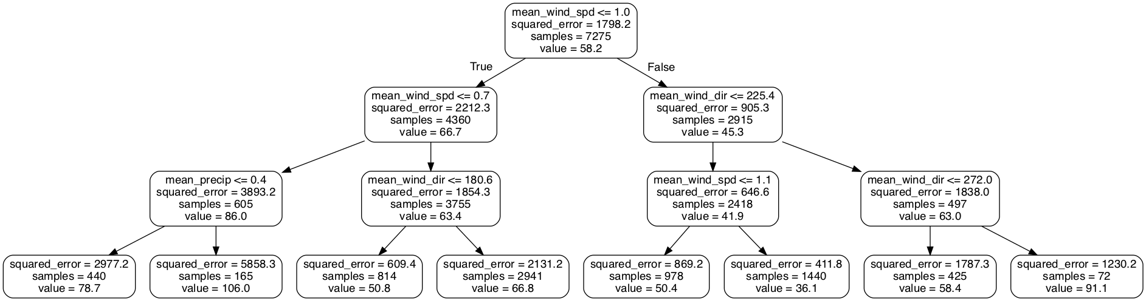
Appendix

