Slide 1
PW1100G MANUAL_CautionS Extraction Tool
By Cyient Offshore Team
Last Update : 28-August-26

Slide 2
Table of contents
Sl.NO | Contents | Slide. No
1 | Background and Objective | 3
2 | Revision History | 4
3 | Tool Interface | 5-6
4 | Inputs | 7
5 | Tool functionality | 8-14
6 | Output | 15-19
7 | Contact | 20

Slide 3
Background and Objective
BACKGROUND
-
OBJECTIVE
The objective of this tool is to automate the extraction of caution statements from
Engine Manual
Engine Manual CIR
SP 72-35 (EM & CIR)
SP 72-51 (EM & CIR)

Slide 4
Revision History
Version | Date Updated | Remarks
V1.0 | 28-Aug-2026 | Initial version of tool

Slide 5
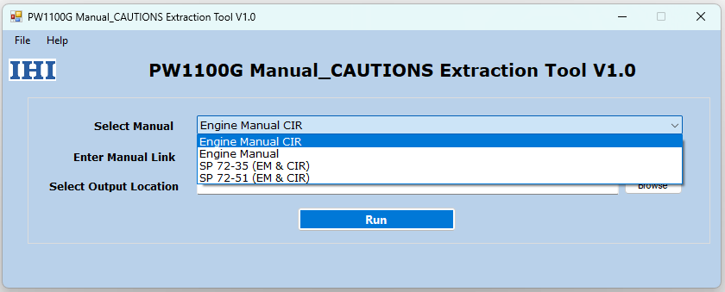
Tool Interface
Below picture is the user interface of PW1100G Manual_CAUTIONS Extraction Tool.
Tool User Interface

Slide 6
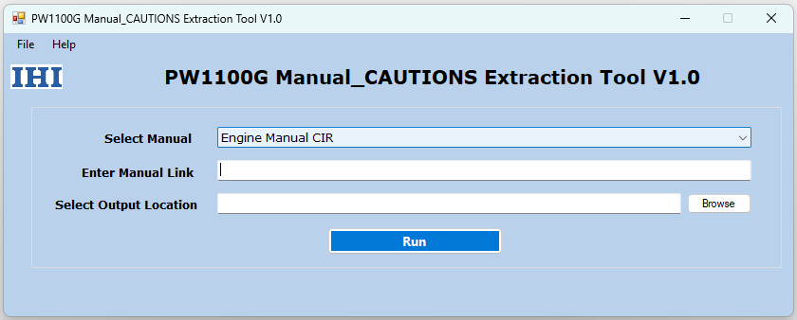
Tool User Interface

Slide 7
Inputs
Manual Type
Manual Link
Report Output location
Tool User Interface

Slide 8
Tool functionality
1. Manual Selection
The Manual Type drop-down list allows the user to select the Manual from which cautions will be extracted.
Available options:
Engine Manual
Engine Manual CIR
SP 72-31 (EM & CIR)
SP 72-51 (EM & CIR)
Select the appropriate Manual type before entering the Manual link.
2. Manual Link
The Manual Link field is used to enter the URL of the Manual page from which cautions need to be extracted.
Example:
http://127.0.0.1:8000/PW1000G-77445-19453-00/PW1000G-77445-16992-00.html - EM
http://127.0.0.1:8000/PW1000G-77445-19453-00/PW1000G-77445-15653-00.html - EM-CIR
http://127.0.0.1:8002/PW1000G-77445-19155-00/ - SP 72-35 (EM & CIR)
http://127.0.0.1:8003/PW1000G-77445-19156-00/ - SP 72-51 (EM & CIR)

Slide 9
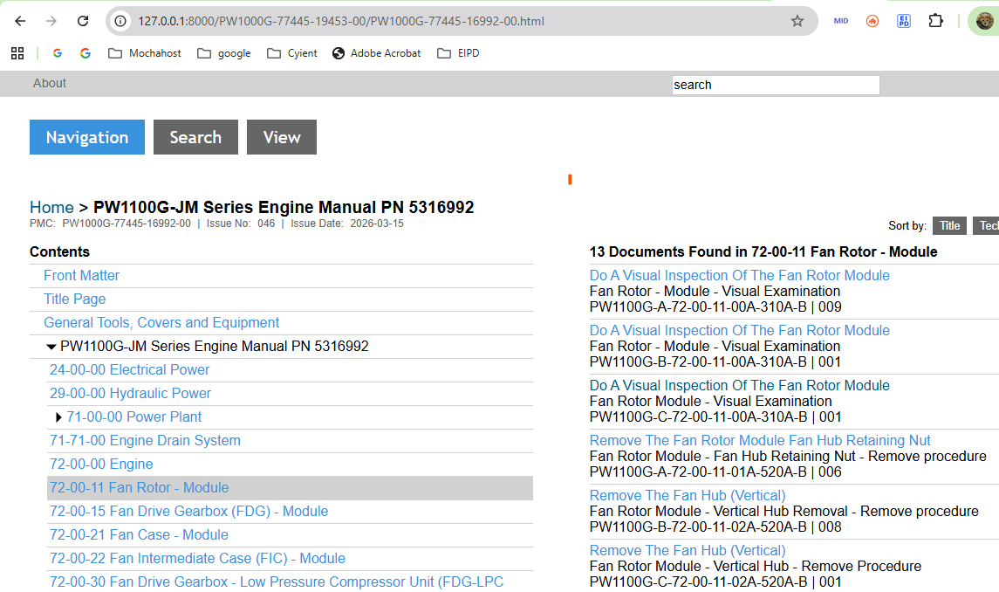
EM Link

Slide 10
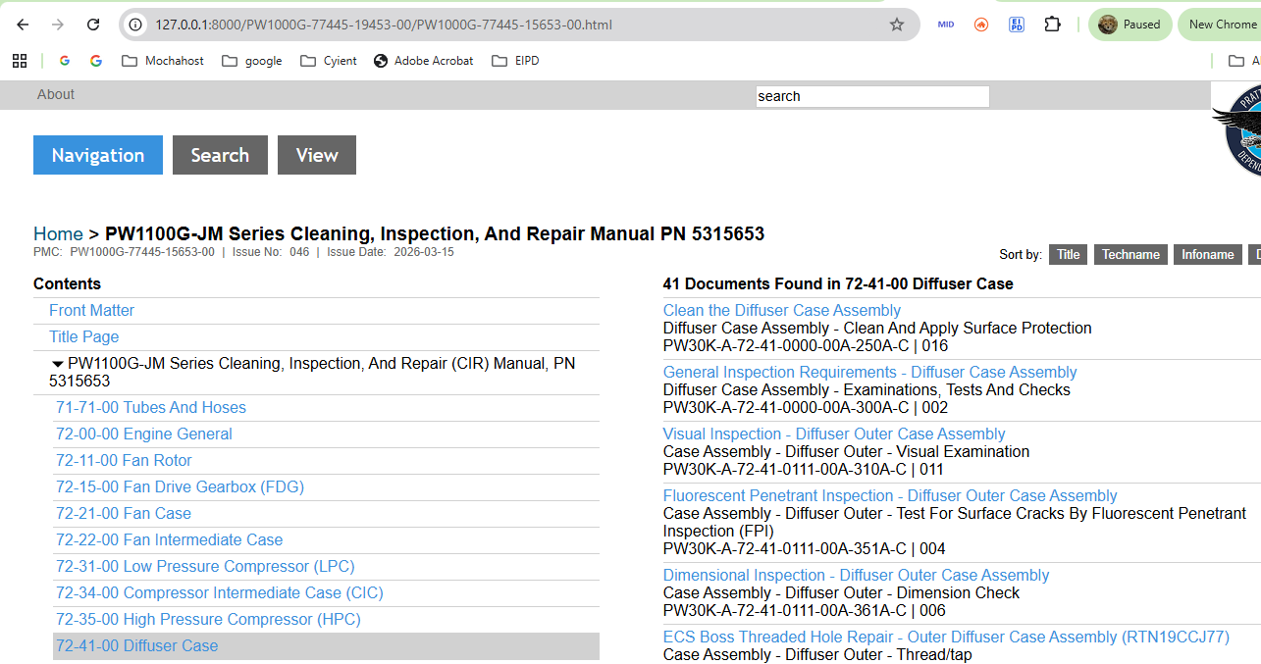
EM CIR Link

Slide 11
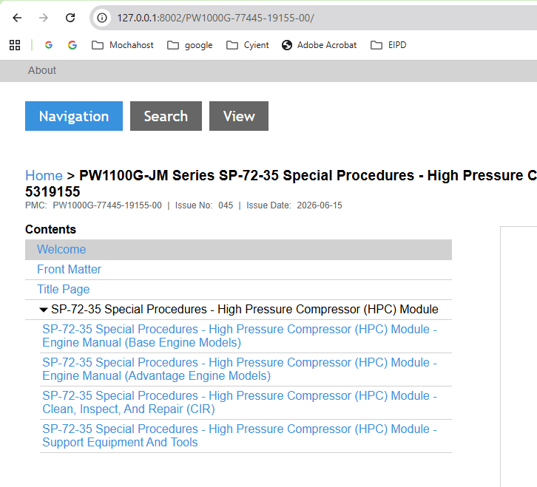
SP 72-35 (EM & CIR) Link

Slide 12
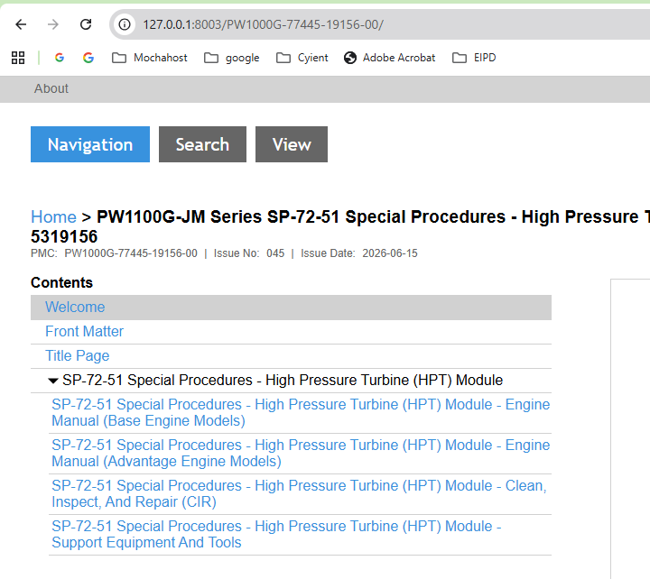
SP 72-51 (EM & CIR) Link

Slide 13
Ensure that the Engine Manual link corresponds to the Manual type selected in the drop-down list.
NOTE : The port numbers may change
3. Output Location
The Output location specifies the path where the extracted Cautions report will be generated.
Users may enter the full file path or browse to the desired location.
Example:
D:\Reports\CautionList.xlsx
4. Run Button
Click Run Button to begin the extraction process.
The tool will:
Open the specified Manual Link in the background.
Scan the Link for task pages.
Extract cautions from these task pages.

Slide 14
If the selected manual link is EM, the output report will contain 2 worksheets:
Sheet 1: All EM cautions.
Sheet 2: EM Cautions having Information Code "-3xx".
If the selected manual link is EM_CIR, the output report will contain 2 worksheets:
Sheet 1: All EM_CIR cautions.
Sheet 2: EM_CIR Cautions having Information Code "-3xx".
If the selected manual link is SP 72-35, the output report will contain 3 worksheets:
Sheet 1: All EM cautions.
Sheet 2: All CIR cautions.
Sheet 3: EM & CIR Cautions having Information Code "-3xx".
If the selected manual link is SP 72-51, the output report will contain 3 worksheets:
Sheet 1: All EM cautions.
Sheet 2: All CIR cautions.
Sheet 3: EM & CIR Cautions having Information Code "-3xx".
4. Generate the report at the specified location.

Slide 15
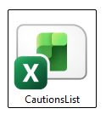
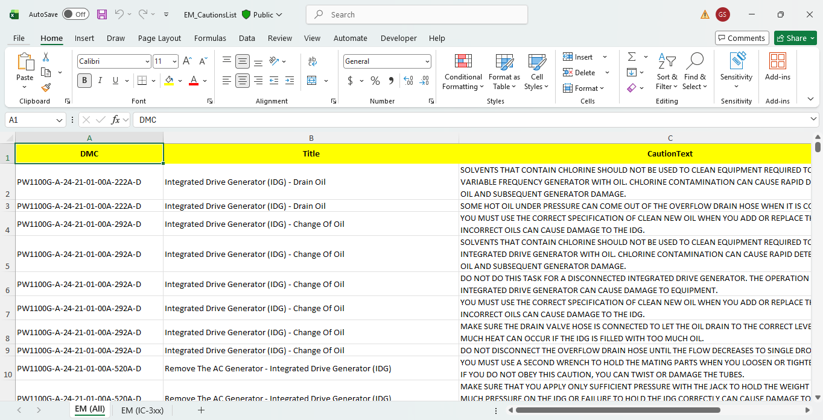
Output
Cautions Report
EM Cautions Report

Slide 16
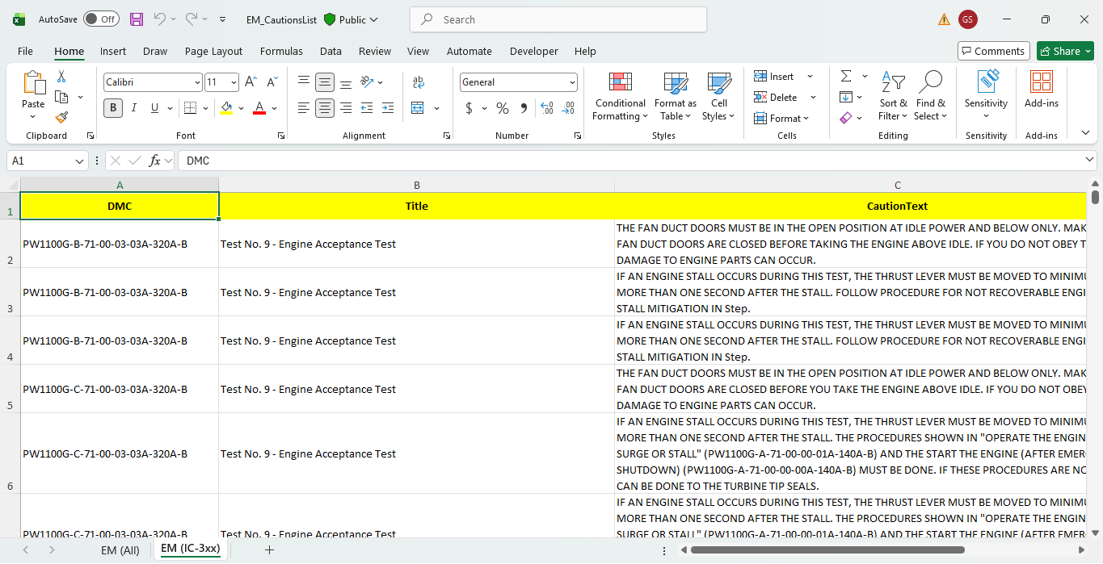
EM Cautions (IC-3xx) Report

Slide 17
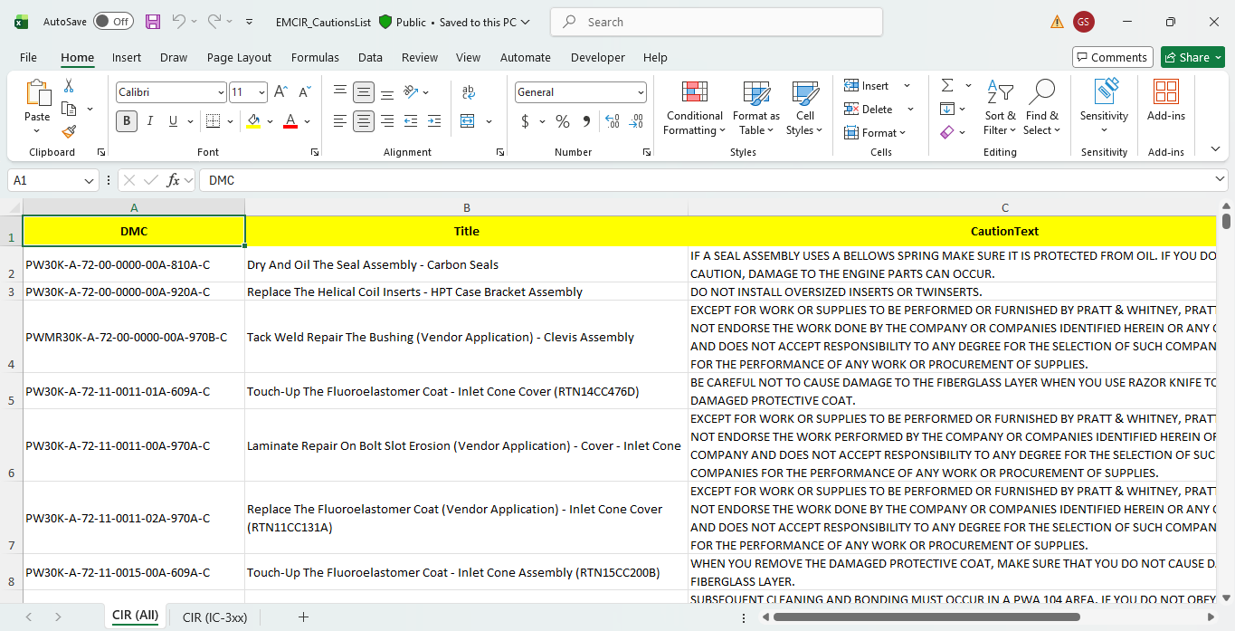
CIR Cautions Report

Slide 18
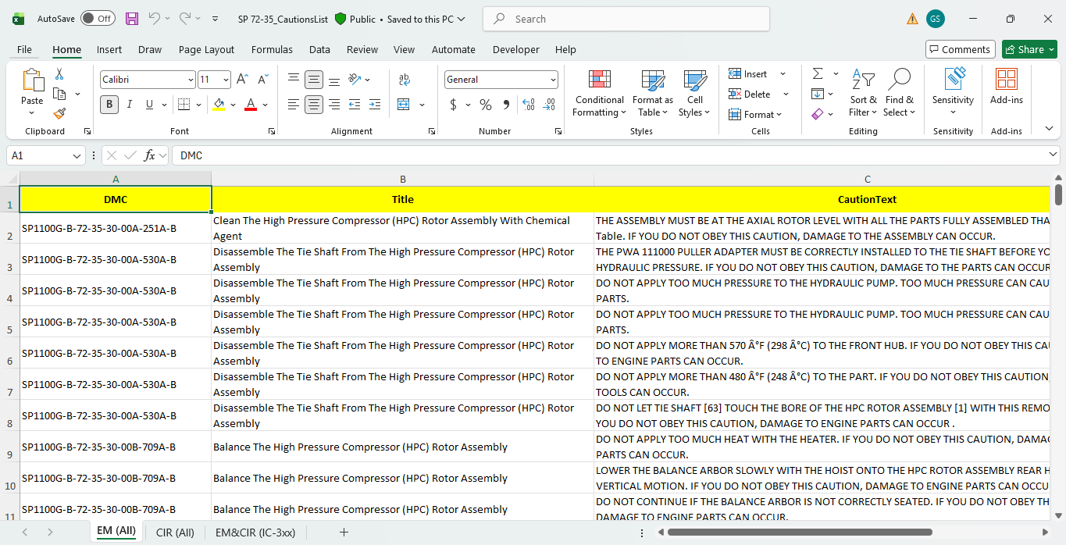
SP 72-35 Cautions Report

Slide 19
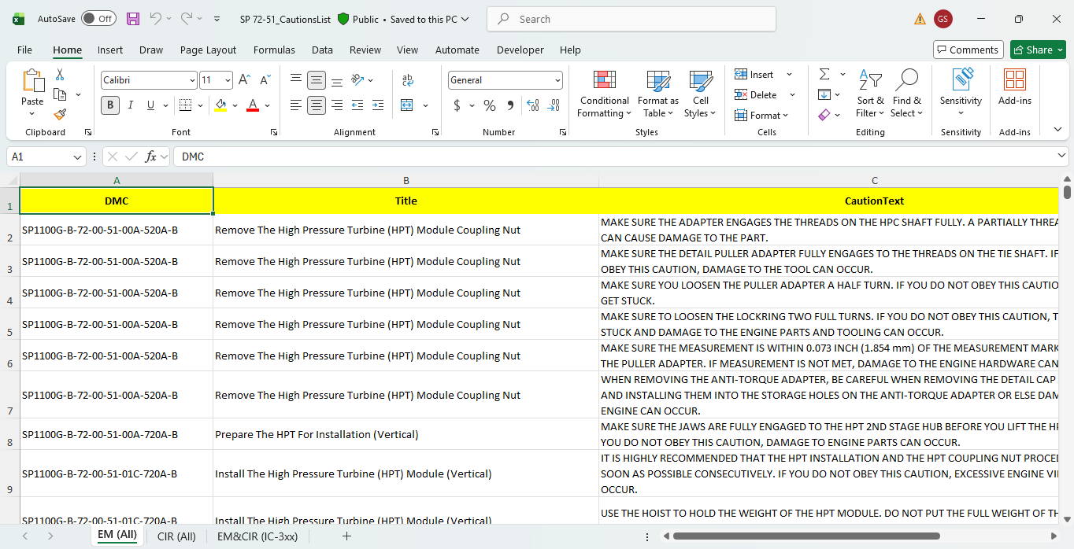
SP 72-51 Cautions Report

Slide 20
Contact
IHI Tatsuya Ito-San ito0114@ihi-g.com
CYIENT Onsite Suraj Prakash prakash7808@ihi-g.com
CYIENT Offshore Veerendra Kotari Veerendra.Kotari@cyient.com

Slide 21
Thank You
Merci
Dank u wel
Danke
Gracias
ありがとうございました
شكرا

