Slide 1
Programming Learning Platform
A Blockly Exercise Platform for Tutors and Students
[Your Name] · COMP 8960SEF Capstone Project · [Presentation Date]
Notes:
Good [morning/afternoon]. Thank you for coming. Today I will show a new platform for programming exercises. It lets tutors run and manage exercises on their own. I will focus on what the system does. At the end I will show how it was built.

Slide 2
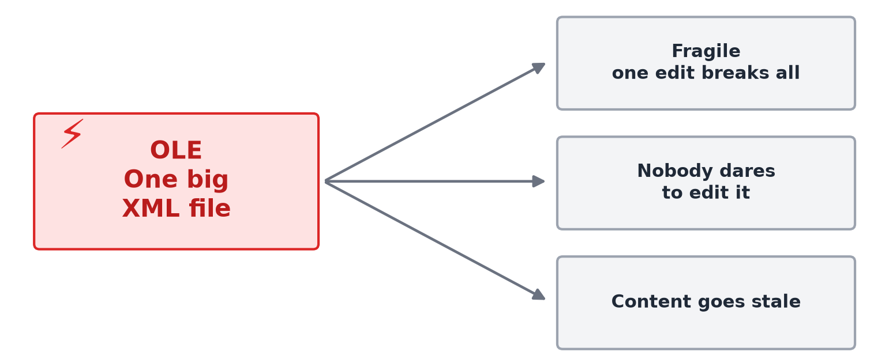
PART 1 — THE PROBLEM AND ITS VALUE
The Problem
• The old platform is called OLE.
• It keeps every exercise in one big XML file.
• One bad edit can break the whole file.
• So nobody dares to touch it.
• Tutors cannot add or fix exercises on their own.
Programming Learning Platform — Capstone
2
Notes:
The university runs exercises on an old system called OLE. It stores every exercise in one big XML file. One small mistake can break the whole file. So people are afraid to edit it. There are few maintainers. The result is stale content and no new exercise types. Tutors have no safe way to author or fix content. This is the real pain we set out to fix.

Slide 3
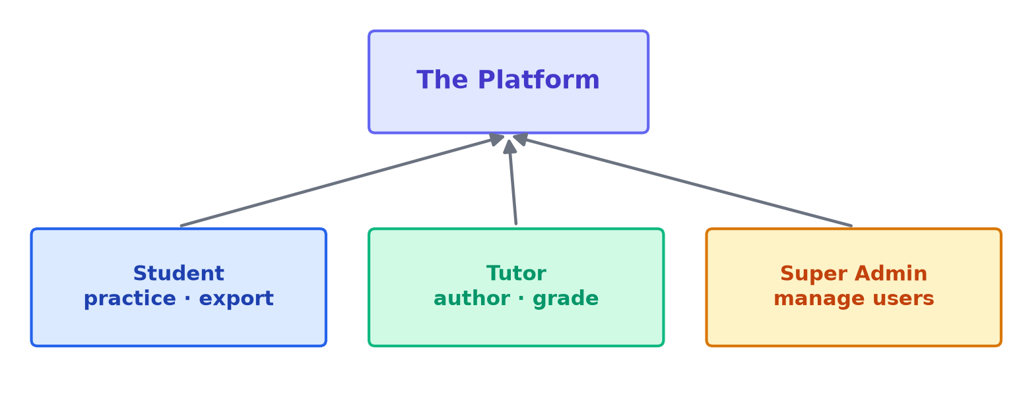
PART 2 — THE SOLUTION AND THE APPROACH
The Solution at a Glance
• A new, standalone platform. It runs apart from OLE.
• Three roles: Student, Tutor, Super Admin.
• Exercises use Blockly. Students drag blocks to write code.
• Block-based coding is a proven way to teach programming [4][8][11].
• Grading is decoupled. Students export. Tutors import and grade.
Programming Learning Platform — Capstone
3
Notes:
The solution is a new, standalone platform. It runs on its own, apart from OLE. It has three roles: student, tutor, and super admin. Exercises use Blockly. Students drag blocks to build code. Block-based coding is a well-known way to teach programming. Tools like Hedy, EduBlocks, and Open Roberta use the same idea. Grading is decoupled. Students export an answer. Tutors import it and grade it. This mirrors the old workflow, but in a safe, modern way.

Slide 4
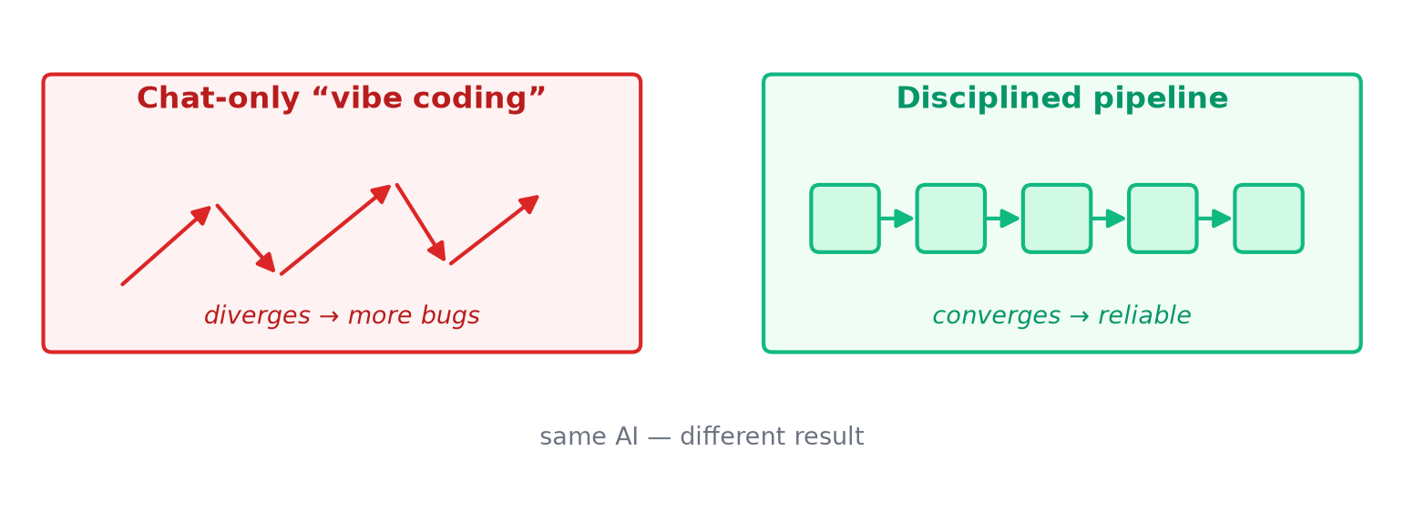
PART 2 — THE SOLUTION AND THE APPROACH
Why We Needed a Real Process
• The first attempt was pure “vibe coding” over chat.
• No plan. No design. No review.
• It worked for small changes. It broke as the project grew.
• One fix often caused new bugs. Progress stalled.
• The lesson: the AI can write code. It needs a process [12].
Programming Learning Platform — Capstone
4
Notes:
A quick word on the approach. The first attempt was pure vibe coding over a chat. There was no plan, no design, and no review. It worked fine for small changes. But it broke as the project grew. One fix often caused new bugs. Progress stalled. The lesson is simple. The AI can write code. But it needs a real process to be reliable. So I rebuilt the project on a disciplined pipeline. I will show that near the end. First, let me show what the system actually does.

Slide 5
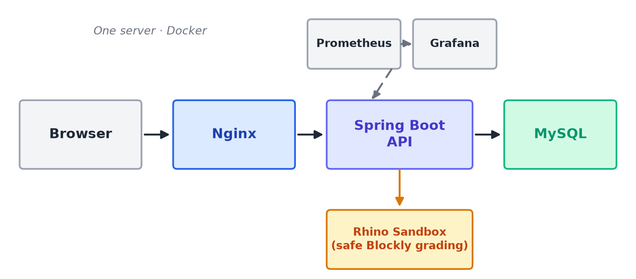
PART 3 — THE SYSTEM (HOW IT WORKS)
System Overview
• Nginx serves the site. Spring Boot runs the API. MySQL stores data.
• Blockly answers are graded on the server, safely.
• It all runs on one server with Docker [10].
Programming Learning Platform — Capstone
5
Notes:
Here is the system at a high level. Requests come in through Nginx. Nginx serves the site and passes API calls to Spring Boot. Spring Boot talks to a MySQL database. When a tutor grades a Blockly answer, it runs on the server. It runs in a safe sandbox, so student code cannot do harm. Prometheus and Grafana watch the system. The whole thing runs on one server with Docker. It is simple to deploy and simple to run.

Slide 6
PART 3 — THE SYSTEM (HOW IT WORKS)
Student: Practice an Exercise
• The student opens a published exercise.
• They drag blocks to build a solution.
• They click Run. The code runs in the browser, safely.
• They see the result right away.
• When done, they export their answer to a file.
SCREENSHOT
Student Blockly workspace + run result
(capture and drop in here)
Programming Learning Platform — Capstone
6
Notes:
Let us start with the student. The student opens a published exercise. They drag blocks to build their solution. They click Run. The code runs right in the browser. It runs in a safe worker, off the main thread. They see the result at once. There is no waiting and no risk to the server. When they are happy, they export their answer to a file. That file is what the tutor will grade later.

Slide 7
PART 3 — THE SYSTEM (HOW IT WORKS)
Tutor: Create and Publish Exercises
• The tutor creates a new exercise. They set the task and the blocks.
• They can edit and publish it.
• Every edit saves a new version. Old versions are never lost.
• Rollback is easy. Just point back to an old version.
SCREENSHOT
Exercise editor + version list
(capture and drop in here)
Programming Learning Platform — Capstone
7
Notes:
Now the tutor side. This is the part OLE could not do well. A tutor can create a new exercise on their own. They set the task and choose the blocks. They can edit it and publish it. Here is the key safety idea. Every edit saves a new version. Old versions are never lost. If an edit is wrong, rollback is easy. You just point back to an older version. So tutors can change content without fear.

Slide 8
PART 3 — THE SYSTEM (HOW IT WORKS)
Tutor: Organize Courses and Categories
• The tutor groups exercises into courses.
• Categories keep exercises tidy.
• Tutors assign exercises to a course.
• They pick which students see them.
SCREENSHOT
Course / category management view
(capture and drop in here)
Programming Learning Platform — Capstone
8
Notes:
Tutors also organize their content. They group exercises into courses. They use categories to keep things tidy. They assign exercises to a course. And they choose which students see them. This gives each tutor full control of their own material. They no longer depend on one shared, fragile file.

Slide 9
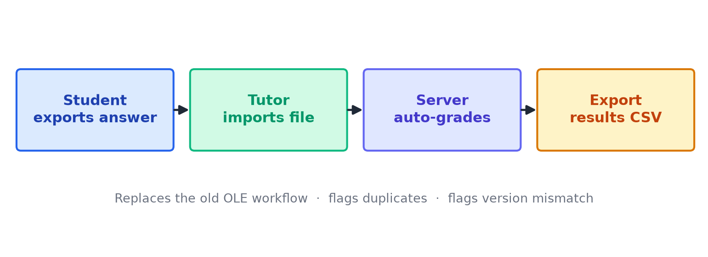
PART 3 — THE SYSTEM (HOW IT WORKS)
The Core: Export / Import Grading
• This replaces the old OLE workflow.
• Student exports an answer. The tutor imports it.
• The system grades Blockly answers automatically, on the server.
• It flags duplicates. It flags version mismatches.
• Tutors can export the results to CSV.
Programming Learning Platform — Capstone
9
Notes:
This is the core of the platform. It replaces the old OLE grading workflow. A student exports an answer file. The tutor imports that file. The system grades the Blockly answer automatically. The grading runs safely on the server. It also checks for problems. It flags duplicate submissions. It flags when a student used an old version. Finally, tutors can export all results to a CSV file. This whole loop used to be manual and painful. Now it is simple.

Slide 10
PART 3 — THE SYSTEM (HOW IT WORKS)
Admin and Monitoring
• Super Admin creates and manages user accounts.
• Admin can disable a user. That user is locked out at once.
• Grafana shows live health of the system [1].
• Alerts fire if something breaks.
SCREENSHOT
Admin user list
(capture and drop in here)
SCREENSHOT
Grafana dashboard panel
(capture and drop in here)
Programming Learning Platform — Capstone
10
Notes:
Two smaller pieces to round this out. First, the super admin manages user accounts. They can create accounts. They can also disable a user. A disabled user is locked out at once, on the next request. Second, monitoring. Grafana shows the live health of the system. If something breaks, an alert fires. So the platform is easy to keep healthy in production.

Slide 11
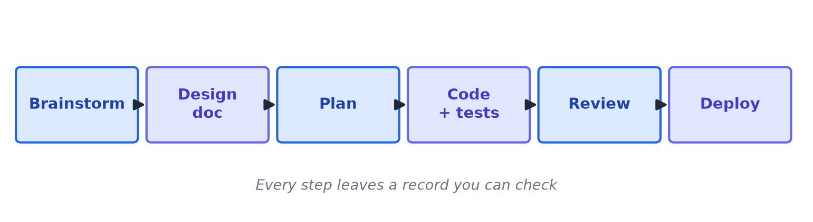
PART 3 — HOW IT WAS BUILT
A Spec-Driven AI Pipeline
• Every feature followed the same steps.
• Brainstorm → design → plan → code with tests → review → deploy.
• Each step leaves a record you can check.
• Every AI decision has a checkpoint and a review gate.
Programming Learning Platform — Capstone
11
Notes:
Now, briefly, how it was built. This is the process that replaced the chat experiment. Every feature followed the same steps. We brainstorm. We write a design. We write a plan. We write code with tests first. We review. Then we deploy. Each step leaves a record you can check later. This is the key. Every AI decision has a checkpoint. And every change passes a review gate before it merges. That is what made the AI reliable.

Slide 12
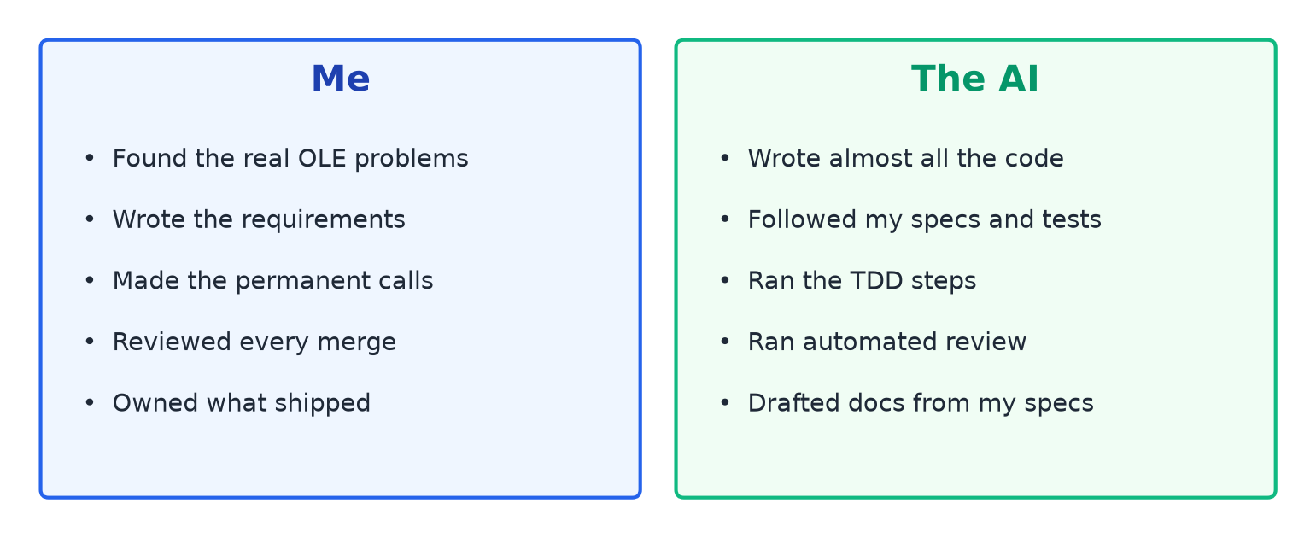
PART 3 — HOW IT WAS BUILT
What I Did vs. What the AI Did
Programming Learning Platform — Capstone
12
Notes:
So who did what? The AI wrote almost all of the code. It followed my specs and my tests. It ran the test steps and the automated review. But the important work was mine. I found the real OLE problems. I wrote the requirements. I made the permanent calls, like one server and no hard deletes. I reviewed and approved every merge. And I owned what shipped. The point is this. Writing code is easy now. Deciding what to build and being accountable is the real work.

Slide 13
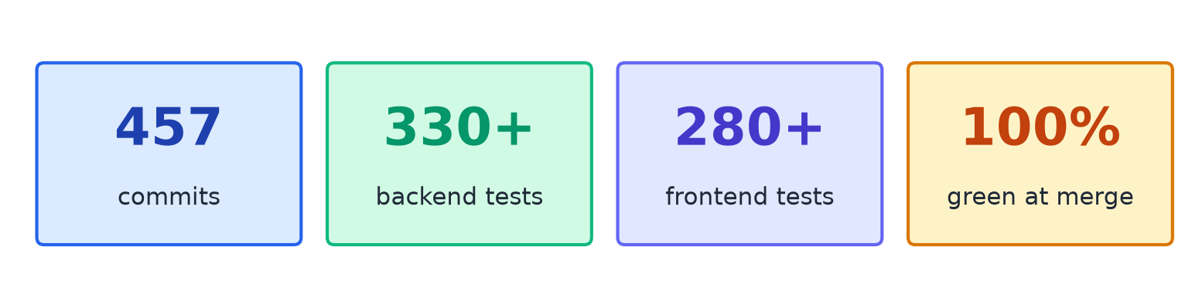
PART 4 — RESULTS AND IMPLICATIONS
Results and Lessons
• A working, deployed platform. It fixes the OLE pain points.
• Real numbers below, all green at every merge.
• Lesson: the process has a cost, but it catches bugs before they ship.
• Future work: likes, profiles, and Python exercises [2][7].
Programming Learning Platform — Capstone
13
Notes:
What did this produce? A working, deployed platform that fixes the OLE pain points. The numbers: 457 commits. Over 330 backend tests and over 280 frontend tests. They were all green at every merge. An honest lesson. The process has a cost. It slows down small changes. But it catches bugs before they ship. For future work: likes, profiles, and Python exercises. The bigger idea is this. A disciplined process makes AI-built software safe to deploy.

Slide 14
Thank You
Questions?
Notes:
Thank you. I am happy to take questions.

Slide 15
APPENDIX
References
[1] Baeldung. (2024). Monitor a Spring Boot app using Prometheus.
[2] Codecademy. (2024). Learn Python 3.
[3] DZone. (2021). JGit library examples in Java.
[4] EduBlocks. (2024). Block-based coding to text-based Python.
[5] Google for Developers. (2025). Save and load (Blockly serialization).
[6] Google for Developers. (2025). Using Blockly APIs.
[7] freeCodeCamp. (2024). Scientific computing with Python.
[8] Hermans, F. (2020). Hedy: A gradual language for programming education. ICER ’20.
[9] ignatandrei. (2024). BlocklyAutomation [software]. GitHub.
[10] Merkel, D. (2014). Docker: Lightweight Linux containers. Linux Journal.
[11] Open Roberta. (2024). Open Roberta Lab [software]. GitHub.
[12] Petre, M. (2004). How expert software engineers understand and use UML. JSS 71(3).
Programming Learning Platform — Capstone
15
Notes:
This appendix lists the references. It is here if a marker asks.

