Slide 1
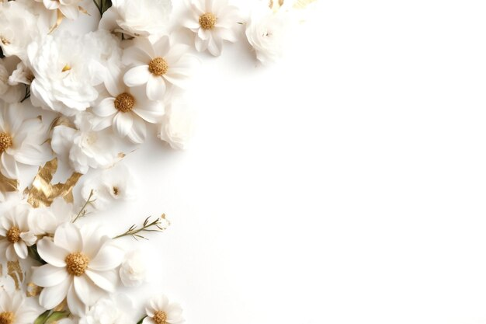
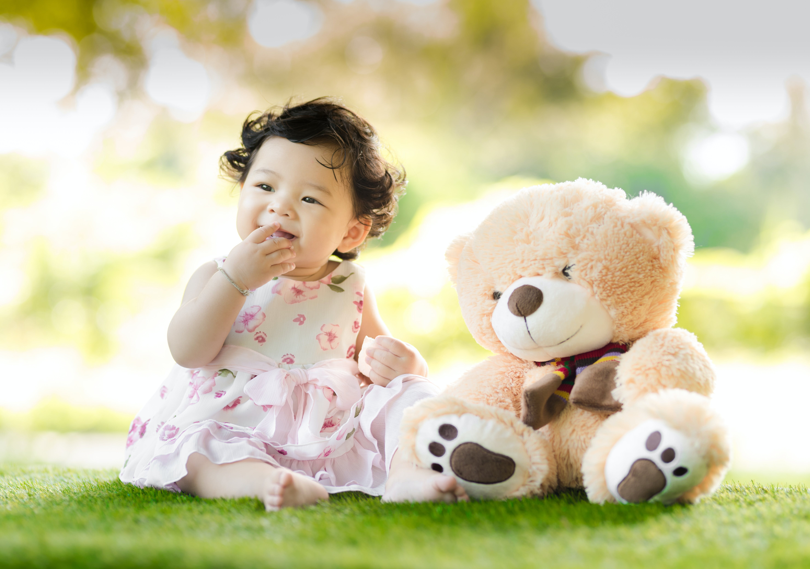
HAPPY BIRTHDAY Dear
On your special day, I wish for you to experience the purest form of joy and to be surrounded by the love of those who cherish you. May the universe bless you with all the beautiful things that life has to offer, and may your journey ahead be filled with endless opportunities and happiness.
Name,

