Slide 1
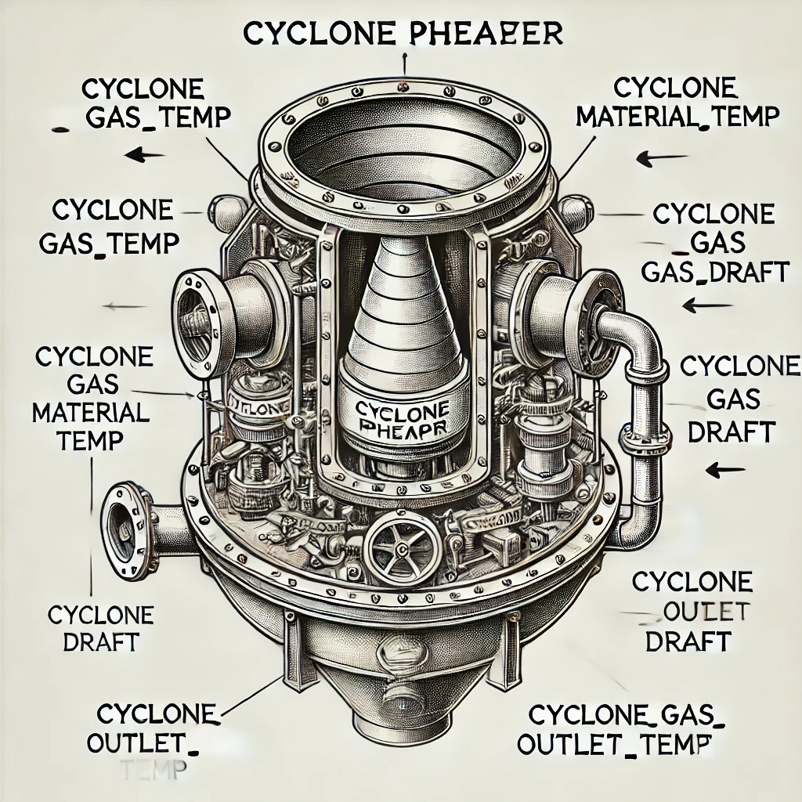
Cyclone Preheater Anomaly Detection
Girish Jerpoth
Flow Chart
Importing Dataset
Convert string into float
Cleaning the Data
Handle Missing Values
Exploratory Data Analysis
Find Correlation Matrix
Dimensionality Reduction
Reduce 6 dimensions to 2
Model Selection
Isolation Forest
Anomaly Detection

Slide 2
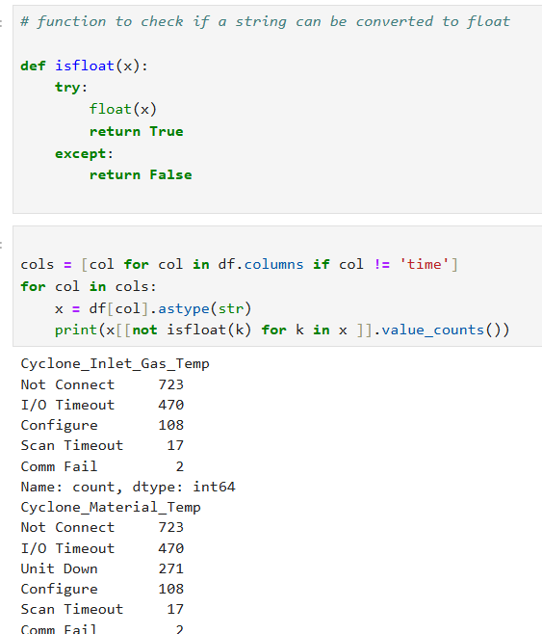
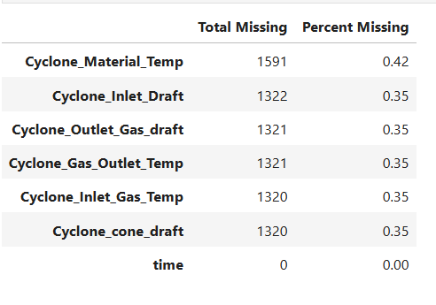
Data Preparation
Data Type Transformation:
Converted object-type columns to numerical float values where applicable.
Reason: Ensures compatibility with numerical analysis techniques and machine learning algorithms.
Handling Missing Values:
Visualization:
Plotted frequency value distributions for each column to understand the spread and nature of missing data.
Imputation:
Replaced missing values with the drop of the respective column.
Reason: There are less than one percent missing values in every columns and most of them belong to the same records , so we can drop them..

Slide 3
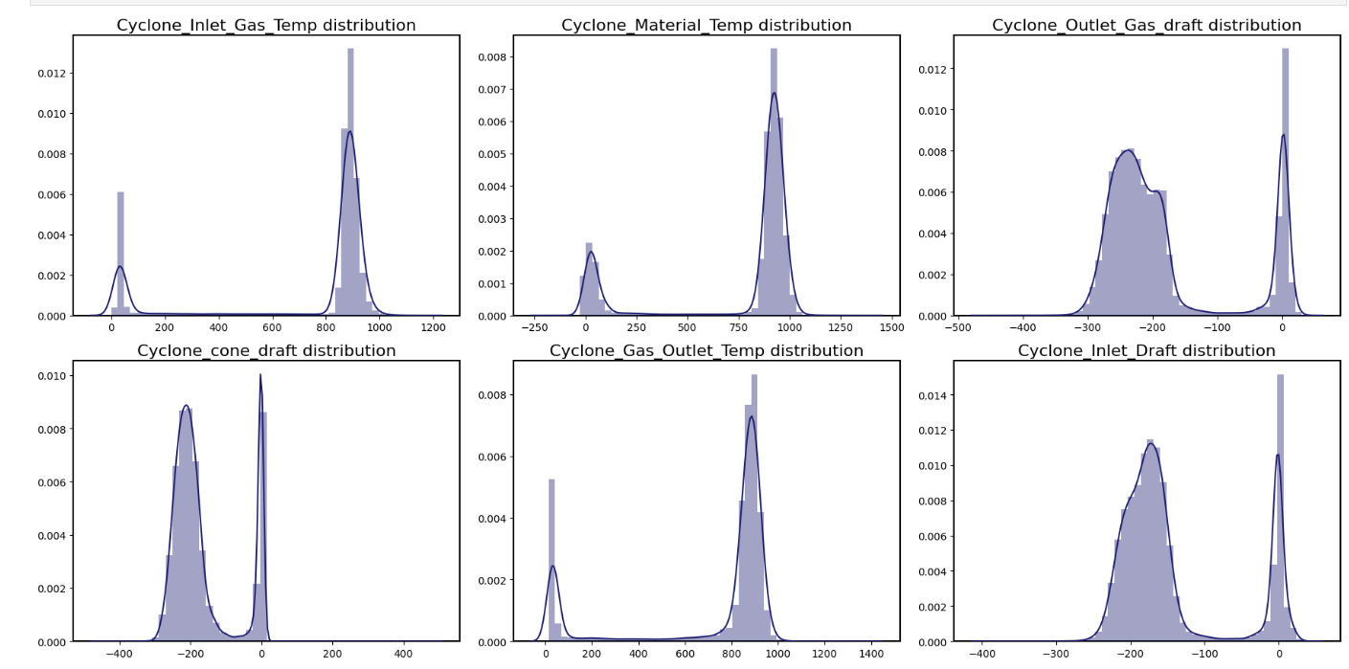
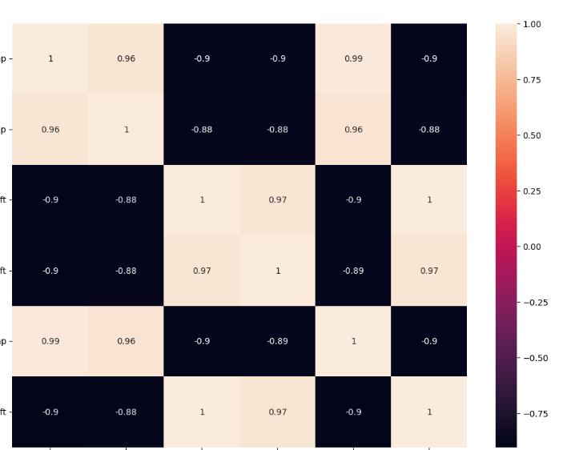
Exploratory Data Analysis (EDA)
Distribution Analysis:
Used distplot to visualize the distribution of each numerical variable.
Objective: Identify skewness, modality, and potential outliers in the data.
Subplots for Multi-Variable Insights:
Created subplots to compare distributions and trends across variables simultaneously.
Reason: Simplifies comparison and highlights inter-variable differences.
Correlation Matrix:
Visualized pairwise correlations using a heatmap.
Goal: Identify strongly correlated variables to understand relationships and potential multicollinearity.
subplot
Pair Plot:
Used pair plots to examine scatter plots between variables.
Benefit: Highlights trends, clusters, and linear relationships between variables.
Box Plots:
Created box plots to identify outliers and examine value ranges for each variable.
Utility: Helps in detecting and visualizing anomalies in the data.
Correlation Matrix

Slide 4
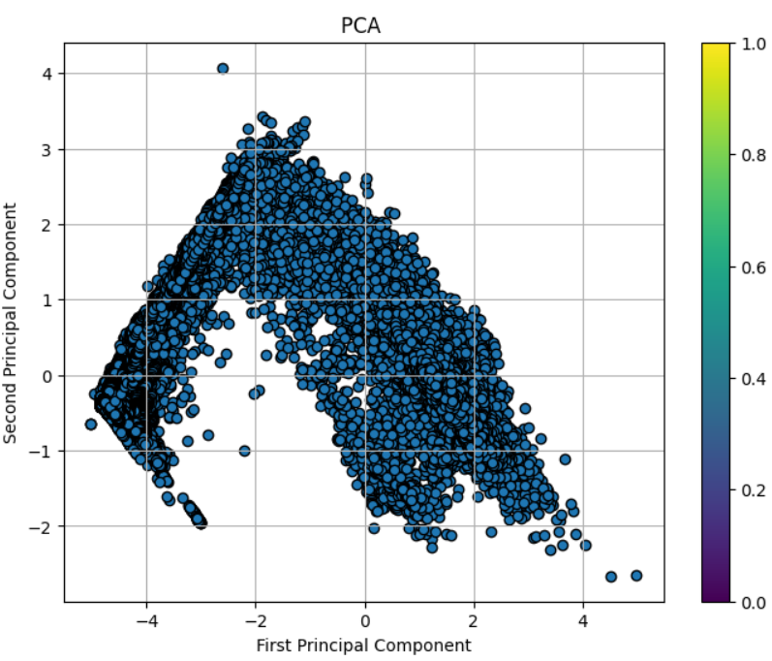
Dimension Reduction
Purpose:
Simplify the dataset by reducing it to its most informative components while preserving variance.
Techniques Used:
Principal Component Analysis (PCA): Reduced the data to 2 principal components for better visualization and analysis.
Process:
Extracted key variables from the dataset.
Applied PCA to capture the dominant patterns in the data.
Standardized the PCA components using StandardScaler to ensure consistency and comparability.
Visualization:
Created a 3D scatter plot to represent relationships and clustering between the PCA components.
Outcome:
Dimensionality reduction helped uncover hidden patterns and prepare data for anomaly detection.

Slide 5
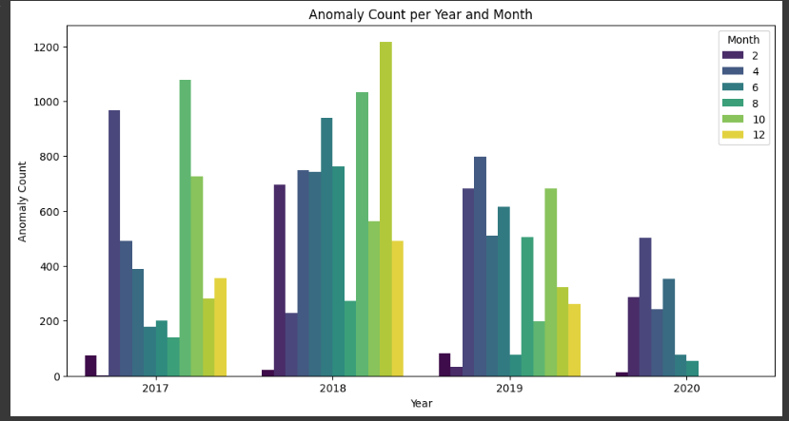
Model Selection and Visualization
Algorithm: Isolation Forest
Reason for Selection:
Efficiency: Handles large datasets like ours (370,000 records) effectively.
Robustness: Does not assume any specific data distribution.
Interpretability: Flags anomalies based on the isolation principle, making results easier to understand.
Scalability: Well-suited for high-dimensional data and capable of detecting global and local anomalies
Out of a total of 358,833 data points, 18,886 anomalies were detected. This highlights the significance of anomaly detection within the dataset.
Insights: Anomaly Trends Analysis
Peak Periods: Highest anomalies occurred in 2017, 2018, and 2019, with notable peaks in August (Month 8) and December (Month 12). December 2018 had the highest count, exceeding 1200.
Identification: Abnormal periods were identified by significant peaks in the bar graph, particularly in late-year months.
Trends: Anomaly counts rose from 2017 to 2018, declined in 2019, and sharply dropped by 2020. Recurring high counts in December suggest seasonal patterns
Thank you
Anomaly Count Vs Year and Month

