Slide 1
進度報告
日期:24/10/21

Slide 2
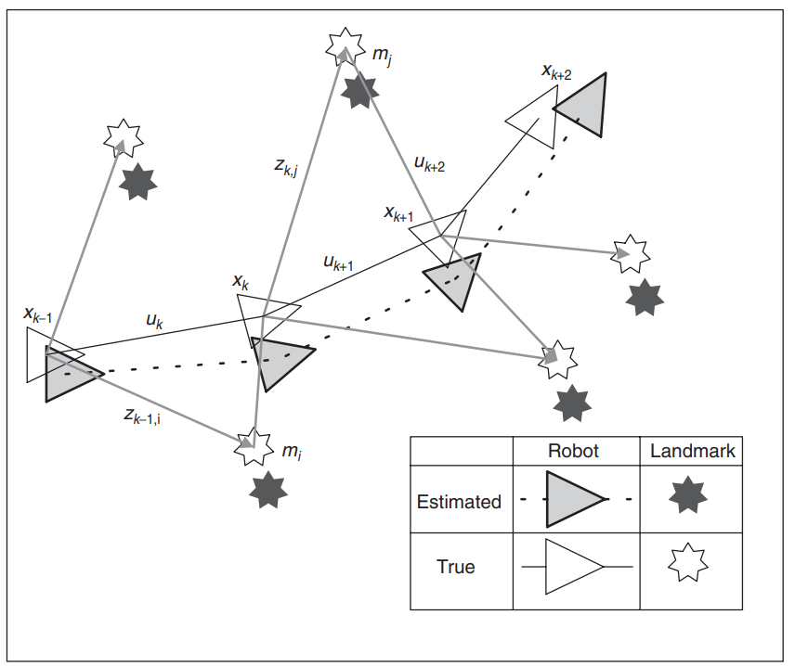
SLAM問題

Slide 3



數學模型

Slide 4


時間更新：
量測更新：

Slide 5
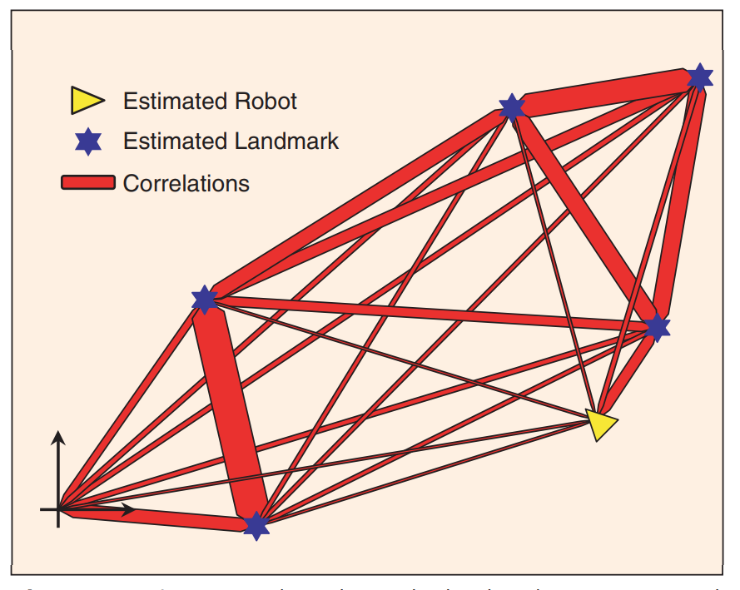

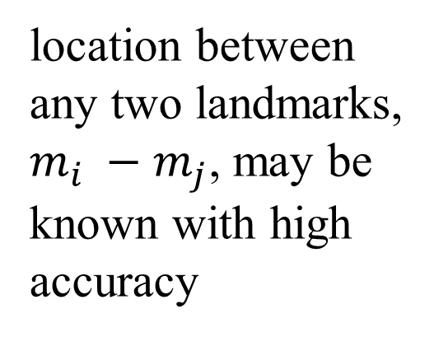
location between any two landmarks, $m_{i} −m_{j}$, may be known with high accuracy

Slide 6
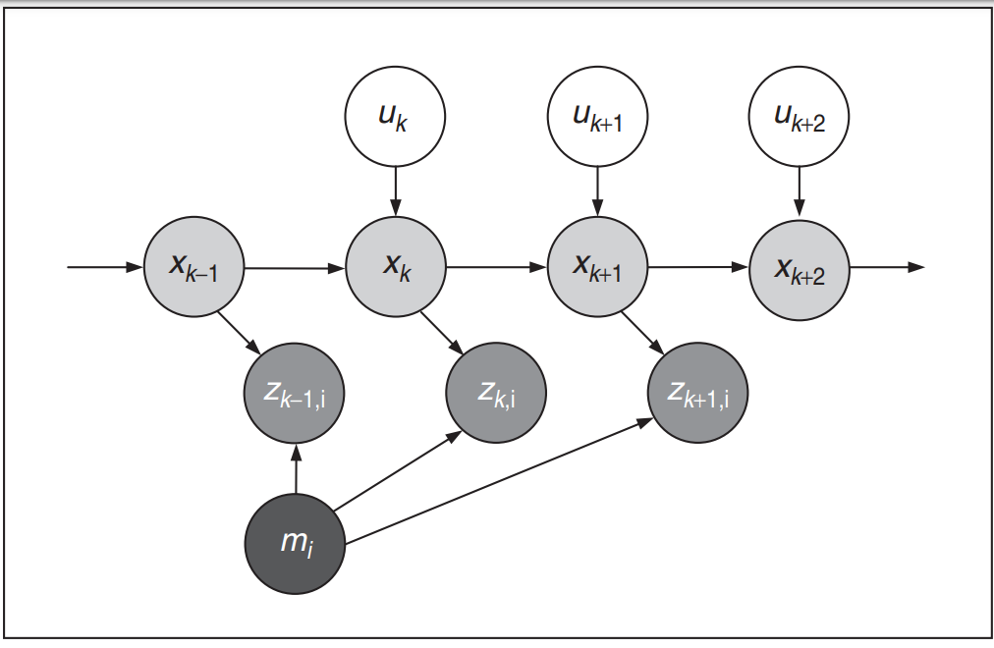
Rao-Blackwellized Filter

