Slide 1
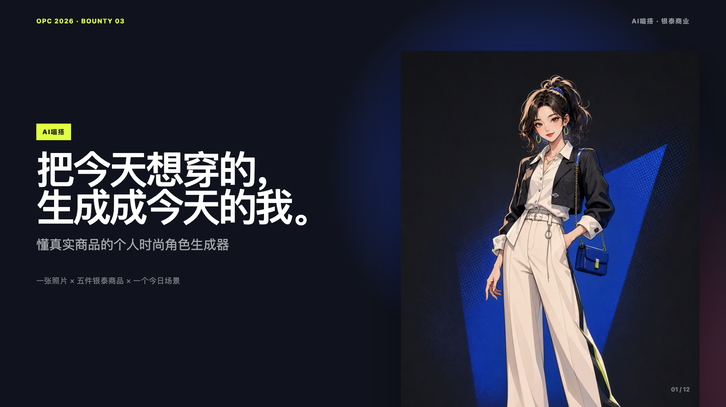
Notes:
[Sources]
- Project-local canonical slide render from deliverables/路演Deck.html
- Project-local UI screenshots, character preview, product samples, and QR assets

Slide 2
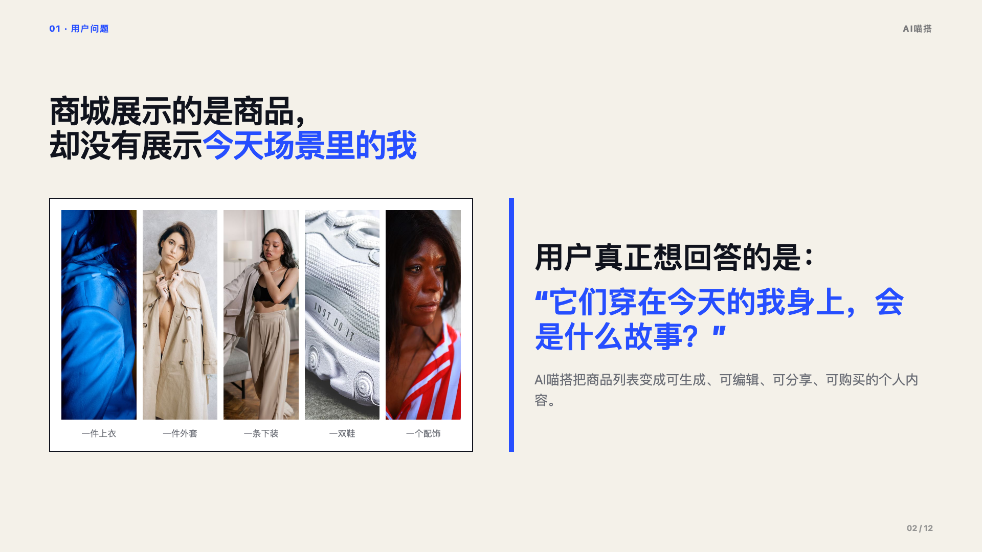
Notes:
[Sources]
- Project-local canonical slide render from deliverables/路演Deck.html
- Project-local UI screenshots, character preview, product samples, and QR assets

Slide 3
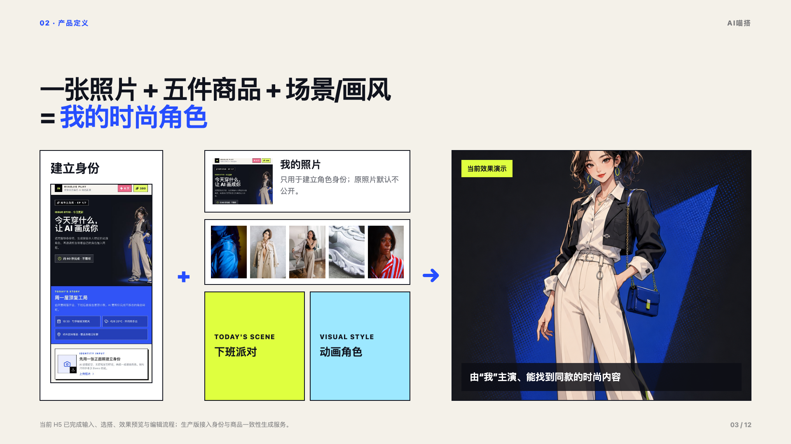
Notes:
[Sources]
- Project-local canonical slide render from deliverables/路演Deck.html
- Project-local UI screenshots, character preview, product samples, and QR assets

Slide 4
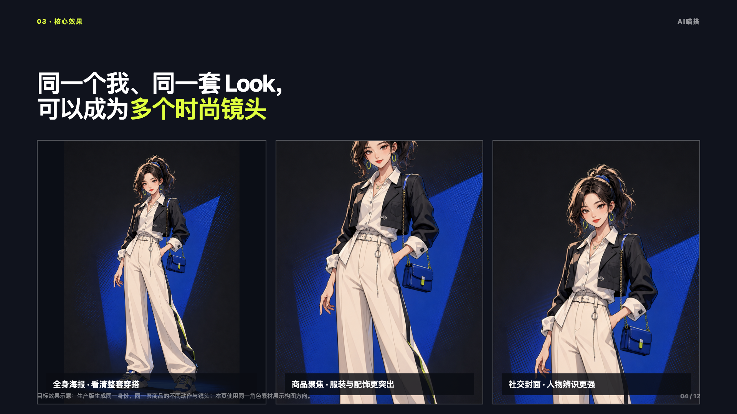
Notes:
[Sources]
- Project-local canonical slide render from deliverables/路演Deck.html
- Project-local UI screenshots, character preview, product samples, and QR assets

Slide 5
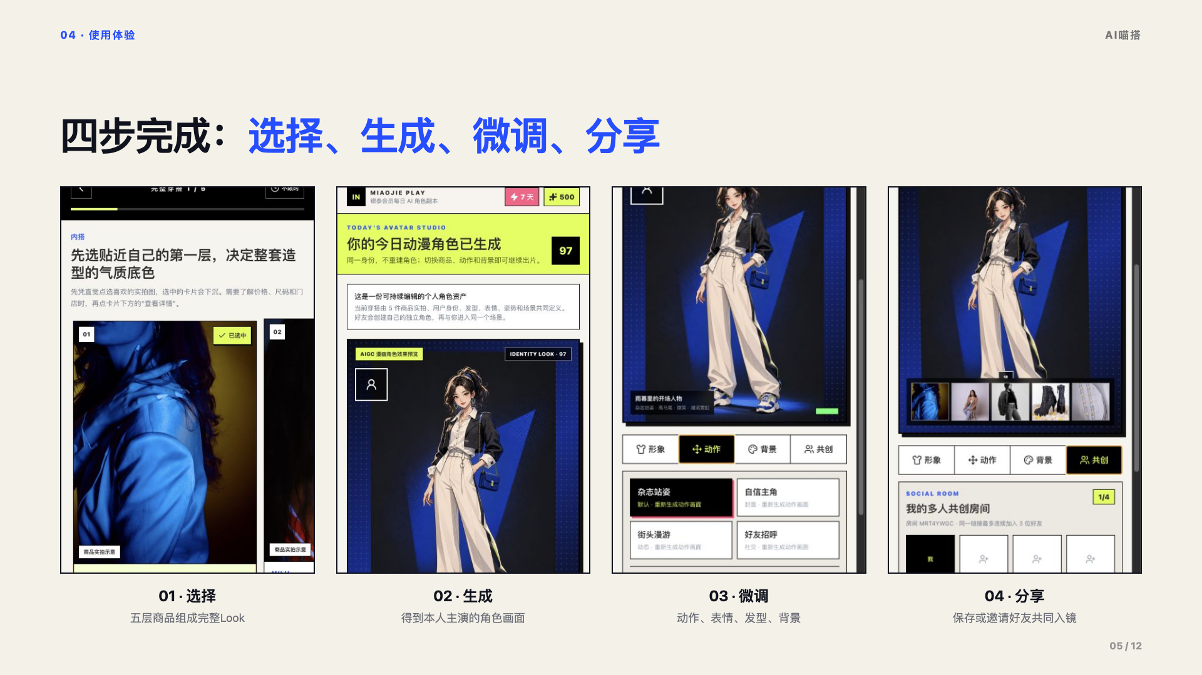
Notes:
[Sources]
- Project-local canonical slide render from deliverables/路演Deck.html
- Project-local UI screenshots, character preview, product samples, and QR assets

Slide 6
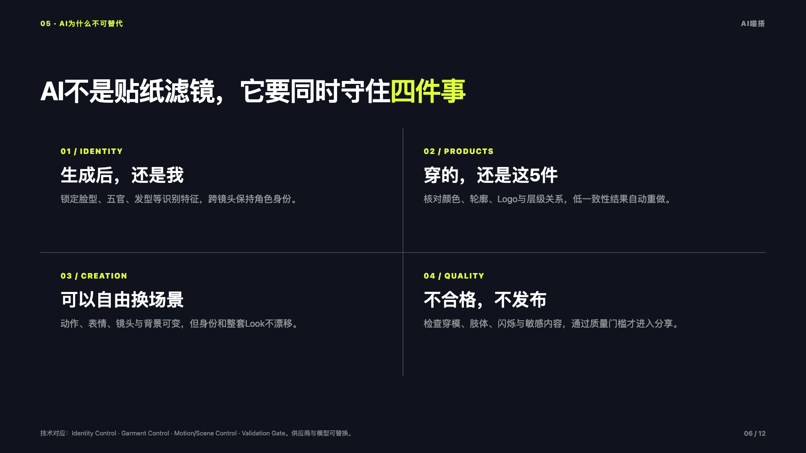
Notes:
[Sources]
- Project-local canonical slide render from deliverables/路演Deck.html
- Project-local UI screenshots, character preview, product samples, and QR assets

Slide 7
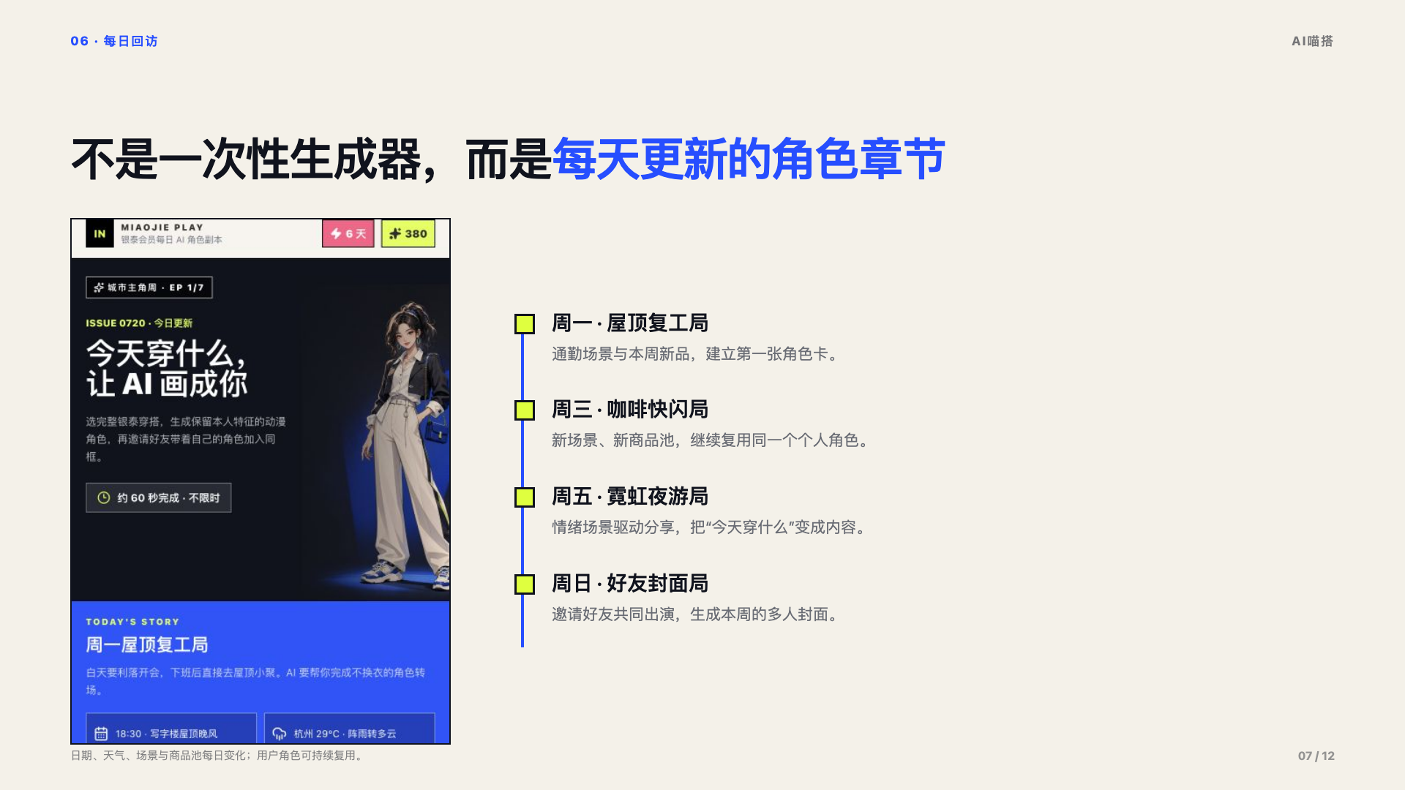
Notes:
[Sources]
- Project-local canonical slide render from deliverables/路演Deck.html
- Project-local UI screenshots, character preview, product samples, and QR assets

Slide 8
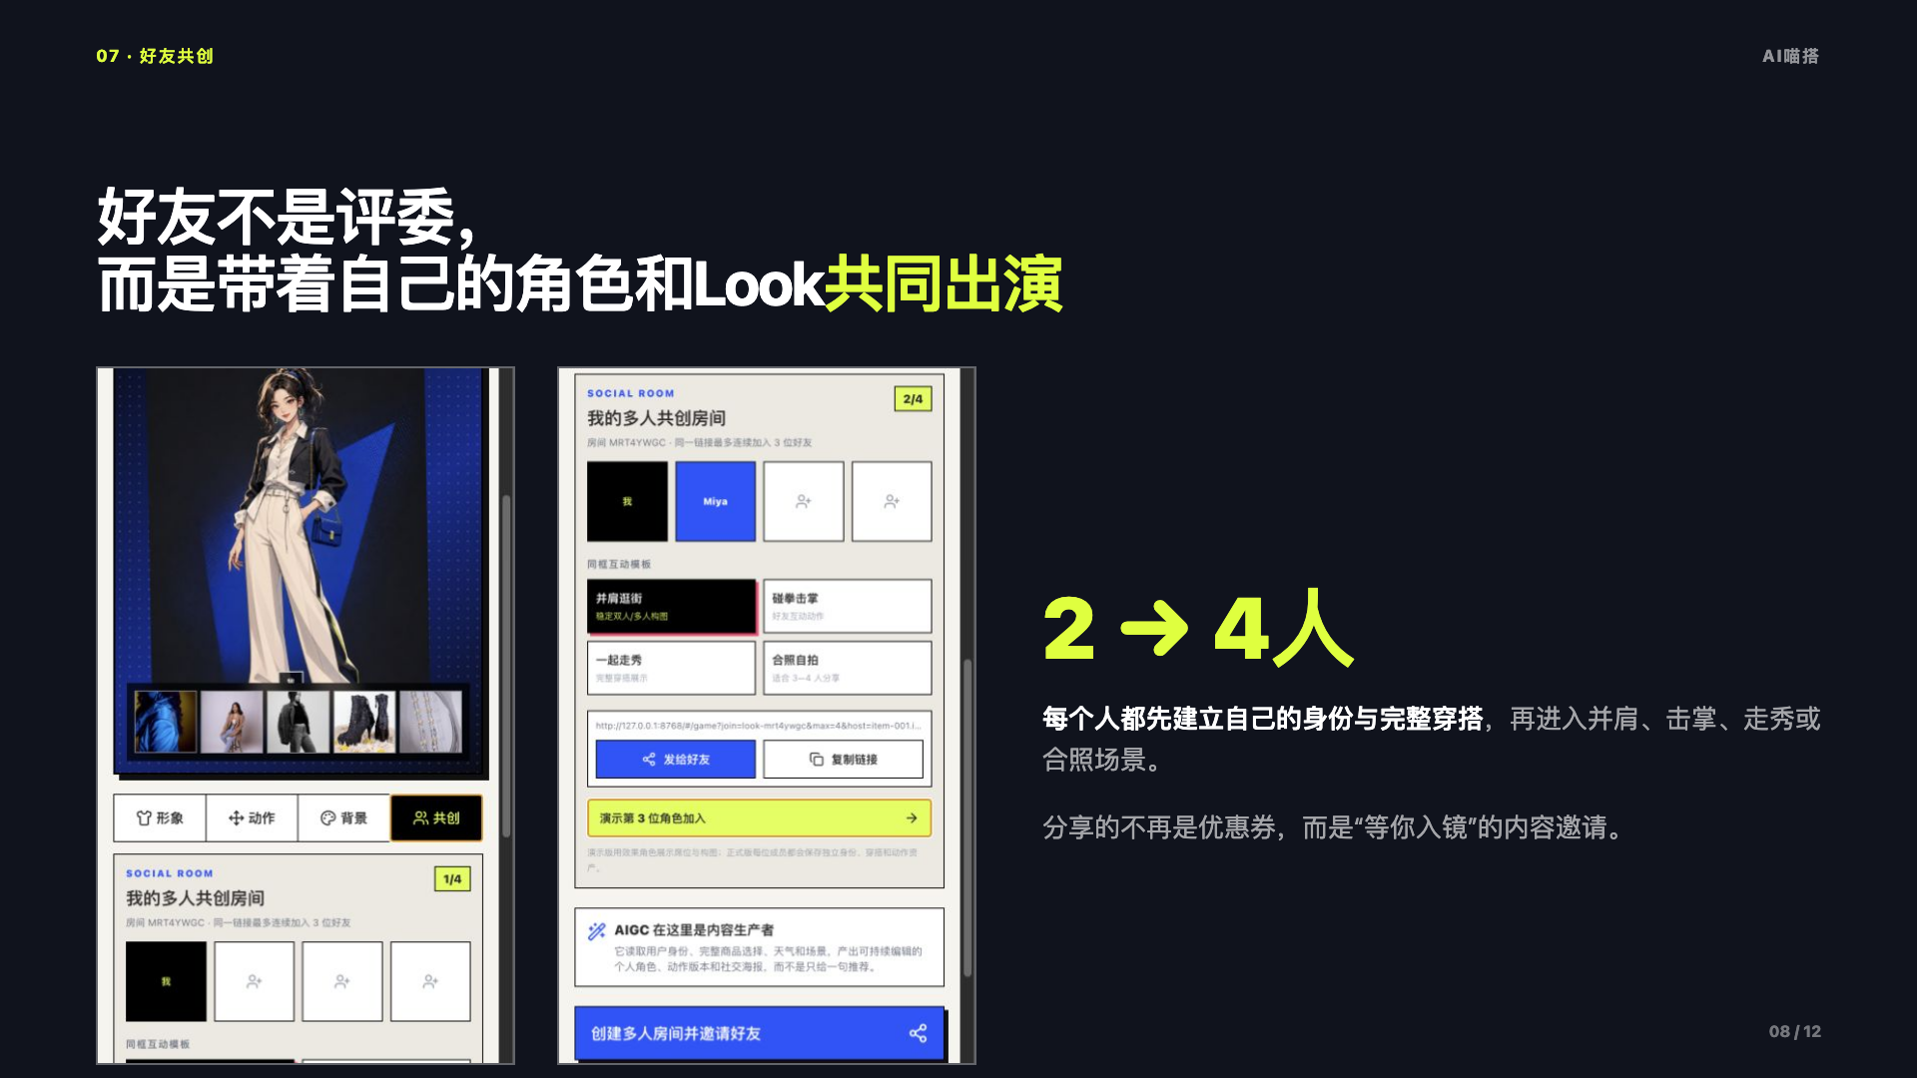
Notes:
[Sources]
- Project-local canonical slide render from deliverables/路演Deck.html
- Project-local UI screenshots, character preview, product samples, and QR assets

Slide 9
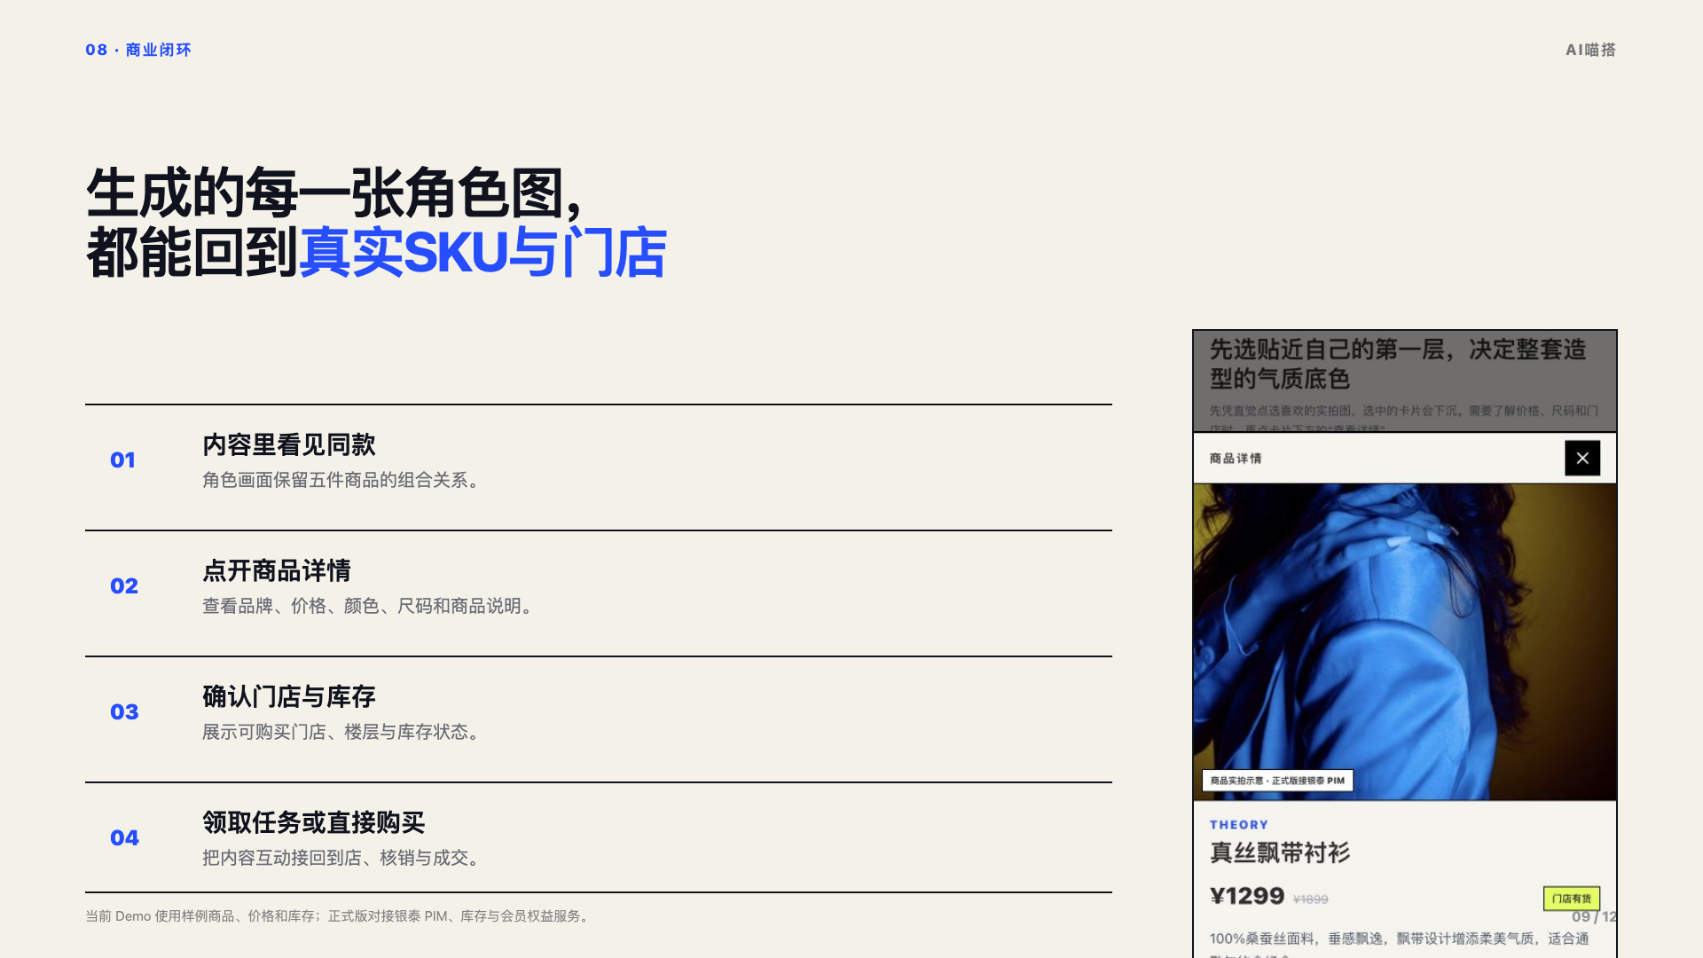
Notes:
[Sources]
- Project-local canonical slide render from deliverables/路演Deck.html
- Project-local UI screenshots, character preview, product samples, and QR assets

Slide 10
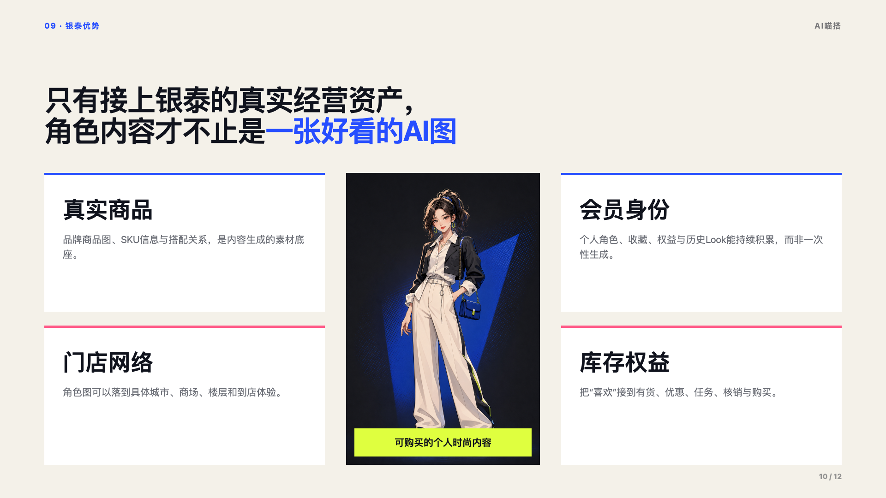
Notes:
[Sources]
- Project-local canonical slide render from deliverables/路演Deck.html
- Project-local UI screenshots, character preview, product samples, and QR assets

Slide 11
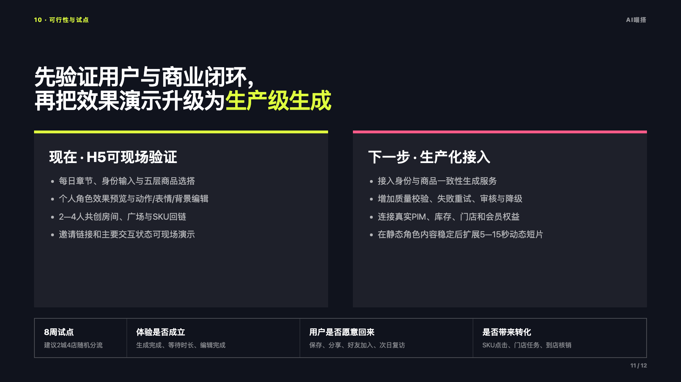
Notes:
[Sources]
- Project-local canonical slide render from deliverables/路演Deck.html
- Project-local UI screenshots, character preview, product samples, and QR assets

Slide 12
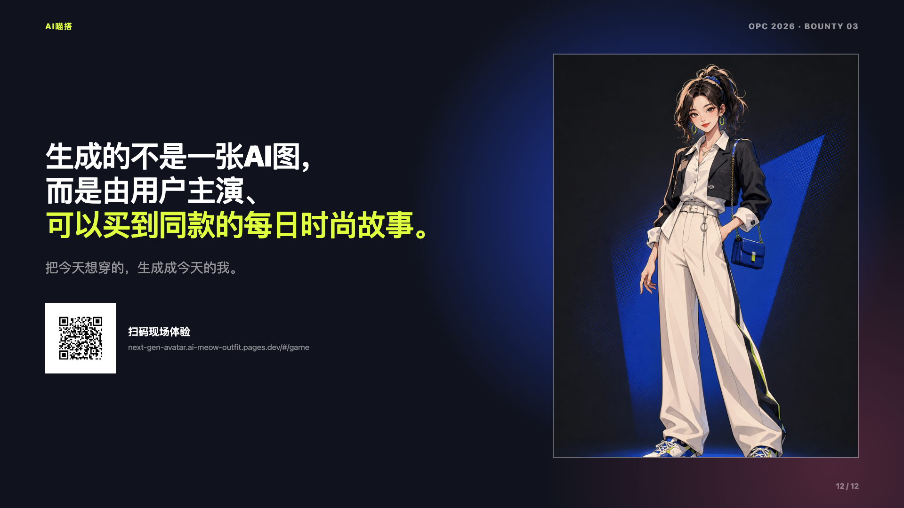
Notes:
[Sources]
- Project-local canonical slide render from deliverables/路演Deck.html
- Project-local UI screenshots, character preview, product samples, and QR assets

