Slide 1
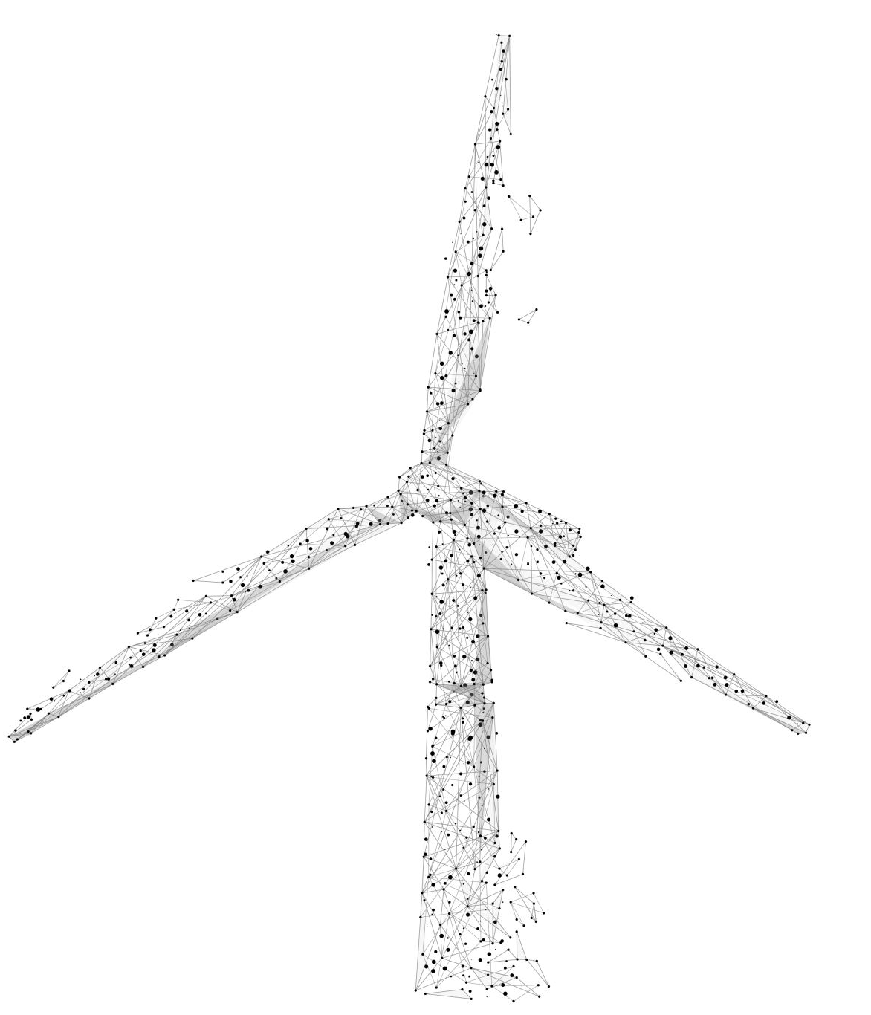
Space Windmill
Jerry

Slide 2
Instructions
Click on the mouse
Move the mouse

Slide 3
Achieved
Learned how to create different scenes
Learned how to make shadow of items
Learned how to let an item disappear in some time

Slide 4
Struggling
Trying to correctly use the functions like floor
Struggling to add diversity to the sketch
`Struggling to let items run periodically

Slide 5
Improvement in the future
Try to make the sketch more related to the original idea
Try to achieve more interactions between items
Try to do more creative and easy-understanding sketches

