Slide 1
深度学习在单分子荧光定位显微镜中的应用
凌星皓 21307110019

Slide 2
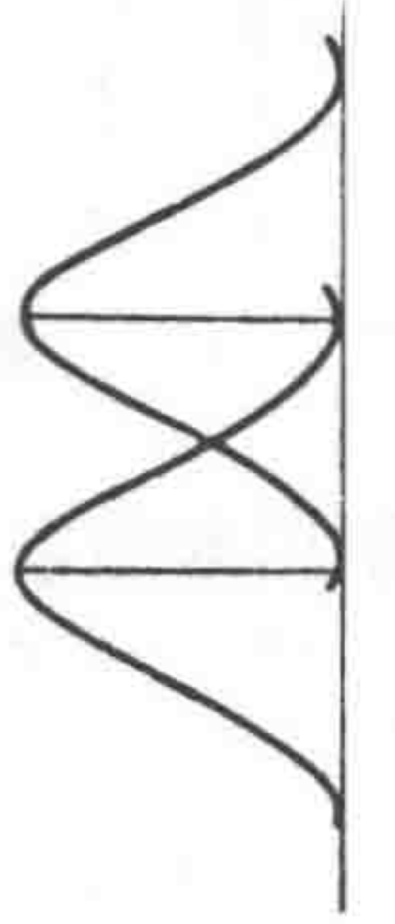
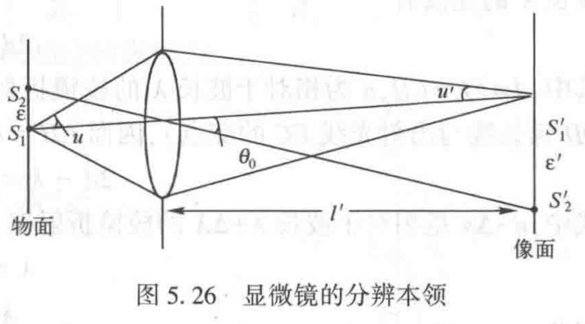
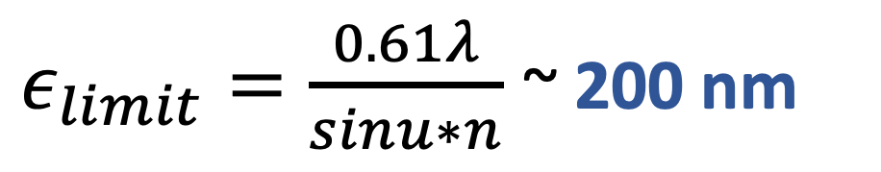
Background1: Diffraction Limit
Diffraction by the aperture
Overlapping limits the resolution
$ε_{limit}=\frac{0.61λ}{sinu∗n}$ ~ 200 nm

Slide 3
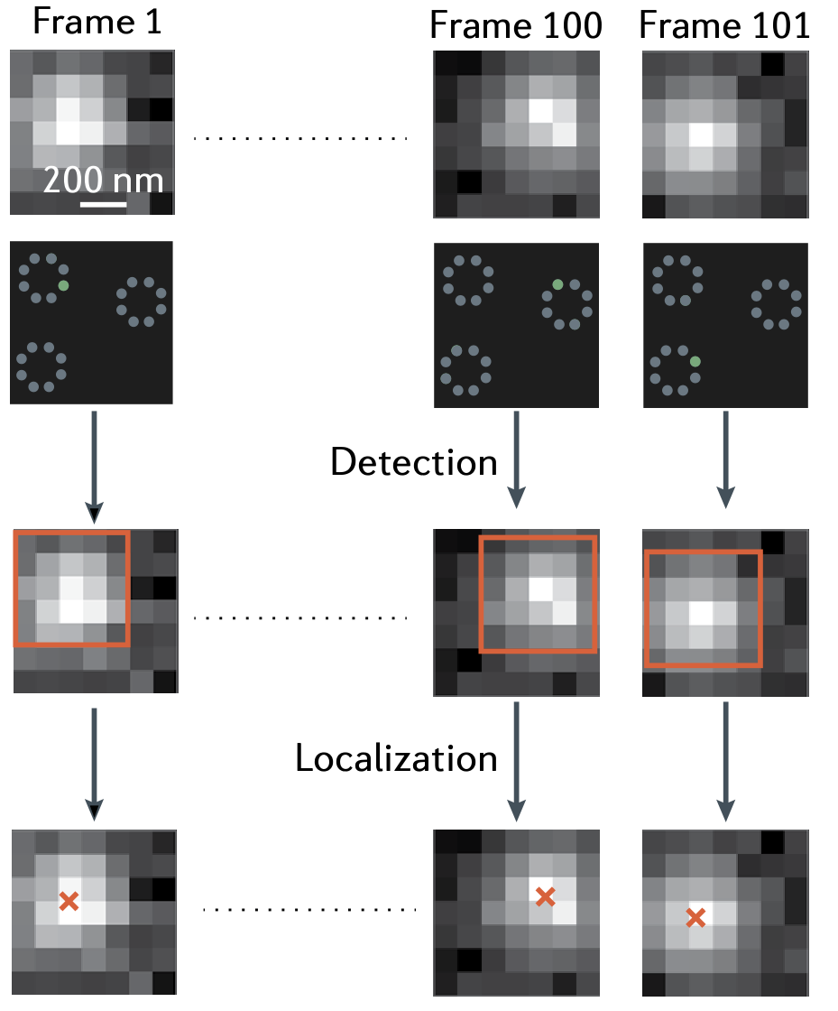
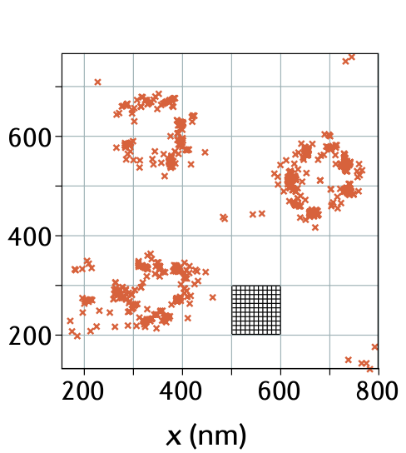
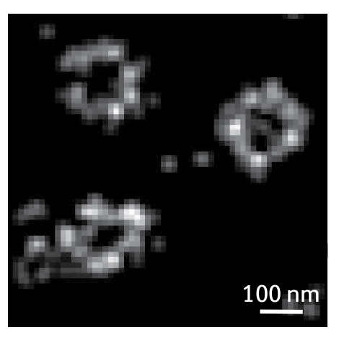
Background2: Localization Microscopy
Solution:
Activate ramdomly;
Localize one by one (no overlapping)
~ 20-60 nm

Slide 4
Problems
High density Imaging
Multi-dimentional information
Aberration correction
……
传统算法劣势: 难以处理或过慢
优势: 物理图像清晰

Slide 5
Causion: another superresolution

Slide 6
Maximum Likelihood Method
---- A classic algorithm

Slide 7
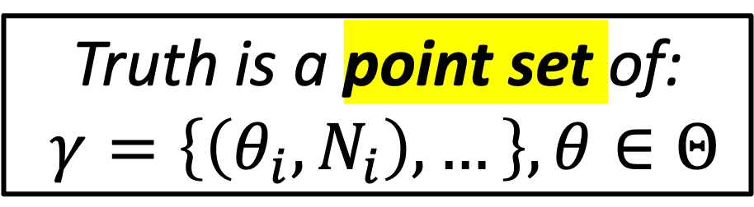
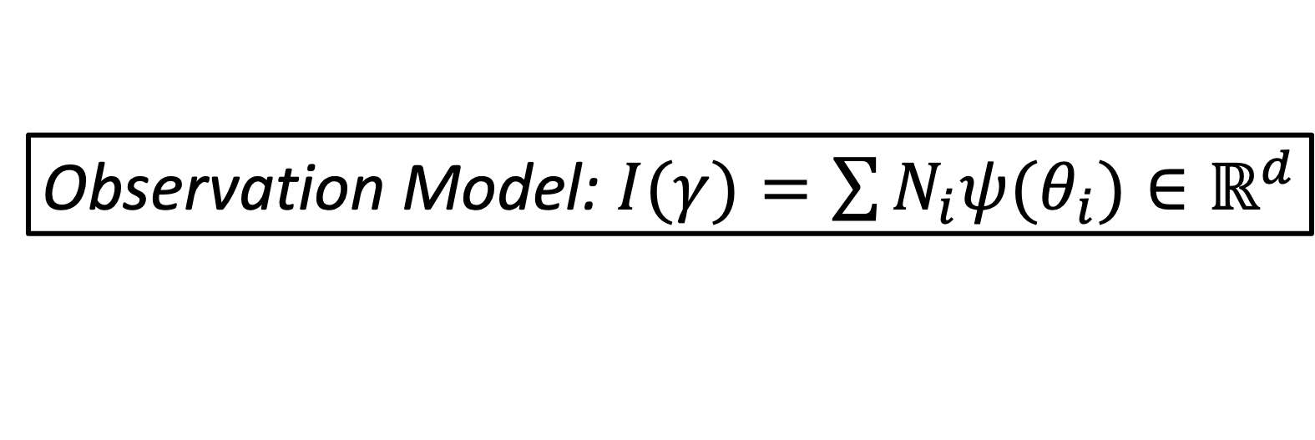

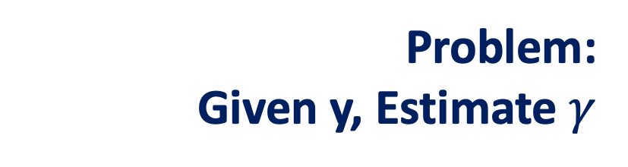
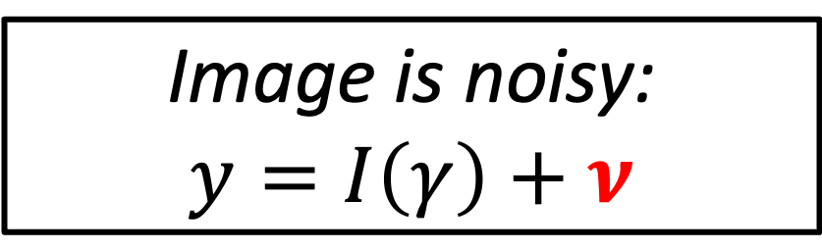
Approach of MLE
Position/polarization/…
Truth is a point set of:
$γ=\left\{\left(θ_{i},N_{i}\right),…\right\},θ∈Θ$
** The number of points is unknown
Observation Model: $I(γ)=\sum{N_{i}ψ(θ_{i})}∈ℝ^{d}$
The model $ψ$ is known!
Image is noisy:
$$y=I\left(γ\right)+ν$$
Problem:
Given y, Estimate $γ$

Slide 8
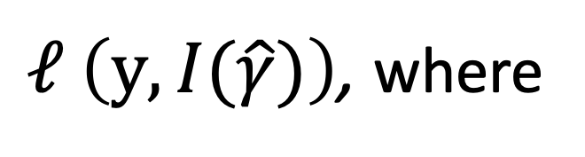
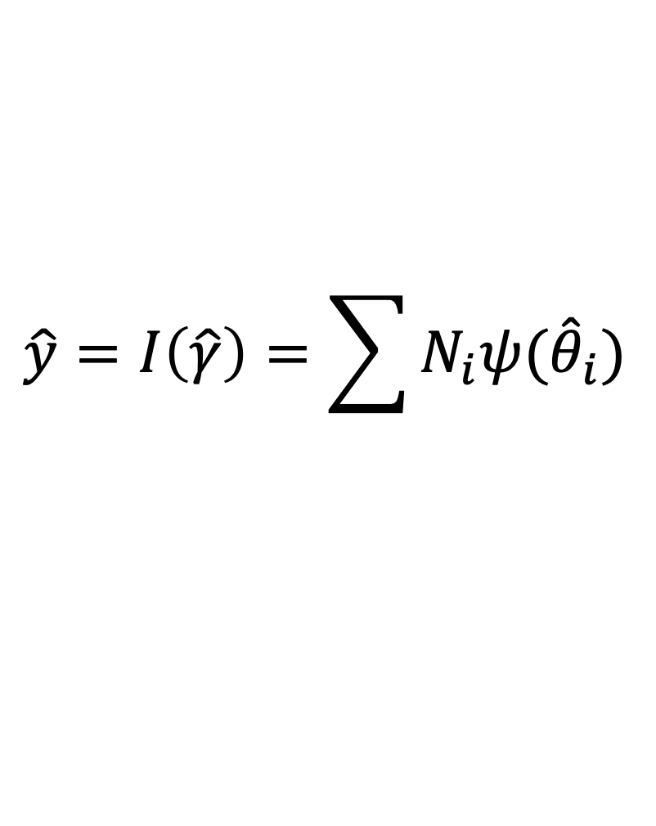
Approach of MLE
Take the likelihood function of the noise distribution $ν$:
$$ℓ_{ }\left(y,\hat{y}\right)=Ρ\left\{experiment=y \right| noise free=\hat{y} \}$$
That is, we need to find the point set $\hat{γ}$ that minimize:
$$\hat{y}=I\left(\hat{γ}\right)=\sum{N_{i}ψ({\hat{θ}}_{i})}$$
$ℓ_{ }\left(y,I(\hat{γ})\right)$, where

Slide 9
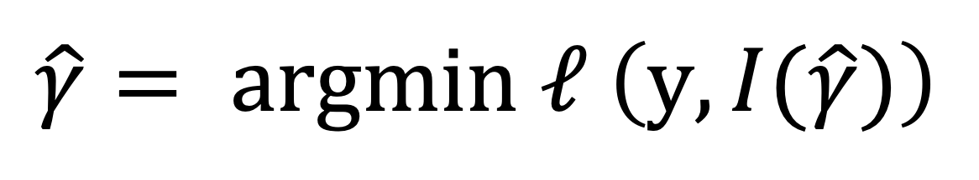
Approach of MLE
Sparsity: only a few numbers of emitters
Algorithm: convex optimization (ADCG.el), complex
Problem: the PSF and noise model needs to be accurate
Aim: CRLB bound
$${\hat{γ}= argmin ℓ}_{ }\left(y,I(\hat{γ})\right)$$

Slide 10
Machine Learning Method
---- the advantage and workflow

Slide 11
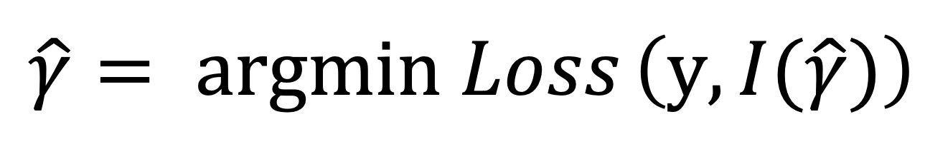
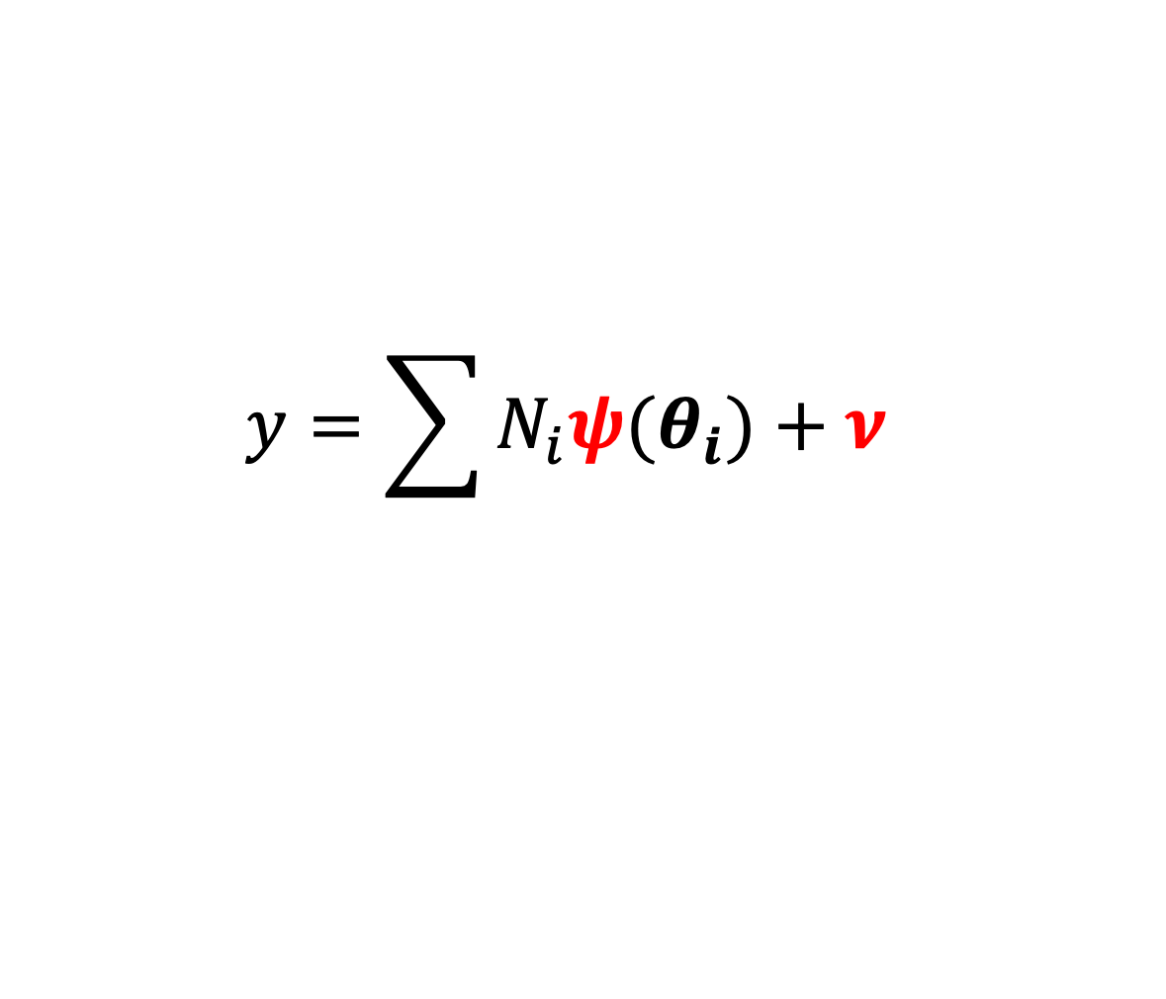
Approach of ML
Advantage: More learnable parameters
$${\hat{γ}= argmin Loss}_{ }\left(y,I(\hat{γ})\right)$$
$$y=\sum{N_{i}ψ(θ_{i})+ν }$$
PSF/noise could be changed in training set

Slide 12
Choice of Loss Function

Slide 13
How to evaluate the network
 | Recall/Precision | Error | Robustness | Resolution
Suitable for: | Classification/ Recognition | Position/ Values | Performance in different context? | Super-resolution
Indicators: | False positive(negative), Accuracy | RMSE/ Precision/ Jaccard index | SNR/pattern/ countings/blinking | FWHM/ FRC

Slide 14
Is it hard ?

Slide 16
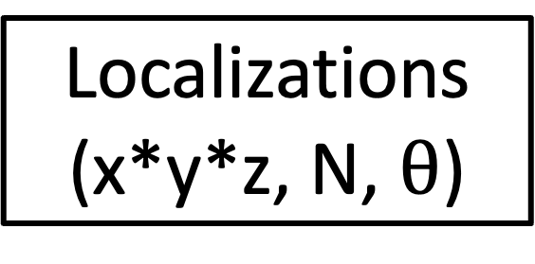
The types of problem
Input
Output
Pixelized image
(512*512)
Localizations
(x*y*z, N, $θ$)
Recognize Algorithm
Convolution
Single emitter image
(9*9)/(7*7)
Super-resolved image
(5120*5120)
Fitting/MLE/ML

Slide 17
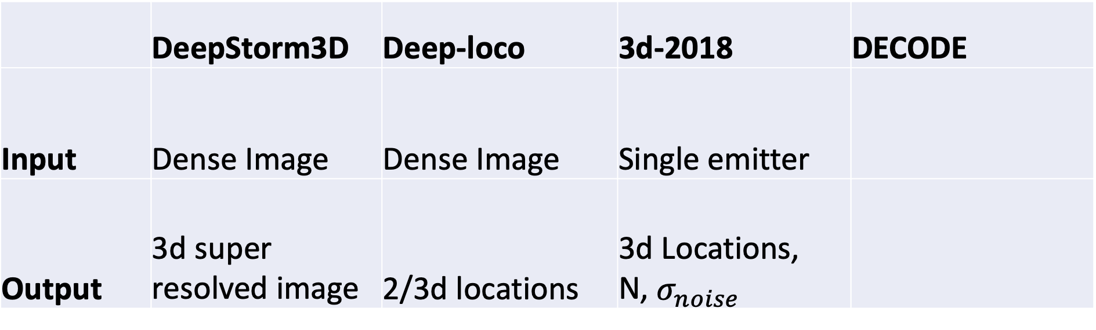
The types of problem
 | DeepStorm3D | Deep-loco | 3d-2018 | DECODE
Input | Dense Image | Dense Image | Single emitter
Output | 3d super resolved image | 2/3d locations | 3d Locations, N, $σ_{noise}$

Slide 18
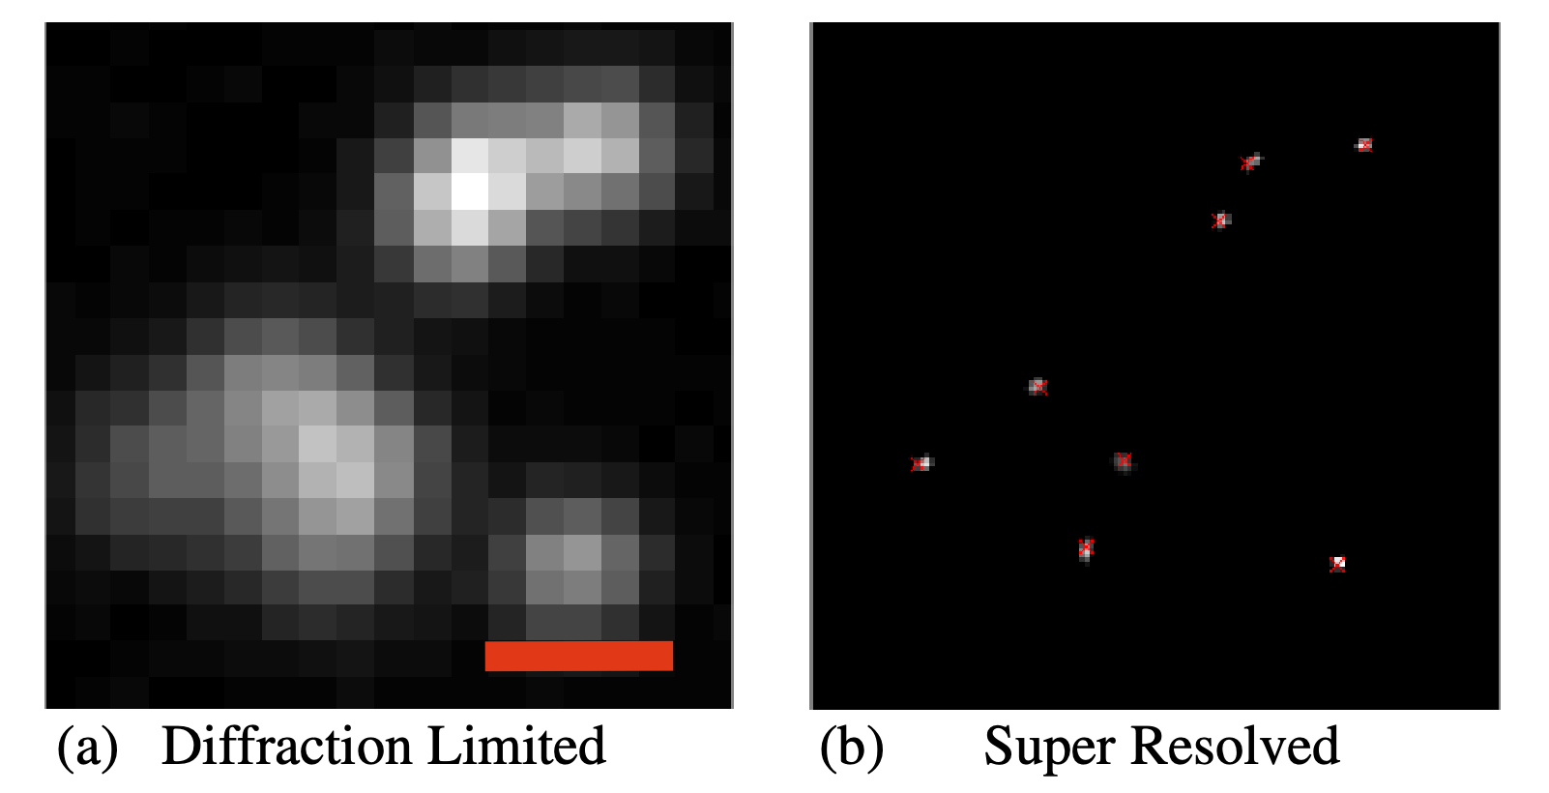
Problem1: Overlapping emitters
Algorithmically difficult to localize (unlike simple Gaussian)

Slide 19
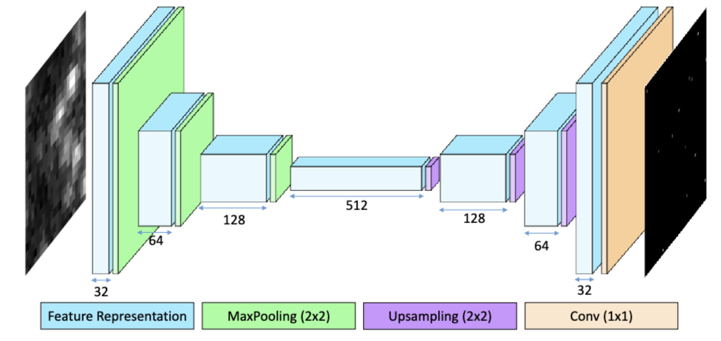
Framework of DeepSTORM network
Encoder-decoder
Output:
Superresolved pixel data
Input:
pixel data
64*64
512*512
Nehme, Elias, Lucien E. Weiss, Tomer Michaeli, and Yoav Shechtman. “Deep-STORM: Super-Resolution Single-Molecule Microscopy by Deep Learning.” Optica 5, no. 4 (April 20, 2018): 458–64. https://doi.org/10.1364/OPTICA.5.000458.

Slide 20
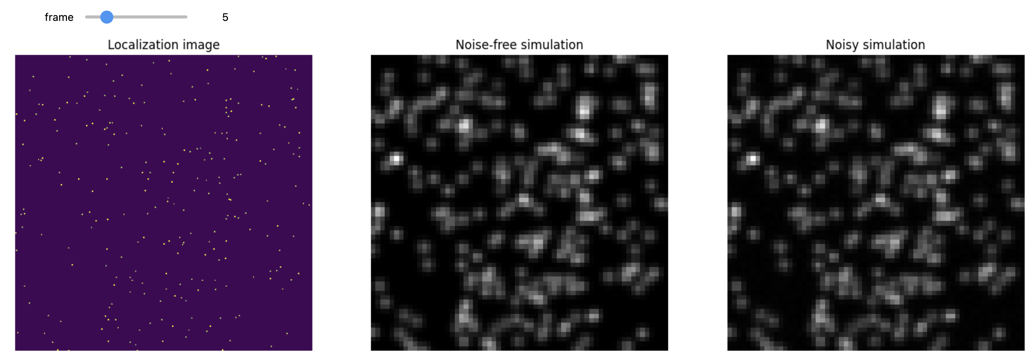
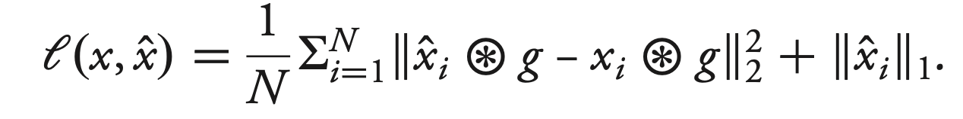
Simulation and Loss
1. Ramdomly generated emitters
2. Convoluted by Gaussian
3. Add noise
L1 loss: encourage sparsity

Slide 21
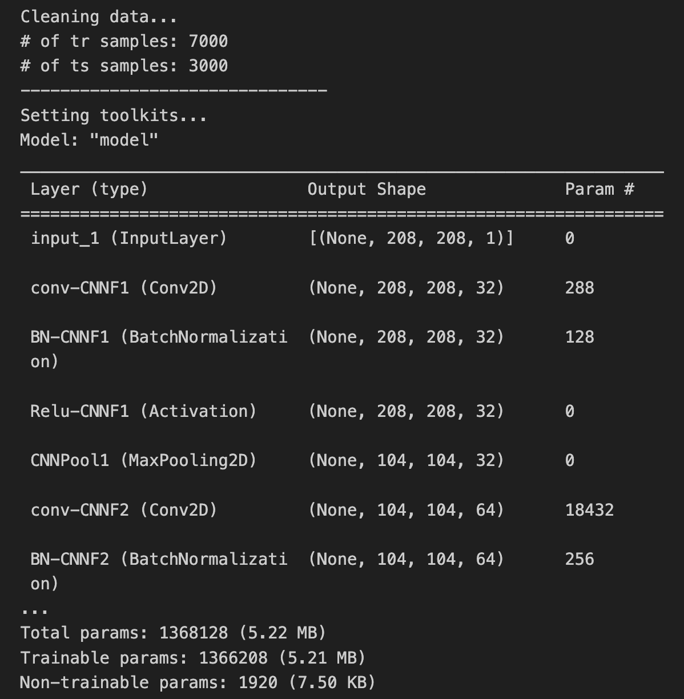
Training
Trainable parameters:
1366208(5.22 MB)
Training data:
7000*208*208(上采样), generated from 20*64*64 image-truth pairs
(Model built on my PC) ->

Slide 22
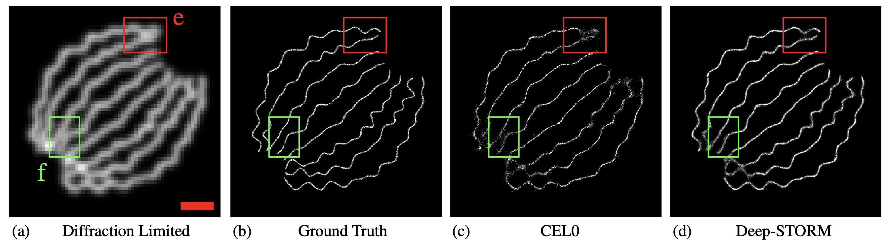
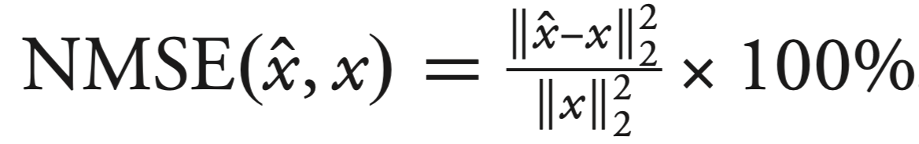
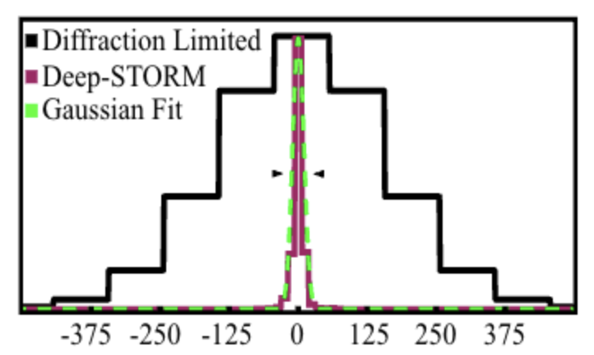
Result: NMSE evaluation on simulated data
69%
37%
conventional algorithm
Deep learning based
FWHM = 24nm

Slide 23
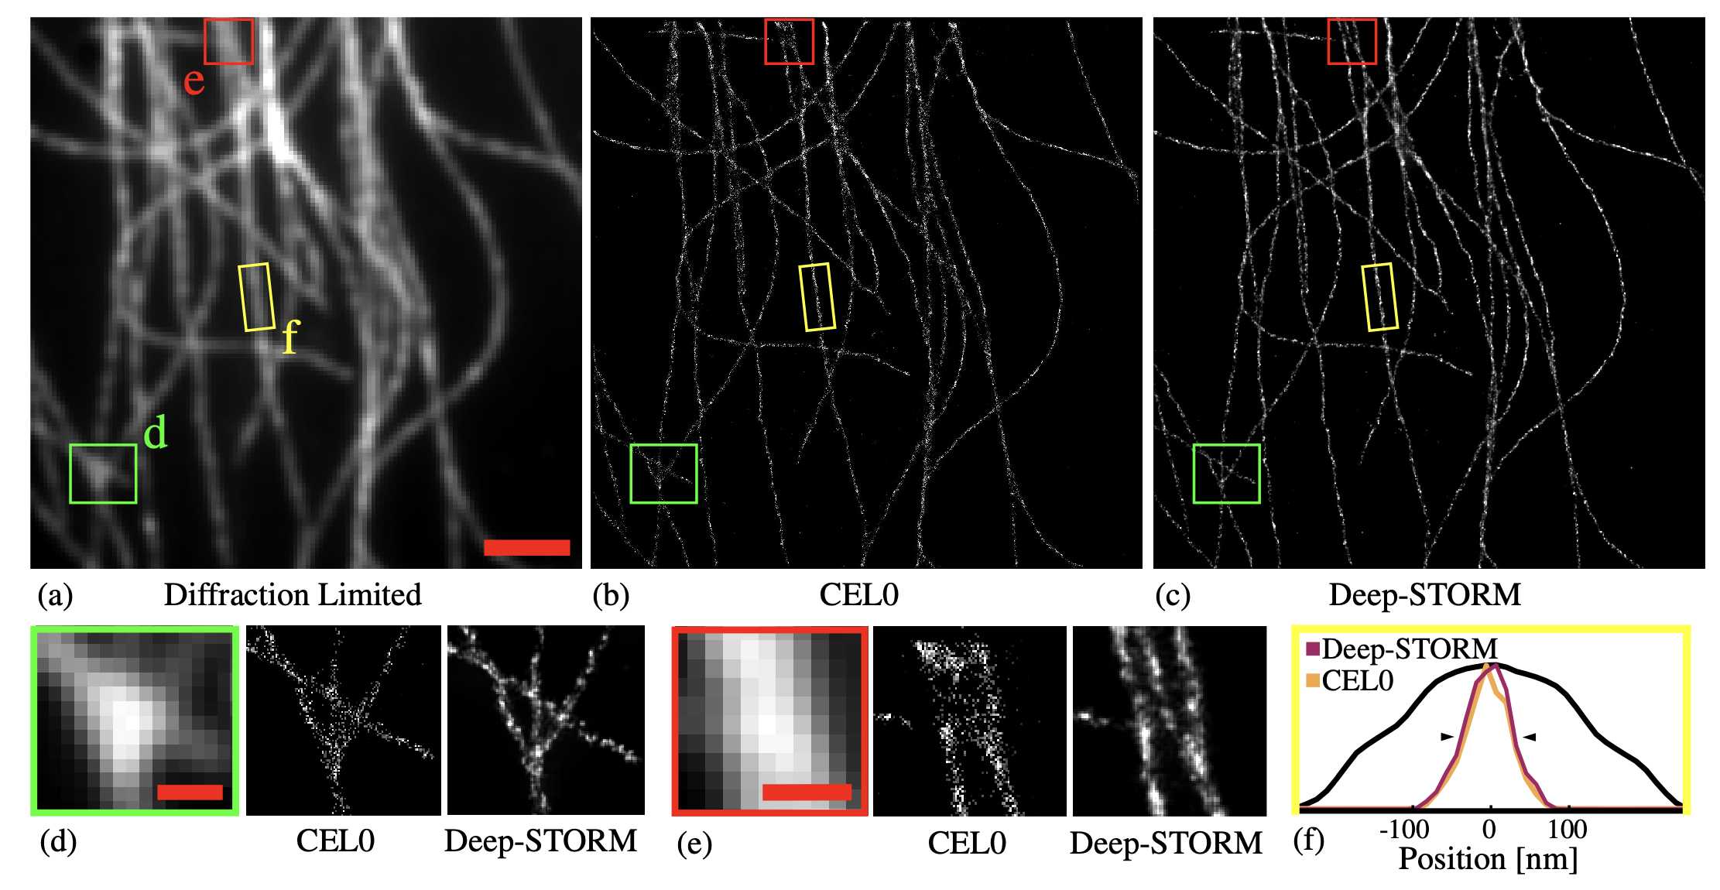
Result: apply to experimental data

Slide 24
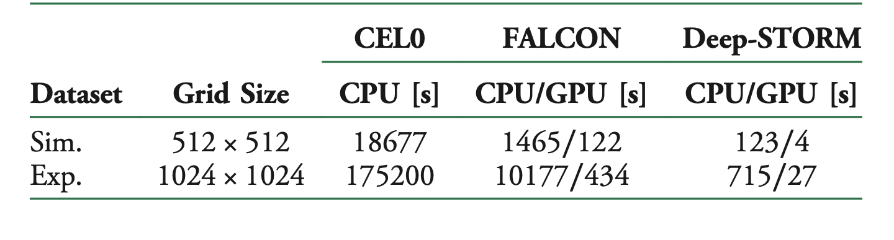
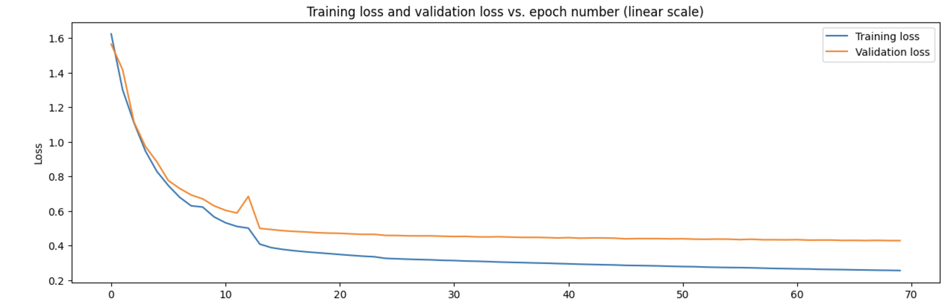
Result: runtime
(Tested by author)
Training time:
about 30min on aliyun cloud(70 epochs)
(Tested on Aliyun)

Slide 25
Discussion
Robustness:
the simulated condition should match with experiment
SNR
Density
Improvement ?
Multidimension: 3D information -> DeepSTROM3D
Robustness: train with different SNR and noise
PSF: Use experimentally measured PSF as convolution kernel

Slide 26
Problem2: z-axis information
Algorithmically difficult to localize (unlike simple Gaussian)

