Slide 1
Superstore Analysis Presentation
Prepared By Jerry Nelson Cobbinah
3rd August, 2025.

Slide 2
Executive Summary
Analysis of sales and customer performance (2011-2014)
Covers general overview and market analysis
Focus: Customer demographics, best-selling/returned products, segment performance
Key findings: Growth opportunities, operational strengths, areas for improvement

Slide 3
Key Metrics Overview
YTD Sales: $2.12M (45.15% increase)
YTD Profit: $263.16K (41.96% increase)
Units Sold: 35K (48.44% increase)
Return Rate: 5.9% (Slightly moderate)

Slide 4
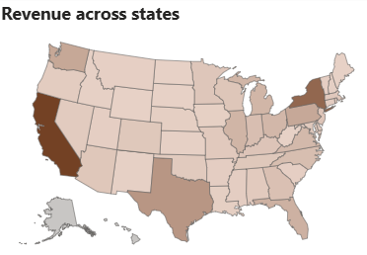
Revenue by State
Highest revenue: California, New York
Indicates stronger customer bases and market penetration

Slide 5
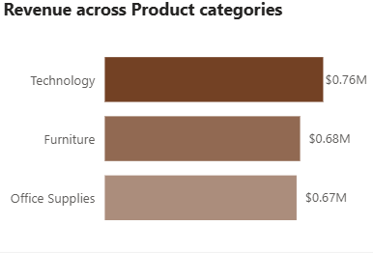
Revenue by Product Category
Technology leads, but not by a wide margin.

Slide 6
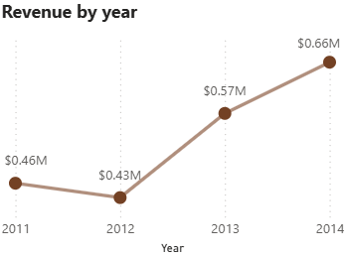
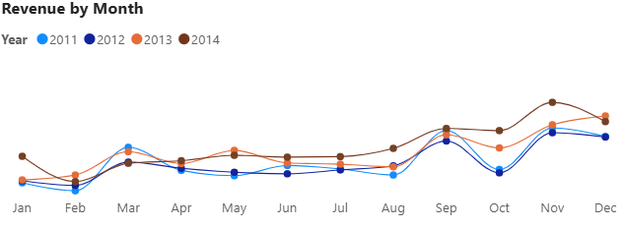
Revenue by Year and Monthly trends
Revenue increased by 45% over the period indicating consistent year-over-year growth.
Strong performance in the final quarter of each business year across the period.

Slide 7
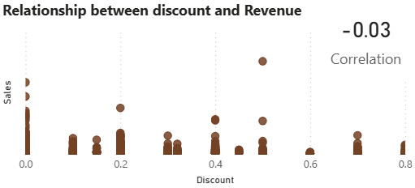
Discount vs Revenue Correlation
Weak negative correlation (-0.03)
Higher discounts not significantly driving revenue
Recommendation: Revisit discounting strategy

Slide 8
Market Overview Summary
Total Orders: 4,713
Total Customers: 667
Unique Products Sold: 1,854
Returned Products: 296

Slide 9
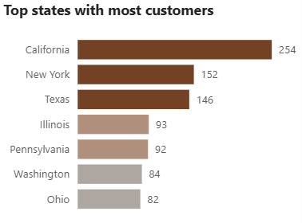
Top Customer States
California: 254 customers
New York: 152 customers
Texas: 146 customers
Strong market presence in high-population states

Slide 10
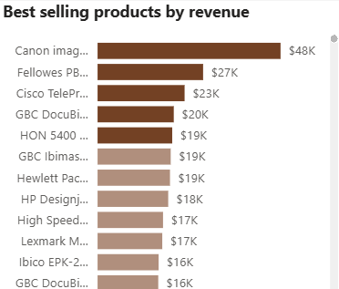
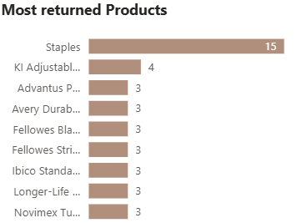
Product Performance
Best Selling
Most returned
Canon imageCLASS printer: $48K
Staples: 15

Slide 11
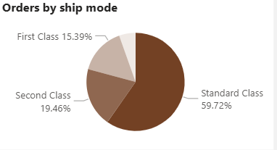
Delivery mode preference
Logistics can optimize for standard class

Slide 12
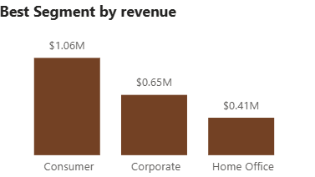
Revenue by Customer segment
Consumer segment is primary market focus

Slide 13
Key Insights
Strong sales/profit growth driven by consumer demand
Technology products lead but have higher returns
Discounts not significantly boosting revenue
California, New York, Texas are key markets
Standard Class shipping dominates logistics

Slide 14
Recommendations
Expand presence in top states (localized campaigns)
Analyze high-return products for quality/expectation issues
Revise discounting strategy
Optimize Standard Class shipping logistics
Invest in Consumer segment with personalized recommendations

Slide 15
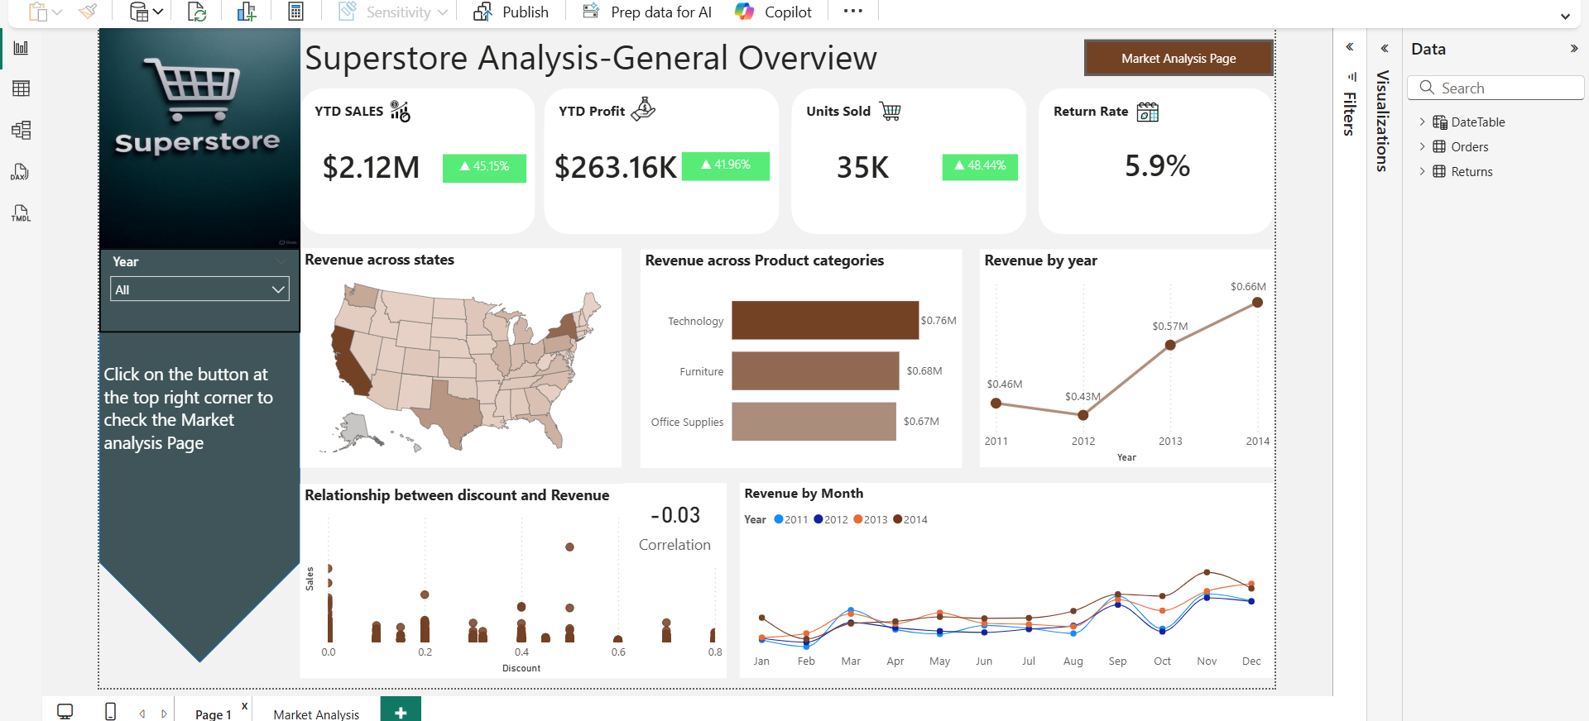
Appendix
General Overview Page

Slide 16
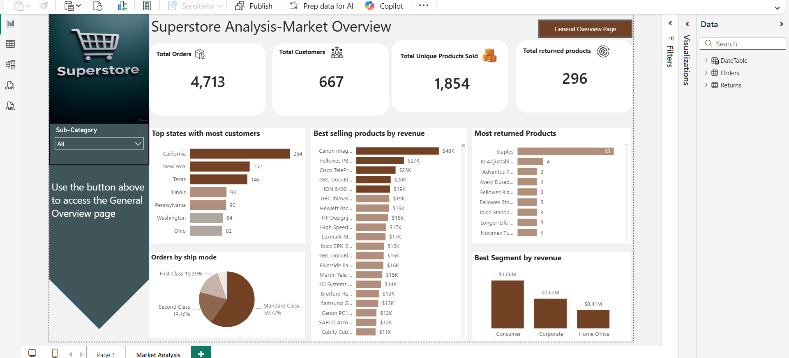
Appendix
Market Overview page

Slide 17
Questions & Answers
Open floor for audience questions
Thank you for your attention!

