Slide 1
Data Professional Survey Analysis
Prepared by: Jerry Nelson Cobbinah
22nd June, 2025

Slide 2

Executive Summary
Analyzed survey data from 630 data professionals to uncover key insights regarding:
Salary distribution by profession and gender
Popular programming languages and tools amongst data professionals
Geographic and demographic trends
Challenges in entering the data industry.
The goal is to gain insights and support decision-making for employers, educators, and aspiring data professionals.

Slide 3

Dataset Overview
Data Source: Online Survey with over 600 respondents.
Fields:
Age, Salary, Job role, Programming language, Salary satisfactory level (1-10), Difficulty breaking into data, and education level.

Slide 4

Data Preparation
Removing Unnecessary columns: Email, time used, time taken etc.
Data Cleaning and Standardization: Entries allowing the “other” option.
Missing Values: “Unspecified” was used to replace missing values.
Grouping: Entries (job role, country etc.) that had less than 10 respondent were classified as under one group.

Slide 5

Methodology
Tool Used: Power Query, Microsoft Excel.
Techniques: Pivot table, filtering, dashboarding.
Charts Used: bar, doughnuts, funnel, pie charts.
Metrics tracked: Salary, Gender, Job roles, Programming Language, Salary Satisfaction.

Slide 6

Insights 1: Salary by Role
Data scientist earn the highest average salary amongst all roles.

Slide 7

Insights 2: Gender Pay Gap
There is no significant difference in salary by gender

Slide 8

Insights 3: Programming tool usage
Python remains the most popular programming language amongst data professionals

Slide 9

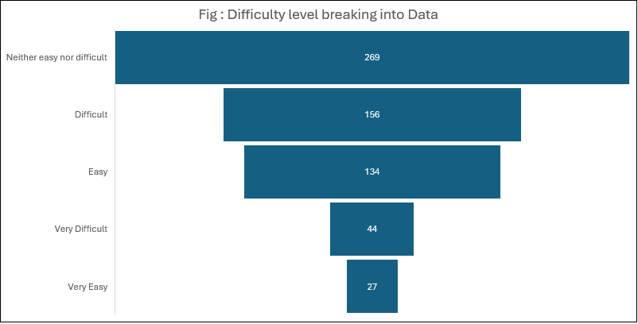
Insights 4: Entry Difficulty
It is moderately difficult to break into data

Slide 10

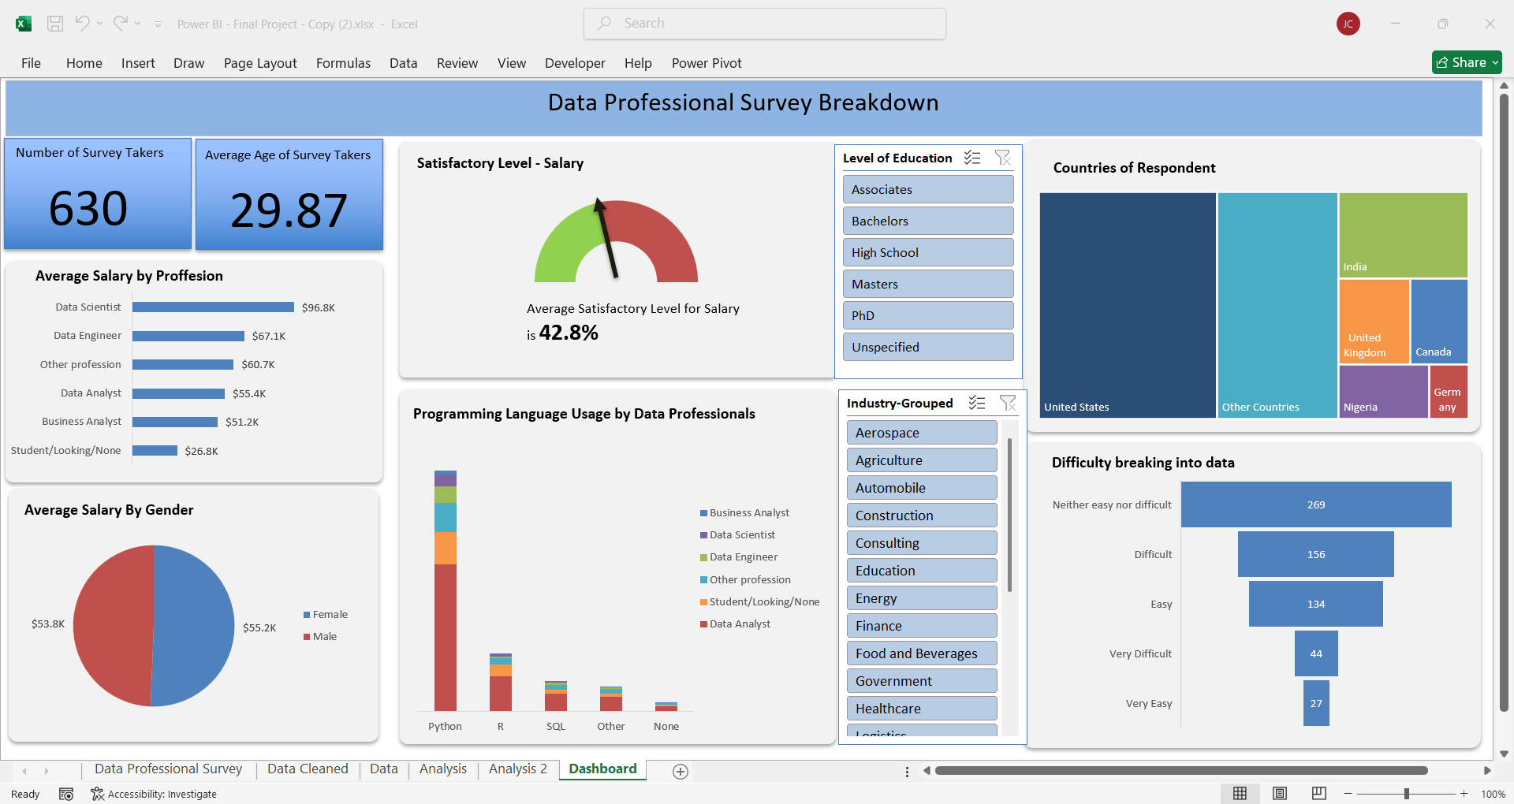
Excel Dashboard
It includes KPI like the number of respondents and average age of respondents. It also includes slicers for further analysis

Slide 11

Recommendations
Educational institutions should emphasize Python and SQL in beginner data courses, as these are the most in-demand tools in industry.
Address entry challenges with clear career path by drafting a good curriculum and making them available to be followed.
Continue to ensure equitable pay policies across gender and geography.

Slide 12

Conclusions
The analysis confirms that:
Technical Skills (especially Python) are the key in the data world.
Salary is strongly tied to experience and role type.
Entry barriers remain a concern for many data aspiring professionals.
The field is dynamic, young, and geographically diverse.

Slide 13
Thank You

