Slide 1
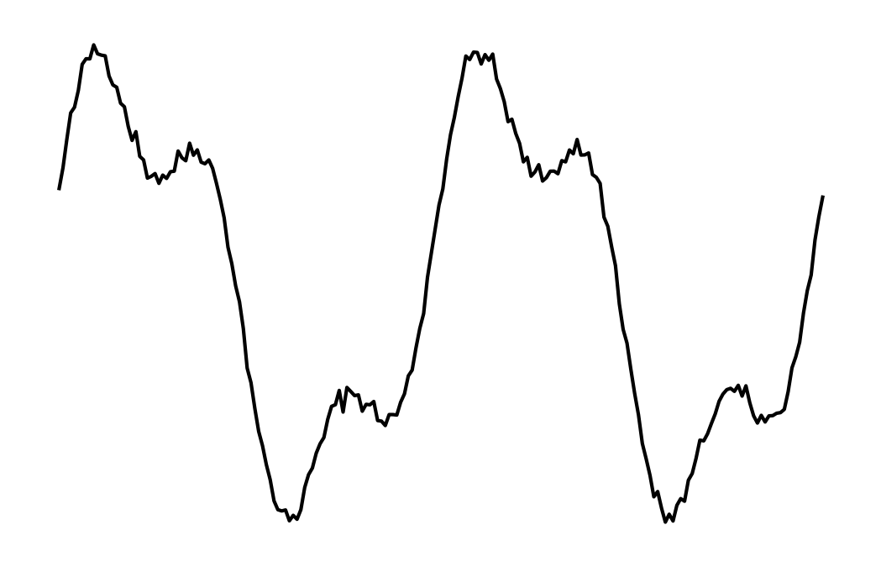
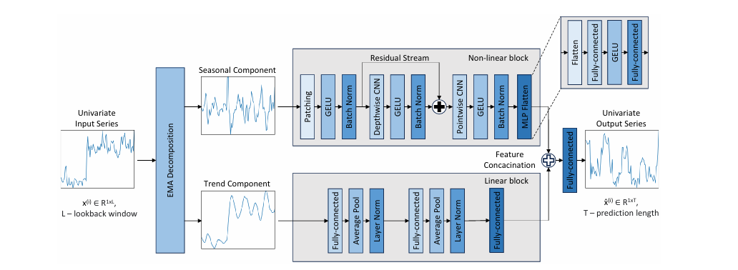
Turbine 1
Backbone
Phase
Attention
……
Turbine 2
Turbine 2

Slide 2
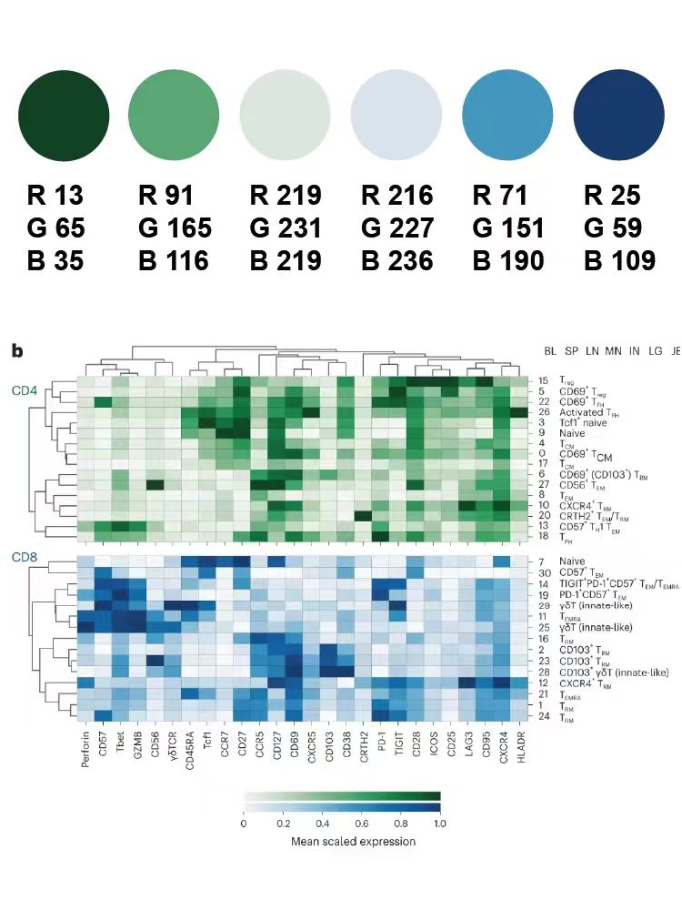

Slide 3
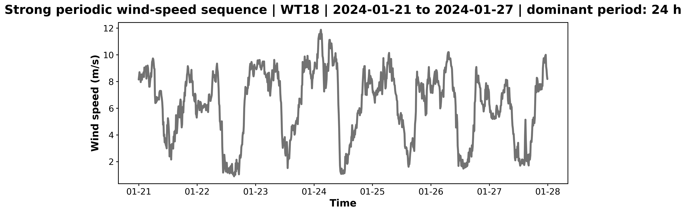
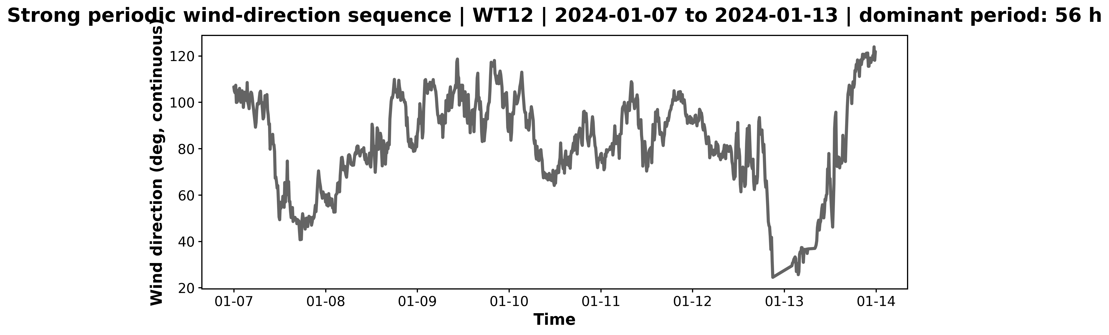
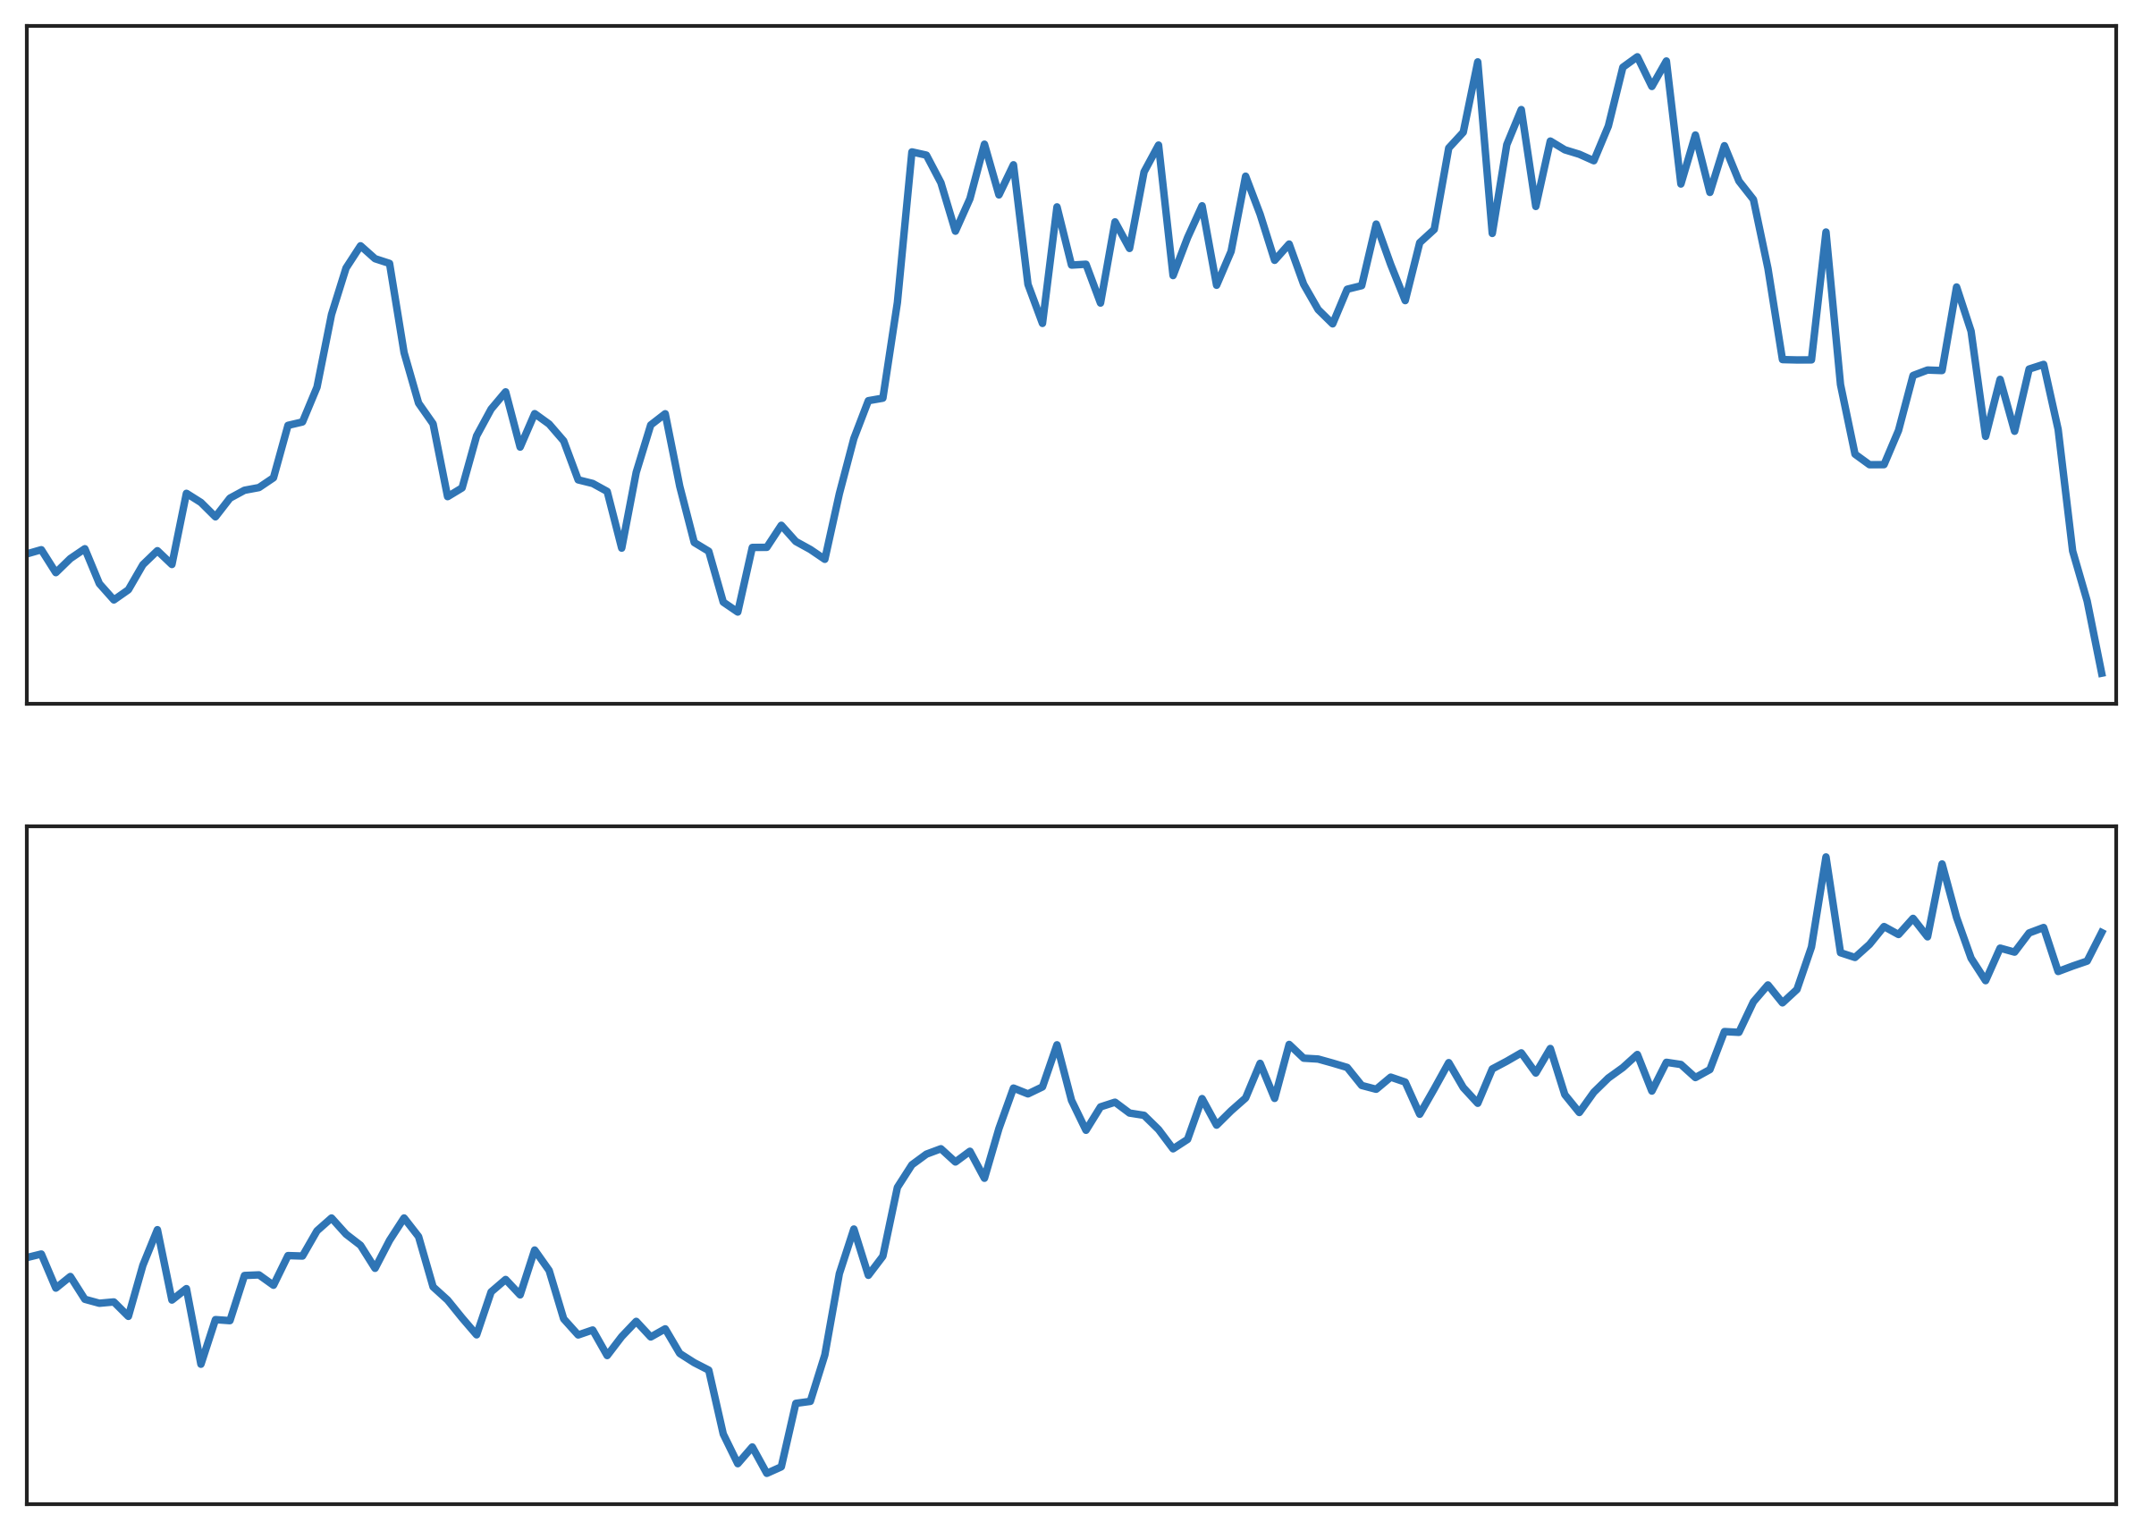
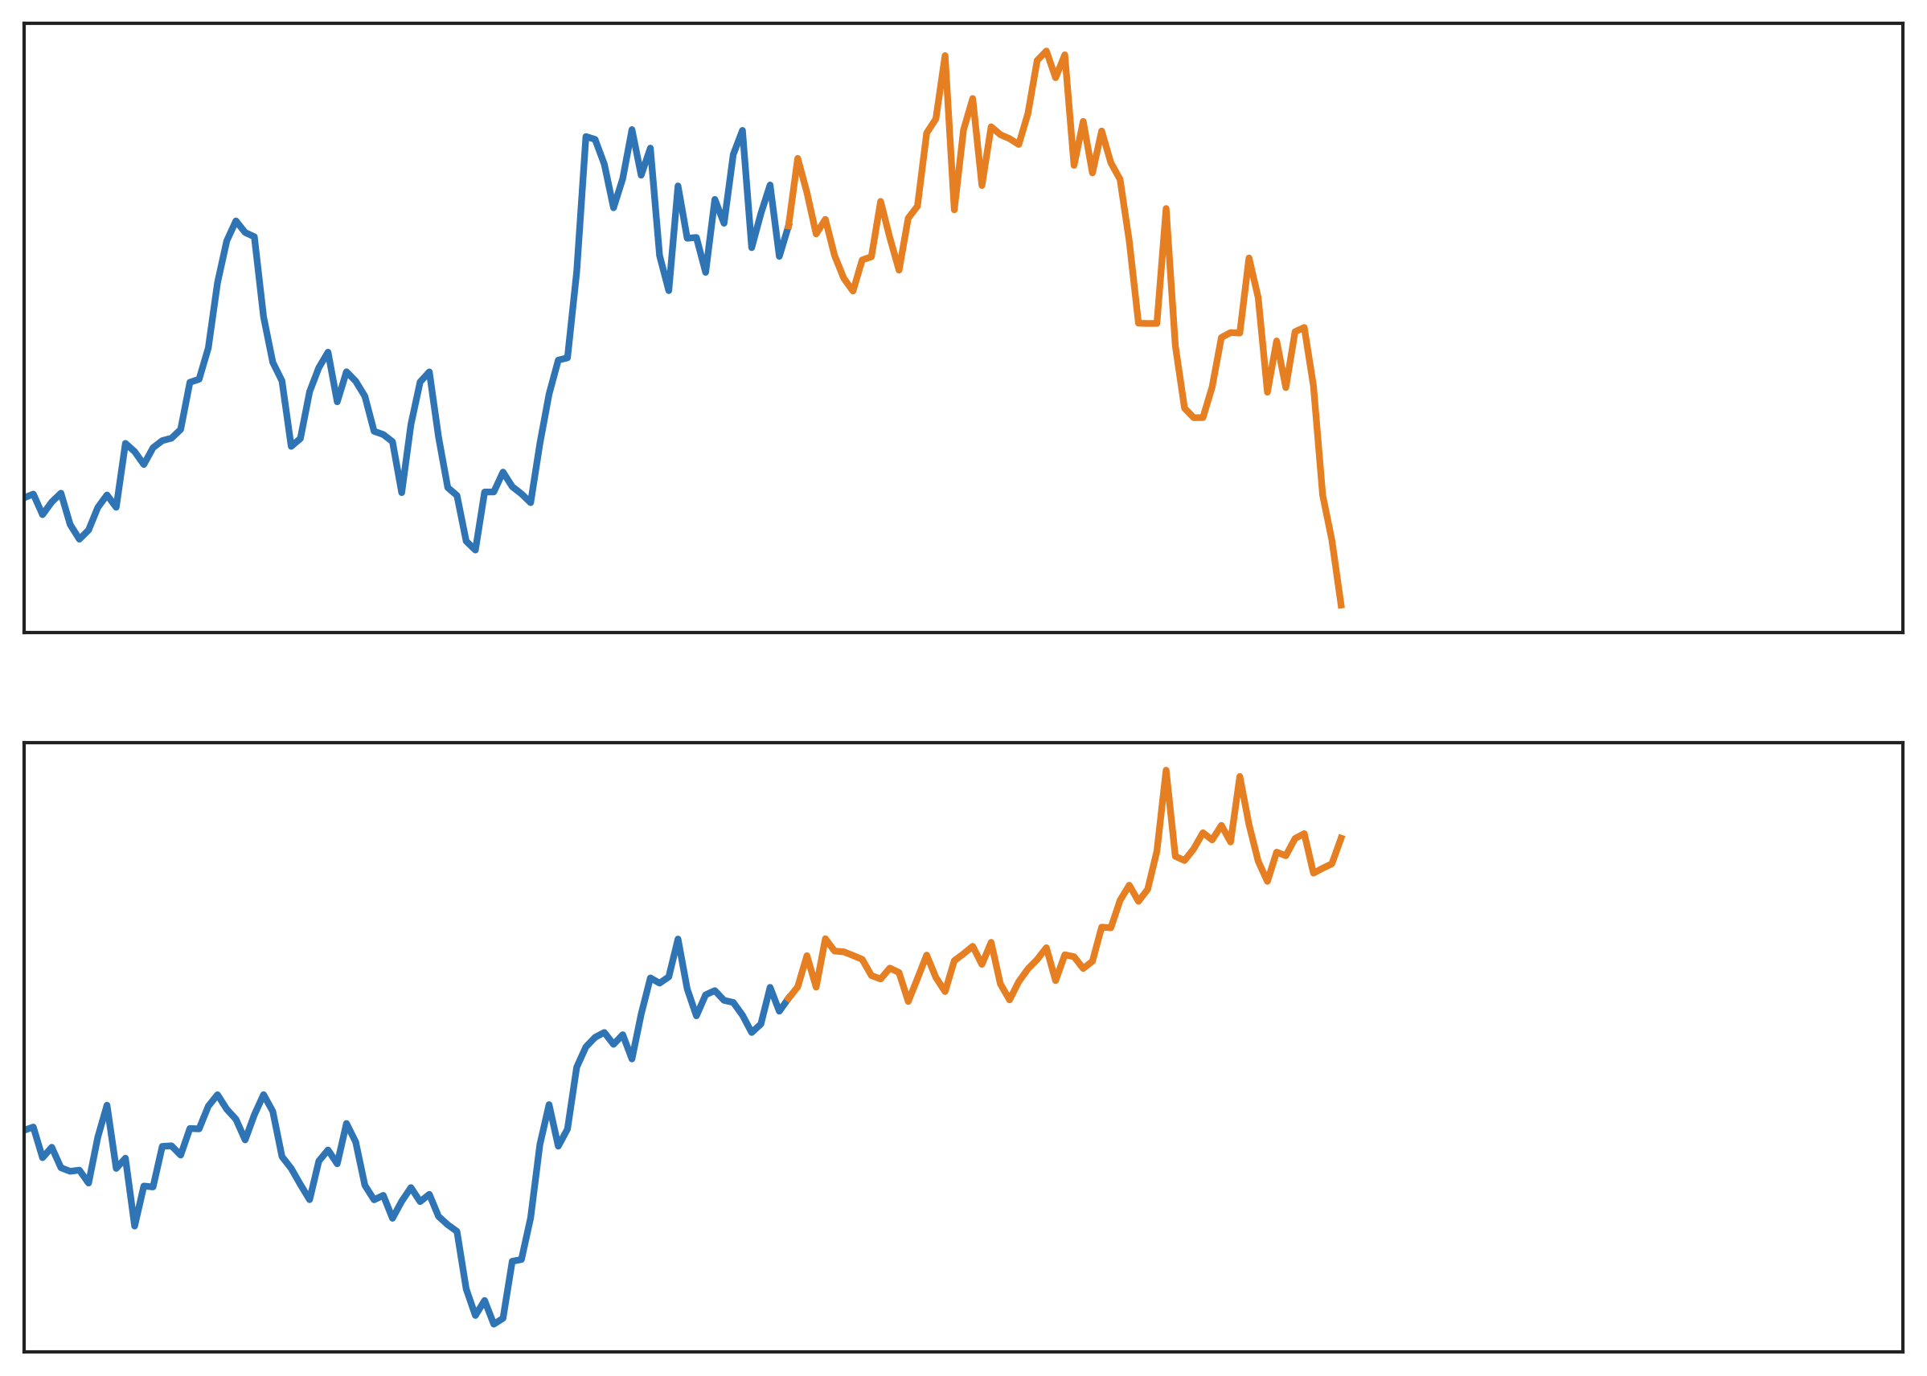
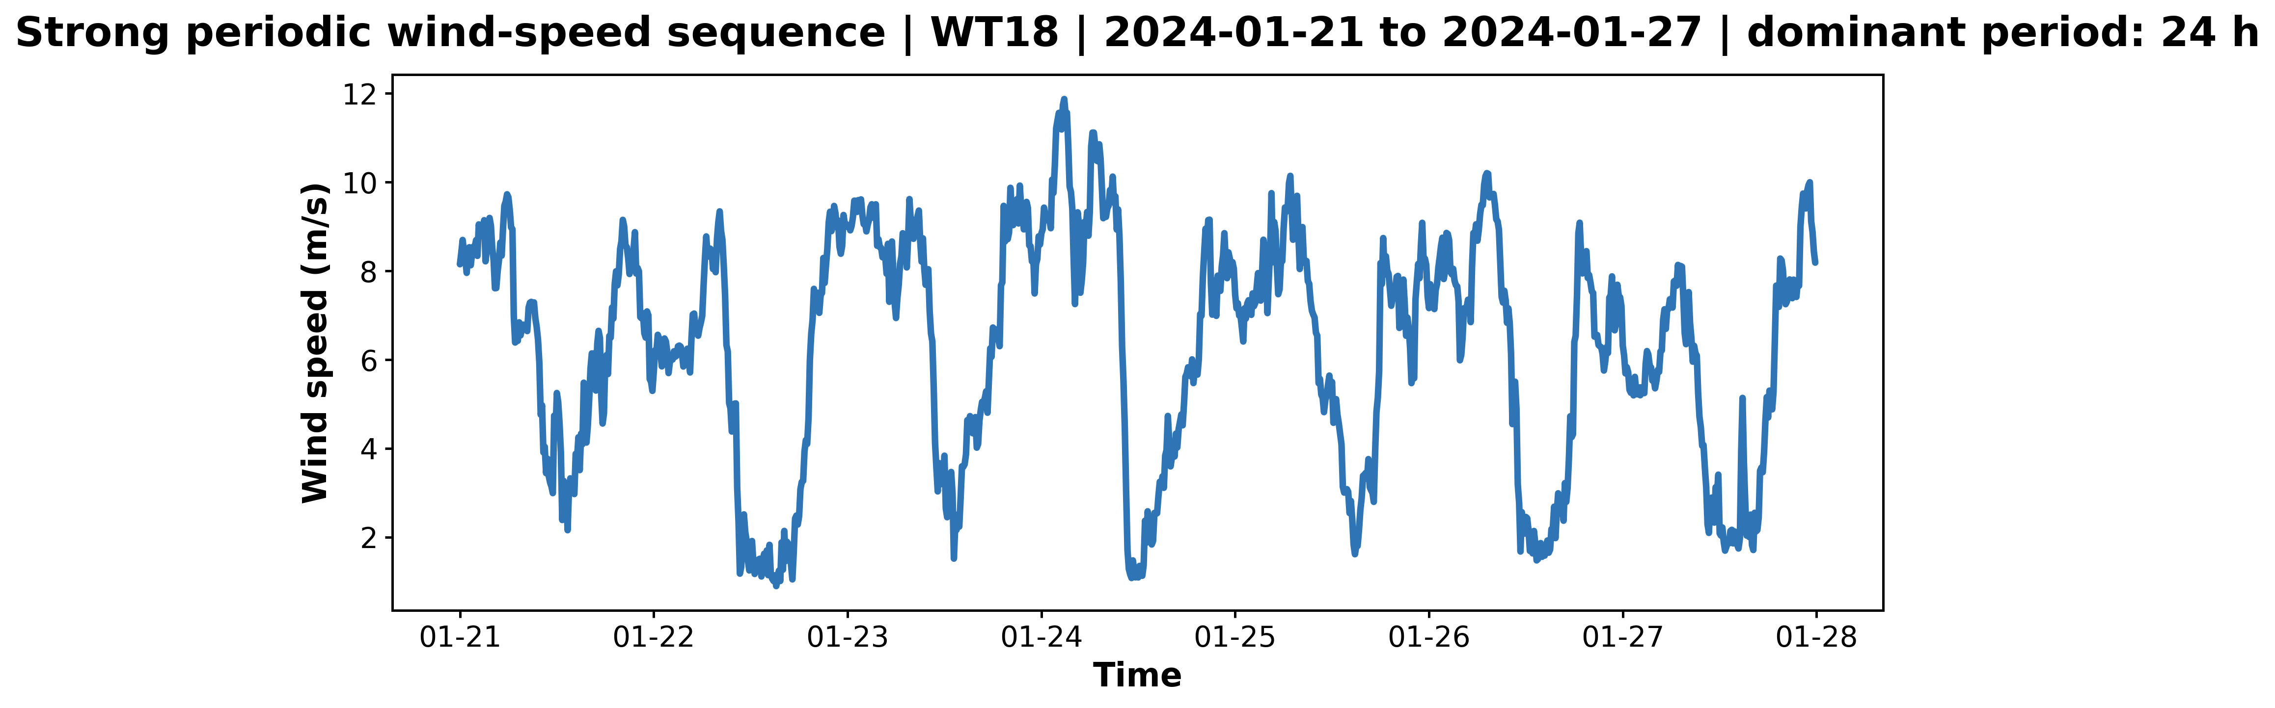
Direction series
Patches
Patch tokens
Multi-Head
Attention
Direction Input
Direction Output
Circular Encoding
Patch Embedding
Patch Attention
Direction Head
Normalization
Joint Prediction Loss
Speed Input
Speed Output
Decomposition
Common Speed Extraction
Phase Attention
Common
Speed Head
Residual MLP
Speed series
Phases
Phase tokens
Multi-Head
Attention

Slide 4
Direction series
Patches
Patch tokens
Attention
Direction Input
Direction Output
Circular Encoding
Patch Embedding
Patch Attention
Direction Head
Normalization
Joint Prediction Loss
Speed Input
Speed Output
Decomposition
Common Speed Extraction
Phase Attention
Common
Speed Head
Residual MLP
Speed series
Phases
Phase tokens
Attention

Slide 6
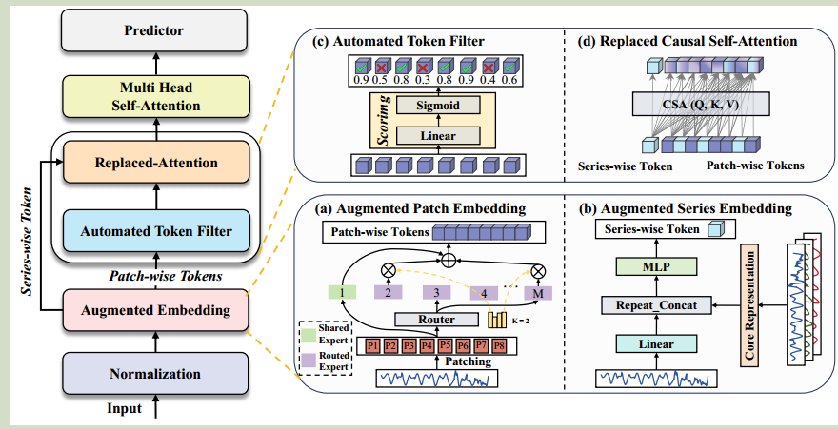
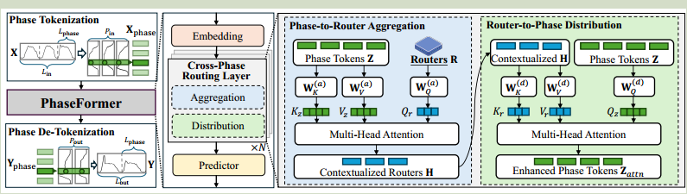
Turbine 1
Backbone 1
Output 1
Turbine 1
Backbone
Output 1
Turbine 2
Backbone 2
Output 2
Turbine 2
Output 2
Turbine 1
Decomposition
Residual 1
Turbine 2
Residual 1

Slide 7
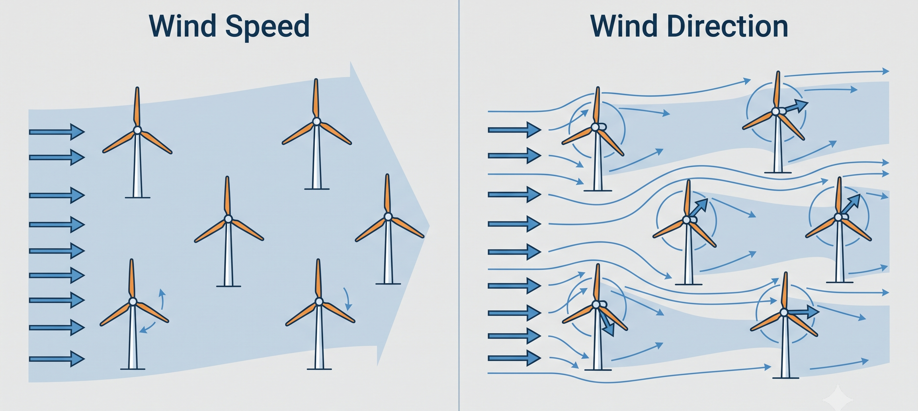
Wind Speed is Correlated
Wind Direction is Turbine-specific

Slide 8
Patches
Patch tokens
Multi-Head
Attention
(a) Patch Attention
Phases
Phase tokens
Multi-Head
Attention
(b) Phase Attention

Slide 9
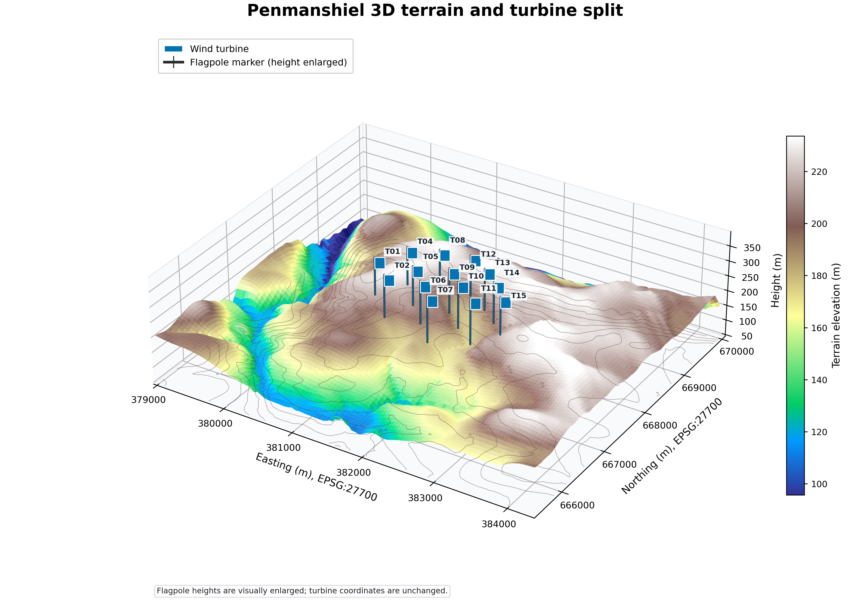
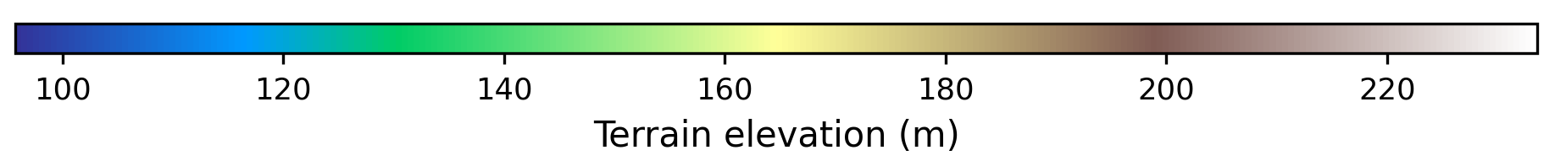
3D Visualization of Wind Turbine Spatial Distribution

Slide 10
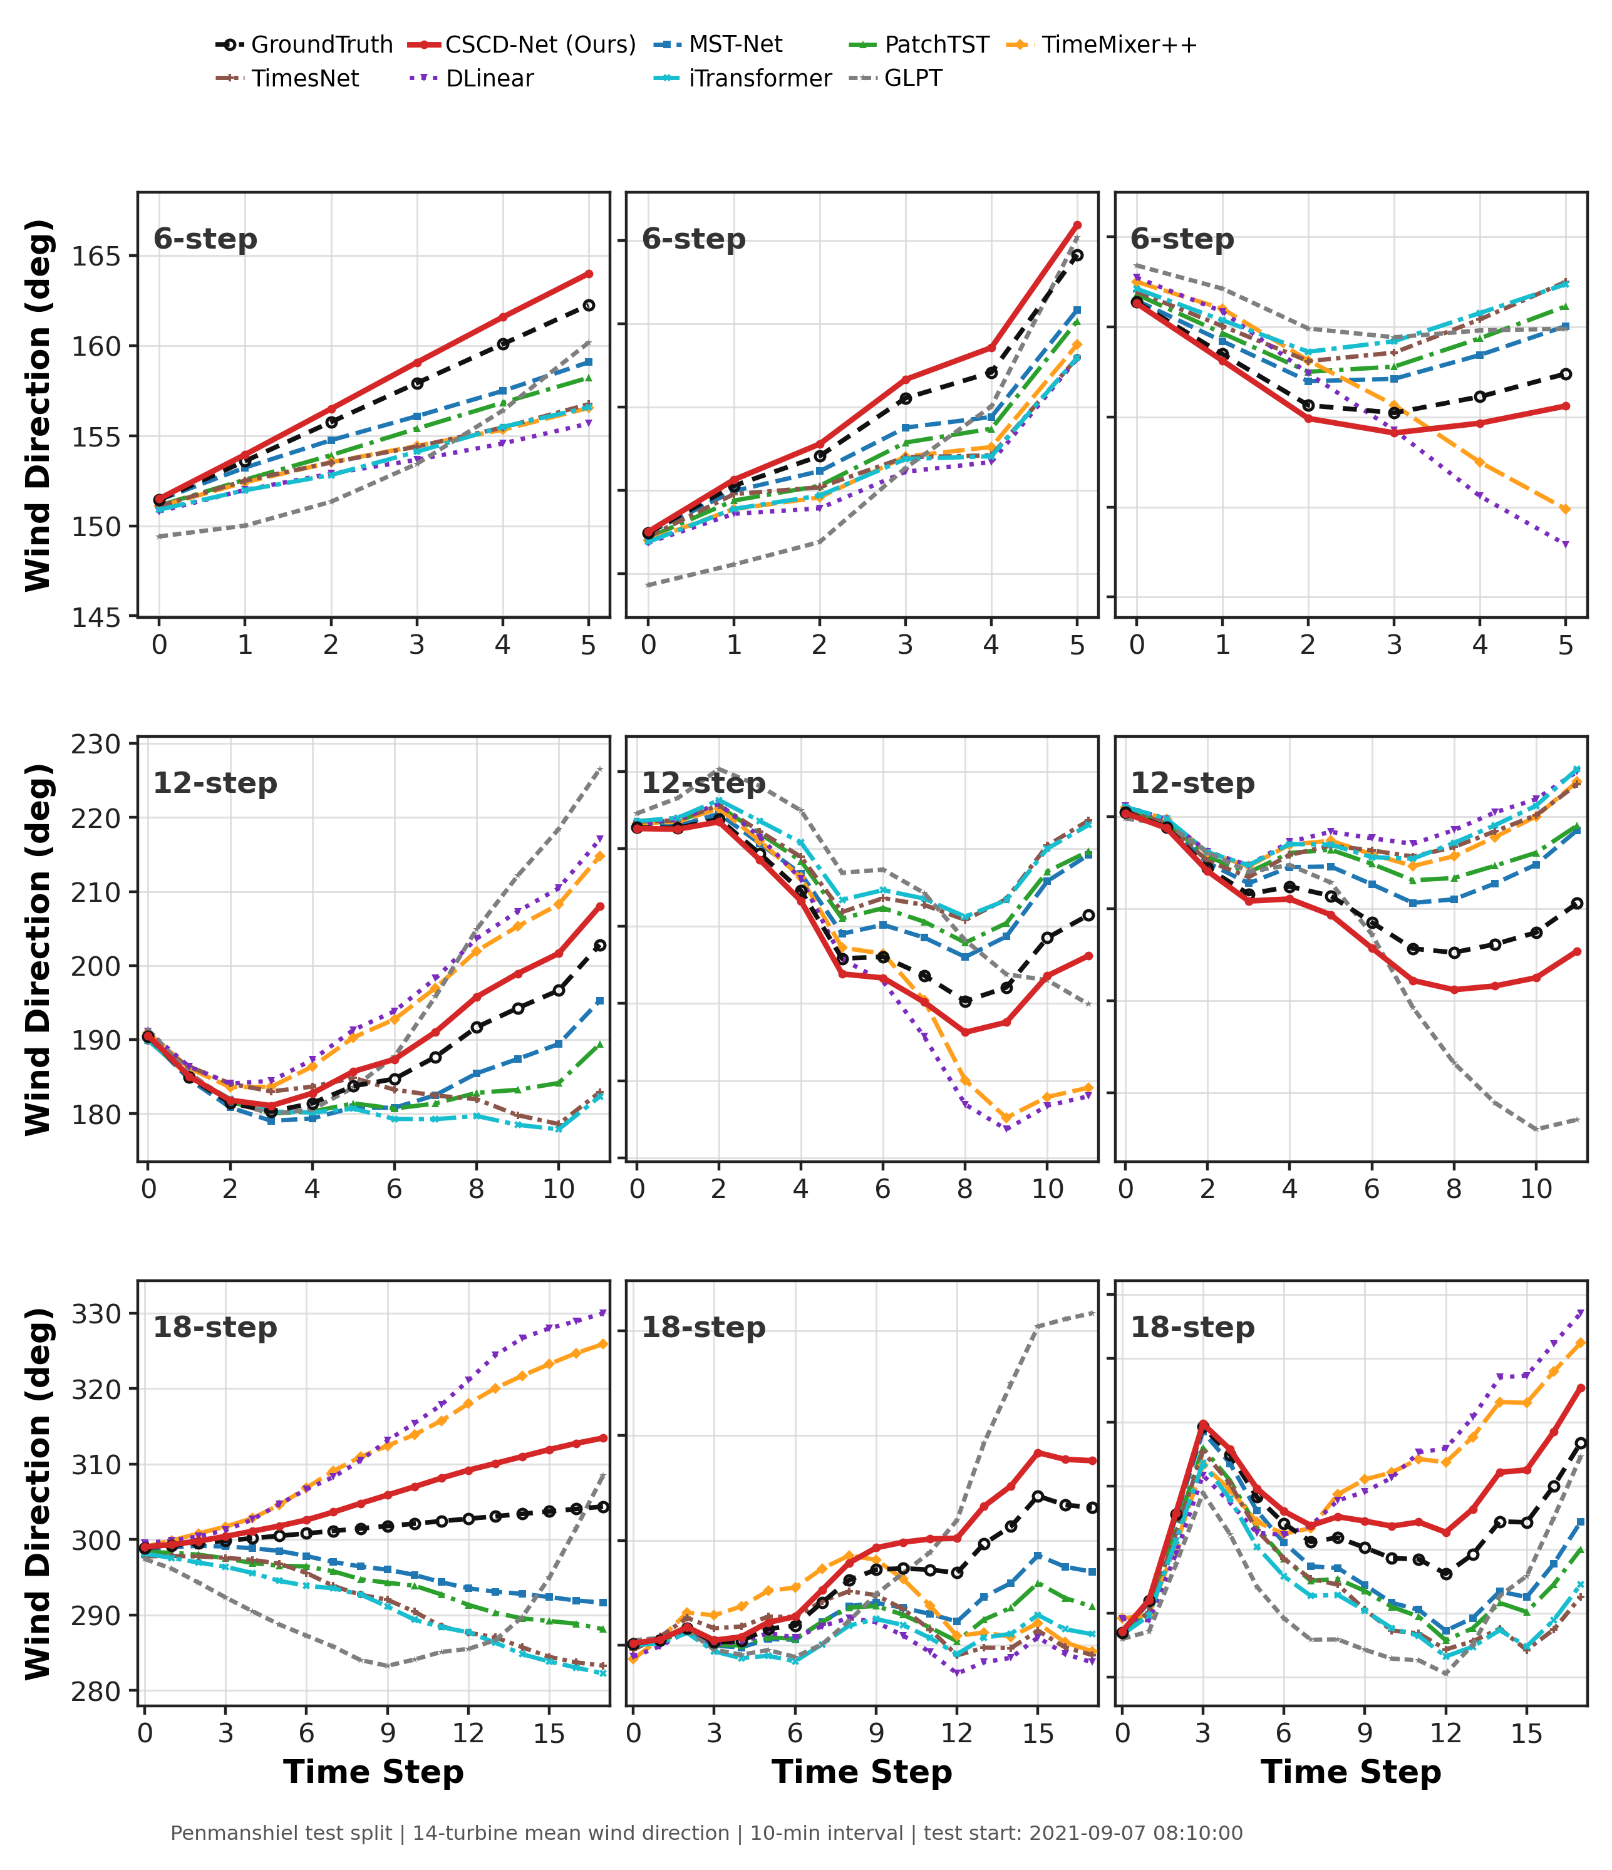

Slide 11
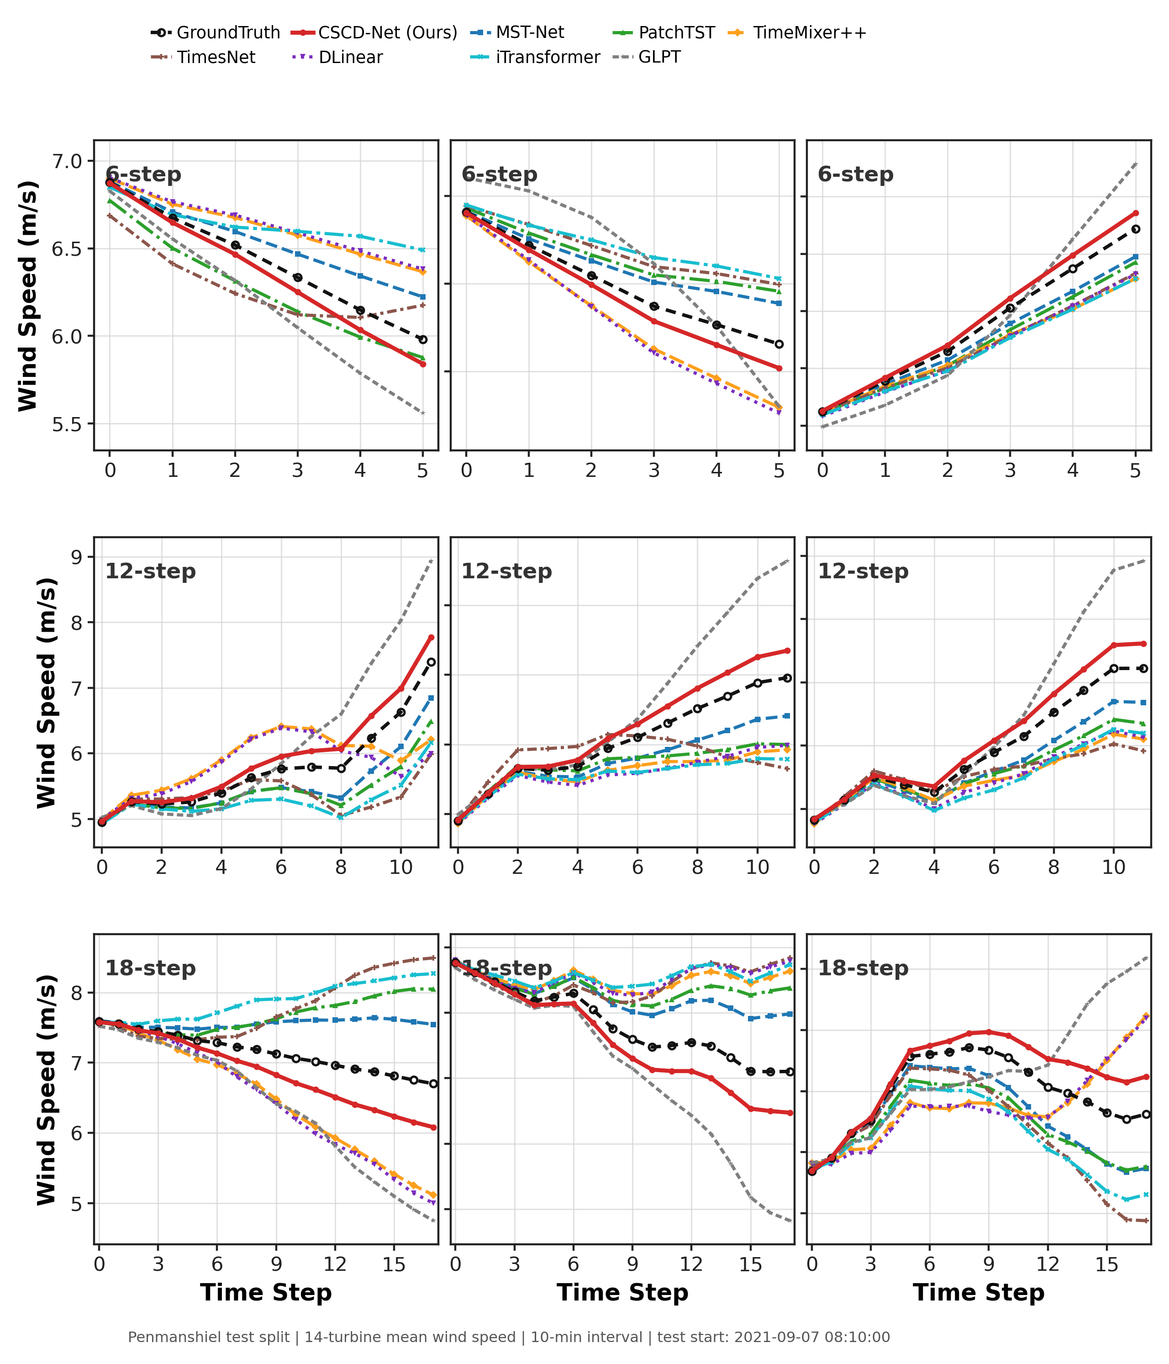

Slide 14
Patch
Wind Speed
Phase
Time

