Slide 1




Levinson’s Theorem for Scattering on Graphs
DJ Strouse
University of Southern California
Andrew M. Childs
University of Waterloo

Slide 2
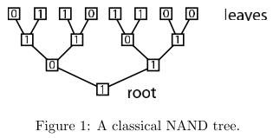
Why Scatter on Graphs?
NAND Tree problem:
Best classical algorithm:
Randomized
Only needs to evaluate of the leaves
Figure from: Farhi E, Goldstone J, Gutmann S. A Quantum Algorithm for the Hamiltonian NAND Tree.
Notes:
Decision problem

Slide 3
Why Scatter on Graphs?
Can a quantum algorithm do better?
Notes:
Worth understanding the scattering scene a little better

Slide 4
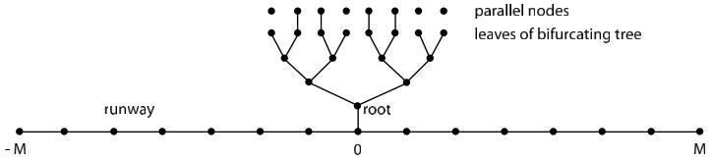
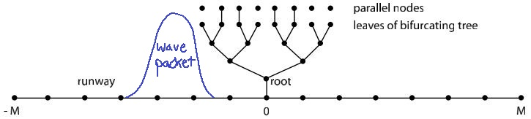
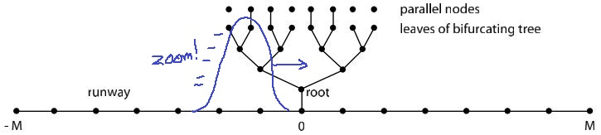
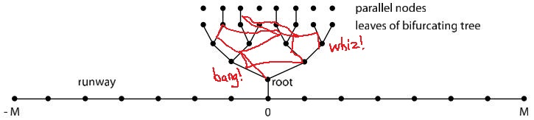
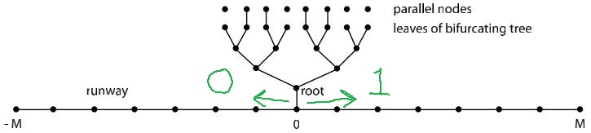
Why Scatter on Graphs?
Farhi, Goldstone, Gutmann (2007)
Connections to parallel nodes represent input
Prepare a traveling wave packet on the left…
…let it loose…
…if found on the right after fixed time, answer 1
Figure from: Farhi E, Goldstone J, Gutmann S. A Quantum Algorithm for the Hamiltonian NAND Tree.

Slide 5
Why Scatter on Graphs?
Can scattering on graphs offer a quantum speedup on other interesting problems?
Notes:
Worth understanding the scattering scene a little better

Slide 6
What You Skipped the BBQ For
Goal: Relate (a certain property of) scattering states (called the winding of their phase) to the number of bound states and the size of a graph
Crash Course in Graphs
Introduction to Quantum Walks (& scattering on graphs)
Meet the Eigenstates
Scattering states (& the winding of their phase)
(The many species of) bound states
Some Examples: explore relation between winding & bound states
A Brief History of Levinson’s Theorem
Explain the Title: “Levinson’s Theorem for Scattering on Graphs”
A Sketch of the Proof
A Briefer Future of Levinson’s Theorem
Free Introduction to Complex Analysis!
Notes:
This talk spans physics and CS, so each of you is absolved from being expected to know anything. (there are no dumb questions)

Slide 7
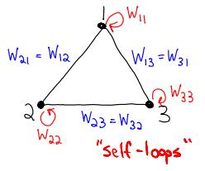
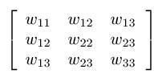
Graphs
Vertices + Weighted Edges
Adjacency Matrix
Notes:
In general in scattering picture, directed graphs with weights to & from complex conjugates of one another, so adjacency matrix is Hermitian, but we simplify to the case with real, symmetric weights. Everything we’ll discuss carries over to the more general case.

Slide 8

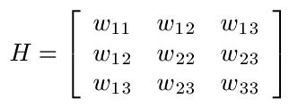

Quantum Walks
Quantum Dynamics: Hilbert Space + Hamiltonian
Basis State For Each Vertex
Adjacency Matrix
Notes:
If you know a bit of QM, then you know that to talk about things moving around, we need a Hilbert space and a Hamiltonian.
We’ll only need notation for “tail” basis states.

Slide 9
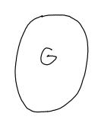
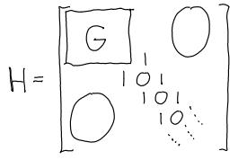
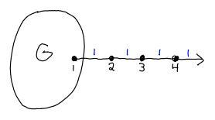

Scattering on Graphs
Basis states on tail:
…where “t” is for “tail”
Notes:
Long graphs aren’t very interesting. We need a tail to speak of scattering.
Most general case = multiple tails (universal for quantum computation)
We focus on single tail, so “scattering” involves only a phase shift.
With tail, adjacency matrix is now infinite!

Slide 10
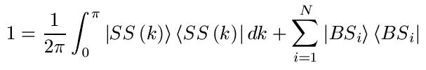



Meet the Eigenstates
(Why) Meet the Eigenstates?
Resolve the
identity…
Scattering states
Bound states
Diagonalize the Hamiltonian…
Represent your favorite state…
…and evolve it!
Notes:
SS normalizable & one species
BS unnormalizable & many species
So this is why we even care about theorems relating scattering and bound states

Slide 11
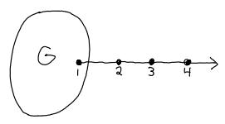
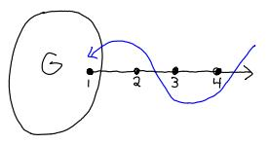
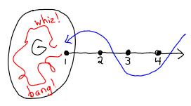
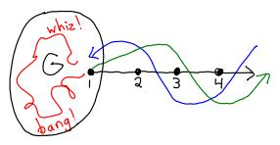
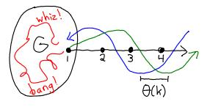


Scattering States
Incoming wave + reflected and phase-shifted outgoing wave
“scattering” = phase shift

Slide 12


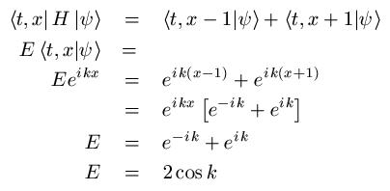
Scattering States
Notes:
Calculations on tails fixes energy
Calculations on graphs fix amplitudes on graph (just more linear equations)

Slide 13


Scattering States
Incoming wave + reflected and phase-shifted outgoing wave
“scattering” = phase shift

Slide 14


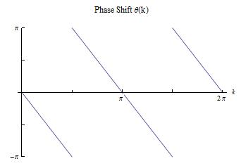
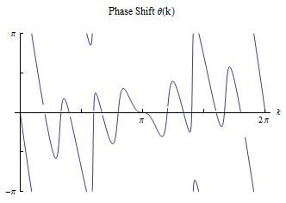


Winding of the Phase
w is the winding number of θ
Notes:
Phi(k) is the property of SS that we’re interested in. More specifically, we’re interested in the winding of Phi(k).

Slide 15
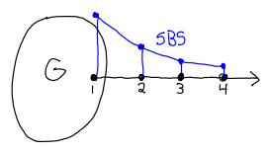
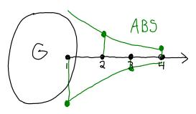




Standard & Alternating Bound States
SBS: exponentially decaying amplitude on the tail
ABS: same as SBS but with alternating sign
Exist at discrete κ depending on graph structure

Slide 16
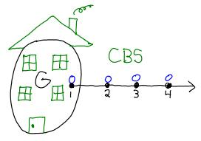

Confined Bound States
Eigenstates that live entirely on the graph
Eigenstate of G with zero amplitude on the attachment point
Exist at discrete E depending on graph structure
Notes:
Zero amplitude on entire tail, including attachment point

Slide 17
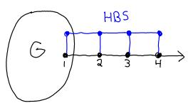
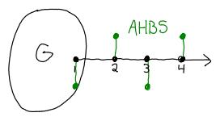





Standard & Alternating Half-Bound States
HBS: constant amplitude on the tail
AHBS: same as HBS with alternating sign
Unnormalizable like SS… but obtainable from BS eqns
Energy wedged between SBS/ABS and SS
May or may not exist depending on graph structure
Unnormalizable like SS…
Notes:
Some of you will spot an unfortunate pun on this page.

Slide 18
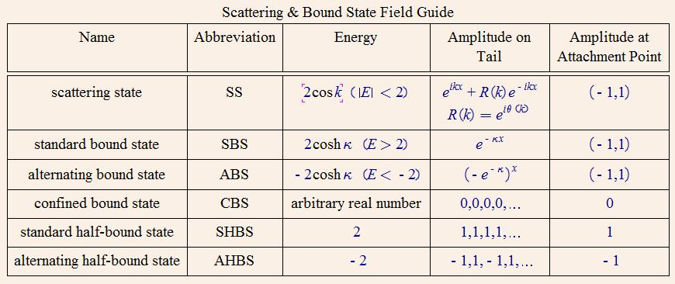
Scattering & Bound State Field Guide
Notes:
Stress main differences between SS & BS:
Normalizability
Likely location
Existence

Slide 19
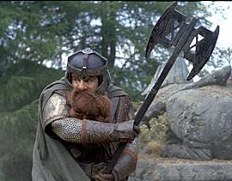
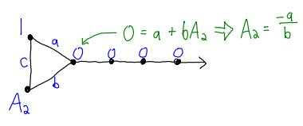
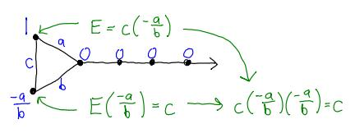
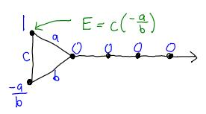
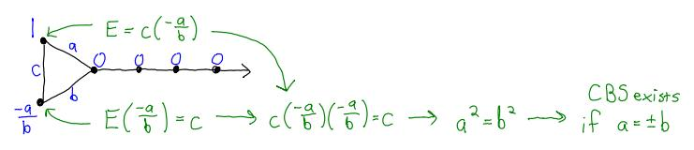
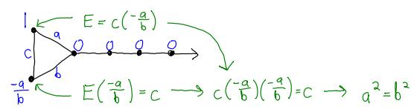
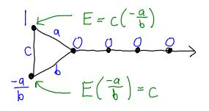
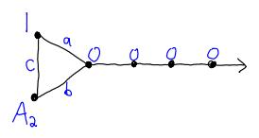
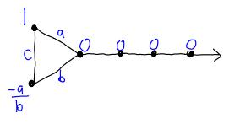
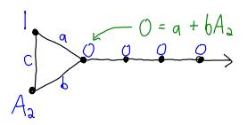
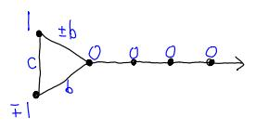
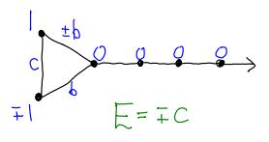
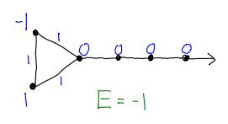
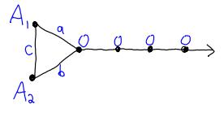
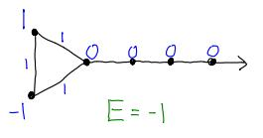
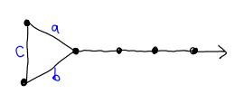
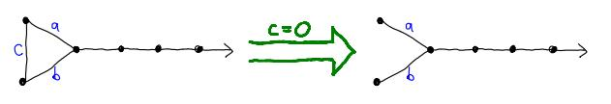
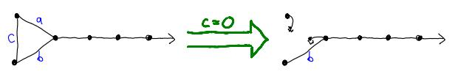
Example: Oh CBS, Where Art Thou?
Depending on a, b, & c, the “triangle” graph can have a confined bound state (CBS) if we look hard
Recall: CBS = eigenstate of graph with zero amplitude on the attachment point
No CBS for any setting of a & b…
…except if a=0 or b=0, but that’s not a very interesting graph

Slide 20
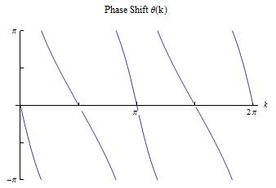
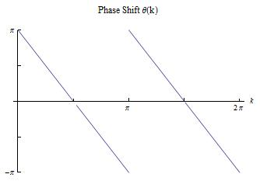
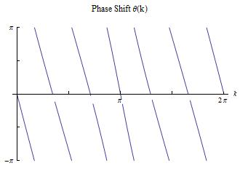
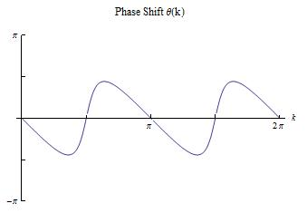
Into the Jungle: Bound States & Phase Shifts in the Wild
One SBS & One ABS
One HBS & One AHBS
One SBS, One ABS, & One CBS
No BS
Notes:
Suggests connection
Based on these examples, you may want to take a guess at what the theorem will look like

Slide 21
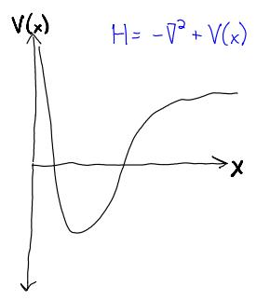


A Brief History of Levinson’s Theorem
Continuum Case:
Levinson (1949)
No CBS
Discrete Case:
Case & Kac (1972)
Graph = chain with self-loops
No CBS & ignored HBS
Hinton, Klaus, & Shaw (1991)
Included HBS
…but still just chain with self-loops
Potential on a half-line
(modeling spherically symmetric 3D potential)
What about arbitrary graphs?
Excerpt from: Dong S-H and Ma Z-Q 2000 Levinson's theorem for the Schrödinger equation in one dimension Int. J. Theor. Phys. 39 469-81
Notes:
Levinson paper is in another language – both mathematically and linguistically
Levinson in continuum with no CBS and momenta unbounded
Other discrete: chains with self-loops & no CBS

Slide 22


The Theorem
Notes:
And just in case you don’t have a photographic memory, here’s the definitions.
Did anyone actually guess this form from the examples?
Very odd: bound states & scattering states – orthogonal (expect nothing to do with each other) but somehow related

Slide 23










Proof Outline
Analytic Continuation!
Notes:
AC: Can we just venture off the unit circle into the complex plane like this? Yes, because analytic functions are uniquely defined for this extension.
AP: behavior of function inside border tells you something about behavior on border (applies to functions that are analytic except at a finite number of points)

Slide 24
Into the Jungle: Bound States & Phase Shifts in the Wild
2+2=4
1+1=2
One SBS & One ABS
One HBS & One AHBS
2+2+2=6
0=0
One SBS, One ABS, & One CBS
No BS
Notes:
Suggests connection
Based on these examples, you may want to take a guess at what the theorem will look like

Slide 25

Future Work
What about multiple tails?
Now R is a matrix (called the S-matrix)…
The generalized argument principle is not so elegant…
Possible step towards new quantum algorithms?
Are there interesting problems that can be couched in terms of the number of bound states and vertices of a graph?
What properties of graphs make them nice habitats for the various species of bound states?
Excerpt from: H. Ammari, H. Kang, and H. Lee, Layer Potential Techniques in Spectral Analysis, Mathematical Surveys and Monographs, Vol. 153, American Mathematical Society, Providence RI, 2009.

