Slide 1

Northwestern University
Formula One Race Outcome Prediction
Exploratory Data Analysis & Feature Engineering
MSDS 422: Practical Machine Learning
Authors: Sara Alsiyat · Qifan Yang · Boqi Niu
Professor: Dr. Irene Tsapara
Date: February 2026
Northwestern University

Slide 2
Agenda
01
Introduction & Problem Statement
Why predict F1 top-10 finishes?
02
Data Integration Strategy
11 tables merged into one unified dataset
03
Exploratory Data Analysis
Key patterns and insights from 74 years of F1
04
Feature Engineering
35+ leakage-safe features across 12 categories
05
Data Leakage Prevention
How we ensured model integrity
06
Baseline Model Performance
Initial three-model comparison results
07
Full Model Comparison
5 models + baseline evaluated on val and test
08
Feature Importance & SHAP
Interpretability analysis of top predictors
09
Ensemble Learning
Voting, weighting, and stacking strategies
10
Model Deployment
Registry, batch scoring, and monitoring pipeline
11
Conclusions & Future Work
Key findings and next directions
Northwestern University

Slide 3


Problem Statement & Research Objectives
The Problem
Research Objectives
F1 race outcomes depend on driver skill, constructor performance, track characteristics, and race conditions.
Finishing in the top 10 determines whether a driver earns championship points, a critical threshold for competitive success.
Can machine learning predict top-10 finishes using only pre-race information?
Build and evaluate ML models for top-10 finish prediction using historical F1 data
Examine how qualifying position, constructor, driver history, and circuit affect outcomes
Explore circuit-level variation in race unpredictability
Compare models for accuracy, interpretability, and decision-support value
Northwestern University

Slide 4


Literature Review
Key findings from 9 reviewed studies informing our approach
Rockerbie & Easton (2022)
Driver–constructor interaction explains large portion of race performance; both factors must be modeled jointly.
van Kesteren & Bergkamp (2023)
Bayesian analysis shows ~88% of F1 result variance from constructor; driver skill accounts for minority.
Bansal (2025)
XGBoost achieves R² = 0.999 on championship points; grid position contributes 75.8% of model performance.
Patil et al. (2023)
Pit frequency and tyre strategy significantly affect championship points; PCA captures 70% variance in 4 components.
Urdhwareshe (2025)
TabNet achieves R² = 0.75 on driver positions using only pre-race features; interpretability via attention masks.
Jafri (2024)
LSTM-based models capture temporal momentum in lap times; composite loss functions improve positional accuracy.
Gu et al. (2021)
NeuralAC models cooperation/competition effects; interaction features outperform individual-only approaches.
Zheng (2022)
Combining internal performance + external context (Elo, momentum) improves sports outcome prediction.
Full annotated bibliography with 9 papers available in the written report.
Northwestern University

Slide 5

Dataset & Integration Strategy
1950–2024
26,000+
11
80+
Time Span
Driver–Race Records
Tables Merged
Features Created
Tables Integrated
Results
Races
Drivers
Constructors
Circuits
Qualifying
Status
Pit Stops
Lap Times
Driver Standings
Constructor Standings
Target Variable: top10_finish — binary indicator (1 = driver finished in top 10, 0 = otherwise). Derived from positionOrder ≤ 10.
Northwestern University

Slide 6




Key EDA Insights
Grid Position Dominance
Constructor Effect: 88%
Starting position is the strongest predictor of top-10 finishes. Pole position converts to top-10 at >95% rate; grid 15+ drops below 30%.
Van Kesteren & Bergkamp (2023) found ~88% of F1 result variance is attributable to the constructor, not the driver.
DNF Rate Decline
Circuit Variation
Did Not Finish rates have dropped from ~40% in the 1950s to under 10% in recent seasons, reflecting reliability improvements.
Some circuits show much higher position volatility, suggesting more unpredictable races — important for modeling uncertainty.
Northwestern University

Slide 7
Feature Engineering: 35+ Features Across 12 Categories
Temporal
Performance
History
Constructor
Circuit
Driver age, race month,
season stage
Rolling 5-race top-10 rate,
DNF rate, avg position
Team rolling stats,
season top-10 rate
DNF rate, volatility,
driver-circuit history
Driver–Team
Interaction
Qualifying
Competitive
Context
Momentum
Races together,
joint success rate
Grid position, front-row
start, top-5/top-10 flags
Field size,
grid percentile
Top-10 streak, points
last 3, position trend
Pit Stop
Championship
Era
Categorical
Avg stops per race,
constructor pit efficiency
Standings position,
points gap to leader
Regulation era encoding
(1950s to ground effect)
Label-encoded driver,
constructor, circuit, country
Northwestern University

Slide 8


Data Leakage: The Issue & The Fix
What Went Wrong
How We Fixed It
Initial models scored 1.000 ROC AUC — a clear sign of data leakage.
Post-race features were included as model inputs:
positionOrder — directly defines the target
points — only awarded to top-10 finishers
milliseconds, laps — post-race outcome data
Championship standings included current race
Strict Leakage Guard
Explicit blocklist of 12+ post-race columns removed from feature matrix.
Temporal shift(1) on All Rolling Features
Every expanding/rolling window excludes the current race.
Championship Standings Fix
Shifted to previous round's standings so model only sees pre-race info.
Leakage Audit Cell
Automated check flags any feature with |correlation| > 0.85 to the target.
Northwestern University

Slide 9
Baseline Model Performance
Temporal 3-way split: Train (< 2018) | Validation (2018–2021) | Test Holdout (2022–2024)
Validation Set (2018–2021)
Test Holdout (2022–2024)
Model | ROC AUC | PR AUC | F1
Logistic Regression | 0.822 | 0.794 | 0.727
Random Forest | 0.840 | 0.802 | 0.781
Gradient Boosting | 0.827 | 0.801 | 0.755
Model | ROC AUC | PR AUC | F1
Logistic Regression | 0.857 | 0.849 | 0.775
Random Forest | 0.869 | 0.854 | 0.808
Gradient Boosting | 0.858 | 0.833 | 0.796
Key Takeaways
Random Forest achieves best overall performance (0.869 ROC AUC on holdout)
Test scores slightly higher than validation — no overfitting detected
All models use only pre-race features after leakage fix — results are realistic
Northwestern University

Slide 10
Implementation Strategy & Pipeline
1
2
3
4
5
Data
Collection
Data
Integration
EDA
Feature
Engineering
Leakage
Audit
Kaggle F1
11 CSV tables
Merge into
driver–race rows
Patterns,
missing data
35+ features
shift(1) safe
Block post-race
columns
6
7
8
9
10
Baseline
Models
Model
Selection
Ensemble
Learning
SHAP
Analysis
Deployment
LR, RF, GB
3-way split
MLP
hyperparameter search
Voting, stacking
weighted blend
Feature importance
interpretability
Registry, batch
monitoring
Key Design Principles
Reproducible pipeline: EDA → feature engineering → modeling → evaluation → deployment
Validation-first mindset: Model choices based on validation; test set held out for final confirmation
Northwestern University

Slide 11
Full Model Comparison
Temporal 3-way split: Train (< 2018) | Validation (2018–2021) | Test Holdout (2022–2024)
Validation Set (2018–2021)
Test Holdout (2022–2024)
Model | ROC AUC | PR AUC | F1
Baseline (Grid LR) | 0.800 | 0.745 | 0.748
Logistic Regression | 0.821 | 0.793 | 0.758
MLP | 0.830 | 0.803 | 0.770
Gradient Boosting | 0.832 | 0.805 | 0.764
Random Forest | 0.837 | 0.805 | 0.763
Model | ROC AUC | PR AUC | F1
Baseline (Grid LR) | 0.790 | 0.724 | 0.757
Logistic Regression | 0.856 | 0.848 | 0.786
MLP | 0.856 | 0.835 | 0.793
Random Forest | 0.863 | 0.832 | 0.790
Gradient Boosting | 0.864 | 0.852 | 0.789
Key Takeaways
• Gradient Boosting achieves the best PR AUC on both validation (0.805) and test (0.852)
• All five models significantly outperform the grid-only baseline, validating the feature engineering pipeline
• Test scores are consistent with validation — no overfitting detected across the temporal split
• Tree-based models (RF, GB) consistently outperform linear and neural network approaches
Northwestern University

Slide 12
Feature Importance & SHAP Analysis
Top Predictive Features
Grid position (starting position) — strongest single predictor
Constructor rolling top-10 rate — team strength signal
Driver 5-race rolling top-10 rate — recent form
Grid percentile — relative field position
Championship standing position — season context
Driver–constructor joint success rate — team synergy
Key SHAP Insights
Grid position has highest mean |SHAP value| — confirms domain knowledge
Constructor features show strong positive SHAP for top teams (Mercedes, Red Bull)
Driver momentum features (streaks, recent form) show asymmetric effects
Circuit-specific features have moderate but consistent directional influence
Era encoding captures structural shifts in competitiveness across regulation periods
Methodology
Permutation importance computed on test set with 8 repeats for stability
SHAP TreeExplainer applied to best tree-based model on 1,000-sample subset
Both methods confirm grid position and constructor strength as dominant predictive signals
Northwestern University

Slide 13
Ensemble Learning Results
Four ensemble strategies built from the top 2 validation models (Random Forest, Gradient Boosting)
Ensemble Method | Val PR AUC | Test PR AUC | Test ROC AUC | Test F1
Soft Voting | 0.808 | 0.845 | 0.867 | 0.797
Weighted Voting | 0.808 | 0.845 | 0.867 | 0.797
Stacking (Meta-LR) | 0.809 | 0.842 | 0.868 | 0.798
Hard Voting | 0.723 | 0.763 | 0.816 | 0.794
Best Single Model
Gradient Boosting
• Test ROC AUC: 0.864
• Test PR AUC: 0.852
• Test F1: 0.789
• Fastest inference, simplest to deploy
Best Ensemble
Stacking (Meta-LR)
• Test ROC AUC: 0.868
• Test PR AUC: 0.842
• Test F1: 0.798
• Marginal ROC gain, lower PR AUC
Takeaway
• Ensembles match but do not clearly exceed the best single model (Gradient Boosting) on this dataset
• Gradient Boosting is recommended for deployment due to comparable performance with simpler architecture
Northwestern University

Slide 14
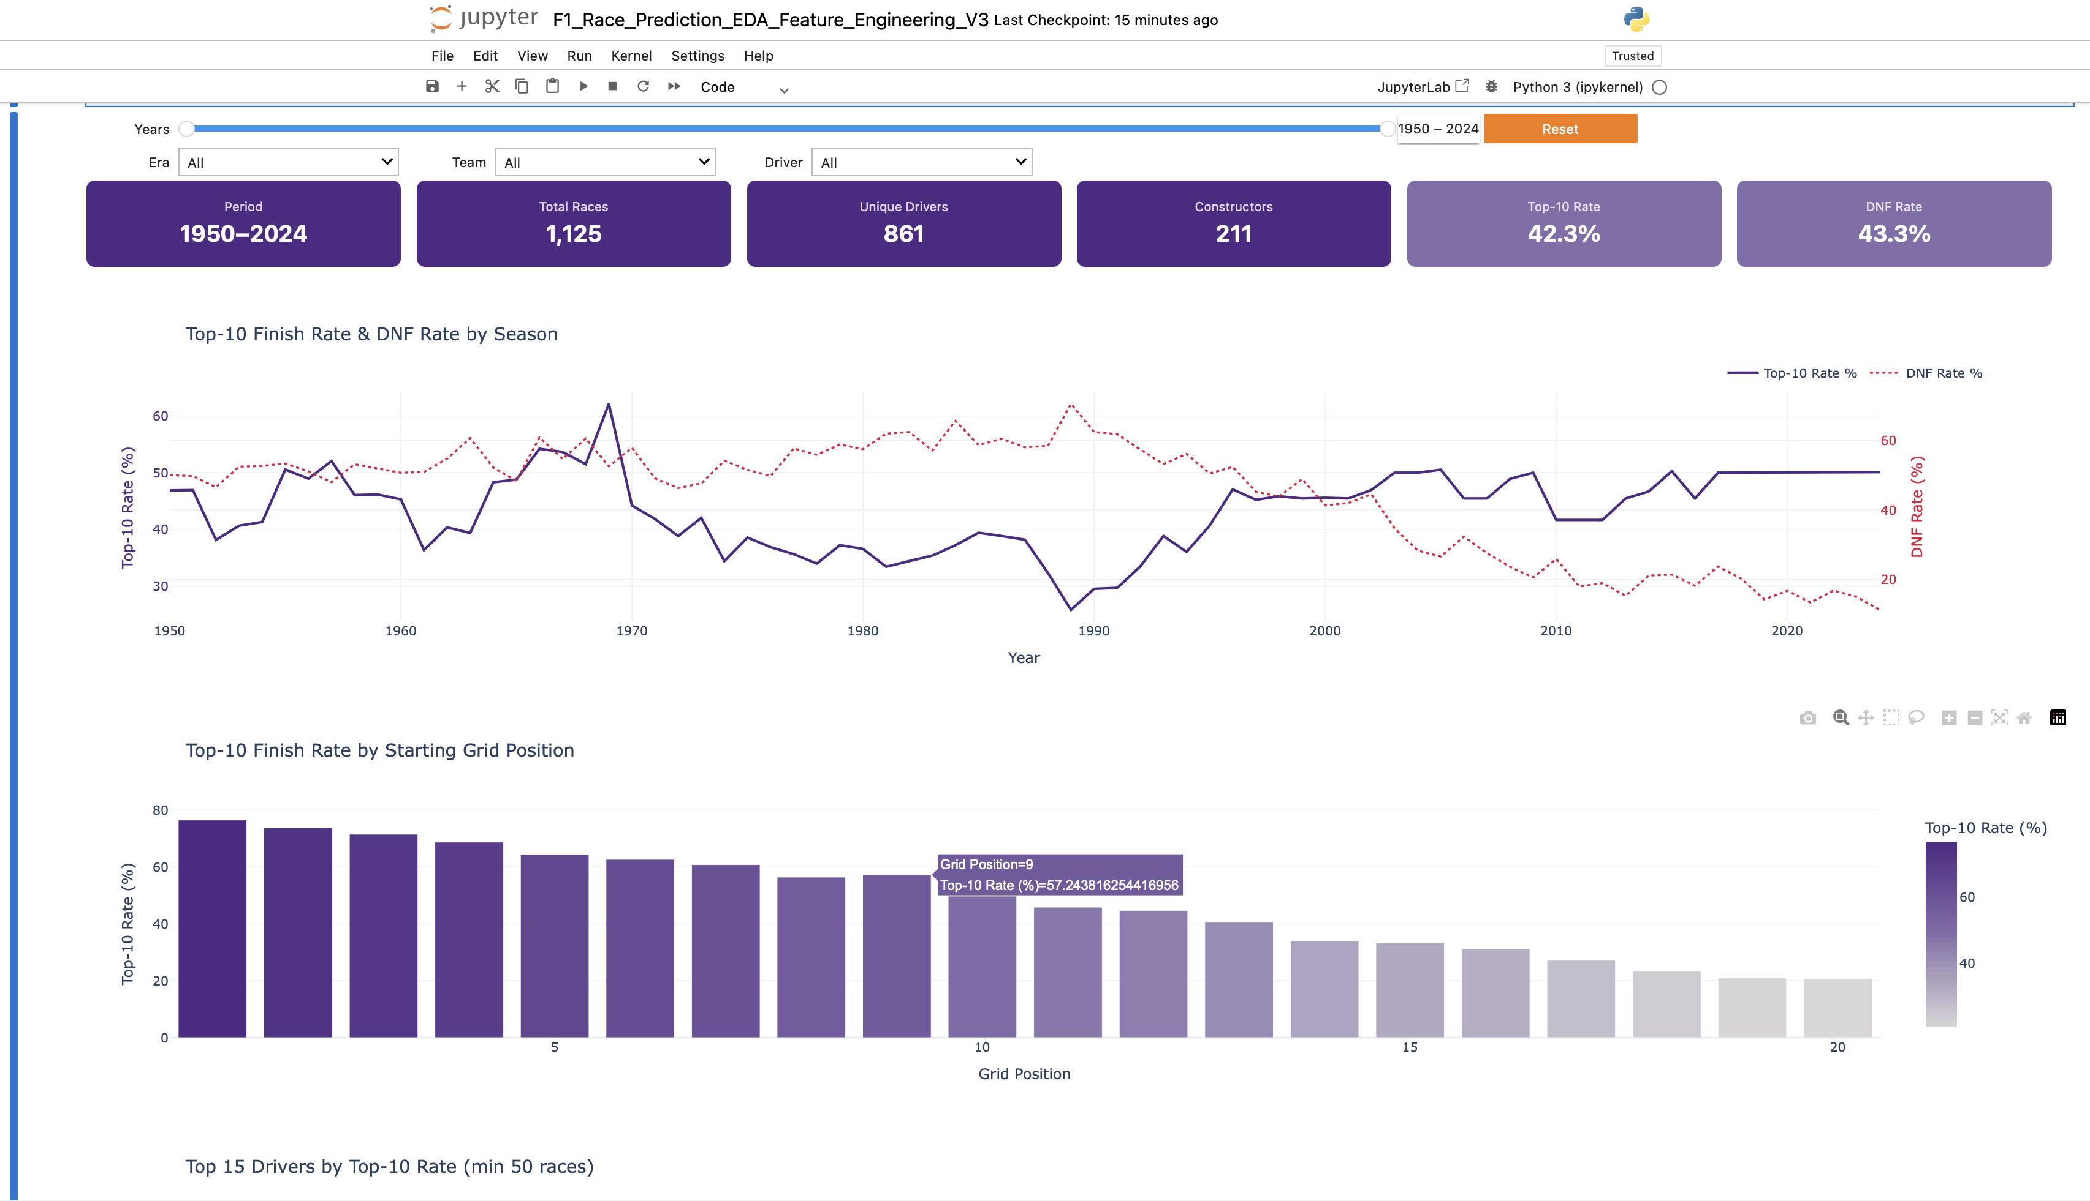
Interactive Dashboard
Live Filtering Dashboard built with ipywidgets + Plotly inside the notebook
Dashboard Features
Year Range Slider
Filter any period from 1950–2024
Era Dropdown
Compare regulation periods
Team Filter
Isolate constructor performance
Driver Filter
Analyze individual drivers
KPI Cards
Period, races, drivers, top-10 rate, DNF rate
7 Interactive Charts
Trends, grid position, top drivers, constructors, era comparison, circuit explorer
Note: Full interactive dashboard runs in the Jupyter notebook with filter controls at top.
Northwestern University

Slide 15
Model Deployment & Monitoring
1
Model Registry
Best model and scaler saved via joblib for reproducible deployment. Feature list and metadata stored as JSON artifacts.
2
BatchPredictor
Offline scoring utility that loads the serialized model and scaler, accepts a DataFrame of pre-race features, and returns top-10 probability estimates.
3
ModelMonitor
Drift detection module that tracks feature distributions and prediction statistics over time. Flags when incoming data diverges from training patterns.
4
Interactive Dashboard
Notebook-based dashboard with season, driver, and constructor filters. Visualizes predicted probabilities alongside actual outcomes for rapid model evaluation.
Northwestern University

Slide 16
Business Impact & Lessons Learned
Business Impact
Lessons Learned
• Builds a predictive system estimating a driver’s Top-10 finish probability before a race using historical F1 data.
• Provides data-driven insights for teams and analysts to evaluate race strategies (qualifying setup, tire choices, reliability risks).
• Enhances broadcast storytelling and race analytics by quantifying performance trends and competitive momentum.
• Supports fan engagement platforms such as fantasy sports and prediction markets through transparent probability forecasts.
• Establishes a reproducible framework for analyzing driver, constructor, and circuit performance across eras.
• Preventing data leakage is critical in sports prediction models.
• Race outcomes should not influence pre-race feature construction.
• Three factors dominate predictive power: Grid position, Constructor strength, and Recent driver performance
• Combining short-term rolling metrics with long-term career statistics improves prediction stability.
• Extensive feature engineering improves signal quality but requires strong evaluation and interpretability checks.
Northwestern University

Slide 17
Assumptions & Limitations in the Analysis
Assumptions
Limitations
• All engineered features represent information available before race start to prevent data leakage.
• Rolling statistics (e.g., last-5 race performance) are built using historically shifted windows.
• Top-10 finish is used as a consistent proxy for race success across different eras.
• Missing qualifying data is approximated using grid position and median imputation.
• Label encoding assumes tree-based models can learn entity differences without artificial ordering.
• Time-based data split:
• Train: <2018
• Validation: 2019–2021
• Test: 2022–2024
• Formula One evolves over time, with rule changes, technological advances, and competitive shifts affecting model stability.
• Dataset lacks important contextual variables such as: weather conditions, safety car events, pit strategy, penalties, and tire compounds
• Early-era missing qualifying data required imputation, potentially weakening signal quality.
• Several engineered features exhibit multicollinearity, complicating interpretation.
• Repeated driver-season patterns may create residual dependence, affecting generalization.
• No weather or safety car data — key real-time variables unavailable in the dataset
• Label-encoded categorical may not capture constructor/driver relationships optimally
• Model assumes static pre-race features; in-race dynamics are excluded by design
Northwestern University

Slide 18
Conclusions & Future Work
Key Findings
Future Directions
• Gradient Boosting achieves the best single-model performance (PR AUC 0.852, ROC AUC 0.864 on test)
• Ensemble methods match but do not clearly exceed the best single model
• Grid position and constructor strength are the dominant predictive features confirmed by SHAP
• The temporal split confirms generalization — no overfitting across a 6+ year test period
• All five models significantly outperform the grid-only baseline (PR AUC 0.724)
• Integrate weather and safety car data as identified by Jafri (2024)
• Explore LightGBM and TabNet for additional gradient boosting baselines
• Build a live prediction interface for pre-race probability estimates
• Extend to multi-class position prediction (e.g., podium, points zone)
• Enforce a strict pre-race feature set to avoid outcome leakage.
• Apply hyperparameter tuning and probability calibration.
• Conduct cross-era evaluation to detect performance degradation from regulatory changes.
• Integrate additional contextual data such as weather, safety cars, penalties, and tire strategies.
• Deploy the best model as a production inference pipeline (batch or API) with monitoring and periodic retraining.
Northwestern University

Slide 19
References
[1]
Bansal, A. 2025. Advanced Machine Learning Approaches for Formula 1 Race Performance Prediction. doi:10.13140/RG.2.2.20910.01607.
[2]
Gu, Y., Q. Liu, K. Zhang, Z. Huang, R. Wu, and J. Tao. 2021. "NeuralAC: Learning Cooperation and Competition Effects." AAAI 35(5): 4072–80.
[3]
Jafri, A. 2024. Predicting Formula 1 Race Outcomes: A Machine Learning Approach. Capstone project.
[4]
Patil, A., N. Jain, R. Agrahari, M. Hossari, F. Orlandi, and S. Dev. 2023. "A Data-Driven Analysis of Formula 1 Car Races Outcome." CCIS, 134–46.
[5]
Rockerbie, D. W., and S. T. Easton. 2022. "Race to the Podium." Applied Economics 54(54): 6272–85.
[6]
Urdhwareshe, A. 2025. "The Use of Machine Learning in Predicting Formula 1 Race Outcomes." Preprints.
[7]
van Kesteren, E.-J., and T. Bergkamp. 2023. "Bayesian Analysis of Formula One Race Results." JQAS 19(4): 273–93.
[8]
Vopani. 2025. Formula 1 World Championship (1950–2024). Kaggle.
[9]
Zheng, X. 2022. "NBA Winner Prediction: A Hybrid Framework." Proc. 4th Int. Conf. Big Data Engineering, 71–80.
Northwestern University

Slide 20
Team Contributions
Team Member | EDA | Feature Engineering | Modeling | Project Oversight | Presentation Creation | Report Writing | Dashboard | Limitations & Future Work
Sara Alsiyat | ✓ | ✓ | ✓ | ✓ | ✓ | ✓ | ✓
Qifan Yang | ✓ | ✓ | ✓ |  | ✓ | ✓ |  | ✓
Boqi Niu | ✓ | ✓ | ✓ | ✓ | ✓ | ✓ | ✓
Northwestern University

Slide 21

Northwestern University
Thank you...
Sara Alsiyat · Qifan Yang · Boqi Niu
MSDS 422 · Dr. Irene Tsapara · Northwestern University
Northwestern University

