Slide 1
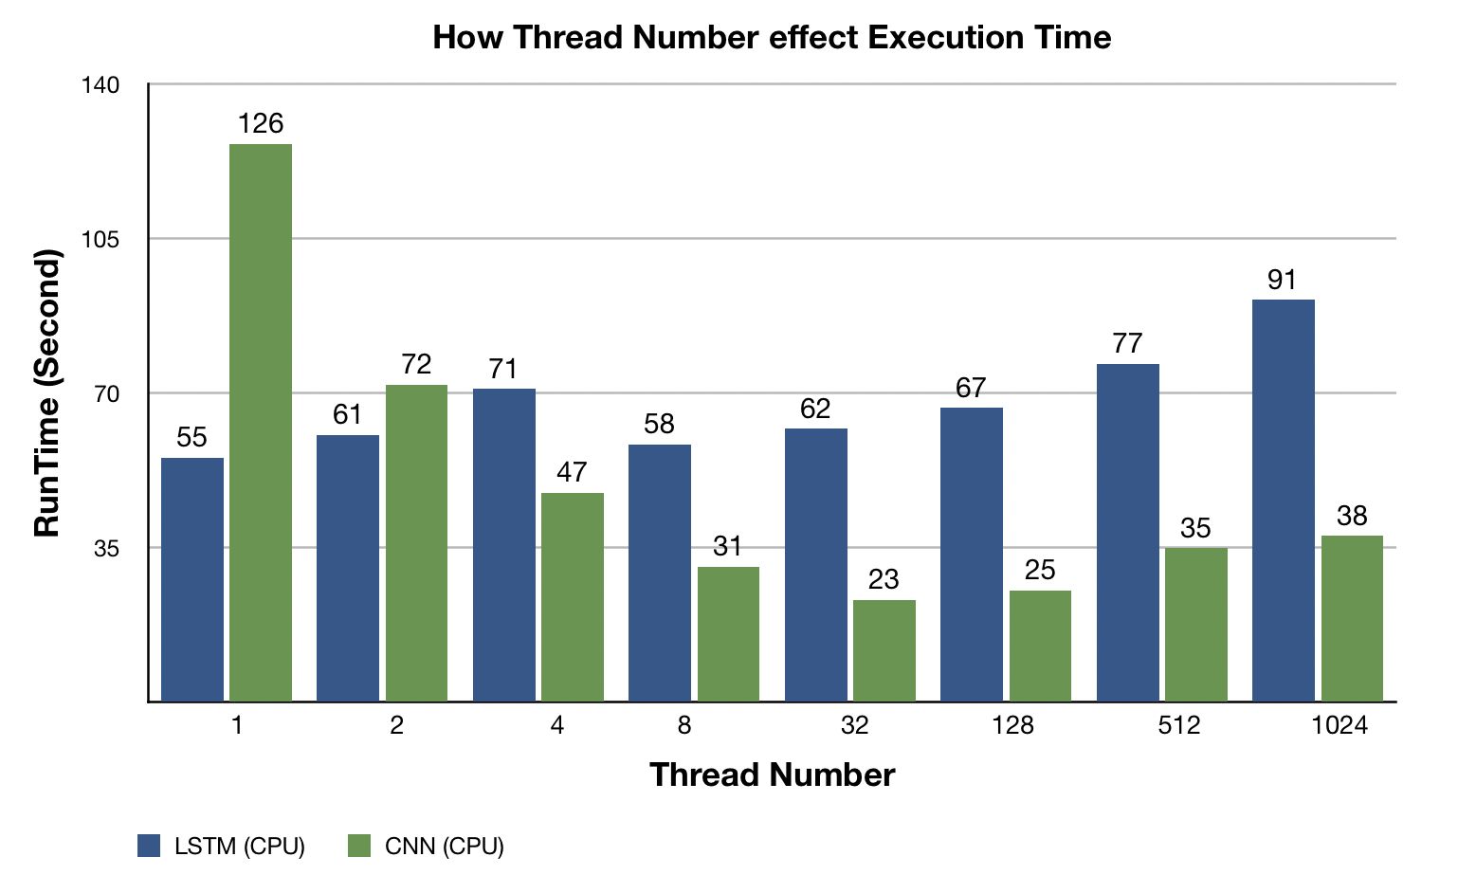
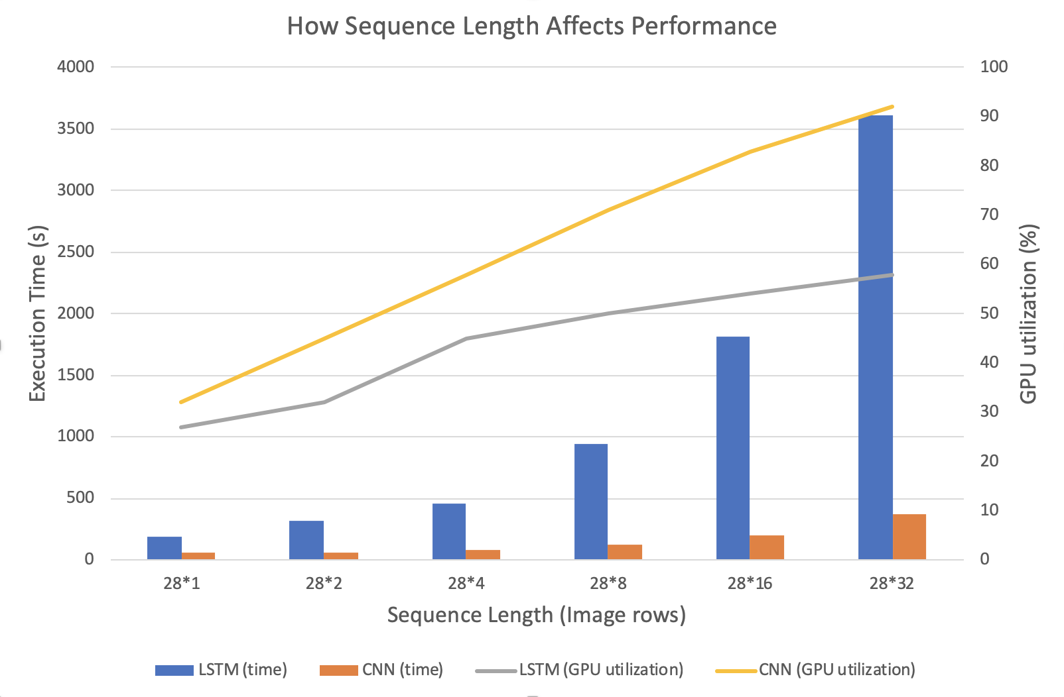
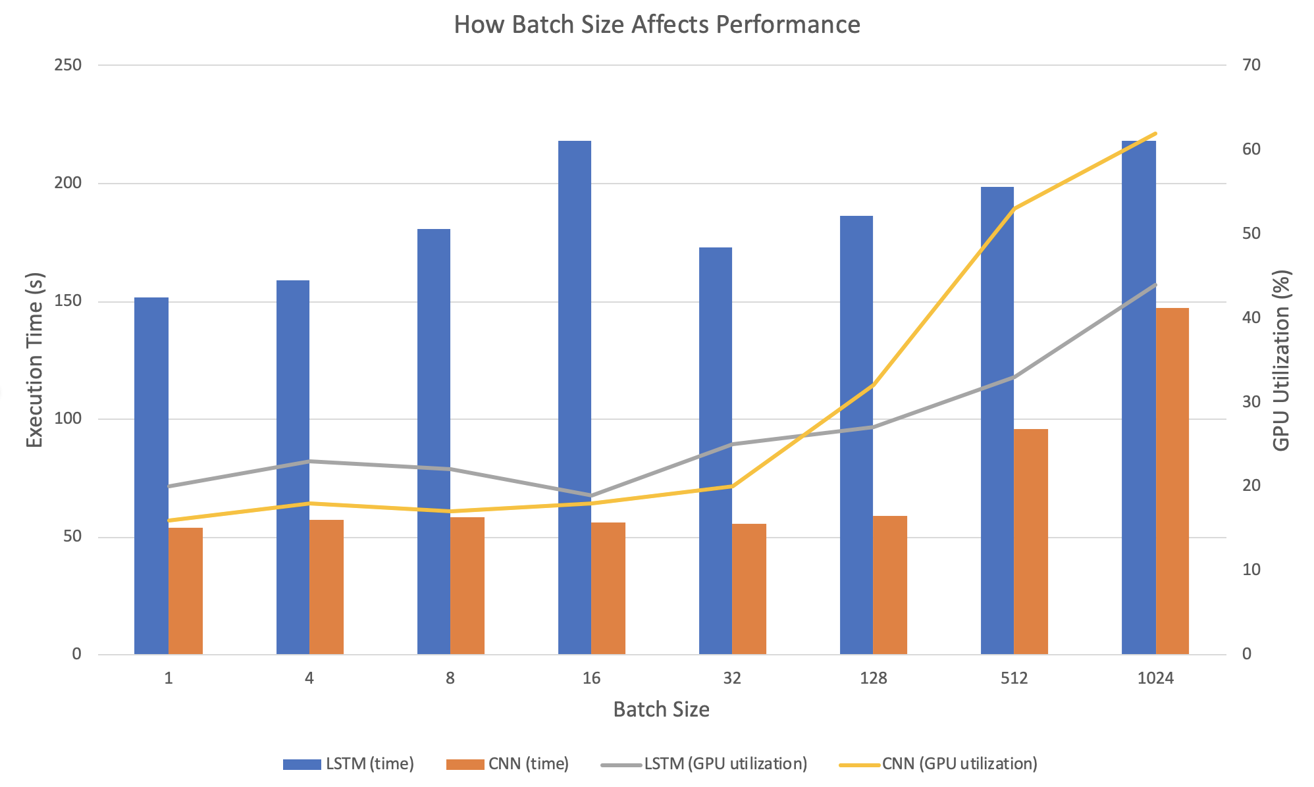

Characterizing the Workload of Dynamic Neural Networks
Zhenyu Zou, Rui Huang
Problem Statement
Early results
We are trying to characterize the workload of LSTM training and comparing its workload with traditional CNN’s workload
LSTM becomes widely used in a wide range of ML and NLP tasks. However, its workload is seldom studied and its training efficiency remains to be improved
We make the following three assumptions about LSTM workload:
LSTM possesses less parallelism than CNN
LSTM benefits less from a large batch size than CNN
LSTM is influenced more by the size of input data than CNN
Existing Work / Related work
Existing benchmark primarily focus on solely running various deep learning models separately in varied environment with different machine and model parameter configuration. However, we compare the performance between LSTM and CNN under same FLOPS with different parameter settings.
We used most of the same parameter variation such as batch size and compare CPU, GPU performance similarly like other related work.
Most related work such as ParaDnn, Dawnbench only focus on the performance in various parameter settings, however, our work narrows and specializes to specific area and makes controlled variable experiment between two DL models in great depth.
LSTM’s running time grows linearly with the increase of sequence length
CNN’s running time grows sub-linearly with the increase of image size
When thread number increases from 1 to 32, CNN’s running time is largely shortened, while LSTM doesn’t change a lot
LSTM cannot be parallelized as much as CNN
Other Contributions / WIP
We investigated the effect of varying number of threads, sequence length, cache rates separately on LSTM and CNN model in broad range and profiled the performance of GPU and CPU separately.
Most of the experiment results that we currently have are based on execution time. We intend to find more correlation of other aspects such as hardware utilization rate. However, we found that the utilization rate varies with respect to different model. Particularly, we found that LSTM has more drastic response to the changes of dataset dimensions compared to LSTM.
For future work, we are interested in the profiling under distributed setting, which may have much different result. In addition, we only deploy a single framework, TensorFlow, in our experiment. Other frameworks may have different results.
What is your Approach
We design a LSTM and a CNN of equivalent model size (with roughly the same FLOPs)
We use MNIST dataset as the common input in both LSTM and CNN training
By varying different model hyperparameters (thread number, batch size, input size, …), we compare the performance between LSTM and CNN
In the same settings, LSTM’s training time is much longer than CNN
When batch size increases, LSTM’s training time grows more rapidly than CNN

