Slide 1
Conference

Slide 2
Theory
History of experiment
Overview of original HS experiment
How does this compare to ours: differences? Similarities?
Expected results
Factors that effect results
Relevant equations and explanations
Overall objectives: drift, diffusion, recombination
Explain about minority/majority charge carriers
Difference between p and n semiconductors
Semiconductor diagram
Circuit diagram

Slide 3
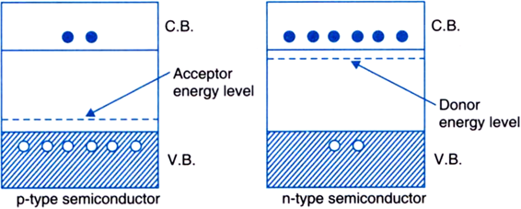
Semiconductors
Valence band
Conduction band
Electrons/holes
Donor/acceptor energy levels

