Slide 1

Movie Recommender
https://github.com/louisyang2015/movie_recommender
Louis Yang
2019 January

Slide 2
Technologies Used
Mostly Python (Numpy, SciPy)
C++ (ALS)
JavaScript (App)
MovieLens dataset
AWS (optional)
Storage: S3, DynamoDB, EFS
Compute: EC2, Lambda
Web Hosting

Slide 3
Linear Model
(user profile)•(item profile) = score
Example:
 | Science Fiction | Romance
Louis | 1 | 0.1
 | Science Fiction | Romance
Star Trek | 1 | 0.05
Titanic | 0.1 | 1
(Louis) • (Star Trek) = 1 * 1 + 0.1 * 0.05 = 1.005
(Louis) • (Titanic) = 1 * 0.1 + 0.1 * 1 = 0.2

Slide 4
ALS Model
Example:
 | ? | ?
Louis | u_{0,0} | u_{0,1}
 | ? | ?
Star Trek | m_{0,0} | m_{0,1}
Titanic | m_{1,0} | m_{1,1}
(Louis) • (Star Trek) = u_{0,0} m_{0,0} + u_{0,1} m_{0,1} = +2.5
(Louis) • (Titanic) = u_{0,0} m_{1,0} + u_{0,1} m_{1,1} = +0.5

Slide 5


ALS Solution
Randomize $\vec{m}$, solve for $\vec{u}$.
now solve for $\vec{m}$
then solve for $\left\{\vec{m},\vec{u},\vec{m},…\right\}$
u_{0,0} 0.3 + u_{0,1} 0.5 = +2.5
u_{0,0} 0.25 + u_{0,1} 0.6 = +0.5
$$\vec{u}=\left[\begin{aligned}22.73 \\ −8.64\end{aligned}\right]$$
22.73 m_{0,0} + -8.64 m_{0,1} = +2.5
22.73 m_{1,0} + -8.64 m_{1,1} = +0.5

Slide 6

ALS Sparse Matrix
Each equation is a single (user, movie, rating)
As of 2018 September, the MovieLens dataset:
280 * 10³ users *11 factors
$$\left[\begin{matrix} & & \\ & & \\ & A & \\ & & \\ & & \end{matrix}\right]\vec{x}=\vec{b}$$
27 *10⁶
ratings

Slide 7
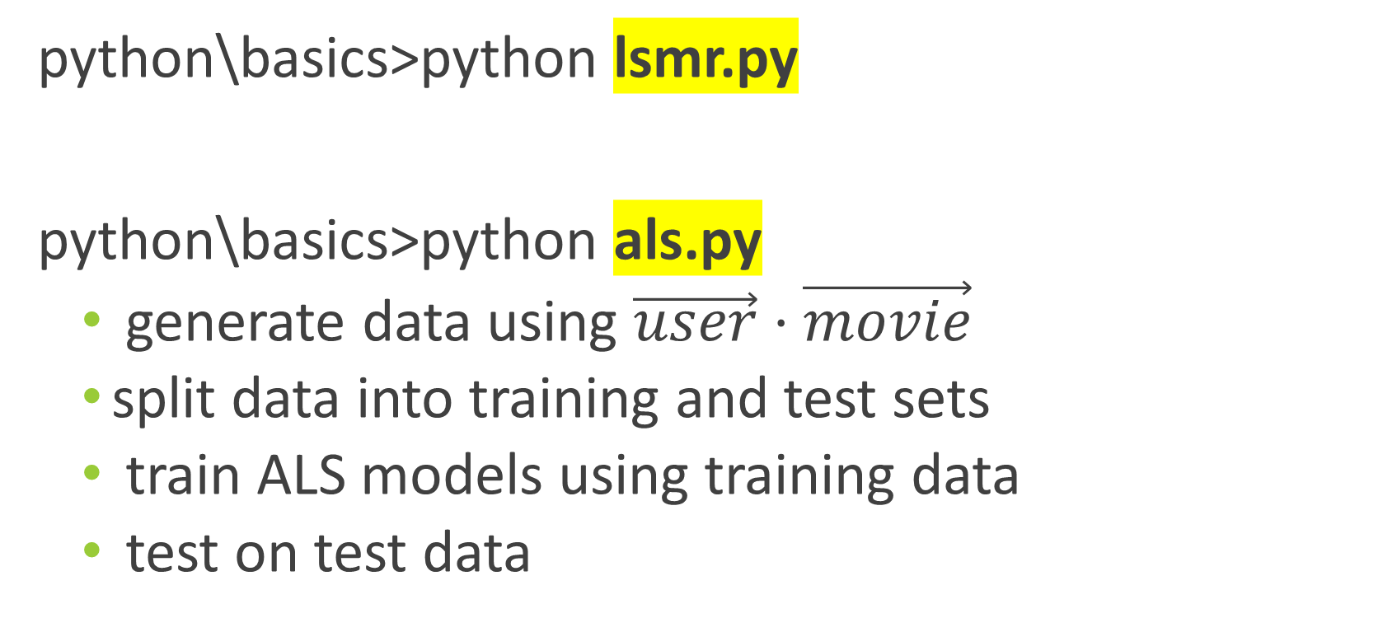
Solving ALS in Python
python\basics>python lsmr.py
python\basics>python als.py
generate data using $\vec{user}⋅\vec{movie}$
split data into training and test sets
train ALS models using training data
test on test data

Slide 8
Rank Agreement Percentage
Rating is not a good metric
Categorical data (scores are approximate)
Users see ranking
Some algorithms don’t use produce scores
Rank Agreement Percentage
Range 0 ~ 100%
Top heavy

Slide 9
Algorithms
python\100k_data>
python count_tags.py
python ls_tag.py
python median_predictor.py
python ratings_als.py
python similar_movies.py
python title_search.py > temp.txt

Slide 10
Movie Median vs Movie Average
Average
Standard (least squares) uses average as the bias term
Median
More responsive to the model
 | User 1 | User 2 | User 3 | Average | Median
Movie 1 | 3 | 3 | 4 | 3.33 | 3
Movie 2 | 2 | 3 | 4 | 3 | 3

Slide 11
Big Data Techniques
Pickle
Multiprocessing
python\basics\multiprocessing>python add.py
Multithreading using C++ (ctypes)
cpp\python>python cpp_ls_test.py
Cluster
python\basics\distributed_work>python cluster_server.py, worker_server.py, add.py

Slide 12
AWS Setup (EC2, EFS)
Setup EC2 instance:
Python3, numpy, scipy, boto3, requests
C++
Upload all scripts in "python\full_data"
Mount EFS using "/etc/fstab"
fs-155b98bd:/ /home/ec2-user/full_data/data efs defaults,_netdev 0 0

Slide 13
Build C++ ALS binary
Upload to AWS
matrix.h, matrix.cpp, ls_linux_dll.cpp
Build C++ shared library file
g++ -O3 -fPIC -shared matrix.cpp matrix.h ls_linux_dll.cpp -o cpp_ls_lib.so -pthread -std=c++11
chmod 644 cpp_ls_lib.so
Testing (optional): python3 cpp_ls_test.py

Slide 14
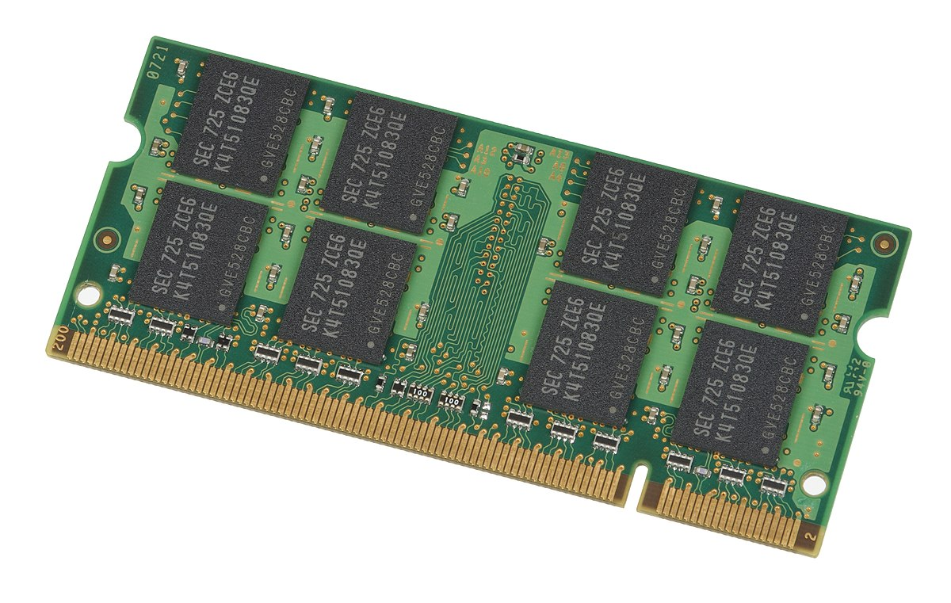

AWS EC2 Worker
build_similar_movies_db.py – 3GB per core
If 2GB / core, then use half of total number of cores
ALS Benchmark
CPU
This Photo by Unknown Author is licensed under CC BY-SA

Slide 15
Model Evaluation (Non ALS)
Data Processing
worker: sudo python3 randomize_training_set.py
Model Evaluation
server: sudo python3 cluster_server.py
worker: sudo python3 worker_server.py
worker: sudo python3 median_predictor.py, tag_count_predictor.py, tag_ls_predictor.py

Slide 16
ALS Model Evaluation
Data Processing
worker: sudo python3 train_als_models.py
Model Evaluation
server: sudo python3 cluster_server.py
worker: sudo python3 worker_server.py
worker: sudo python3 als_predictor.py

Slide 17
ALS Full Dataset Models
alsX_item_factors.bin, alsX_movie_ids.bin
sudo python3 train_als_models.py training_set_ratio=1
download → "python\app\recommend"
download → "python\app_local"

Slide 18
Similar Movies
Similar Movies (similar_movies.bin)
server: sudo python3 cluster_server.py
This step requires 3GB / Core If using 2GB / core, 16 cores: worker: sudo python3 worker_server.py cpu_count=8
worker: sudo python3 build_similar_movies_db.py
Use "user data" to auto start "worker_server.py"
#!/bin/sh
cd /home/ec2-user
./startup
cd full_data
sudo python3 worker_server.py

Slide 19
Other Data Processing
Windows (title_search_index.bin, tmdb_data.bin)
python build_title_search_index.py
python download_tmdb_data.py
Application files: python\app_local

Slide 20
App Front End
Basic JavaScript only
Example:
<div id="model_params_div"></div>
class ModelParams
API Example: recommend

Slide 21
App Local
E:\proj2018\movies_recommend\python\app_local>python server.py
Open: python\app_local\web_page\index.html

Slide 22
App Back End
Lambda
DynamoDB
Build Process
Windows (python\app\):
copy in the ALS models
python build.py
Linux
cd recommend
sudo python3 -m pip install numpy --target .
sudo python3 -m pip install scipy --target .
python3 ec2_build.py

