Slide 1
MAE 106 Verification 1
GROUP 7
Jerry Chen
Abby Baldwin
Brooke Bain
Duration
03 min
Robotic
SPRING 2026

Slide 2
Contents
Agenda
Mechanical Design Verification
Electrical Design Verification
Control Design Verification
Group 7
Robotic Project
April/2025

Slide 3
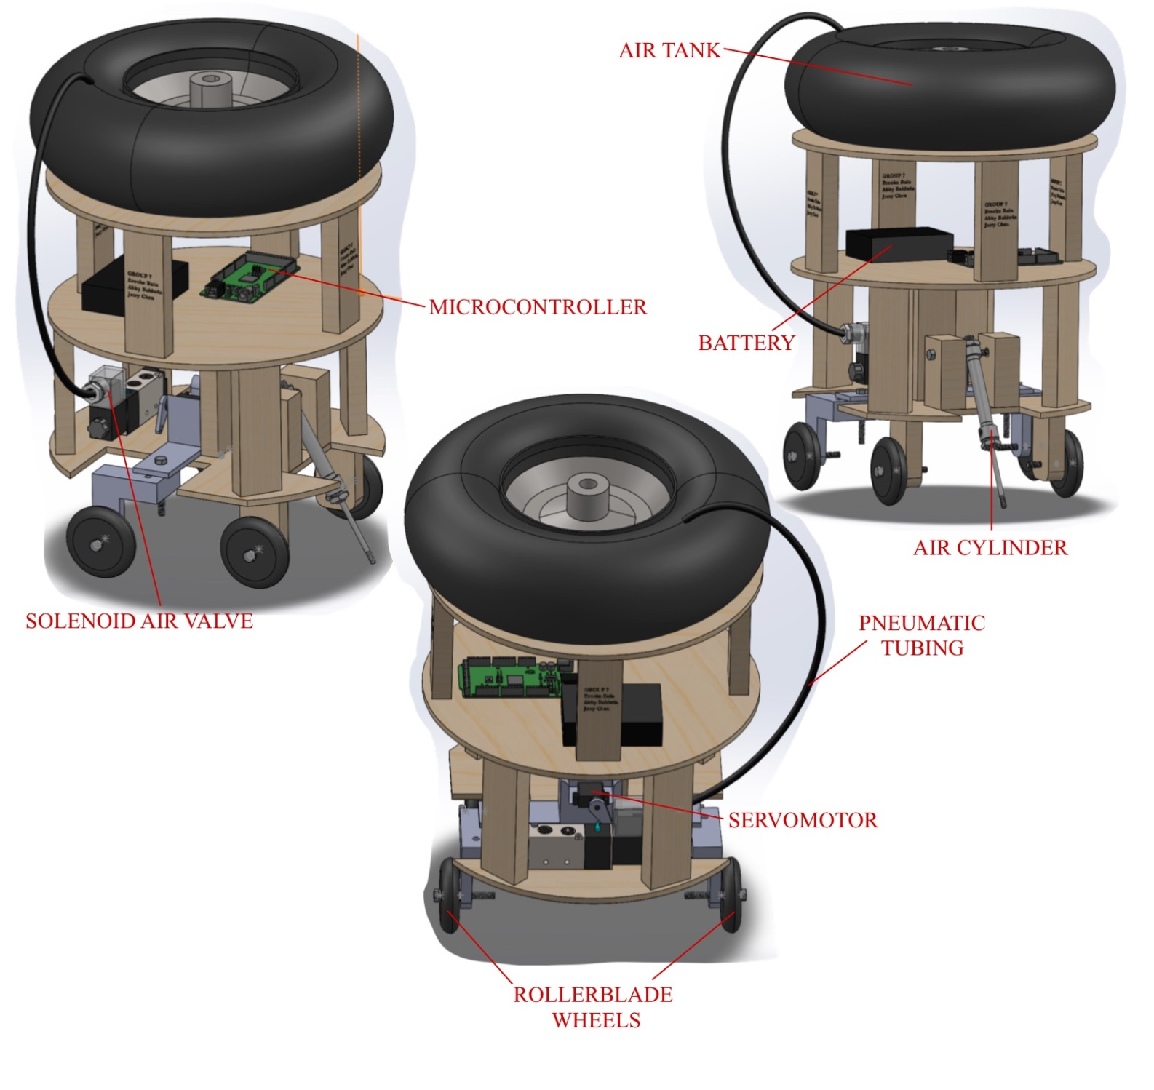
Our SolidWorks Model
All Components with Accurate Dimensions including:
· Microcontroller
· Servomotor
· Air cylinder
· Solenoid air valve
· Air tank (i.e. large rubber tire)
· Pneumatic (air) tubing (any approximation that shows an adequate path is enough
· Battery
· Rollerblade wheels
*All components are connected to the robot

Slide 4
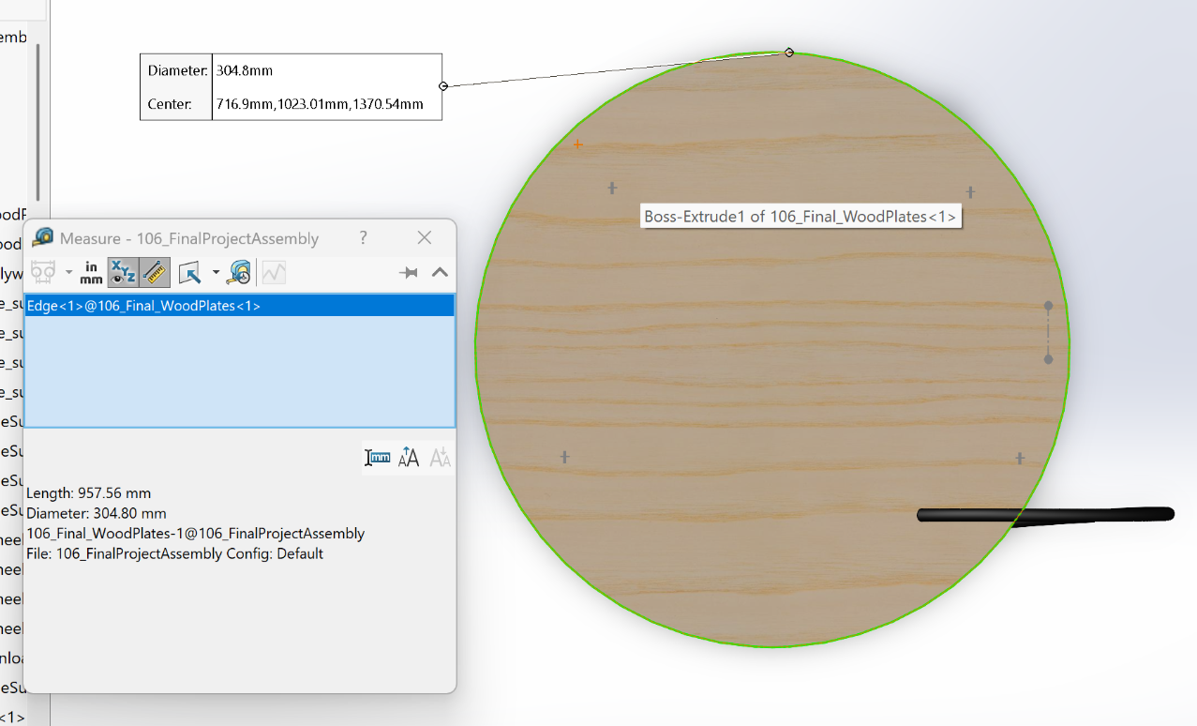
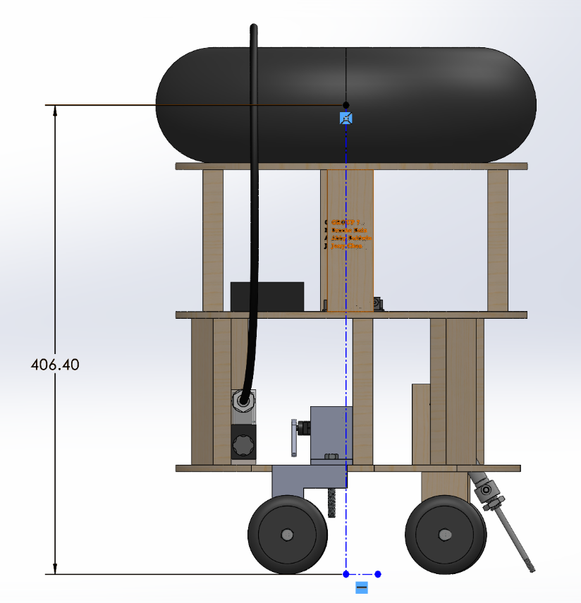
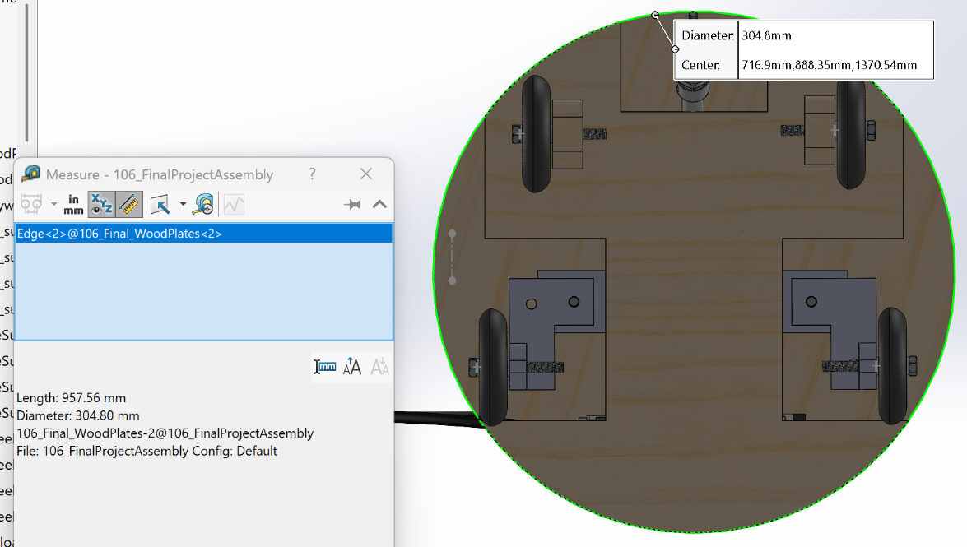
Dimensional Compliance: 12" Diameter & 16" Height Verification
No component extends beyond the 304.8mm = 12in diameter of the robot
Height from middle of the tire to the bottom of the wheels is 406.4mm = 16in
TOP VIEW
BOTTOM VIEW

Slide 5
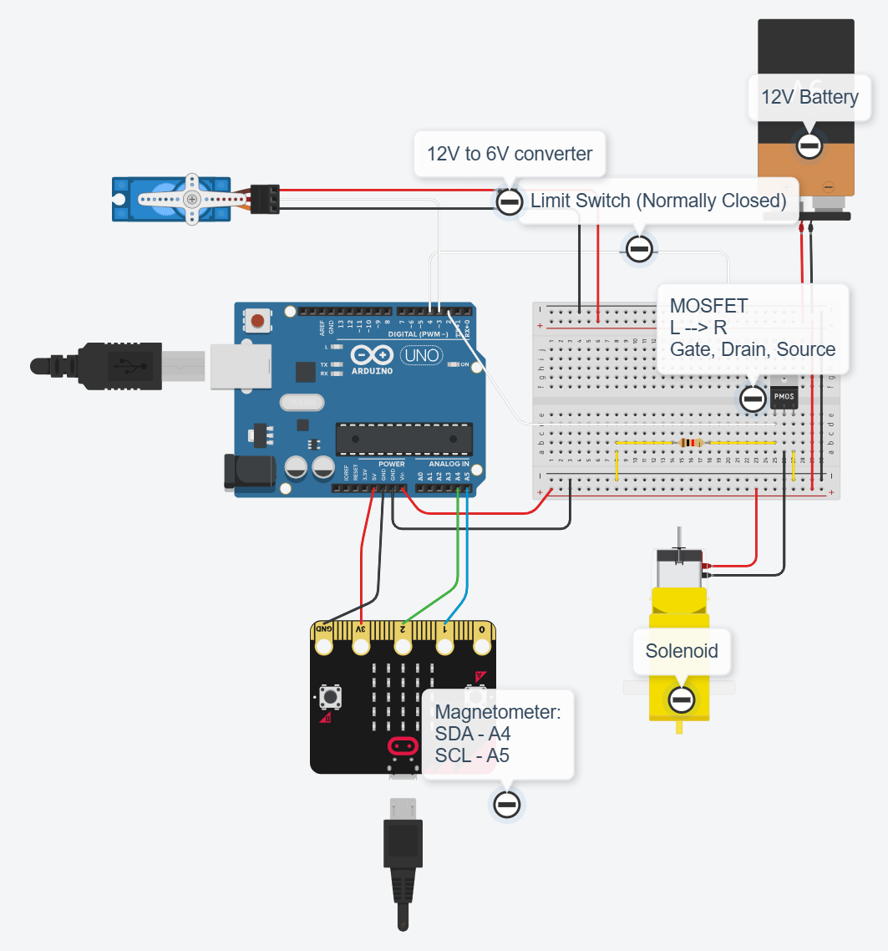
02
Electrical Design Verification
Wiring Diagram with all electrical parts, including
Servo motor
12 Volt battery
Limit switch
Arduino board
Solenoid
Magnetometer
12V to 6V converter
MOSFET
Group 7
Robotic Project
April/2025

Slide 6
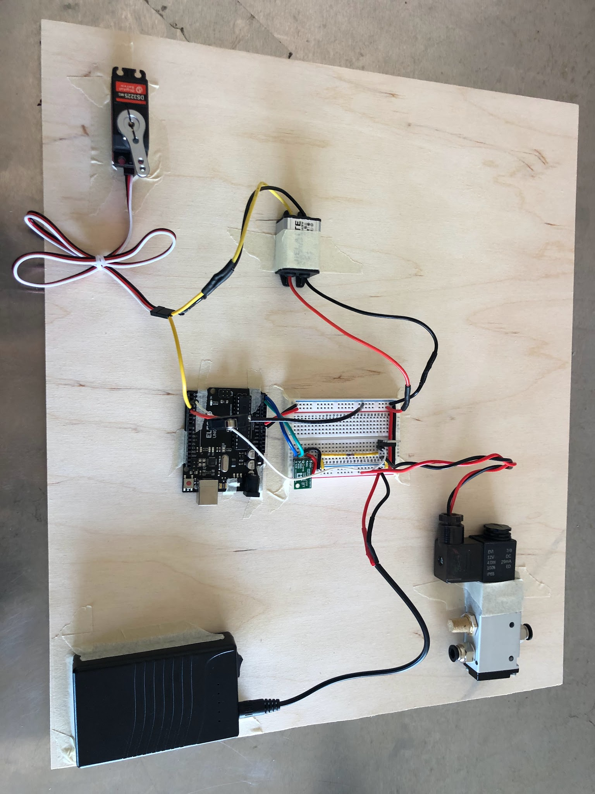
02
Electrical Design Verification
Group 7
Robotic Project
April/2025

Slide 7
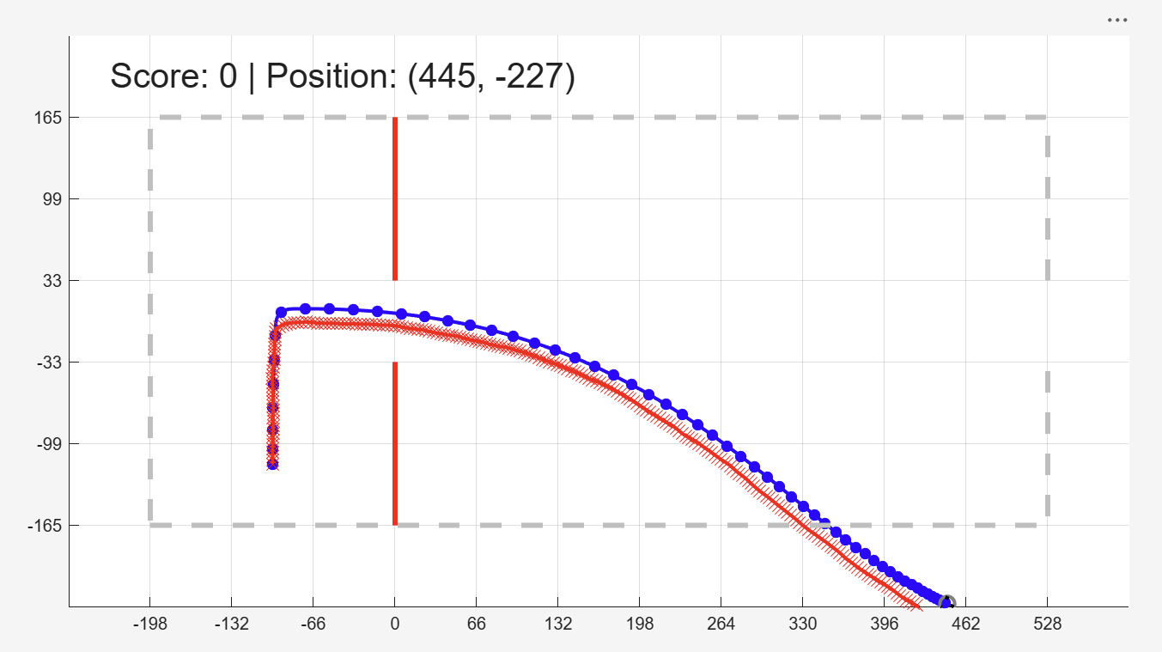
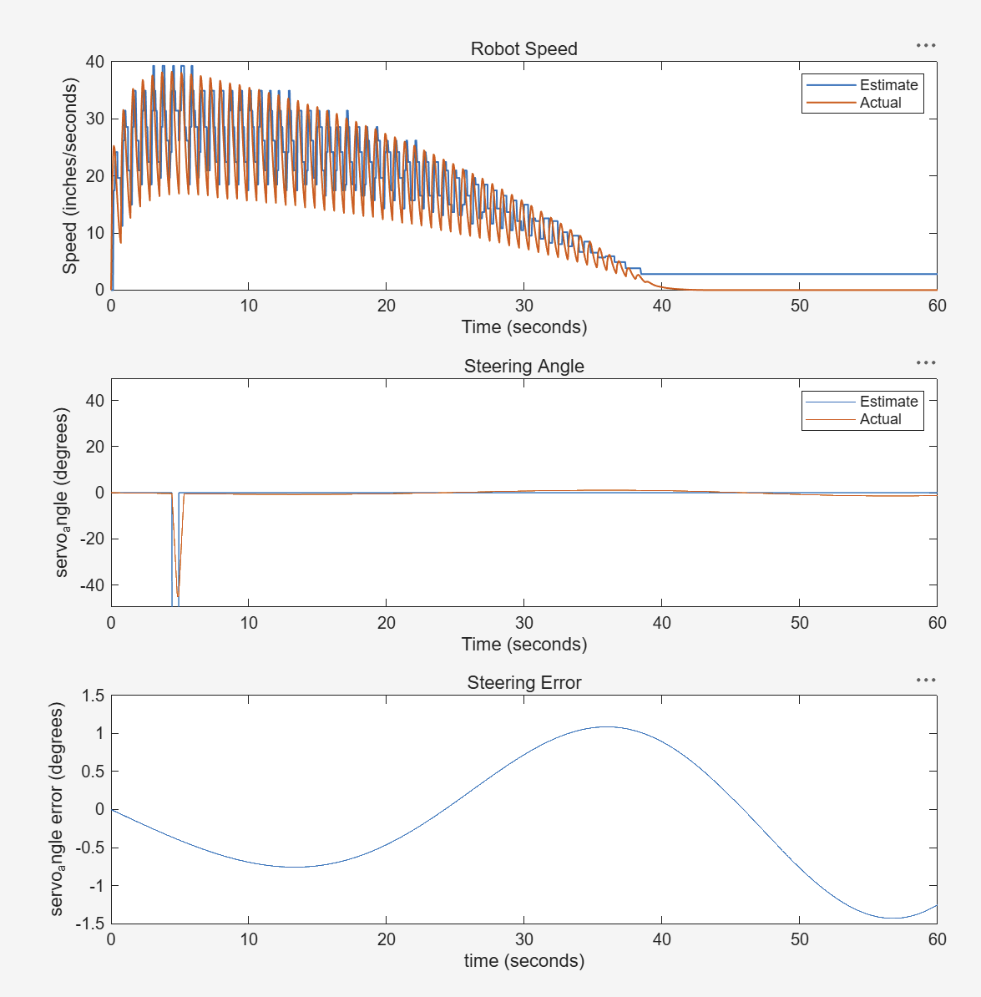
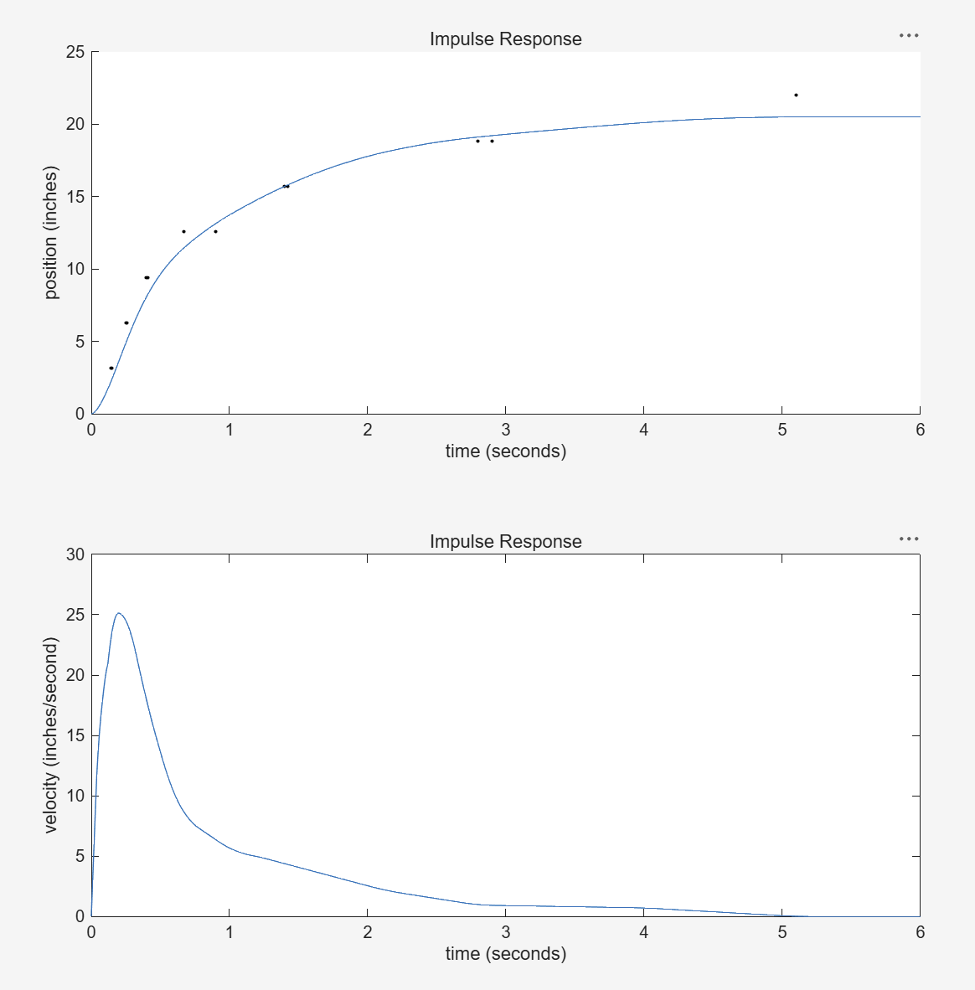
03
Open Loop Control
What we did well
We set:
control_variables.c1_n_ticks_before_turn = 35
control_variables.c1_total_time_turning = 0.49;
Scores array:
0 0 50 50 0 0 100 0 100 0
Group 7
Robotic Project
April/2025

Slide 8
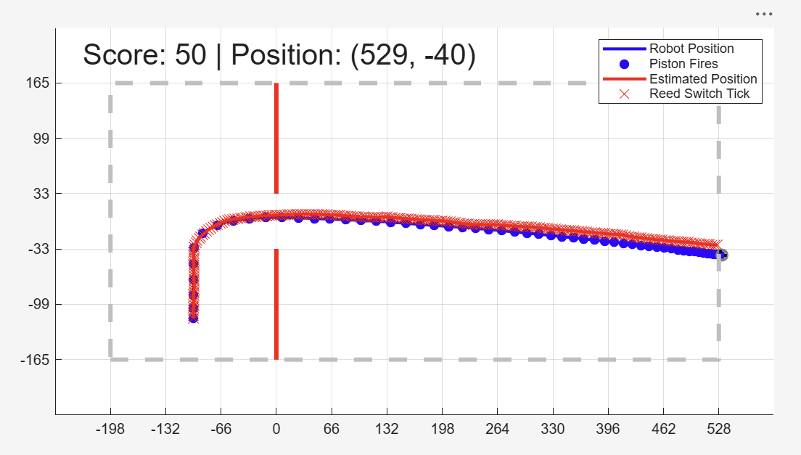
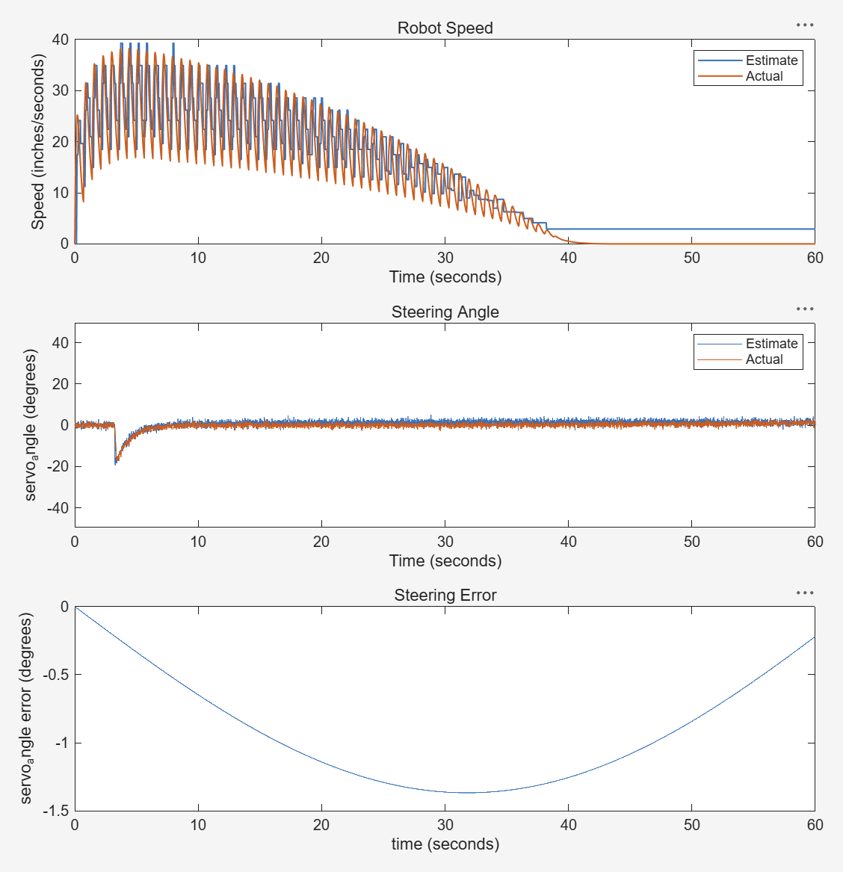
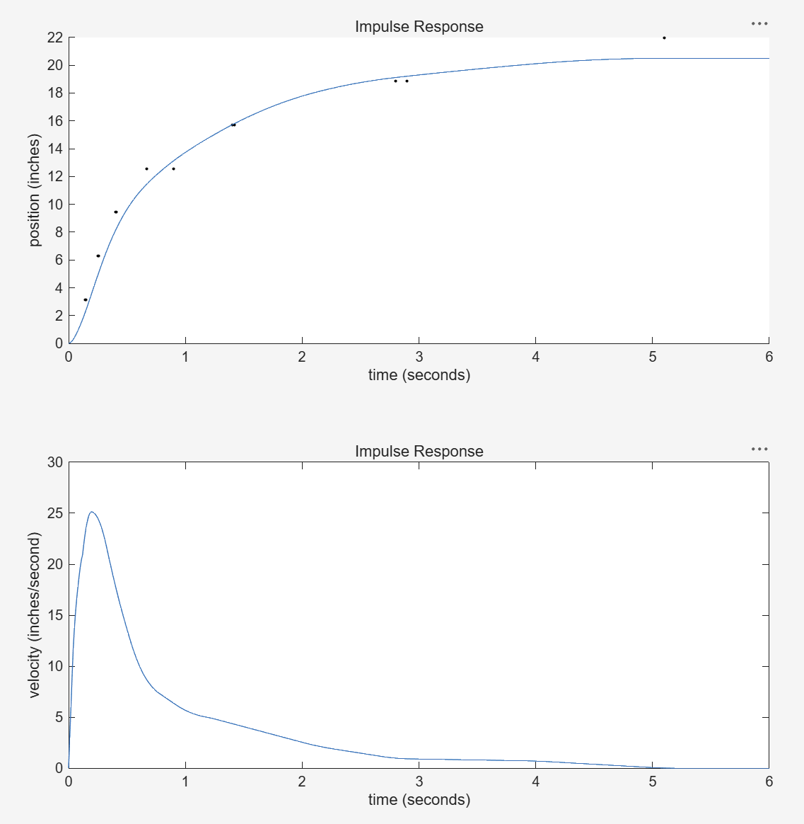
03
Hybrid Control
What we did well
We set:
control_variables.c2_n_ticks_before_turn = 25;
control_variables.c2_total_time_turning = 0.5;
control_variables.c2_Kp = .2;
Scores array:
50 50 50 50 150 150 50 150 150 50
Group 7
Robotic Project
April/2025

Slide 9
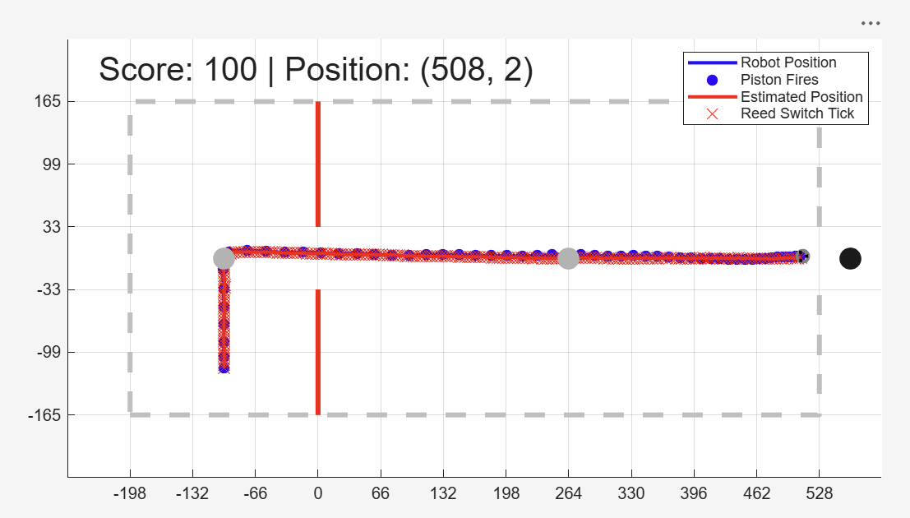
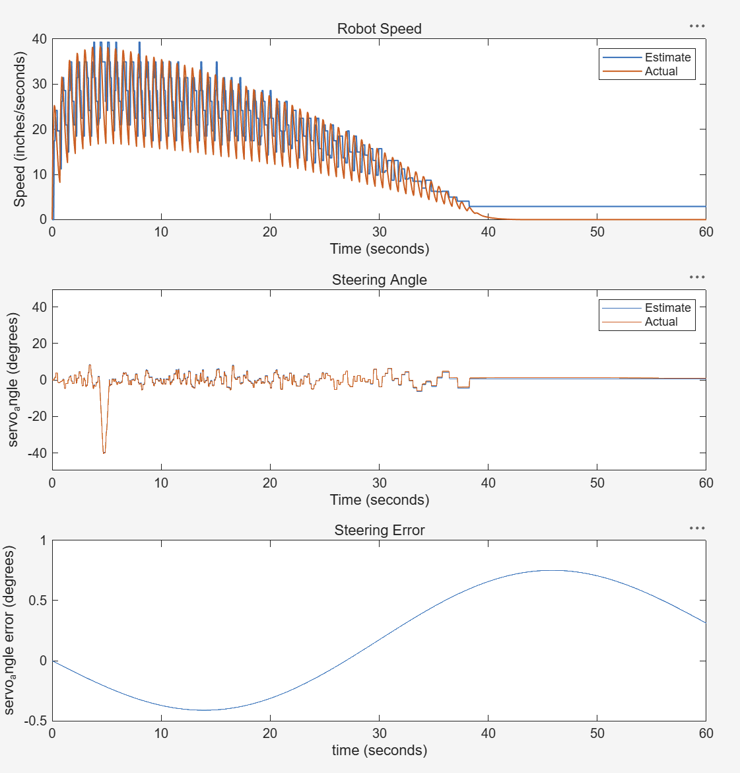
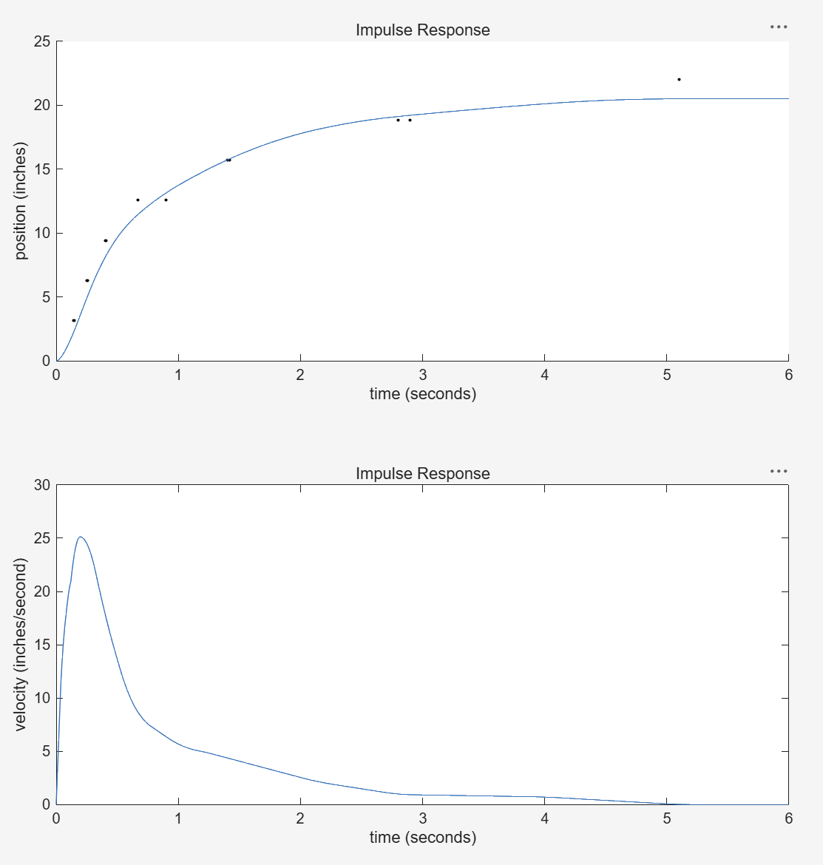
03
Close Loop Control
What we did well
We set:
control_variables.c3_Kp = 1
control_variables.c3_change_target_distance = 12;
control_variables.c3_position_desired_list = control_variables.grid_size*[-1.5 0;
4 0;
8.5 0];
Scores array:
100 100 100 100 100 100 100 100 100 100
Group 7
Robotic Project
April/2025

Slide 10
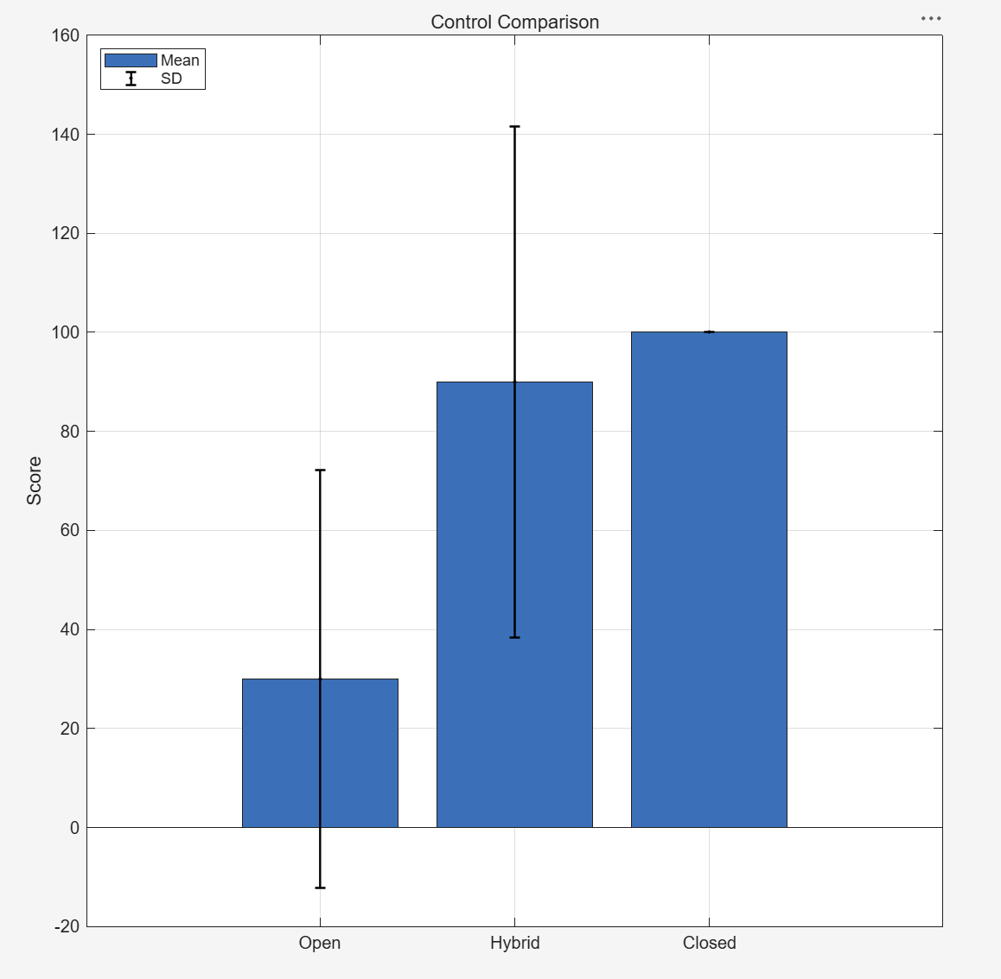
03
Summary
What we did well
We choose:
control_variables.piston_time_on = 0.25;
control_variables.piston_time_off = 0.75;
Group 7
Robotic Project
April/2025

Slide 11
Thank you

