Slide 1
MAE 106 Verification 2
Debugging Manual
GROUP 7
Abby Baldwin
Jerry Chen
Brooke Bain
Robotic
SPRING 2026

Slide 2
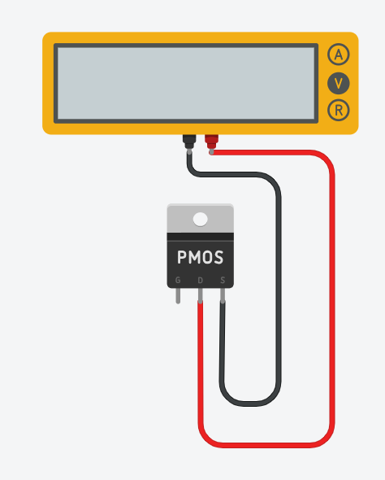
01
MOSFET
Symptoms
Test
No voltage between terminals when powered
Set the multimeter on voltage diode
Connect positive to drain and negative to source
Results
  If it’s not continuous, MOSFET is working because no voltage was applied
  If it is continuous, the MOSFET is broken and should be replaced
Group 7
Robotic Project
April/2025

Slide 3
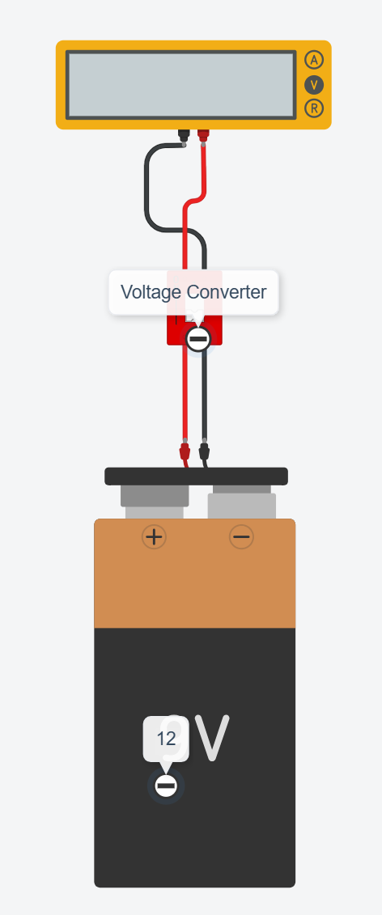
02
Voltage Converter
Symptoms
Test
Output terminals very far off of 6V
Motor moves strangely or vibrates
Set the multimeter on voltage
Connect the 12V battery to the input of the converter
Connect the multimeter to the output of the converter
Results
  If the multimeter reads 6V, the converter is working
  If the multimeter reads 0V or 12V, or anything else that is far from 6V, the converter is not working
Group 7
Robotic Project
April/2025

Slide 4
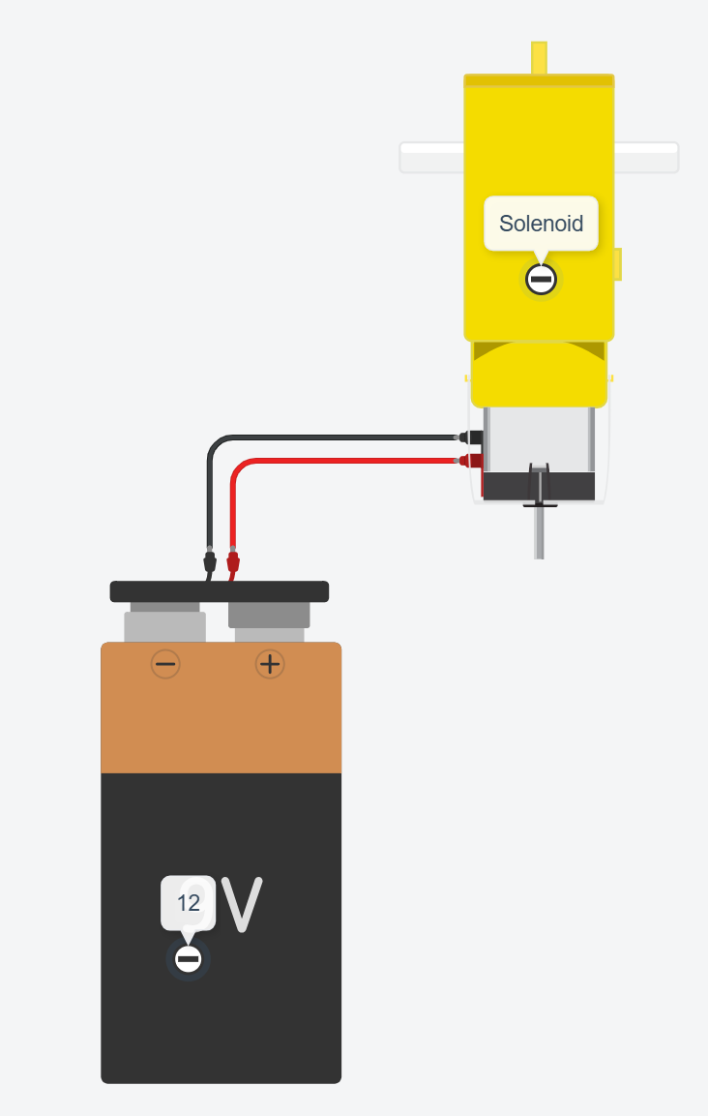
03
Solenoid
Symptoms
Test
Piston does not fire or solenoid does not click
Piston fires but lacks usual force
Disconnect the solenoid from all circuit elements
Connect the solenoid terminals directly to the 12V power source then promptly disconnect them
Results
  If the solenoid clicks, it is working
  If the solenoid makes no sound or only hums, it is not working
Group 7
Robotic Project
April/2025

Slide 5
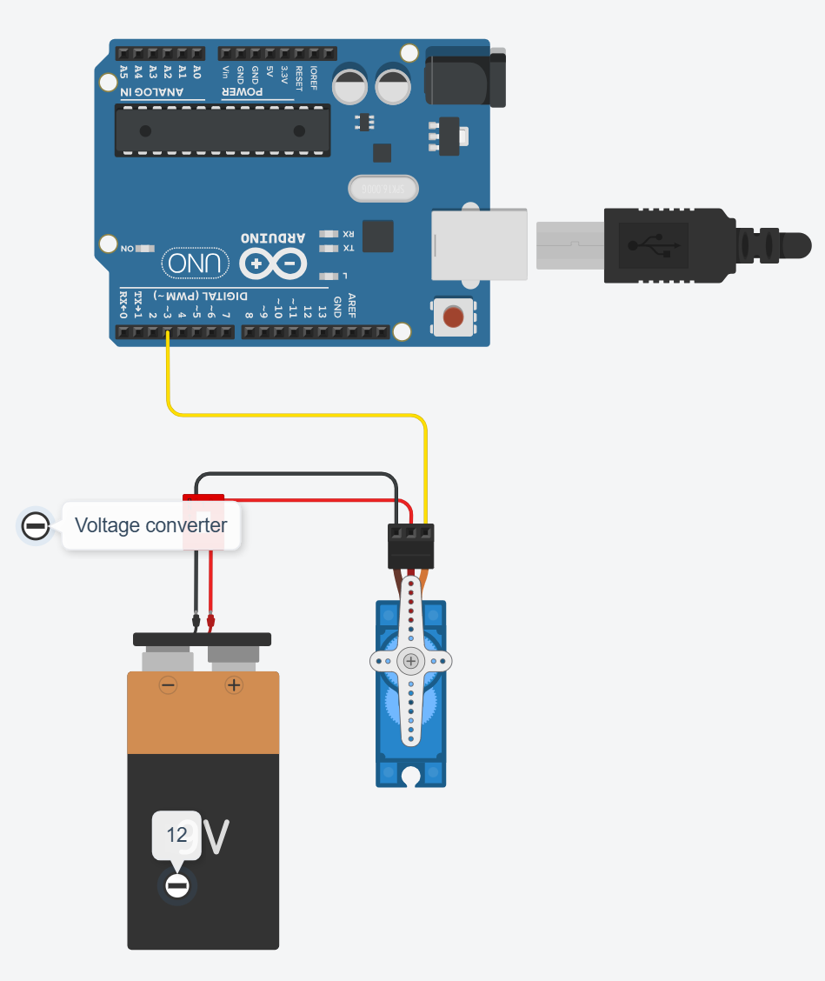
04
Servo Motor
Symptoms
Test
Servo oscillates or otherwise does not hold a steady angle
Servo does not move at all
Connect the 12V battery, voltage converter, servo, and Arduino as shown
Upload the code to the arduino and attempt to change the position slightly in either direction
Results
  If the servo actuates and holds a steady position it is working
  If the servo does not move or continues to move erratically, it is not working
#include <Servo.h>
Servo myservo; // Create a servo object to control motor
int servoPin = 3; // The digital pin your servo signal wire is connected to
// ==========================================
// CHANGE THIS NUMBER TO CHANGE THE POSITION:
// Valid range is 0 to 180 degrees
// ==========================================
int targetPosition = 90;
void setup() {
myservo.attach(servoPin); // Links the servo object to physical pin 3
// Move to the target position immediately on startup
myservo.write(targetPosition);
}
void loop() {
// Keeping the position updated in the loop
myservo.write(targetPosition);
delay(15); // A small delay to let the servo physically reach the position
}
Group 7
Robotic Project
April/2025

Slide 6
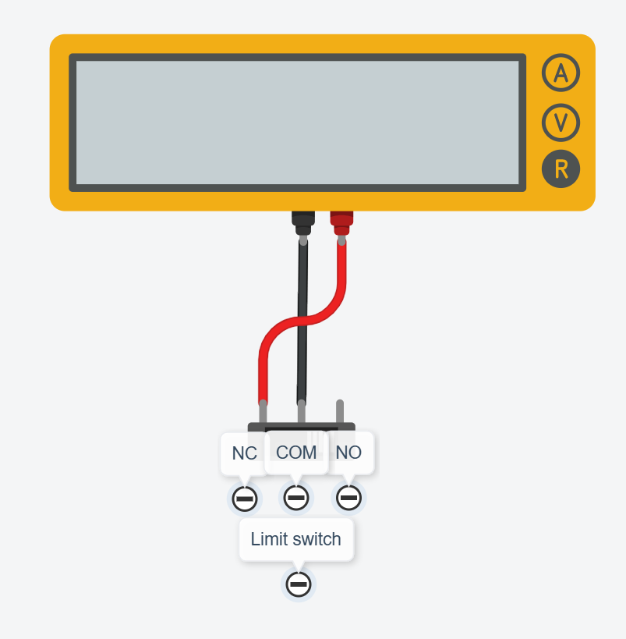
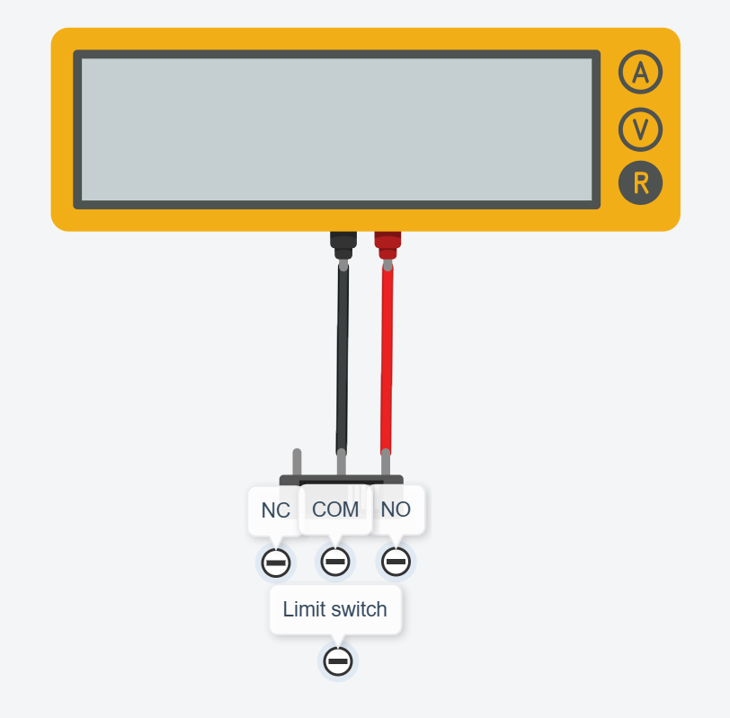
05
Limit switch
Symptoms
Test
The serial monitor flickers between off and on
The robot does not react to the trigger
Set the multimeter to measure low-level resistance
First connect negative to the common terminal and positive to the closed terminal and actuate the switch
Results
  If it reads 0 resistance, it is working
Then connect negative to the common terminal and positive to the open terminal
Results
  If it reads a nonzero resistance, it is working
Group 7
Robotic Project
April/2025

Slide 7
Thank you

