Slide 1
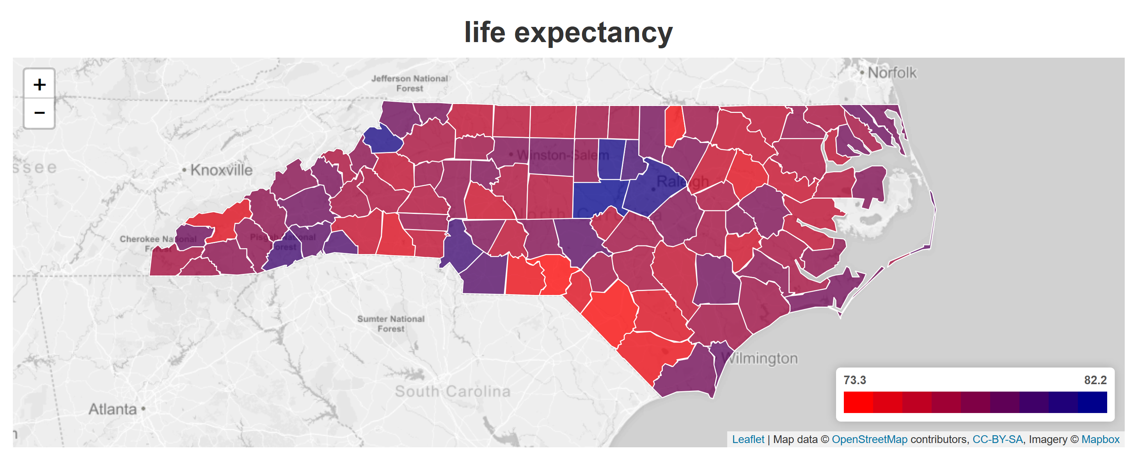
Choropleth Maps of NC Counties

Slide 2
Project Procedure
Jupyter / Python
DATA PREP
Flask App
DISPLAY
Postgres
Project 3
SQLAlchemy
SQLAlchemy
Flask APP
Python: Flask, SQLAlchemy
HTML/CSS: Bootstrap
JavaScript: D3, mapbox, leaflet.js, plotly.js
DATA

Slide 3
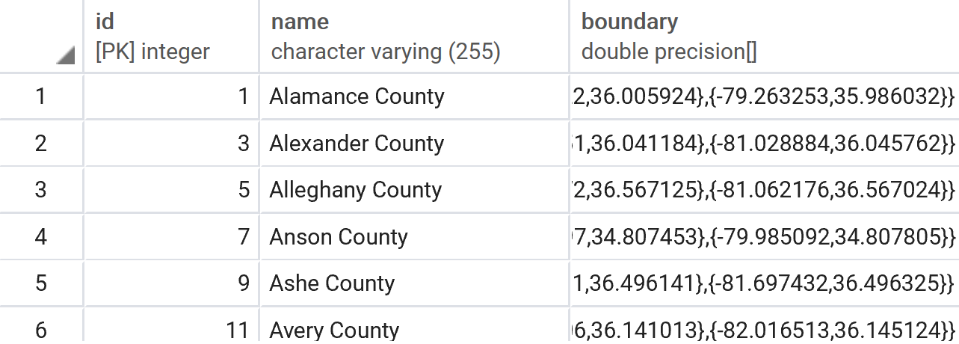
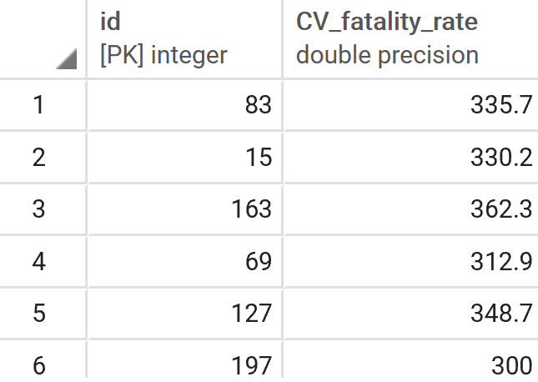
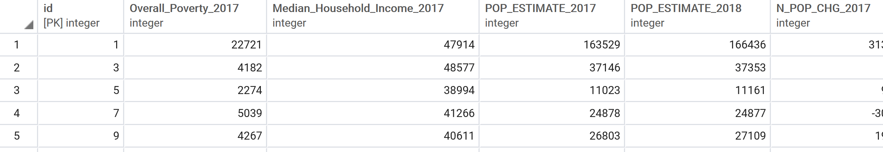
Project3 DB Tables

Slide 4

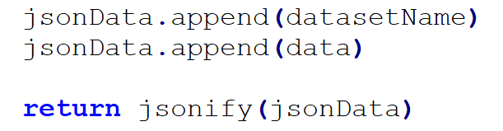
Dataset Selection
URL Converter

Slide 5
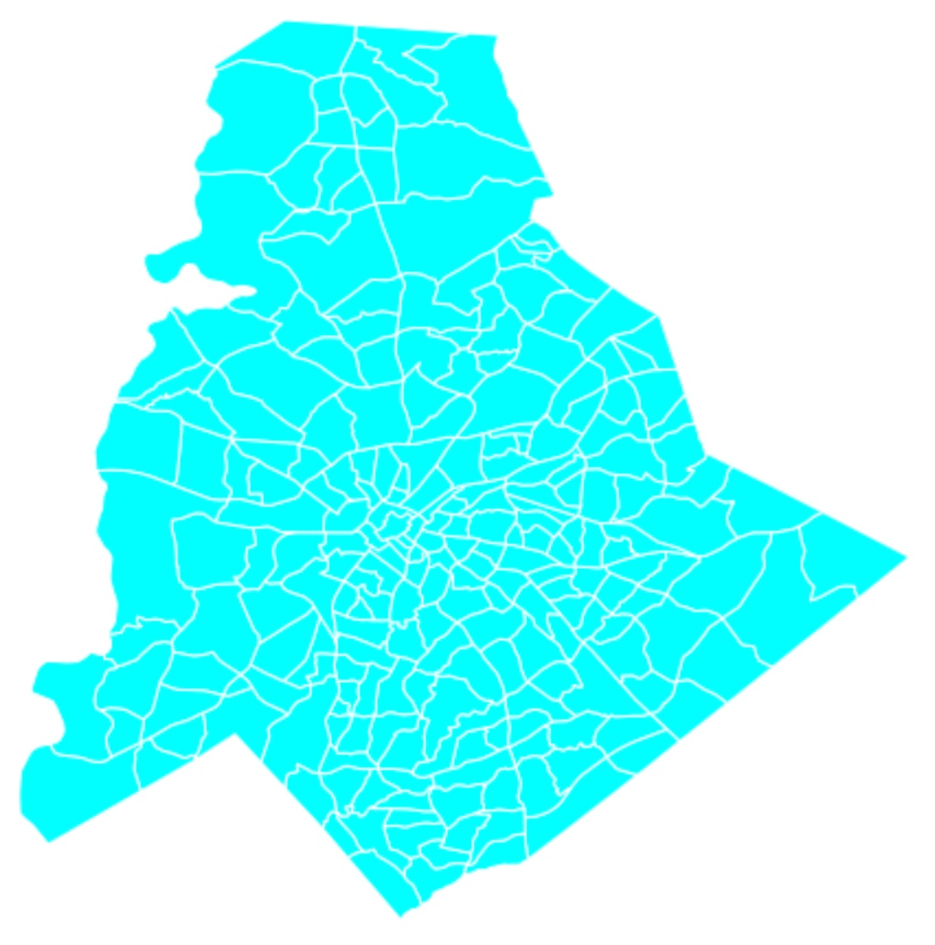
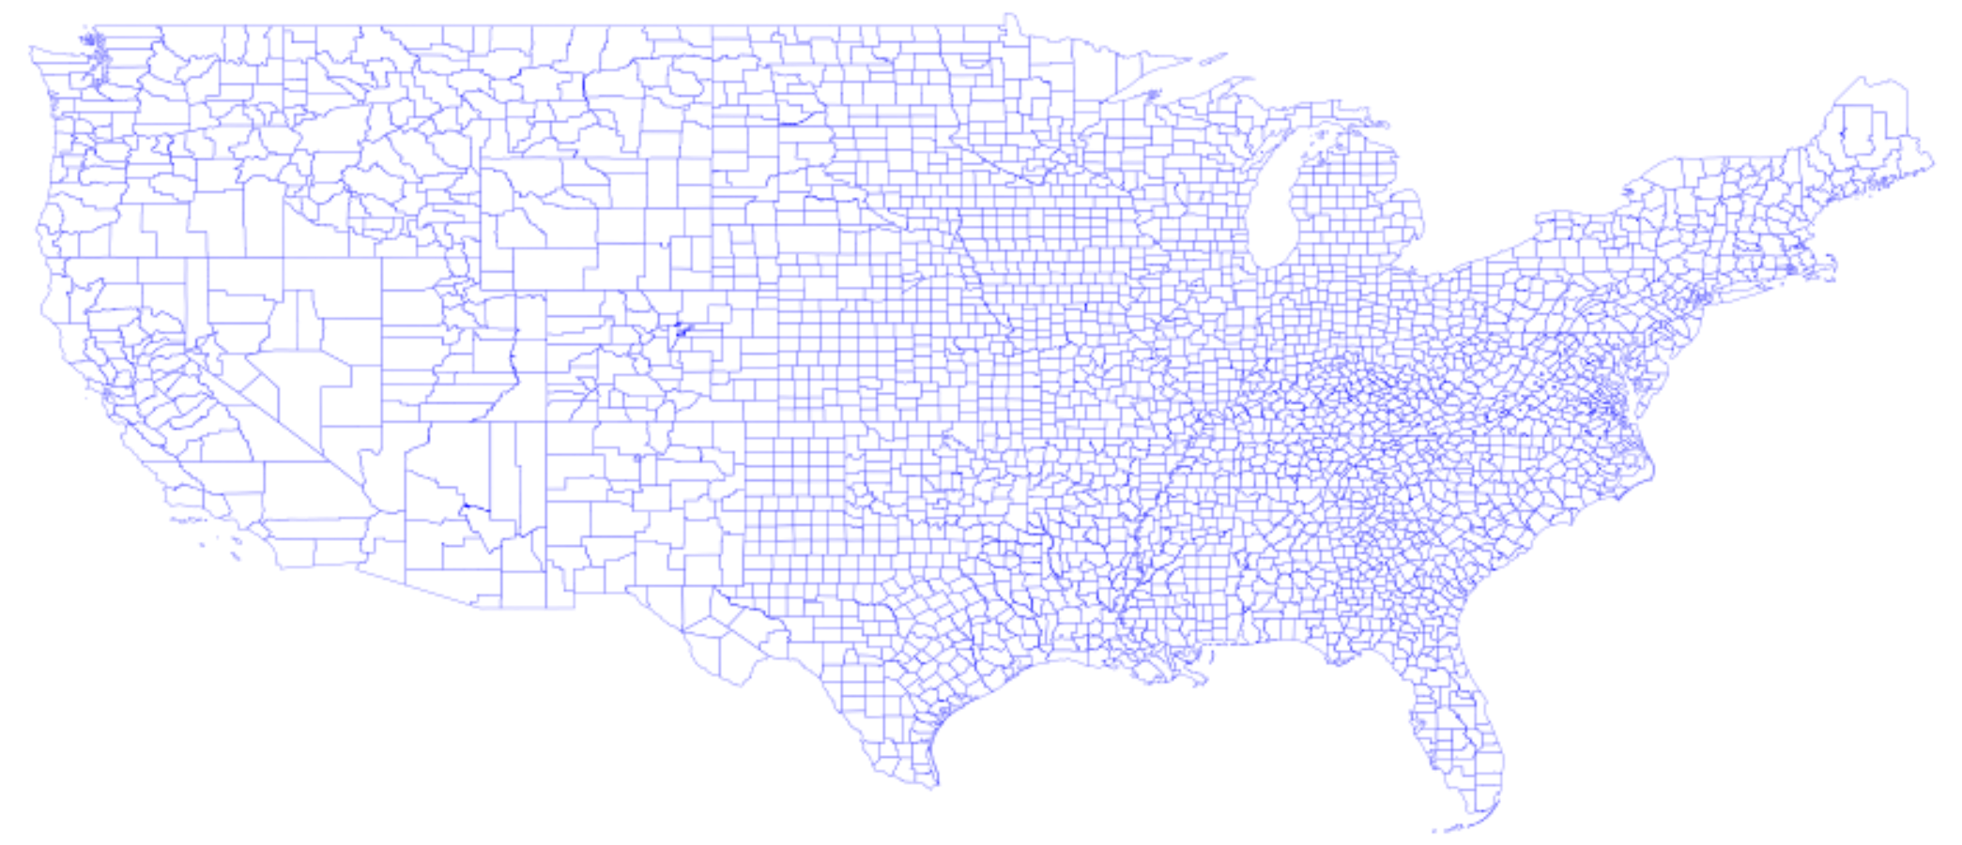
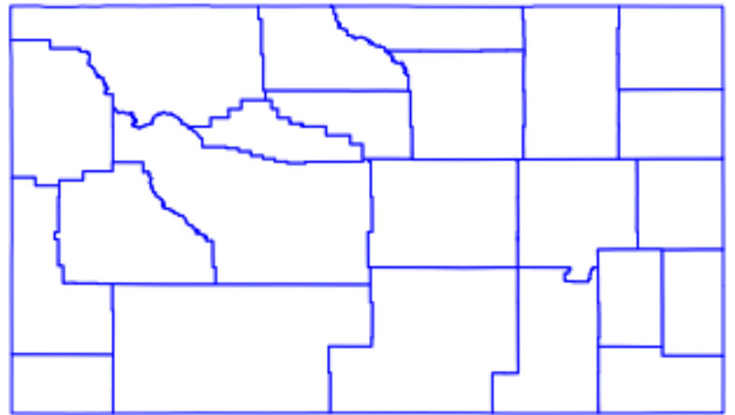
Future Work

