Slide 1
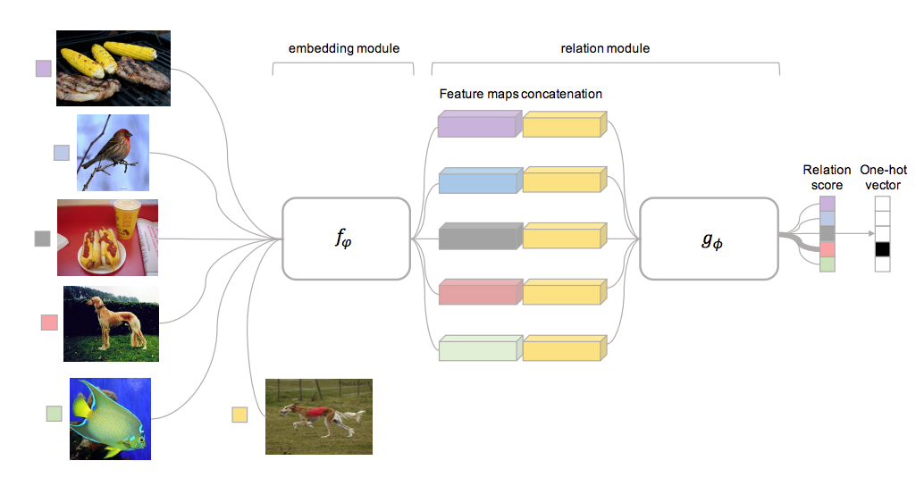
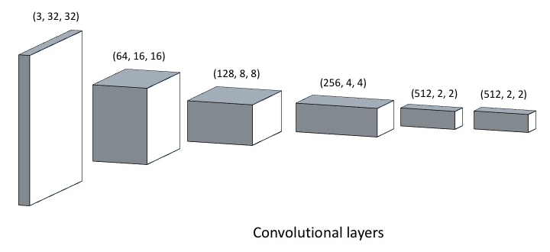
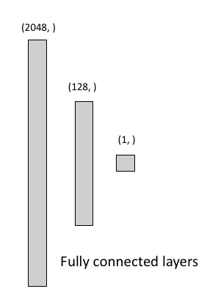
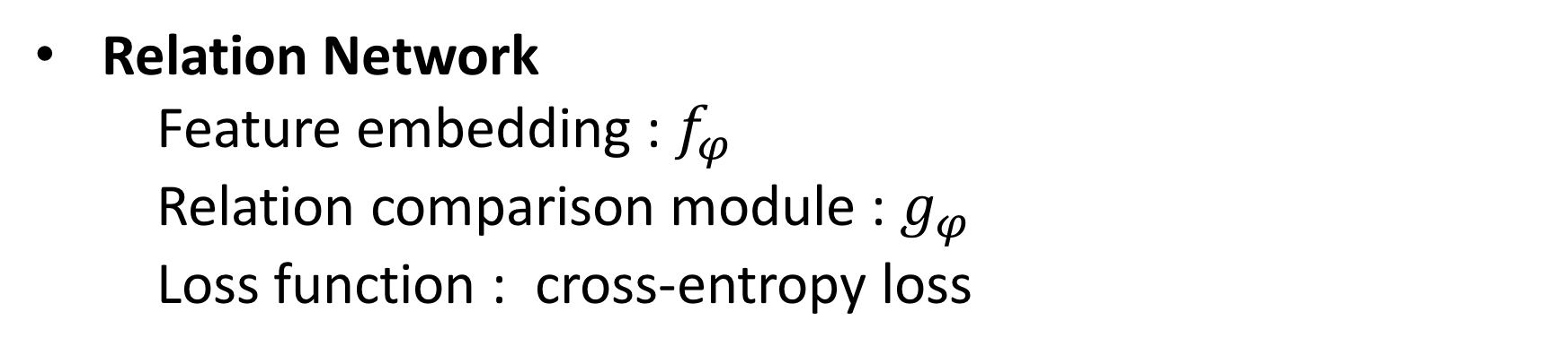
Few-Shot Learning on Cifar-100 Group 14: Hung Cheng, Hsin-Yu Tsai, Chi-Jui Ho, Jing-Cheng Chang 2018.07.04
Abstract
Goal 1/5/10 shot learning on Cifar-100
Dataset 80 base class: 500/100 for train/test
20 novel class: k-shot images/2000 for train/test
Approach Siamese Neural Network [1], Relation Network [2]
Approach
Siamese Neural Network
Traditional version
Feature extractor : 5 convolutional layers
Classifier :
Input : L1 distance of the 2 feature vector
Output : 2 fully connected layer, sigmoid
Loss function : binary cross-entropy
Learn to tell whether 2 images are from same classes
Relation Network
Feature embedding : $f_{φ}$
Relation comparison module : $g_{φ}$
Loss function : cross-entropy loss
Our version
Structure is similar to traditional version.
Alternatives : concatenate 2 feature vector, add CNN
layer to obtain new relation between 2
feature vector
A more effective way to evaluate the correlation.
Random sample 20 classes from 80 base classes, each pick k images to stimulate few shot learning.
The model will learn how to compare with 2 feature vector, fix a support set and pick k query image(s) to obtain relations between support set and decide which class has the highest relation score.
Experiment
Siamese Neural Network
Comparison accuracy between 1/5/10 shot training
Relation Network
Comparison accuracy between 1/5/10 shot training
number of query images equals to k
 | 1-shot | 5-shot | 10-shot
accuracy | 0.3555 | 0.4980 | 0.5280
 | 1-shot | 5-shot | 10-shot
accuracy | - | 0.42050 | -
With/Without Sigmoid at feature extractor output
40 base classes
Accuracy progress compare with validation
50 validation episodes
5-shot | with Sigmoid | without Sigmoid
accuracy | 0.2980 | 0.3420
 | 1-shot | 5-shot | 10-shot
validation | - | 0.4430 | -
test | - | 0.4205 | -
Accuracy progress along the augmentation of data pool
classes | 20 classes | 40 classes | 60 classes | 80 classes
accuracy | 0.2740 | 0.3795 | 0.4330 | 0.4465
With/Without fine tune (without data augmentation)
With/Without fine tune
5-shot | without fine tune | with fine tune
accuracy | 0.2930 | 0.41150
5-shot | without fine tune | with fine tune
accuracy | 0.4390 | 0.4910
Data augmentation (without fine tune)
Random horizontal/vertical flip, random rotate angle < 15
Comparison between traditional method and ours
5-shot | without augmentation | with augmentation
accuracy | 0.4115 | 0.4205
Accuracy | Traditional method | Our method
validation | 0.8070 | 0.8210
test | 0.4205 | 0.3900
Reference
[1] Siamese Neural Networks for One-shot Image Recognition, Koch et al., ICML’ 15 workshop
[2] Learning to Compare: Relation Network for Few-Shot Learning, Sung et al., CVPR’18
[3] Low-shot Visual Recognition by Shrinking and Hallucinating Features, Hariharan et al., ICCV’17

