Slide 1
GPU Implementation of Order-Independent Pixel-based Texture Synthesis
Jieru Hu
ME 759 Final Project

Slide 2
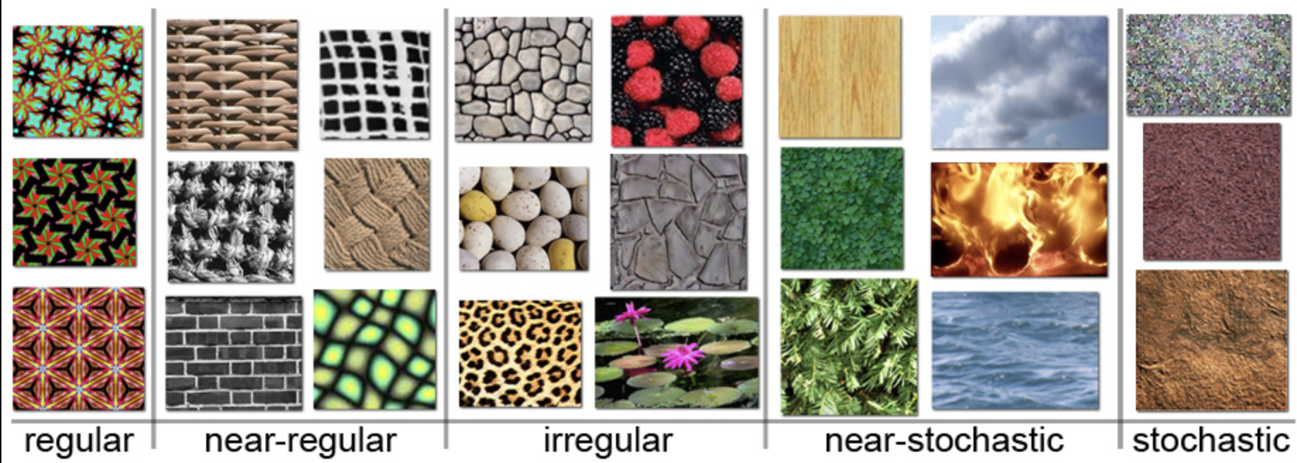
What is Texture Synthesis ?
Texture synthesis is the process of algorithmically constructing a large digital image from a small digital sample image by taking advantage of its structural content. It is an object of research in computer graphics and is used in many fields, amongst others digital image editing, 3D computer graphics and post-production of films. (https://en.wikipedia.org/wiki/Texture_synthesis)
Figure 1. Different kinds of textures from the nature.

Slide 3
Motivation Behind
When I was a junior undergraduate student, I did an independent study in the Spatial Automation Lab in Mechanical Engineering Department under supervision of Professor Vadim Shapiro and his phd student Xingchen Liu.
A slow CPU-based implementation was implemented at that time under guidance. A stronger and more efficient GPU solution is highly advised.
After learning CUDA in 759, I would like to implement a GPU-based solution for the problem and see how much speedup I can gain.

Slide 4
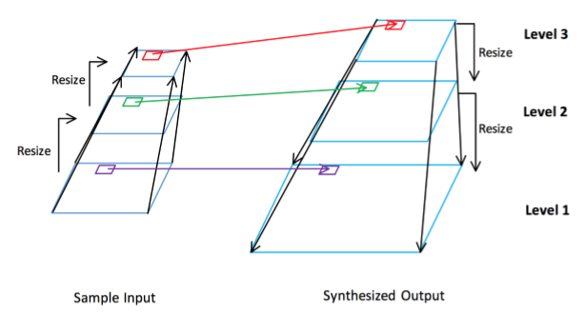
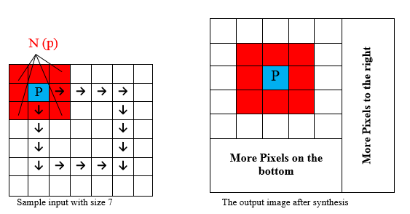
CPU-Based Sequential Implementation
The Order-independent algorithm improves the quality of the algorithm’s generated output by operating the synthesis through multiresolution pyramids.
The multiresolution strategy allows a bottom-up, hierarchical representation of images, through which we are able to filter and extract features of convoluted images and apply them to the consecutive output.
On each pyramid level, we choose pixels for the synthesis from the input pixels in the sample that share the highest neighborhood resemblance.
Figure 2. A three-level pyramid level synthesis, with the synthesis proceeding with decreasing order.
Figure 3. Pixel sampling from the input with sample size of 7 and neighborhood size of 3.

Slide 5
Limitation of CPU Solution
The efficiency of CPU implementation is low since the pixel sampling, SSD calculation and selection takes extremely long time, since all the target pixels are operated through a scan-line order, and there are several iterations of thousands of pixels calculations on each level.
It takes 30 minutes to produce a 400*400 pixel output texture from a 100*100 input pixel.

Slide 6
GPU-Based Implementation
Characteristic of CUDA Program
Texture Synthesis Solution
SIMD (Single Instruction Multiple Data)
Shared Memory for increased data access speed within block
Avoid transferring data across host and device
Designate each thread to perform an independent pixel SSD calculation and selection
Cached the input candidate pixels in the shared memory since they are access repeated by all threads during synthesis
Implement kernel functions for random noise initialization, texture bilinear rescaling, box filtering on device

Slide 7
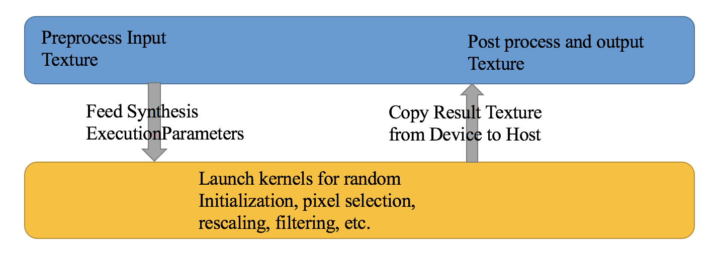
GPU-Based Implementation
CPU: Apply OpenCV for pre-processing and post-processing of the texture image
GPU: Responsible for launching different kernels on device for texture synthesis
Figure 4. Working flow of the GPU synthesis implementation

Slide 8
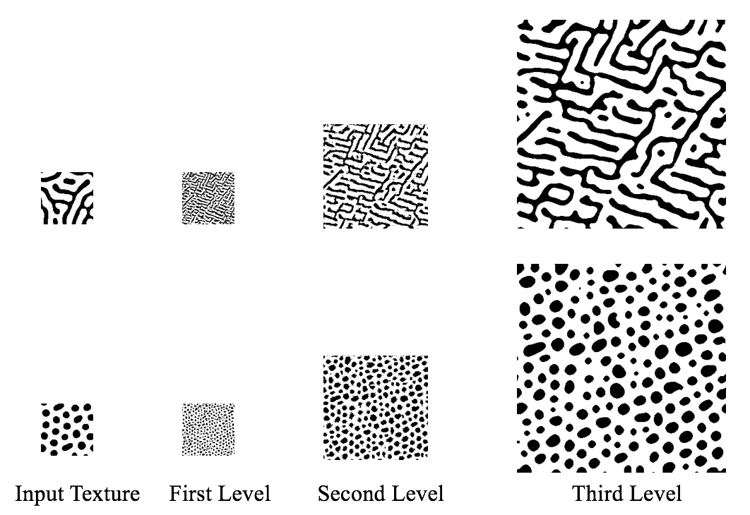
Result Texture
Figure 5. Texture synthesis results after three levels of GPU implementation

Slide 9
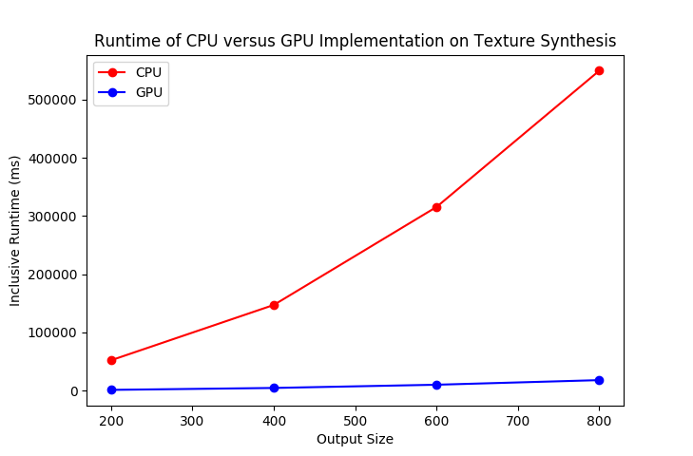
CPU VS GPU Implementation Timing Comparison
Figure 6. Runtime comparison between GPU and CPU implementation of synthesis

Slide 10
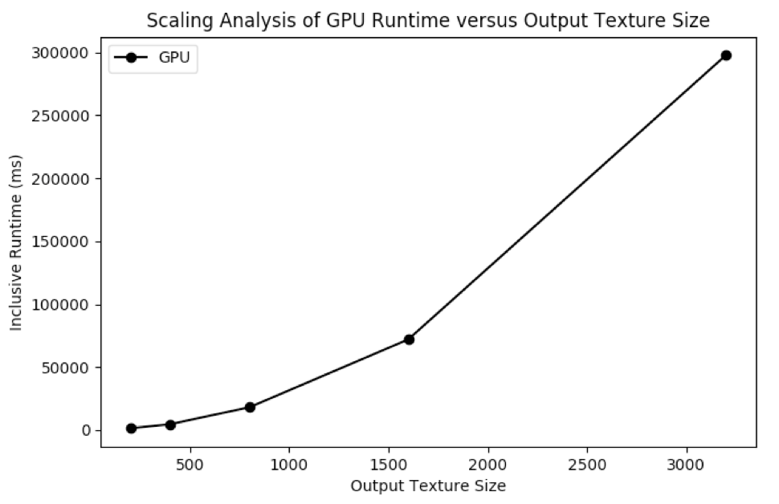
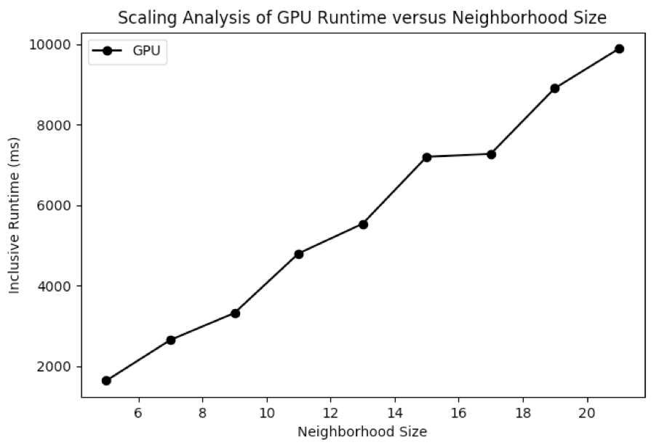
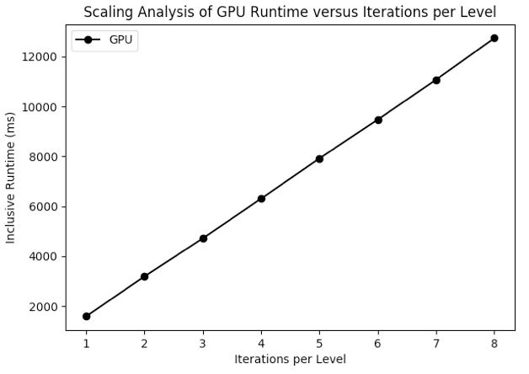
GPU-Based Implementation Scaling Analysis
Figure 7. Scaling Analysis of GPU Runtime versus Output Size
Figure 8. Scaling Analysis of Runtime versus neighborhood Size
Figure 9. Scaling Analysis of Runtime versus Iterations per Level

Slide 11
Thanks for the semester

