Slide 1
Enhanced Memory Properties in MIS TD by Forming Trench Structure at the Gate Edge
Presenter: Jian-Yu Lin¹
Jian-Yu Lin^{1*} , Jenn-Gwo Hwu^{1, 2}
Graduate Institute of Electronics Engineering,
Department of Electrical Engineering, National Taiwan University, Taipei , Taiwan
Notes:
Good morning everyone, my name is Jian-Yu Lin, from Nation Taiwan University. Today I’m going to talk about my research topic: “Enhanced Memory Properties in MIS TD by Forming Trench Structure at the Gate Edge”

Slide 2
Outline
Introduction
Metal-Insulator-Semiconductor (MIS) Tunnel Diode (TD)
Memory Properties of MIS-TD
Device Structure and Fabrication
Results and Discussion
Conclusion
Notes:
Here is my outline , first I will have a brief introduction of the physics and structure of Metal-insulator-semiconductor tunnel diode.
And its memory characteristics.
And then the fabrication process of my devices
followed by results and discussion
finally conclusion.

Slide 3
Outline
Introduction
Metal-Insulator-Semiconductor (MIS) Tunnel Diode (TD)
Memory Properties of MIS-TD
Device Structure and Fabrication
Results and Discussion
Conclusion

Slide 4
What is MIS Tunnel Diode?
MIS tunnel diode (TD)
MOS capacitor
V_{G}
oxide thickness < 4 nm
Al
SiO₂
SiO₂
Direct
tunneling current
Si (p)
Al
Diode-like I-V curve.
Notes:
MIS-TD is similar to Mos capacitor, except the oxide thickness is much more thinner so the electrons can directly tunnel through the oxide layer.
As a result, when we measure the I-V curve, we can get a diode-like I-V curve.
At negative voltage, MIS-TD has a large forward bias current
At positive voltage, MIS-TD has a smaller reverse bias saturation current

Slide 5
MIS Tunnel Diode (Reverse Bias)
At reverse bias
V_{G}>0
Al
SiO₂
Si (p)
depletion region
Al
current flow
fringing field
Fringing electric field > bulk electric field.
Saturation current mainly flow through gate edge.
Notes:
From our previous research, we know that at the reverse bias region the fringing electric field is larger than bulk electric field in MIS-TD.
Consequently, reverse bias saturation current mainly flow through device edge.
By utilizing this edge flowing saturation current And MIS-TDs have many applications such as
temperature sensor, light sensor and it also can be used as a memory device
-> so in the next page I will talk about how this MIS TD memory work.

Slide 6
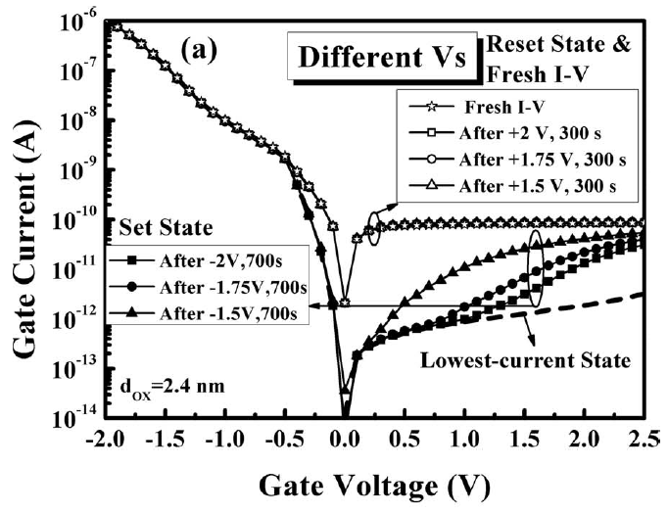
Memory Properties of MIS-TD
In previous work:
Apply negative and positive stress to MIS-TD.
Lower and higher current was measured.
2-state current phenomenon.
Potential for memory device use.
Reference: Tzu-Yu Chen et al., “Effect of Electrons Trapping/De-Trapping at Si-SiO2 Interface on Two-State Current in MOS(p) Structure with Ultra-Thin SiO2
by Anodization,“ ECS Journal of Solid State Science and Technology, 2 (9) Q159-Q164, 2013. DOI: 10.1149/2.025309jss
Notes:
also In our previous work, we found that by applying –stress and +stress to the gate of the MIS TD,
we can manipulate the saturation current to 2 different levels, shown in the right figure -> which shows 2-state current characteristic .
This implies that MIS TD has the potential for memory device use

Slide 7
In this work…
New structure of MIS-TD is proposed.
Conventional: Planar MIS
New Structure: Trench MIS
V_{G}
V_{G}
Al
Al
SiO₂
SiO₂
Al₂O₃
Si (p)
Si (p)
Al
Al
better memory properties.
Notes:
In this work, we propose a new structure of MIS-TD, called Trench MIS.
Compared with conventional planar MIS structure, Trench MIS has a better memory properties.

Slide 8
In this work…
Current
Window
Trench MIS TDs have better memory properties.
more obvious 2-state current.
10 times larger current window.
2-state current
Current
Window
Current Window (CW)=
read current (after “Set”, open)- read current (after “Reset”, solid)
Reset: -1.75V for 20s
Set: +1V for 10s
Notes:
For example: in the following results and discussion section: we will show that endurance test
we read the current @0.2V after SET, RESET stress
the better memory properties means:
obvious 2-state current
10 times larger CW than planar MIS
and the current window is the read current difference between SET and RESET states.
** Planar current window=52 pA
Trench=650 pA

Slide 9
Outline
Introduction
Metal-Insulator-Semiconductor (MIS) Tunnel Diode (TD)
Memory Properties of MIS-TD
Device Structure and Fabrication
Results and Discussion
Conclusion

Slide 10
Device Structure and Fabrication
Top view
Cross section
Planar MIS
Trench MIS
Planar MIS
Trench MIS
V_{G}
V_{G}
85 um
85 um
Al
Al
2.5nm
SiO₂
2.5nm
SiO₂
500nm
Al₂O₃
Al
Al
Si (p)
Si (p)
SiO₂
Al₂O₃
Al
Al
Effective oxide thickness (EOT)=2.5 nm
Notes:
Here shows the top view and the cross section of the planar and trench MIS
And the depth of the trench is about 500nm
The oxide thickness is about 2.5nm

Slide 11
Device Structure and Fabrication
Radio Corporation of America (RCA) clean
Si (p)
p-type (100)-oriented silicon wafers with a resistivity of 1–10 Ω·cm
Notes:
first, we use a p-type silicon wafer as substrate and perform RCA clean

Slide 12
Device Structure and Fabrication
Radio Corporation of America (RCA) clean
Grow SiO₂ by anodic oxidation
SiO₂
Si (p)
Notes:
Grow SiO2 layer by anodic oxidation

Slide 13
Device Structure and Fabrication
Radio Corporation of America (RCA) clean
Grow SiO₂ by anodic oxidation
SiO₂
Rapid thermal annealing (RTA) in N₂ ambient @ 950 °C for 15 s.
Si (p)
Notes:
and RTA

Slide 14
Device Structure and Fabrication
Radio Corporation of America (RCA) clean
Grow SiO₂ by anodic oxidation
Al
SiO₂
Rapid thermal annealing (RTA) in N₂ ambient @ 950 °C for 15 s.
Si (p)
Deposit 200 nm Al by thermal evaporation
Notes:
Then we deposit 200nm Al by thermal evaporation as the top electrode

Slide 15
Device Structure and Fabrication
Circle structure patterned by photolithography
PR
Al
SiO₂
Si (p)
Notes:
After that, we use photolithography to define our pattern

Slide 16
Device Structure and Fabrication
Circle structure patterned by photolithography
Etch Si substrate by reactive ion etch (RIE)
PR
Al
SiO₂
Si (p)
Notes:
then we use PR as mask to perform RIE to form the trench structure.

Slide 17
Device Structure and Fabrication
Circle structure patterned by photolithography
Etch Si substrate by reactive ion etch (RIE)
Form a layer of Al₂O₃ : (1) thermal evaporate Al. (2) dip into nitric acid (HNO₃) to oxidize Al.
PR
Al
Al₂O₃
SiO₂
Si (p)
Al₂O₃ layer:
protect Si substrate from being exposed to air.
Notes:
because after RIE, the Si substrate is exposed to the air
we form a layer of Al2O3 To protect it.
this Al2O3 layer is formed by first evaporate a film of Al, and then oxidize Al by nitric acid.

Slide 18
Device Structure and Fabrication
Circle structure patterned by photolithography
Etch Si substrate by reactive ion etch (RIE)
Form a layer of Al₂O₃ : (1) thermal evaporate Al. (2) dip into nitric acid (HNO₃) to oxidize Al.
PR
Al
SiO₂
Al₂O₃
Si (p)
Lift-off PR
Al₂O₃ layer:
protect Si substrate from being exposed to air.
Notes:
we lift-off the PR

Slide 19
Device Structure and Fabrication
Circle structure patterned by photolithography
Etch Si substrate by reactive ion etch (RIE)
V_{G}
Form a layer of Al₂O₃ : (1) thermal evaporate Al. (2) dip into nitric acid (HNO₃) to oxidize Al.
Al
SiO₂
Al₂O₃
Si (p)
Lift-off PR
Al
removed backside native oxide by buffer oxide etchant (BOE)
Al₂O₃ layer:
protect Si substrate from being exposed to air.
200nm Al formed as back electrode by thermal evaporation
Notes:
At last we form a 200nm Al as back electrode by thermal evaporation after we removed native oxide by BOE

Slide 20
Outline
Introduction
Metal-Insulator-Semiconductor (MIS) Tunnel Diode (TD)
Memory Properties of MIS-TD
Device Structure and Fabrication
Results and Discussion
Conclusion

Slide 21
I-V Curves: After Reset Stress
Reset: V_{G}<0
Reset: V_{G}<0
Al
Al
SiO₂
SiO₂
Al₂O₃
Si (p)
Si (p)
Al
Al
Apply -1.5V for 120s and then -1.75V for 20s to gate as “Reset” stress.
Measure I-V from -0.5V~0.5V (solid symbol).
Notes:
At the beginning, we measure the I-V curves after Reset and Set stress.
we first apply negative voltage stress to the gate, which was used as RESET stress
and then we measure the I-V curve sweep from -0.5V~0.5V

Slide 22
I-V Curves: After Set Stress
Set: V_{G}>0
Set: V_{G}>0
Al
Al
SiO₂
SiO₂
Al₂O₃
Si (p)
Si (p)
Al
Al
Apply +1V for 20s to gate as “Set” stress.
Measure I-V from +0.5V~-0.5V (open symbol).
Notes:
After that, we apply positive stress to both planar and trench, which was used as SET stress
then measure current sweep from +0.5V~-0.5V as shown in the figure as open symbol.

Slide 23
I-V Curves: 2-state Current
V_{read}=0.2V
V_{read}=0.2V
Al
Al
SiO₂
SiO₂
Al₂O₃
Si (p)
Si (p)
Al
Al
Trench MIS has a more obvious 2- state current phenomenon.
Notes:
So in this figure, we can see Trench shows a more obvious 2-state current than planar,
which can be seen in the current difference of solid and open symbol @0.2V.

Slide 24
Memory Endurance Measurement
3 endurance measurements with different “set stress”.
same reset stress.
read @V_{G}=0.2V
each 50 cycles.
Notes:
To Further examine the memory characteristics we measured 3 endurance tests.
For example: 1st endurance....

Slide 25
Memory Endurance Results
Reset (solid), Set (open).
Trench MIS:
stabler multi-level memory function.
larger current window.
Current Window=
read current (after “Set”, open)- read current (after “Reset”, solid)
Notes:
3 endurance test are shown in this figure.
x-coordinate represent cycles number
y-coordinate represent read current @0.2V
under different stresses conditions: Trench MIS 4 different stable current levels compared with planar MIS
-> which shows trench MIS has multi-level memory function.
besides, Trench MIS has a larger current window (red solid and open sample)

Slide 26
Electron Traps Mechanism: Reset
Reset (-1.75V 20s), then Read “0”
V_{read} =0.2V
Reset: trap electrons
Al
Al₂O₃
Al
e⁻
SiO₂
depletion region
Si (p)
current flow
electron flow
fringing field
Electrons trap in Al₂O₃/SiO₂ interface and SiO₂ layer.
Notes:
At the end, we propose a electron trap mechanism to explain why trench MIS has better memory properties.
first, we start from RESET stress operation:
RESET traps electrons into the interface @the trench edge and SiO2 layer
when we later read@0.2V, the electron appeal by the gate will see repulsive coulomb force stopping them from approaching gate.
As a result, less electron can tunnel through gate and read current is small
.

Slide 27
Electron Traps Mechanism: Set
Set (+1V 10s), then Read “3”
V_{G} =0.2V
Set: detrap electrons
Al
Al
SiO₂
e⁻
depletion region
Si (p)
current flow
electron flow
Trench structure offers extra electron traps.
Better memory properties.
fringing field
Notes:
Then, we apply SET stress operation:
which detraps electrons in the interface @the trench edge and SiO2 layer
repulsive coulomb force is smaller
As a result, more electron can tunnel through gate and read current is high
So why trench MIS has better memory properties is because it has more electron traps located @ trench edge.
Thus, can results a bigger change in coulomb force and thus bigger change in read current.

Slide 28
Outline
Introduction
Metal-Insulator-Semiconductor (MIS) Tunnel Diode (TD)
Memory Properties of MIS-TD
Device Structure and Fabrication
Results and Discussion
Conclusion

Slide 29
Conclusion
In this work, a new structure of MIS TD, trench MIS TD, is proposed.
Trench MIS TDs have better memory properties than planar MIS TD.
Electron trap mechanism : more electron traps offered by trench structure.
However, we still need more study to verify this mechanism.

Slide 30
Thank you for listening !

Slide 31
Q&A

Slide 32
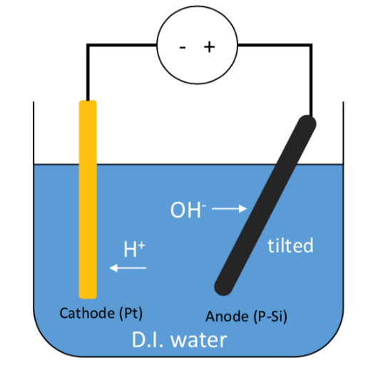
Anodic Oxidation (ANO)
Can be performed in room temperature, then RTA.
Uniform oxide layer.
Si²⁺ +2e⁻ +2H₂O →SiO₂+2H₂

Slide 33
Functions of Al₂O₃ Layer
Functions of this layer:
protect Si substrate from moisture and air.
provide electron traps in Al₂O₃/Si interface.
V_{G}
Al
SiO₂
e⁻
Al₂O₃
Si (p)
Al

Slide 34
Uniformity of Al₂O₃ layer
V_{G}
Evaporated Al oxidized by nitric acid.
The Al₂O₃ layer is non-uniform:
may influence the moisture and air protection.
Solutions (different ways to form sidewall):
Al₂O₃ sidewall: by sputter Al target in Ar/O₂ ambient.
SiO₂ sidewall: by anodic oxidation.
Al
SiO₂
Al₂O₃
Si (p)
Al
V_{G}
Al
SiO₂
2nd ANO SiO₂
Si (p)
Al
Notes:
some part of the al oxide sidewall is too thin to protect the Si substrate from moisture and air.
So recently we tried to solve this problem by using different ways to form the sidewall

Slide 35
Quality of Al₂O₃ Layer
Purpose of this layer: protect Si substrate from moisture and air.
Prototype trench MIS (native oxide)
trench MIS in this work
V_{G}
V_{G}
Al
Al
SiO₂
SiO₂
Al₂O₃
native oxide
Si (p)
Si (p)
Al
Al
Current window easily degrades.
might because the instability of native oxide.
Current window is more stable.
Acceptable quality of Al₂O₃ Layer.
but can be improved.

Slide 36
Further Verification of the Mechanism
Top view:
V_{G}
Al
SiO₂
Al₂O₃
Al
Al
Si (p)
Al
Trench structure offers electron traps at gate edge
More edge (by different mask pattern design).
Better current window.

Slide 37
Improvement of Stress Time
Currently, the “Reset” and “Set” stress time is still too long (>1s)
Possible ways to improve:
increase the edge of the pattern under the same footprint.
increase the depth of the trench structure.
∵ more edge or more trench → more electron traps.
V_{G}
Al
SiO₂
Al
500nm
Si (p)
Al₂O₃
Al

