Slide 1


Dependency of Transient Current Behavior on Oxide Thickness in Trench Structure MIS TDs
Jian-Yu Lin^{1*} , Jenn-Gwo Hwu^{1, 2}
Graduate Institute of Electronics Engineering,
Department of Electrical Engineering, National Taiwan University, Taipei , Taiwan
Presenter: Jian-Yu Lin
*Acknowledgement: this work was supported by the Ministry of Science and Technology of Taiwan under Contracts MOST 110-2221-E-002-140 and 110-2622-8-002-014
Notes:
Good morning everyone, my name is Jian-Yu Lin, from Nation Taiwan University. Today I’m going to talk about “Dependency of Transient Current Behavior on Oxide Thickness in Trench Structure MIS TDs”
注意”So”語助詞

Slide 2
Outline
Introduction
Metal-Insulator-Semiconductor Tunnel Diode (MIS TD)
Transient Current in MIS TDs
Results and Discussion
Experiments
TCAD Simulation
Conclusion
Notes:
Here is my outline , first I will have a brief introduction about what is Metal-insulator-semiconductor tunnel diode and the transient current in this kind of device.
Second part is the results and discussion
followed by the conclusion.

Slide 3
Outline
Introduction
Metal-Insulator-Semiconductor Tunnel Diode (MIS TD)
Transient Current in MIS TDs
Results and Discussion
Experiments
TCAD Simulation
Conclusion

Slide 4
What is MIS TD?
*Metal-insulator-semiconductor tunnel diode (MIS TD)
MIS tunnel diode (TD)
MOS capacitor
Direct
tunneling current
V_{G}
oxide thickness
< 4 nm
Al
SiO₂
SiO₂
Si (p)
Al
Diode-like I–V curve.
V_{G} < 0: forward bias region.
V_{G} > 0: reverse bias region.
*Metal-Insulator-Semiconductor (MIS)
Notes:
MIS TD is an abbreviation for Metal-insulator-semiconductor tunnel diode (MIS TD).
it has almost the same device structure as MOS capacitor does.
Except, MIS TD has a thinner oxide thickness (usually smaller than 4 nm)
This allows MIS TD to have a large direct tunneling current.
So when we measure the I-V curves of the device, we can get a diode like I-V.

Slide 5
What is MIS TD?
*Metal-insulator-semiconductor tunnel diode (MIS TD)
MIS tunnel diode (TD)
Direct
tunneling current
V_{G}
oxide thickness
< 4 nm
Al
SiO₂
Si (p)
Al
Diode-like I–V curve.
V_{G} < 0: forward bias region.
V_{G} > 0: reverse bias region.
*Metal-Insulator-Semiconductor (MIS)
Notes:
MIS TD is an abbreviation for Metal-insulator-semiconductor tunnel diode (MIS TD).
it has almost the same device structure as MOS capacitor does.
Except, MIS TD has a thinner oxide thickness (usually smaller than 4 nm)
This allows MIS TD to have a large direct tunneling current.
So when we measure the I-V curves of the device, we can get a diode like I-V.

Slide 6
Transient Current in MIS TDs
Trench structure MIS (Trench MIS)
New special structure
Planar structure MIS (Planar MIS)
Normal structure
Trench MIS TDs
I-V more obvious hysteresis.
Stronger transient current.
J. -Y. Lin and J. -G. Hwu, IEEE Transactions on Electron Devices 68, 4189-4194 (2021)
Notes:
So our group has done a lot of research about MIS TDs.
And one of the research is the transient current in MIS TDs.
For example, in our previous work, we propose a new structure for MIS TDs. called Trench MIS.
Compared with normal structure MIS, in here we called it Planar MIS,
Trench MIS demonstrate a stronger transient current.
To elaborate, please look at this I-V curves.
If you focus on low voltage region.
For trench MIS (red lines), you can see the sweep forward and backward…….hysteresis
This indicate stronger transient current in Trench MIS.

Slide 7
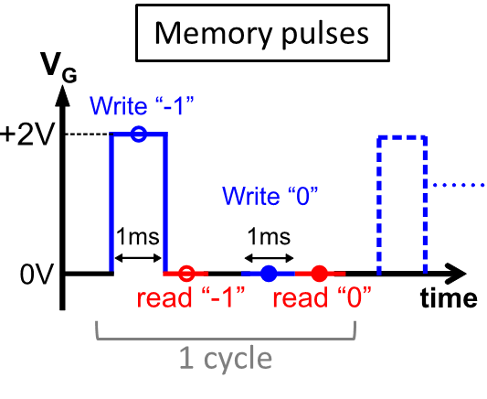
Transient Current in MIS TDs (cont.)
Endurance Property
Transient current behavior
Store two memory states.
Trench MIS TDs:
potential for memory devices.
J. -Y. Lin and J. -G. Hwu, IEEE Transactions on Electron Devices 68, 4189-4194 (2021)
Notes:
In the same research, we demonstrated that this transient current can be used to store two different memory states.
And because of this
Trench MIS has the potential to be used as Memory devices

Slide 8
In This Work…
Trench structure MIS (Trench MIS)
Different d_{ox}
Experiment
Investigate the dependency of
transient current.
on the tunneling oxide thickness (d_{ox})
Notes:
So in this work
we follow up the previous research in Trench MIS
we further investigate the dependency of transient current on the oxide thickness using exp. and simulation.
We believe this work can deepen our understanding about the transient current of Trench MIS devices.

Slide 9
Outline
Introduction
Metal-Insulator-Semiconductor Tunnel Diode (MIS TD)
Transient Current in MIS TDs
Results and Discussion
Experiments
TCAD Simulation
Conclusion
Notes:
now we come to the first experiments part in the results and discussion

Slide 10
Device Structure
*Detailed fabrication process can be found in IEEE Transactions on Electron Devices 68, 4189-4194 (2021)
Notes:
Here shows the top view and the cross section of the planar and trench MIS.
Detailed fabrication process can be found in our previous work.

Slide 11
I-V Curves with Different d_{ox}
d_{ox} ⬆
d_{ox} ⬆
For Trench MIS, when d_{ox} ↑
more apparent hysteresis.
stronger transient current.
Notes:
At the beginning, I want to first talk about the I-V curves with different dox
left figure show Planar with not transient current.
On the other hand, the right figure show the Trench MIS.
If we look at the color region,
when the dox thicker, transient current become stronger.

Slide 12
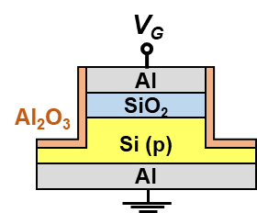
Memory Retention Measurement
Memory pulses
d_{ox}
Solid: read “-1”.
For Trench MIS, when d_{ox} ↑
Stronger transient current ( i.e. |read “-1” current| ↑).
Where does “transient current” come from?
Notes:
This trend can be also observed in the memory retention property.
Apply memory pulses to the gate of MIS TD.
first is the write “-1” operation, which apply 2V for 1ms to the gate of the device.
And at read “-1” operation, we quickly switch the Vg to 0 V and read the gate current
Write 0, we apply a 0V to the gate, followed by read “0” operation to read the gate current.
See the right retention measurment. y-axis represent the read current.
horizontal axis represent time.
In this figure we can notice that read “0” signal are all close to 0 current line, so we can barely see the open symbol.
However, the read “-1” transient current would increase with oxide thickness.
In order to fully explain this trend, I have to first talk about where…

Slide 13
The Origin of Read “-1” Transient Current
*solid arrows: current flow
Write “–1” (V_{G}=2V)
Read “–1” (V_{G}=0V)
d_{ox}
*n_{inv} : inversion carriers
*n_{excess} : excess electrons
*n_{excess} ≈ n_{inv} (@V_{G} = +2V) – n_{inv} (@V_{G} = 0V)
I_{read “–1”} = (| I_{e (T)} |+| I_{h (T)} |) – (| I_{e (D)} |+| I_{h (D)} |)
⇒
| read “-1” current | ∝ n_{excess} ∝ n_{inv} (@V_{G}=2V)
Notes:
First look at this band diagram of trench MIS。
This shows what happens when we apply a write “-1” pulse to the device.
As you can see, the 2 V Vg will attract inversion carriers to the interface.
After that gate voltage was quickly switch to 0 V to read the gate current.
Because the switching from 2V to 0V is so quick that the ninv attracted by 2 V gate voltage
don’t have time to be recombined or repelled at the beginning of read “-1” condition.
These inversion charges will become excess electrons, nexcess,
and cause the whole device under non-equilibrium state.
To return to equilibrium, the number of nexcess has to decrease.
So the process of nexcess decrease creates the transient current we observe in the left side retention figure.
To sum up, we can write down this relation
since the read “-1” current comes from the nexcess
it should be proportional to nexcess.
and the nexcess is proportional to the ninv @ 2V。

Slide 14
d_{ox} and Transient Current
| read “-1” current | ∝ n_{excess} ∝ n_{inv} (@V_{G}=2V)
2.6 nm (thin)
3.05 nm (thick)
n_{inv, 1} ↓
n_{inv, 2} ↑
P_{t, 1} ↑
P_{t, 2} ↓
−
−
−
−
−
−
−
−
−
−
+2V
+2V
n_{excess, 1} ↓
n_{excess, 2} ↑
d_{ox}
Al
SiO₂
Si (p)
tunneling probability (P_{t})
P_{t, 1} > P_{t, 2}
n_{inv, 1} < n_{inv, 2}
n_{excess, 1} < n_{excess, 2}
| read “-1” | ₁ < | read “-1” | ₂
Notes:
Using this relation, we can now came back to explain the dox and read “-1” current relation.
Please look at the right-side band diagram.
For thick oxide sample, because the device will have smaller oxide tunneling probability Pt
At 2 V, thick oxide device can accumulate more ninv, and also more nexcess.
And because read “-1” current is proportional to nexcess, thick oxide device should have stronger transient current.

Slide 15
Outline
Introduction
Metal-Insulator-Semiconductor Tunnel Diode (MIS TD)
Transient Current in MIS TDs
Results and Discussion
Experiments
TCAD Simulation
Conclusion

Slide 16
Silvaco TCAD Simulation Setting
Fig. Simulated structure of Trench MIS.
TCAD Simulation
Two trends of d_{ox} — transient current
d_{ox} = 2.5 ~ 3 nm
d_{ox} ↑, |read “-1” current| ↑.
d_{ox} > 3 nm (simulation)
d_{ox} ↑, |read “-1” current| ↓.
Fig. Silvaco TCAD simulation process.
Notes:
Top figure show the simulated device structure.
bottom figure show the simulation process.
Basically, we simulated write “-1” to read “-1” operations.
And the simulated results are shown on the right-side.
y-axis…x-axis
if you give a closer look at this figure, you can notice there are two different trends of dox-transient current
in here, I mark with two different colors.
in yellow part, the transient current increase with dox
However, when dox become too thick, in the green region,
we can notice the transient current will start to decrease.
So in order to explain these two trends,
in the following, I will split this figure into two different parts to discuss about it.
at first, I want to talk about the yellow part
不能解釋兩區差異

Slide 17
Simulated Retention: Part 1
Trench MIS TDs
d_{ox}
d_{ox}
TCAD Simulation
Experiment
d_{ox} = 2.5 ~ 3 nm
d_{ox} ↑, |read “-1” current| ↑.
d_{ox} ↑ » n_{excess} ↑ » |read “-1” current| ↑
Notes:
The first part….
the trend align well with our previous experiment results on the right side
And in the previous part, we argue that this is because dox increase, nexcess will increase……
So now we are going to use TCAD to prove that when doX increase, the nexcess will increase too.

Slide 18
Simulated Retention: Part 1
n_{excess} at t= 1.35 ms (simulation)
d_{ox}
TCAD Simulation
d_{ox} ↑
P_{t} ↓
n_{inv} ↑
n_{excess} ↑
d_{ox} = 2.5 ~ 3 nm
d_{ox} ↑, |read “-1” current| ↑.
*d_{ox} ↑ » n_{excess} ↑ » |read “-1” current| ↑
Notes:
I draw the simulated nexcess into two contour plots, shown on the right.
You can notice when the dox increase, nexcess increase too
according to our explanation in the experimental part.
This is because…..
This leads to the larger transient current observed in the simulation results.
Therefore, TCAD results prove our previous explanation.

Slide 19
Simulated Retention: Part 2
n_{excess} at t= 1.35 ms (simulation)
d_{ox}
TCAD Simulation
d_{ox} = 2.5 ~ 3 nm
d_{ox} ↑, |read “-1” current| ↑.
d_{ox} ↑ ↑
C_{ox} ↓
n_{inv} ↓
n_{excess} ↓
d_{ox} > 3 nm (simulation)
d_{ox} ↑, |read “-1” current| ↓.
| read “-1” current | ∝ n_{excess}
Notes:
However, in the simulation, we also observe an opposite trend in simulation, when dox is thicker than 3 nm.
That is, the read “-1” transient current would decrease with the increasing dox.
In order to explain this trend, we also extract the nexcess
We found that when dox become too thick, it will result in the decrease of Cox, and resulting in the device to hold fewer ninv, and nexcess.
So this explain why transient current will start to decrease when the dox become too thick.

Slide 20
Outline
Introduction
Metal-Insulator-Semiconductor Tunnel Diode (MIS TD)
Transient Current in MIS TDs
Results and Discussion
Experiments
TCAD Simulation
Conclusion
Notes:
這是今天的outline，大概分為幾個部分，

Slide 21
Conclusion
Investigated “transient current – d_{ox}“ relation of Trench MIS TDs by (1) experiments and (2) TCAD simulation.
d_{ox} = 2.5 ~ 3 nm: d_{ox} ↑, P_{t} ↓, n_{excess} ↑, |Transient current| ↑.
d_{ox} = 3 ~ 5 nm: d_{ox} ↑, C_{ox} ↓, n_{excess} ↓, |Transient current| ↓.
|Transient current| ∝ excess electrons (n_{excess}).
Notes:
As a brief summary of this work, we found that transient current is proportional to nexcess.

Slide 22

Thank you for listening!
Presenter: Jian-Yu Lin
Graduate Institute of Electronics Engineering
National Taiwan University

Slide 23
Acknowledgement
This work was supported by the Ministry of Science and Technology of Taiwan under Contracts MOST 110-2221-E-002-140 and 110-2622-8-002-014.

Slide 24
Q&A

Slide 25
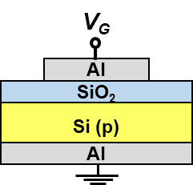
Memory Retention
d_{ox}

Slide 26
Turn Around in Experiment
d_{ox}
Y-axis: Current Window ≈ |read “-1” current |.
X-axis: d_{ox} from 3.25 ~ 2.45 nm.

Slide 27

Transient TCAD with Different EOTs
Electron concentration under linear scale (different d_{ox})
$$n_{excess}=n_{e}\left(@ t=1.35 ms\right)−n_{e}\left(@ t=∞\right)$$

Slide 28
TCAD Simulation: Models
Physical Models
1. Concentration-dependent mobility (conmob)
2. SRH (srh)
3. Auger (auger)
4. Band gap narrowing (bgn)
5. Field-dependent mobility (fldmob)
6. Quantum/direct tunneling (qtunnsc)
7. Bohm quantum potential (bqp) models
consider distribution of electrons in the inversion layer (quantum confinement)
Notes:
print印出解的過程，transient使用model相同，method不同 (Gummel + Newton vs. quasi-static + Newton method)

Slide 29
TCAD and Experiment (Different Time Scale)
Trench MIS TDs
d_{ox}
d_{ox}
Experiment
TCAD: time = 1 ~ 30 ms.
limited by the simulation time (may be several days).
improvements are needed in the future work.
Experiment: time = 65 ms ~ 4 s.

Slide 30
Trench Structure

Slide 31

Lower Oxide Electric Field in Trench MIS (TCAD)
Device structure
Contour plot of total electric field
Notes:
也因此可以驗證我們剛剛的解釋: 也就是trench的反偏壓電流較小，就是來自於他的oxide跨壓較小所造成的

Slide 32
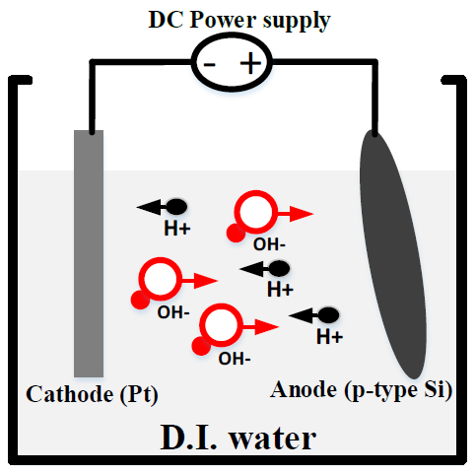



Anodic Oxidation (ANO) System
Jun-Yao Chen, “Effect of Compensatory Embedded Aluminum on the Electrical Characteristics of MIS Tunnel Diode with Ultrathin Oxide” Master thesis, Graduate Institute of Electronics Engineering, College of Electrical Engineering and Computer Science, National Taiwan University 2016.

Slide 33
Effect of Passivation Layer
SiO₂ (ANO)
SiO₂ sidewall devices are more unstable.

Slide 34
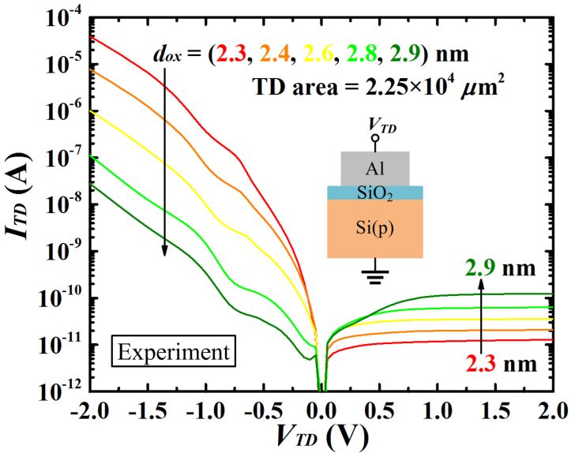



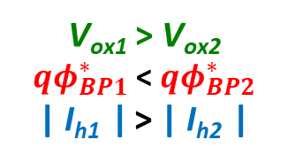


d_{ox}-Dependency of I–V Curves
Oxide tunneling limited
Minority carriers supply limited
Thick Oxide
Thin Oxide
+2V
E_{Fp}
+2V
E_{Fp}
$${qφ}_{BP1}^{∗}$$
$${qφ}_{BP2}^{∗}$$
| I_{h1} |
| I_{h2} |
V_{ox1}
V_{ox2}
Al
SiO₂
Si (p)
V_{ox1} > V_{ox2}
${qφ}_{BP1}^{∗}$ < ${qφ}_{BP2}^{∗}$
| I_{h1} | > | I_{h2} |
$$qφ_{Bp}^{∗}=qχ_{S}−qΦ_{M}+E_{g}−qV_{ox}$$
$$I_{h} ={ A}^{∗}A_{eff}{ P}_{t}{ T}^{2}exp\left(−\frac{qφ_{Bp}^{∗}}{k_{B}T}\right)\left[1−exp\left(−\frac{qV_{TD}}{k_{B}T}\right)\right]$$
d_{ox} , V_{ox}  , ${qφ}_{BP}^{∗}$ , and | I_{h} | .
C. Liao, W. Kao, and J. Hwu, IEEE Journal of the Electron Devices Society, vol. 4, no. 6, pp. 424-429, 2016, doi: 10.1109/JEDS.2016.2591956.

Slide 35
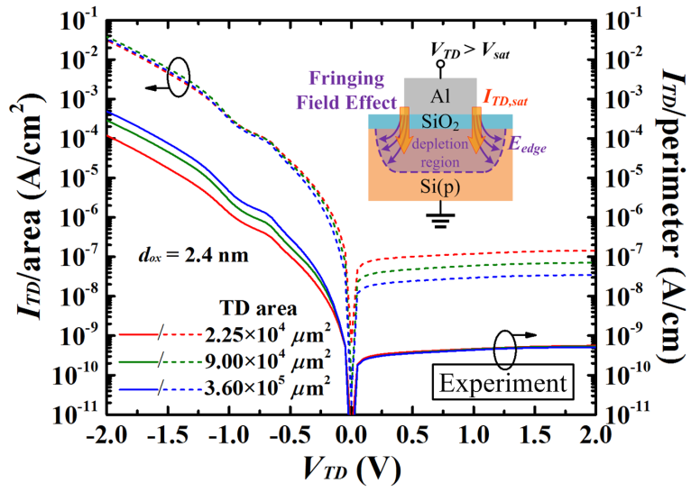
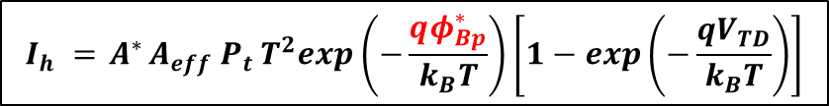

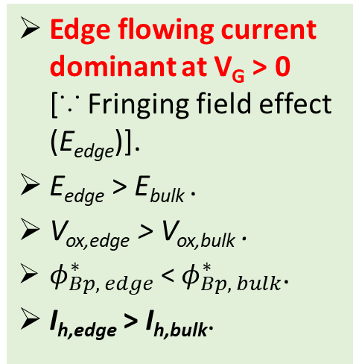
Perimeter-Dependencies of I–V Curves
Edge flowing current dominant at V_{G} > 0 [∵ Fringing field effect (E_{edge})].
E_{edge} > E_{bulk} .
V_{ox,edge} > V_{ox,bulk} .
$φ_{Bp, edge}^{∗}$ < $φ_{Bp, bulk}^{∗}$.
I_{h,edge} > I_{h,bulk}.
$$qφ_{Bp}^{∗}=qχ_{S}−qΦ_{M}+E_{g}−qV_{ox}$$
$$I_{h} ={ A}^{∗}A_{eff}{ P}_{t}{ T}^{2}exp\left(−\frac{qφ_{Bp}^{∗}}{k_{B}T}\right)\left[1−exp\left(−\frac{qV_{TD}}{k_{B}T}\right)\right]$$

Slide 36
Device Structure
Notes:
Here shows the top view and the cross section of the planar and trench MIS

Slide 37
Device Fabrication (1/2)
Radio Corporation of America (RCA) clean
Ultra-thin oxide grown by anodic oxidation
RTA in N₂ at 950 ⁰C for 15 s
Thermal evaporate 250nm Al as top electrode
Si (p)
Photolithography
Al wet etching
Si substrate etching by RIE
Notes:
first, we use a p-type silicon wafer as substrate and perform RCA clean

Slide 38
Device Fabrication (1/2)
Radio Corporation of America (RCA) clean
Ultra-thin oxide grown by anodic oxidation
Rapid thermal annealing (RTA) in N₂ at 950 ⁰C for 15 s
SiO₂
Thermal evaporate 250nm Al as top electrode
Si (p)
Photolithography
Al wet etching
Si substrate etching by RIE
Notes:
Grow SiO2 layer by anodic oxidation
followed by RTA

Slide 39
Device Fabrication (1/2)
Radio Corporation of America (RCA) clean
Ultra-thin oxide grown by anodic oxidation
RTA in N₂ at 950 ⁰C for 15 s
Al
SiO₂
Thermal evaporate 250nm Al as top electrode
Si (p)
Photolithography
Al wet etching
Si substrate etching by RIE
Notes:
Then we deposit 200nm Al by thermal evaporation as the top electrode

Slide 40
Device Fabrication (1/2)
Radio Corporation of America (RCA) clean
Ultra-thin oxide grown by anodic oxidation
RTA in N₂ at 950 ⁰C for 15 s
PR
Al
SiO₂
Thermal evaporate 250nm Al as top electrode
Si (p)
Photolithography
Al wet etching
Si substrate etching by RIE
Notes:
After that, we use photolithography to define our pattern

Slide 41
Device Fabrication (1/2)
Radio Corporation of America (RCA) clean
Ultra-thin oxide grown by anodic oxidation
RTA in N₂ at 950 ⁰C for 15 s
PR
Al
SiO₂
Thermal evaporate 250nm Al as top electrode
Si (p)
Photolithography
Trench MIS only process
Al wet etching
Si substrate etching by RIE
Notes:
then we use PR as mask to perform RIE to form the trench structure.

Slide 42
Device Fabrication (2/2)
Remove native oxide by BOE
Deposit Al₂O₃ by in-situ oxidation of dc sputtering Al target in Ar/O₂ ambient
Al₂O₃
Lift-off photoresist (PR)
PR
Al
Furnace annealing in N₂ at 200 ⁰C for 10 minutes
SiO₂
Si (p)
Backside native oxide removal
Al₂O₃ layer (passivation layer):
protect Si substrate from being exposed to air.
200 nm Al back electrode deposition
Notes:
because after RIE, the Si substrate is exposed to the air
we form a layer of Al2O3 To protect it.
this Al2O3 layer is formed by DC sputtering.

Slide 43
Device Fabrication (2/2)
Remove native oxide by BOE
Deposit Al₂O₃ by in-situ oxidation of dc sputtering Al target in Ar/O₂ ambient
Lift-off photoresist (PR)
Al
Furnace annealing in N₂ at 200 ⁰C for 10 minutes
SiO₂
Al₂O₃
Si (p)
Backside native oxide removal
200 nm Al back electrode deposition
Notes:
we lift-off the PR
and perform furnace annealing to improve the quality of al2O3

Slide 44
Device Fabrication (2/2)
Remove native oxide by BOE
Deposit Al₂O₃ by in-situ oxidation of dc sputtering Al target in Ar/O₂ ambient
V_{G}
Lift-off photoresist (PR)
Al
Furnace annealing in N₂ at 200 ⁰C for 10 minutes
SiO₂
Al₂O₃
Si (p)
Backside native oxide removal
Al
200 nm Al back electrode deposition
Notes:
At last we form a 200nm Al as back electrode by thermal evaporation after we removed native oxide by BOE

