Slide 1
Inside AlphaGo
李旭 于晗

Slide 2
Header
Title
Inside AlphaGo
General purpose
My purpose is to inform my audience about how AlphaGo works
Central idea
sf
Organizational patterns
Chronological order

Slide 3
History of AlphaGo
2016.03 AlphaGo 4 : 1 Li Shishi
2016 – 2017 60 consecutive wins on Chinese Go webside
2017.01 AlphaGo 2.0 born
2017.05 AlphaGo 3 : 0 Ke Jie

Slide 4

Contents
What is Machine Learning?
Deep Learning In AlphaGo.
The meaning of AlphaGo.

Slide 5
What is Machine Learning?
Program
Program
X
Y
Machine Learning
X1
Machine Learning
Program
X2
…
Xn
Training Set

Slide 6
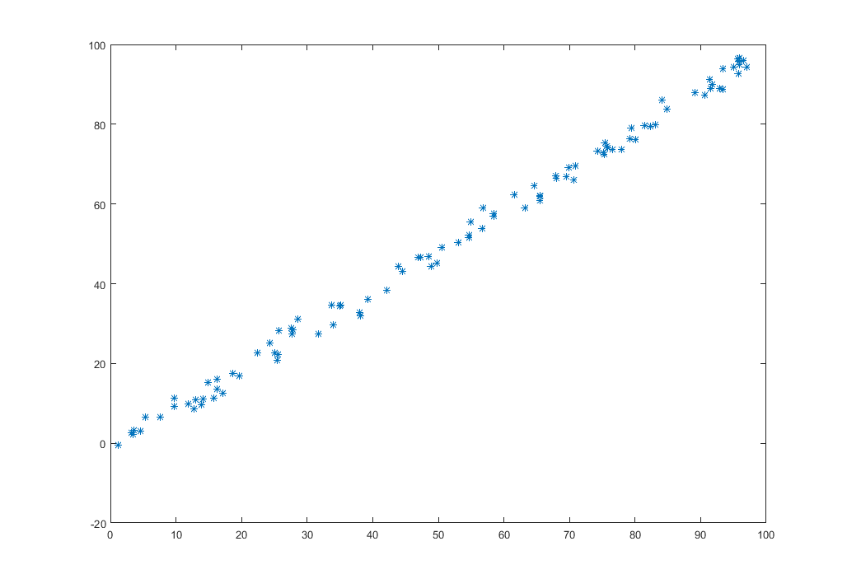
Simple Example For ML
Training Output：
y = x
New x: 18
Result: 18

Slide 7
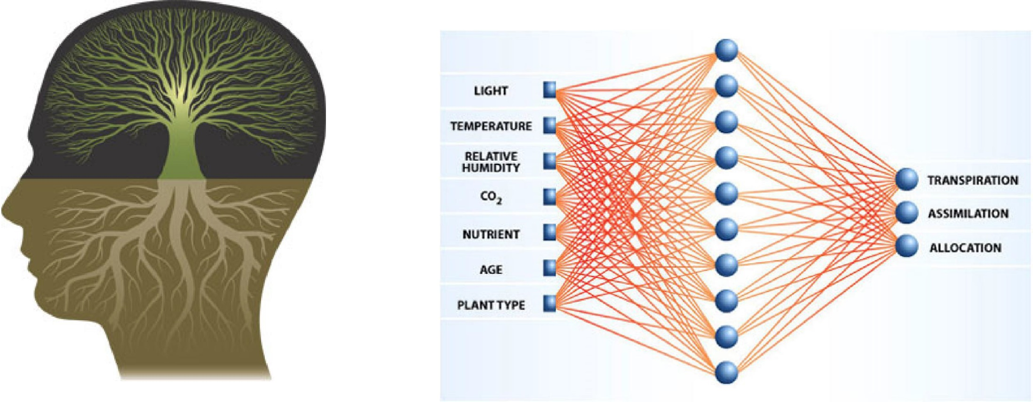
Neural Networks
Input layer
Hidden layer
Output layer

Slide 8
Deep Learning

Slide 9
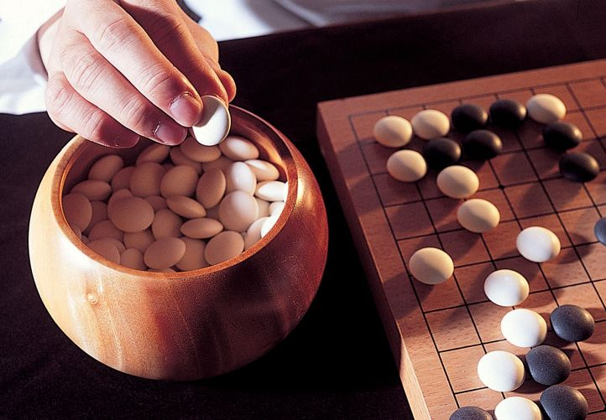
Go is difficult!
How human play Go?
Analyze global and local situation.
Find some feasible moves.
Predict a few more steps and choose the best move.

Slide 10
AlphaGo
Analyze global and local situation.
X1
Features
Deep Learning
X2
Value Network
…
Winning Probability
Xn
Find some feasible moves.
X1
Features
Deep Learning
X2
Policy Network
…
Feasible Moves
Xn

Slide 11
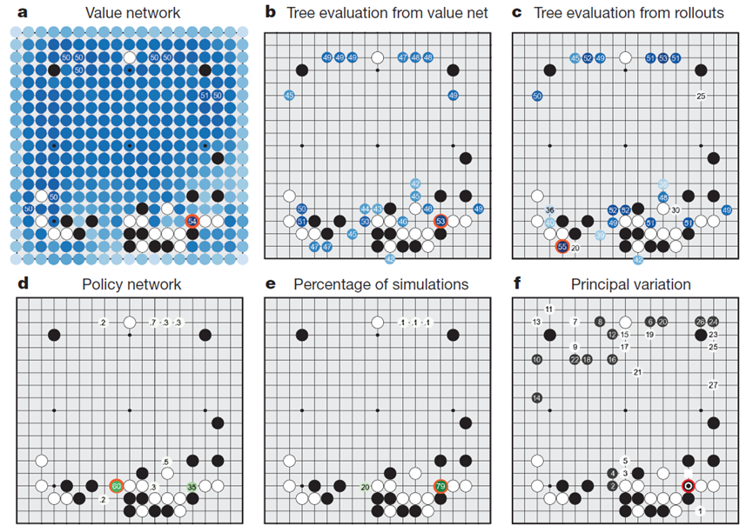
An example about how AlphaGo works

Slide 12
Advantages of AlphaGo
Powerful computing ability
Never tired

Slide 13
Thanks！

