Slide 1
KDD CUP 2017
Highway Tollgates Traffic Flow Prediction Travel Time & Traffic Volume Prediction
徐昊、孙浩然、李旭、冯翰
June 1st

Slide 2
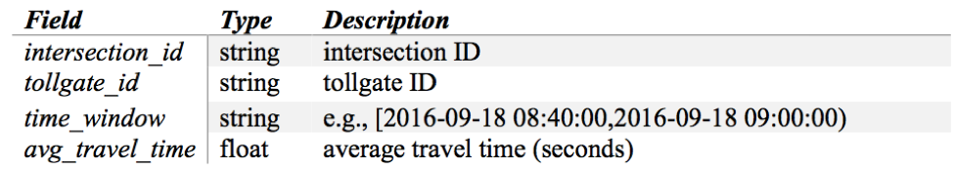
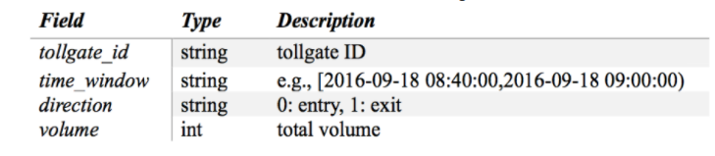

Task
Task 1：
To estimate the average travel time from designated intersections to tollgates
Task 2：
To predict average tollgate traffic volume

Slide 3
Dataset
Training Set
Data collected from 2016.9.19 to 2016.10.17
Including travel time, weather at each time window.
Testing Set
Given：data in specific time region（6：00 – 8：00；15：00 – 17：00）from 2016.10.18 to 2016.10.24
Predict：data in the following time region（8：00 – 10：00；17：00 – 19：00） from 2016.10.18 to 2016.10.24

Slide 4
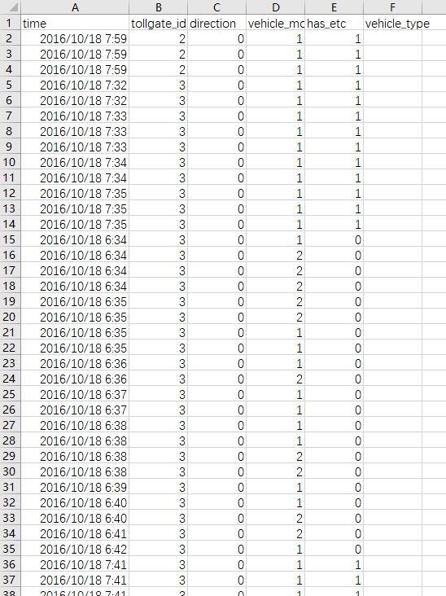
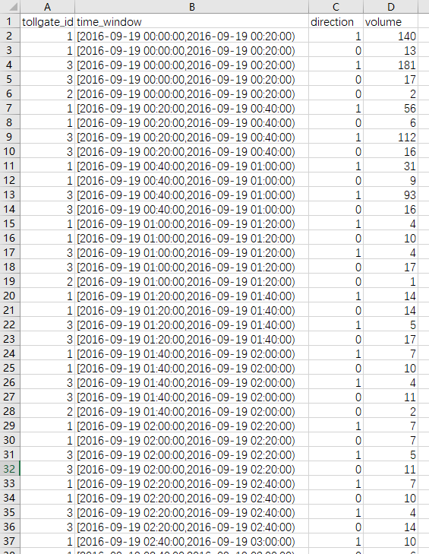
Data Analysis
Data Format：
Count the data for each vehicle, and get the average travel time and traffic volume in each 20min time window

Slide 5
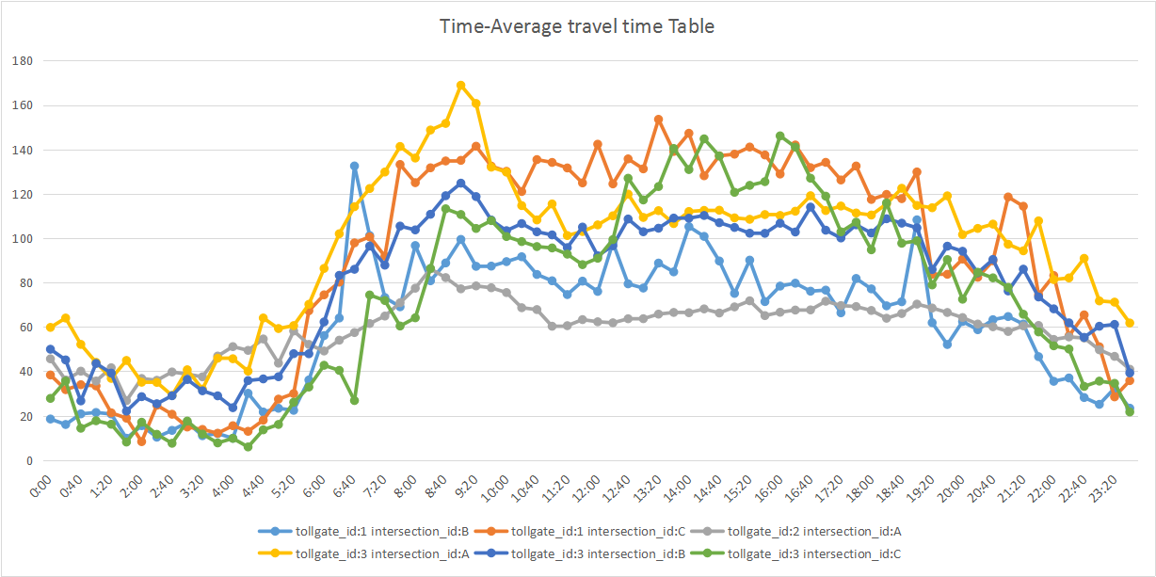
Data Analysis
Time correlation：
Relation between average travel time and time of a day

Slide 6
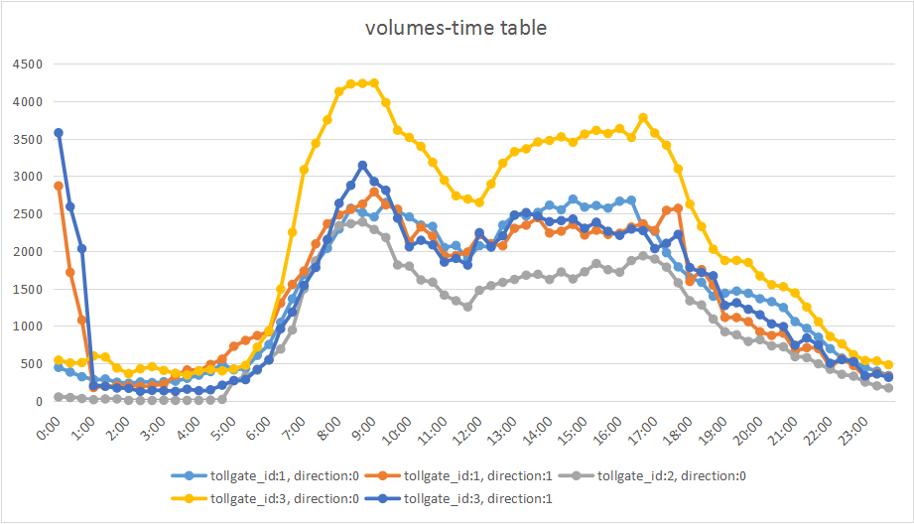
Data Analysis
Time correlation：
Relation between traffic volumes and time of a day

Slide 7
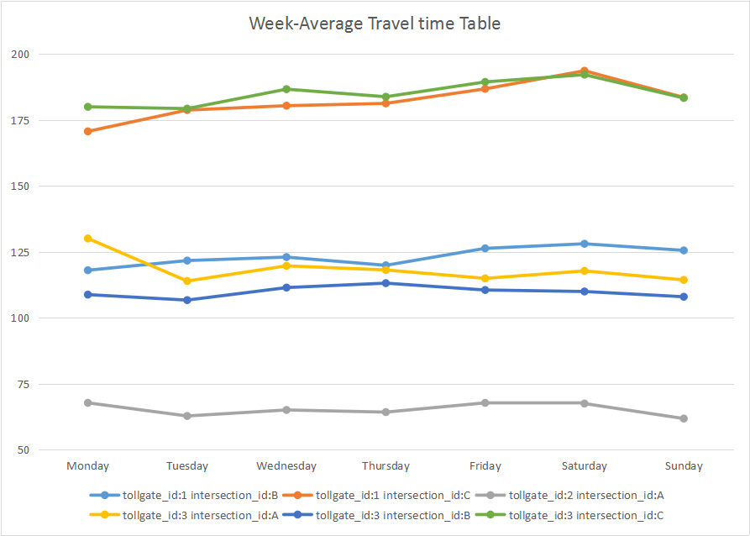
Data Analysis
Date correlation （Monday to Sunday）：
Relation between average travel time and weekday

Slide 8
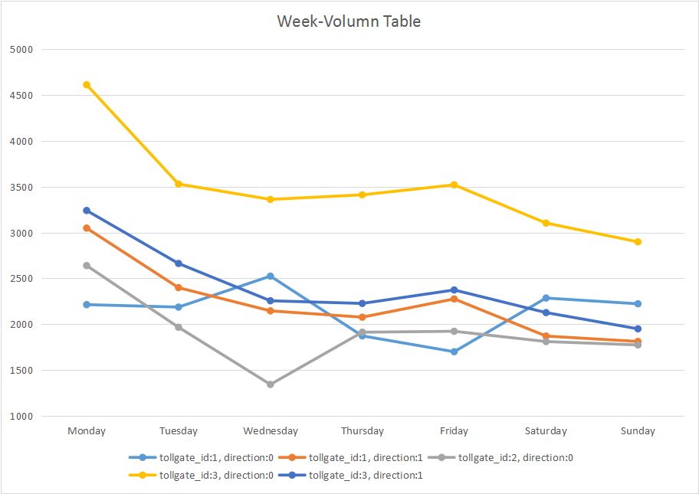
Data Analysis
Date correlation （Monday to Sunday）：
Relation between traffic volumes and weekday

Slide 9
Training
Model：
Neural Network（MLP）
2 hidden layers, 10 neurons each
Features (Input layer)
tollgate
route
direction
weekday
precipitation
traffic volume/average travel time before given time (20min/40min/60min… ago)
traffic volume/average travel time at same time in history

Slide 10
Result
MAPE (Mean Absolute Percentage Error)
Task 1: 0.201

Slide 11
Result
MAPE (Mean Absolute Percentage Error)
Task 2: 0.157

Slide 12
Thanks

