Slide 1


TablePuppet: Towards a Generic Framework for Learning over Relational Tables
Lijie Xu†, Chulin Xie, Yiran Guo, Haiyang Lu, Gustavo Alonso, Bo Li, Guoliang Li, Wei Wang, Wentao Wu, Ce Zhang
†Institute of Software, Chinese Academy of Sciences (ISCAS)
with others (UIUC, ETH, Tsinghua, Microsoft, UChicago)
xulijie@iscas.ac.cn

Slide 2



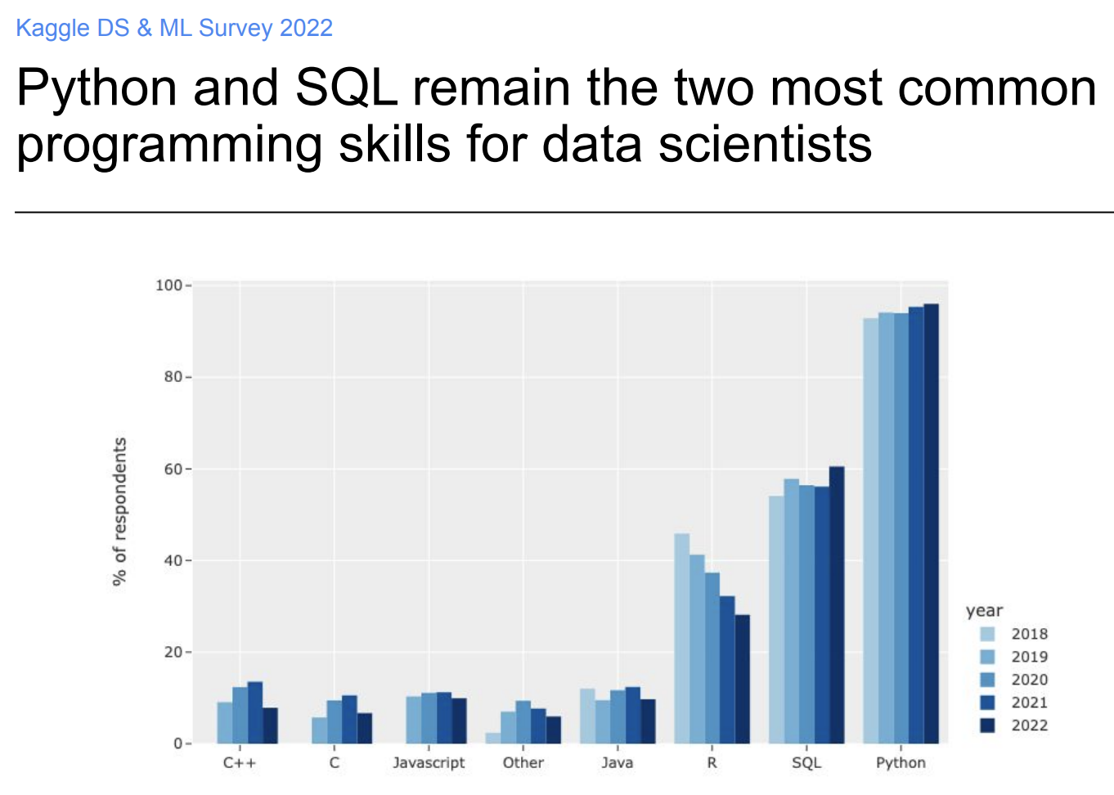



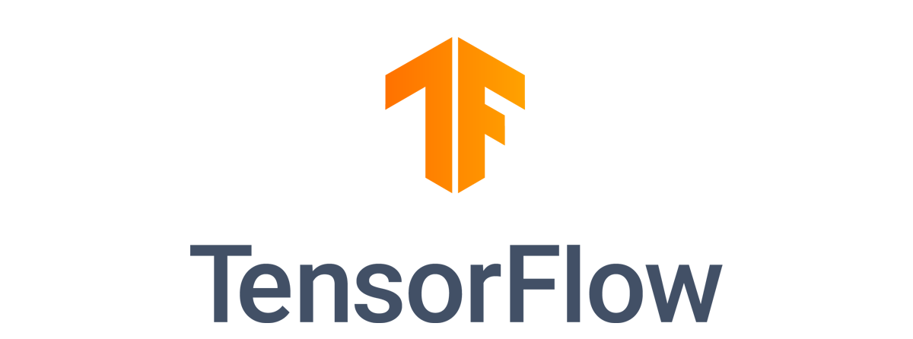


Learning over relational data
Regression, classifiction, clustering, etc.
Train ML models on table features
Python
From 23,997
data scientists
SQL
Table features
Database
SQL Query Engine
E.g., Bank transactions,
Retail orders,
Hospital medical records
Source: https://www.kaggle.com/kaggle-survey-2022

Slide 3


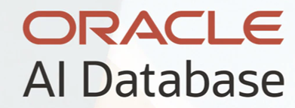
Learning over relational data
In-Database Machine Learning
Apache MADlib
In-Database ML
using SQL+ML query
CREATE MODEL m using SVM
FEATURES feature_cols
TARGET label_col
FROM table_name
WITH params = args;
GaussML
Oracle Machine Learning
Database
SQL + ML Query Engine
…
…
E.g., Bank transactions,
Retail orders,
Hospital medical records

Slide 4
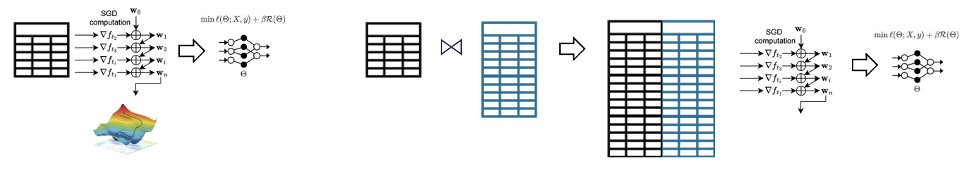
Learning over relational data
How to implement ML training over relational data?
Learning over a single table
Learning over joins
Problem: The joined table could be much larger than individual tables →
Storage and training overhead
ML training algorithms
(e.g., Stochastic Gradient Descent)
Training
algorithms
Table
ML models
Table 1
Table 2
Joined table
ML models

Slide 5
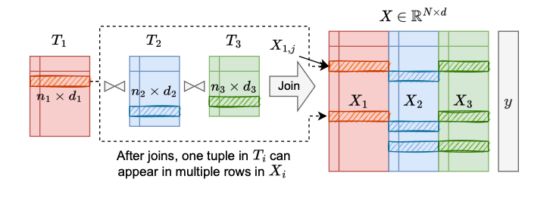
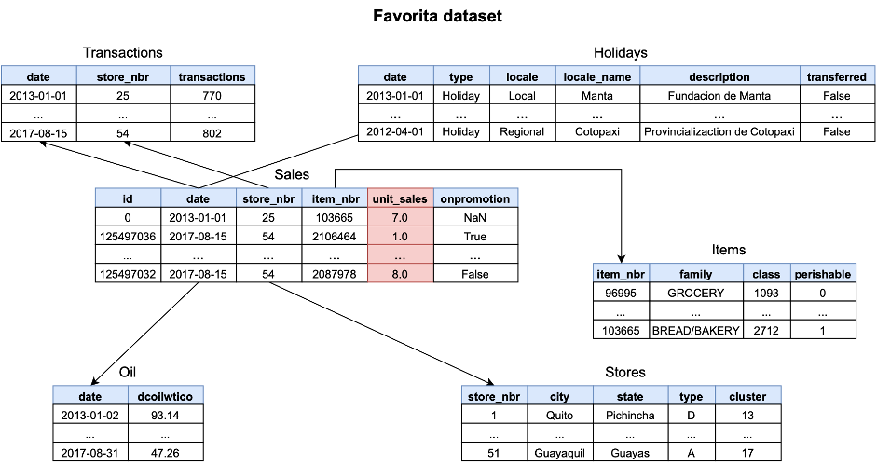

Learning over joins - Example
$$t_{1}$$
Example: Learning over joins on six tables
There are duplicate tuples after joins
Joined table
(40 GB)
~4 GB
It is impractical to store the joined table

Slide 6

More general case: Learning over joins and unions
Learning over joins and unions in a distributed environment
Distributed/cloud databases
Challenges
1. High I/O communications to perform joins
and unions
2. High storage and computation overhead
for learning over the large joined table
join
3. Privacy problem due to distributed
communications
union
Research problem: how to train ML models on distributed tables requiring joins and unions without table sharing?
Database sharding
(horizontal partitions)
Beijing
Shanghai

Slide 7
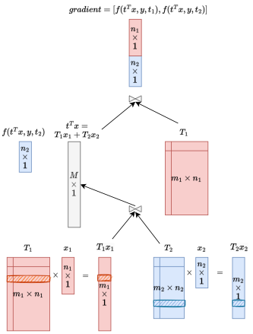
Related work – Factorized learning
Learning over joins in a single database without materializing the joined table
Factorized learning approaches ^{[1, 2, 3, 4]}
Decouple the ML computation, distribute partial computation to each table, and aggregate/join the computation results.
Only support specific ML training algorithm (Gradient Descent), but do not support more efficient (mini-batch) SGD.
Linear models ☺, Neural network models ☹.
join
Single DB
Arun Kumar et al. Learning Generalized Linear Models Over Normalized Data. SIGMOD 2015
Maximilian Schleich et al. Learning Linear Regression Models over Factorized Joins. SIGMOD 2016
Lingjiao Chen et al. Towards Linear Algebra over Normalized Data. VLDB 2017
Maximilian Schleich et al. A Layered Aggregate Engine for Analytics Workloads. SIGMOD 2019

Slide 8
Related work – Federated learning
Partitioned tables
Logical global
table
Federated learning approaches ^{[1, 2, 3, 4]}
Push ML computation (decouple gradient computation) to each table and aggregates the computation results.
Suppose a table is either horizontally or vertically partitioned.
SQL joins and hybrid scenarios (joins and unions) ☹
Horizontal
Federated
Learning
Logical global
table
Yang Liu et al. Vertical Federated Learning: Concepts, Advances, and Challenges. IEEE TKDE 2024
Qiang Yang et al. Federated Machine Learning: Concept and Applications. ACM TIST 2019
Qinbin Li et al. Federated Learning on Non-IID Data Silos: An Experimental Study. ICDE 2022
Afsana Khan et al. Vertical federated learning: a structured literature review. Knowl. Inf. Syst. 2025
Vertical
Federated
Learning

Slide 9
Our approach: Two-level decomposition (TablePuppet)
Problem:
Train ML models on the global joined table without table sharing
Two-level decomposition:
Decompose the learning process into two steps:
(1) learning over joins, followed by (2) learning over unions
Logical joined
table
Learning over Joins
Pushes ML computation down to the individual tables being joined
join
union
Learning over Unions
Further pushes learning down to the horizontal partitions of each table
Database sharding
(horizontal partitions)
Beijing
Shanghai

Slide 10
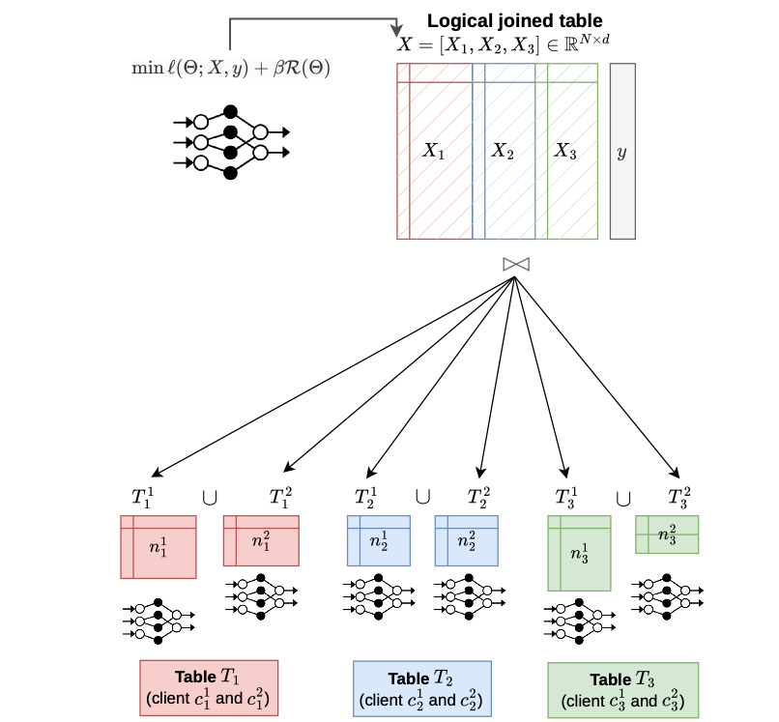

Our approach: Two-level decomposition
TablePuppet framework
Problem 1: How to store/organize the ML models?
Global model needs to cover all the table features, but these features are distributed in different machines.
Global model
All the table features
Model decomposition and distribution
Do not store the global model
Split global model to small local models for each table
Each local model covers the parameters associated with the table features.
Push ML over the global model (global joined table) down to each local model (horizontal table)
Features of Table 1
Features of Table 2
Features of Table 3

Slide 11
Our approach: Two-level decomposition
TablePuppet framework
Problem 1: How to store/organize the ML models?
Global model needs to cover all the table features, but these features are distributed in different machines.
Global model
All the table features
Model decomposition and distribution
Do not store the global model
Split global model to small local models for each table
Each model covers the parameters associated with the local table features.
Push ML over the global model (global joined table) down to each local model (horizontal table)

Slide 12
Our approach: Two-level decomposition
Problem 2: How to generate the logical joined table?
TablePuppet framework
Global model
All the table features
Features of Table 1
Features of Table 2
Features of Table 3

Slide 13
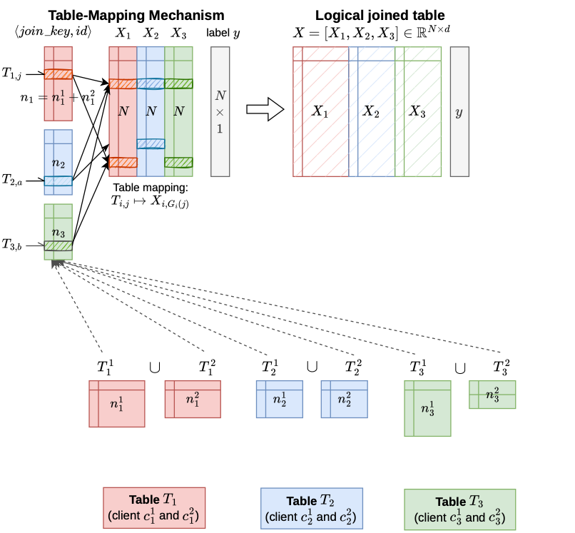
Our approach: Two-level decomposition
Problem 2: How to generate the logical joined table?
TablePuppet framework
Table-mapping mechanism
Aggregate the <hash(join_key), row id> of each horizontal table to form a logical joined table
<hash(join_key), row id>

Slide 14
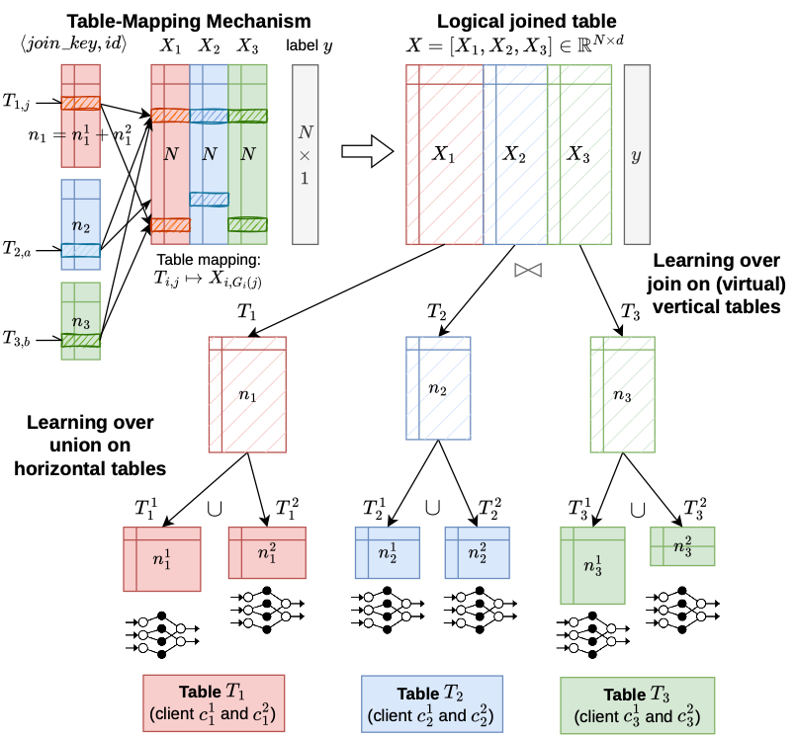


Our approach: Two-level decomposition
Problem 3: How to perform learning over unions?
TablePuppet framework
Learning over Joins (LoJ)
Push ML on joined table to (virtual) vertical tables
Support both SGD and ADMM training algorithms
Optimize the computation on duplicate tuples

Slide 15
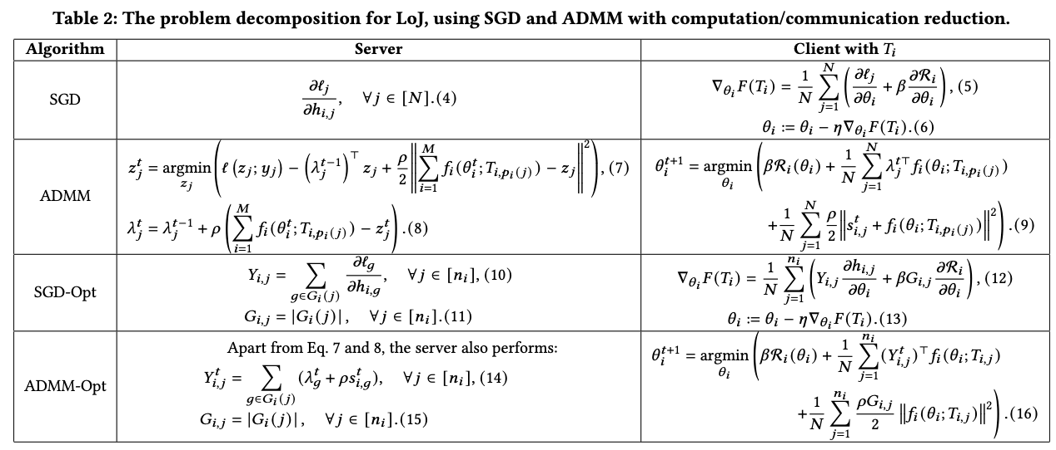



Our approach: Two-level decomposition
Problem 3: How to perform learning over unions?
TablePuppet framework
Learning over Joins (LoJ)
Push ML on joined table to (virtual) vertical tables
Support both SGD and ADMM training algorithms
Optimize the computation on duplicate tuples
$O(N)$
$$O(n)$$
Computation complexity from $O(N)$ to $O(n)$
ADMM: Alternating Direction Method of Multipliers

Slide 16
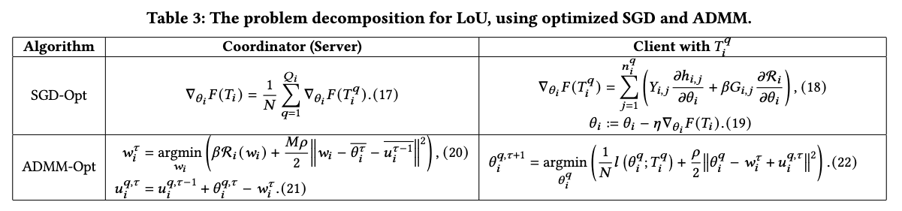
Our approach: Two-level decomposition
Problem 4: How to perform learning over unions?
TablePuppet framework
Learning over Unions (LoU)
Push ML computation on the vertical table to local horizontal tables
Perform local model updates

Slide 17
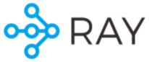
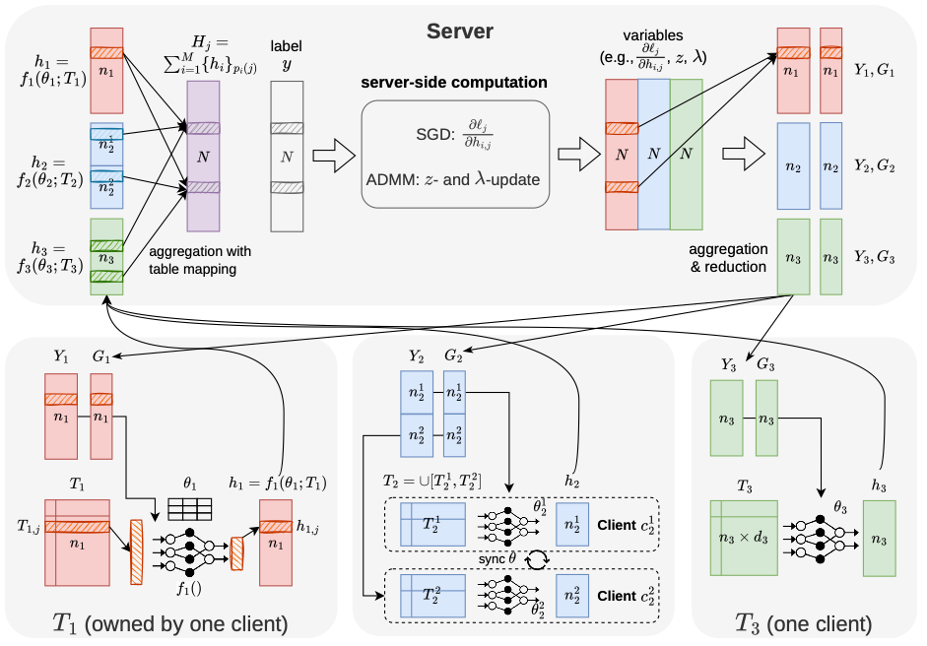
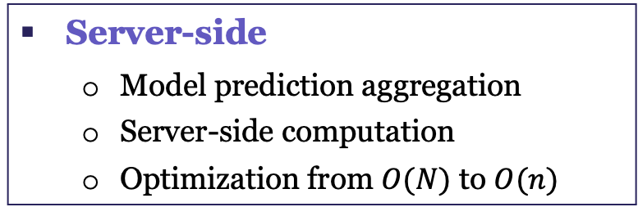
TablePuppet framework implementation
Server-Client architecture based on Ray
TablePuppet training process
Server-side
Model prediction aggregation
Server-side computation
Optimization from $O(N)$ to $O(n)$
Client-side
local model update
Send model predictions to the server

Slide 18
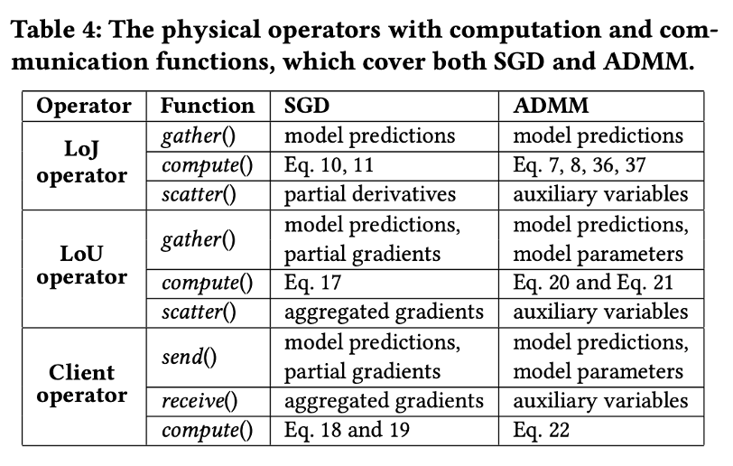
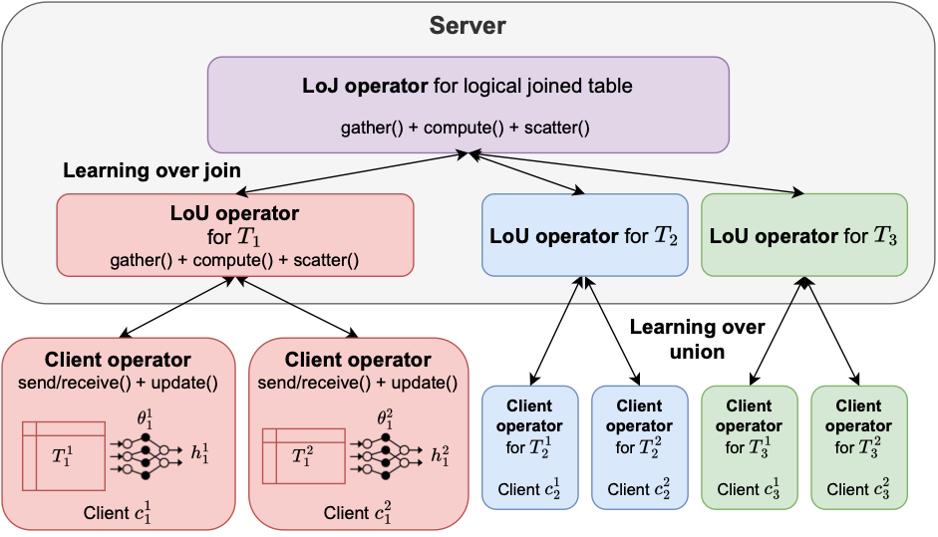
TablePuppet framework implementation
General operators to cover two ML training algorithms
TablePuppet architecture
(Three physical operators)

Slide 19


TablePuppet framework - Privacy guarantee
Differential Privacy (DP)
Where to add DP?
Table features
Local model updates (DP-SGD)
Model predictions
Label (label-DP)
Server-side computation
Auxiliary (intermediate) variables
Server-side computation
label
Intermediate
variables
Model
predictions
Table
features
Local model update

Slide 20
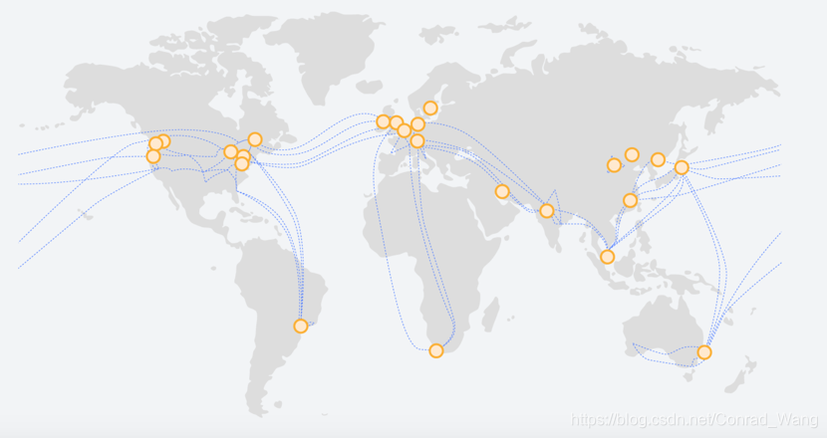
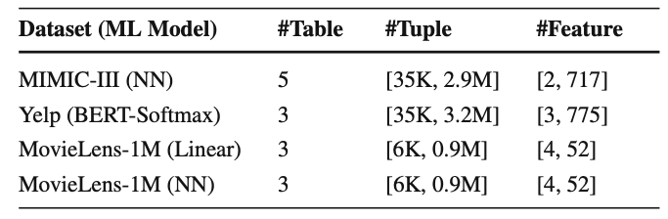
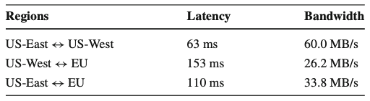
Evaluation – Experiments on AWS cloud instances
TablePuppet (Server)
TablePuppet (Client)
Train both linear models and neural network models
on three datasets with multiple tables
EU (Stockholm)
US-West (Oregon)
US-East (Virginia)
TablePuppet (Client)
Accuracy evaluation: Model accuracy on TablePuppet vs. Model accuracy directly on the global joined table
Performace evalution: Training time and communication time (TablePuppet vs. Federated learning)

Slide 21
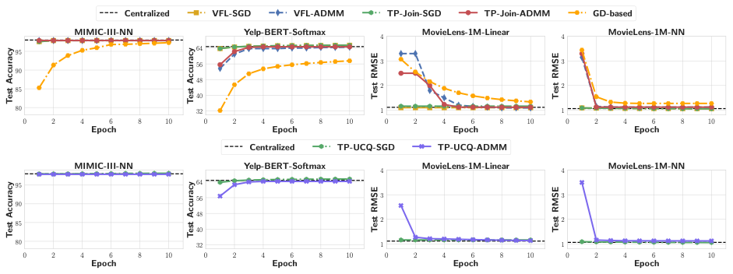
Evaluation – Accuracy results
Physical/global
joined
table
Baseline: Directly running ML over the global joined table (dash line)
Result: SGD/ADMM algorithms atop TablePuppet can achieve comparable model accuracy to the baseline.
Join-only scenario
Join-Union scenario
Implication: Our two-level decomposition approach with optimizations on duplicate tuples is effective.

Slide 22
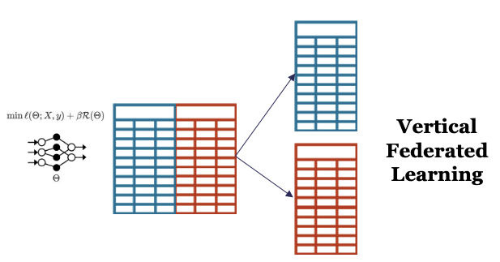
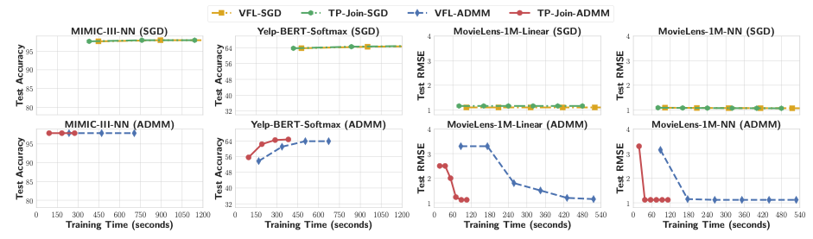
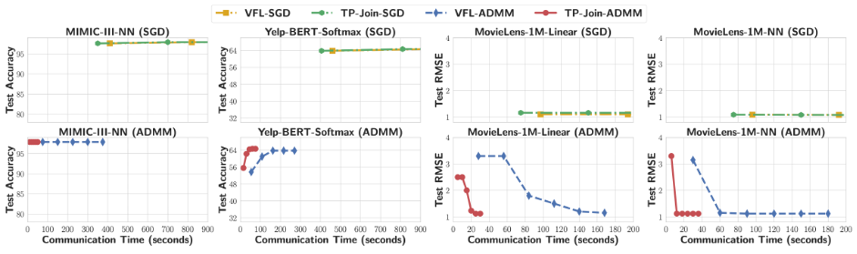
Evaluation – Performace reusults in Join-Only scenario
Baseline: Vertical Federated Learning (VFL) approaches on global joined table that are vertically partitioned.
Result: SGD/ADMM algorithms atop TablePuppet have less training & communication time than baseline.
VFL baseline
Global joined table
Implication: Our optimizations on duplicated tuples are efficient (reduces the computation and communication overhead)

Slide 23
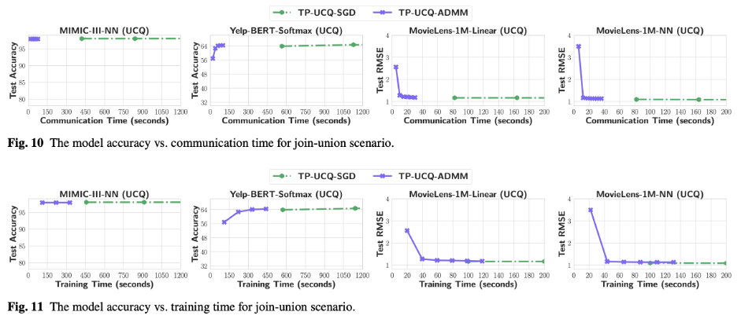
Evaluation – Performance results in Join-Union scenario
Result: ADMM atop TablePuppet takes shorter communication time to converge.
Join-Union scenario

Slide 24
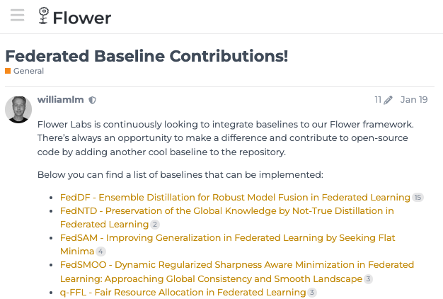
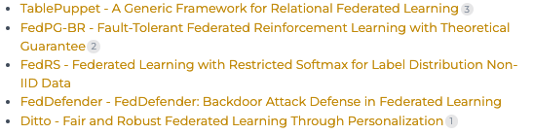
Open source
TablePuppet framework
https://github.com/JerryLead/tablepuppet

Slide 25
Thank you! Q&A
TablePuppet framework
Notes:
OK, thanks for your attention.

