Slide 1
Introduction to Parameter Server Consistency models
Lijie Xu@Alibaba
February 4, 2014

Slide 2
An example: Matrix Factorization

Slide 3
An example: Matrix Factorization

Slide 4
Algorithm: MF with SGD

Slide 5
Distributed Matrix Factorization with SGD

Slide 6
Problems
What, if too many params?
Oops, I got the old params
Too many synchronizations
I run very fast
Sorry, I’m slow

Slide 7
Parameter Server

Slide 8
Problems
I run very fast
Sorry, I’m slow

Slide 9
Consistency models - BSP

Slide 10
Consistency models – Arbitrary BSP

Slide 11
Consistency models - SSP

Slide 12
Consistency models

Slide 13
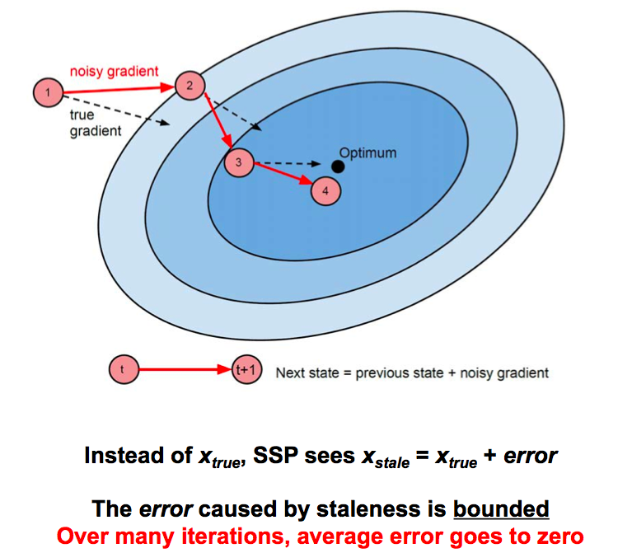
Cons of SSP

Slide 14
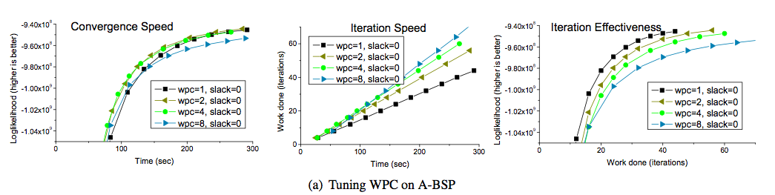
Evaluation - BSP

Slide 15
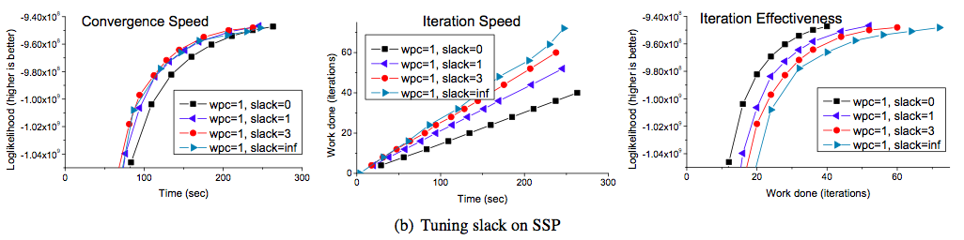
Evaluation - SSP

Slide 16
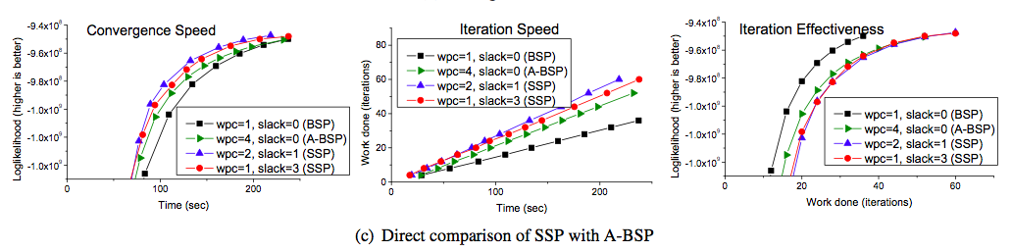
Evaluation – BSP vs. A-BSP

