Slide 1
Contents
Single Perceptron (linear)
Neural Network (non-linear, shallow)
Deep NN (deep learning)
Transformer w/ Embeddings
Related techniques
Normalization
Boost learning
Regularization

Slide 2
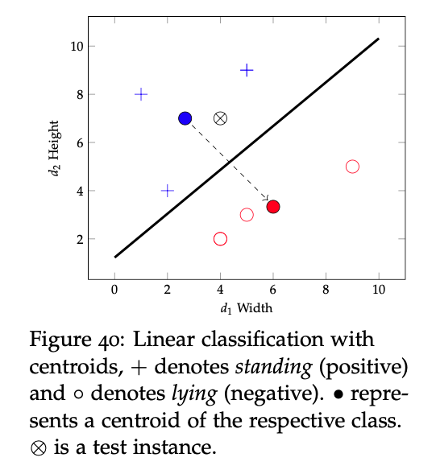
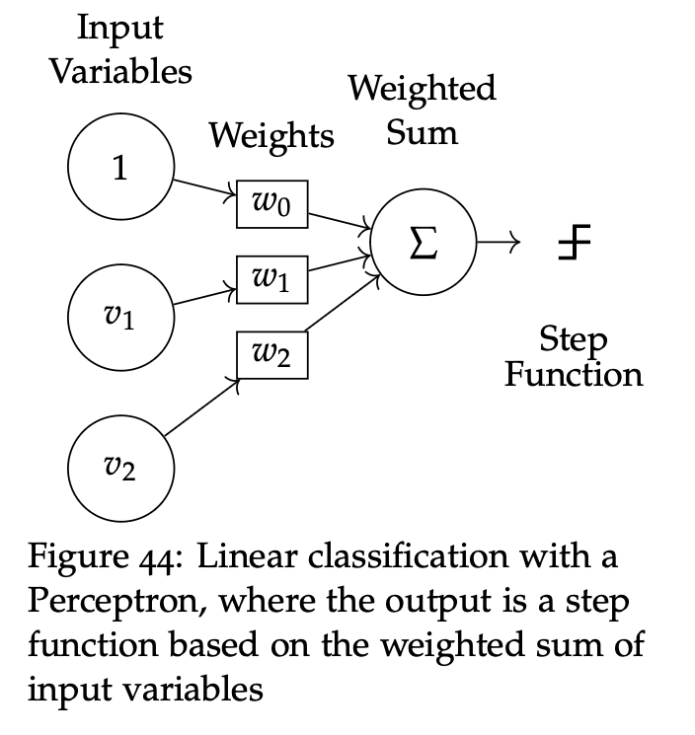
Single Perceptron

Slide 3
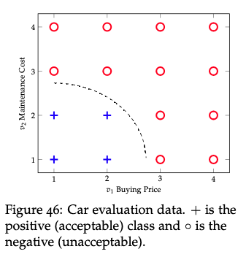
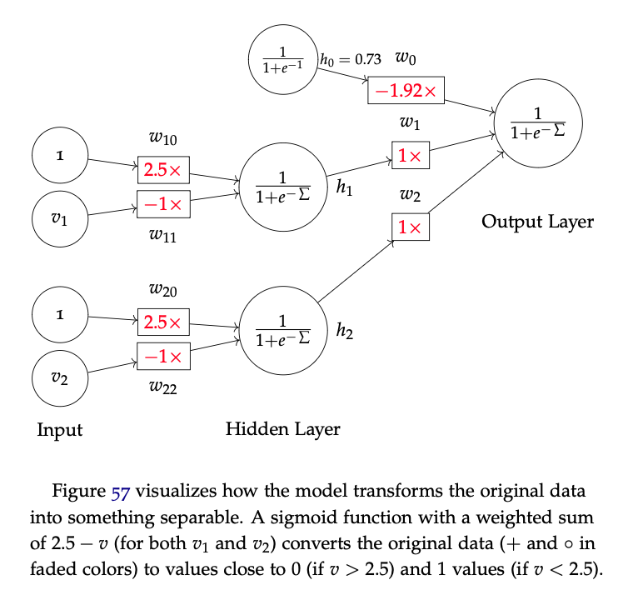
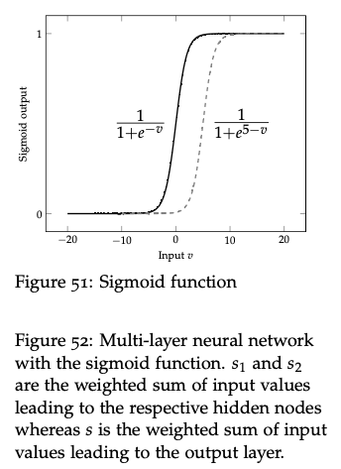
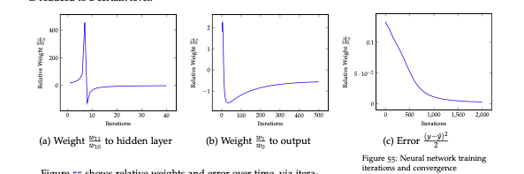
Multi-layer (Shallow) Neural Network
Notes:
Consider talking about:
Pope Benedict XVI

Slide 4
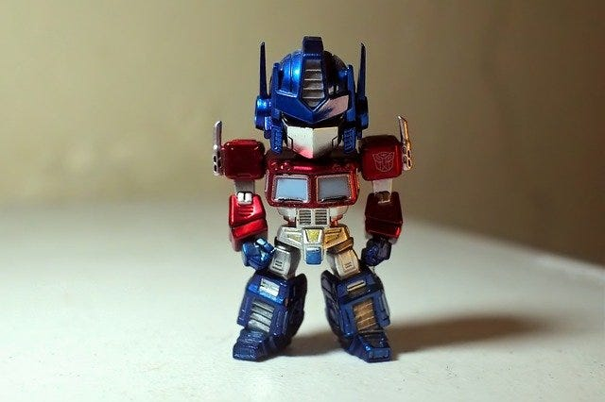
Transformer (Deep NN)

Slide 5
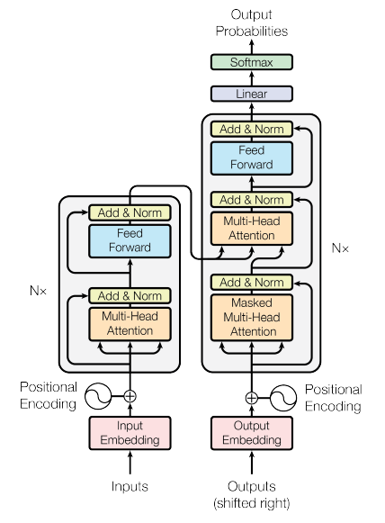
Transformer (Deep NN)

Slide 6
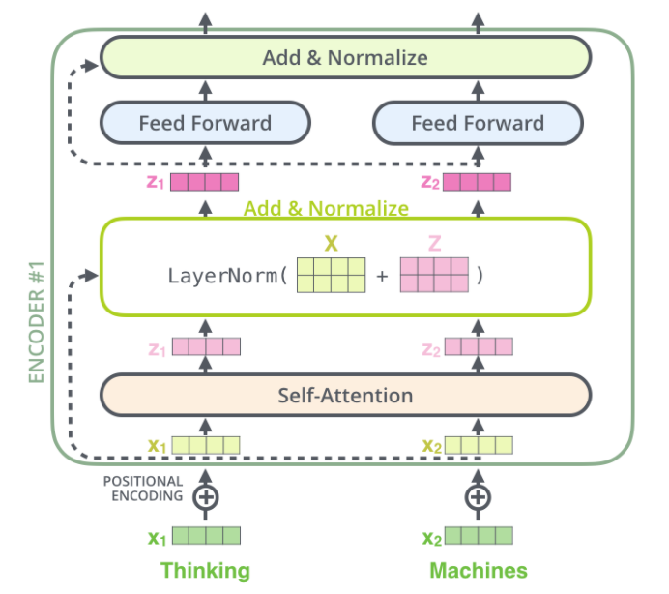
Transformer (Deep NN)

Slide 7
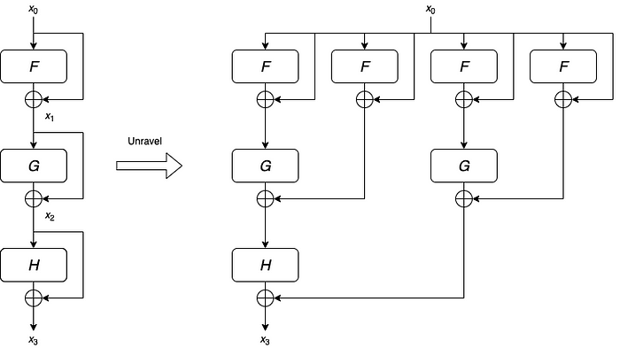
Residual (Skip) Connections

Slide 8
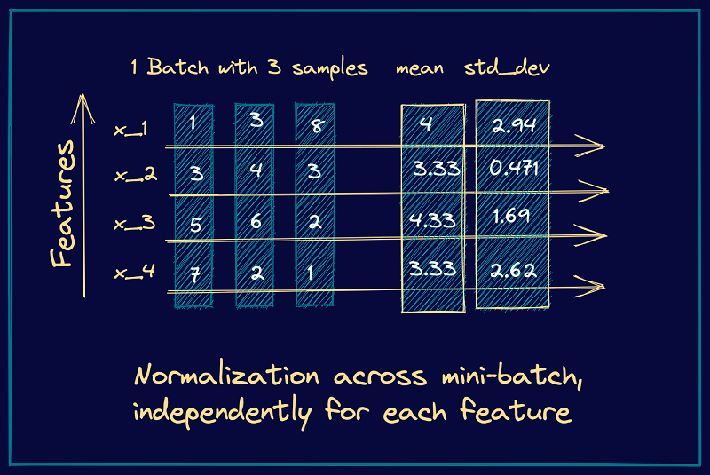
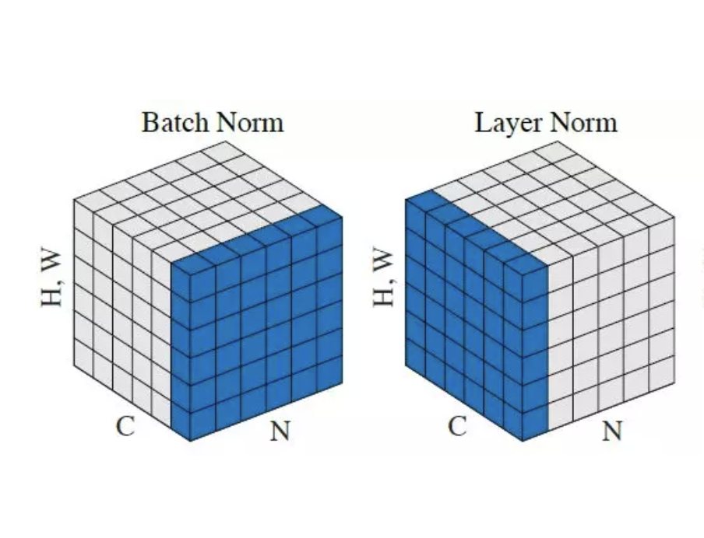
Batch & Layer Normalizations

Slide 9
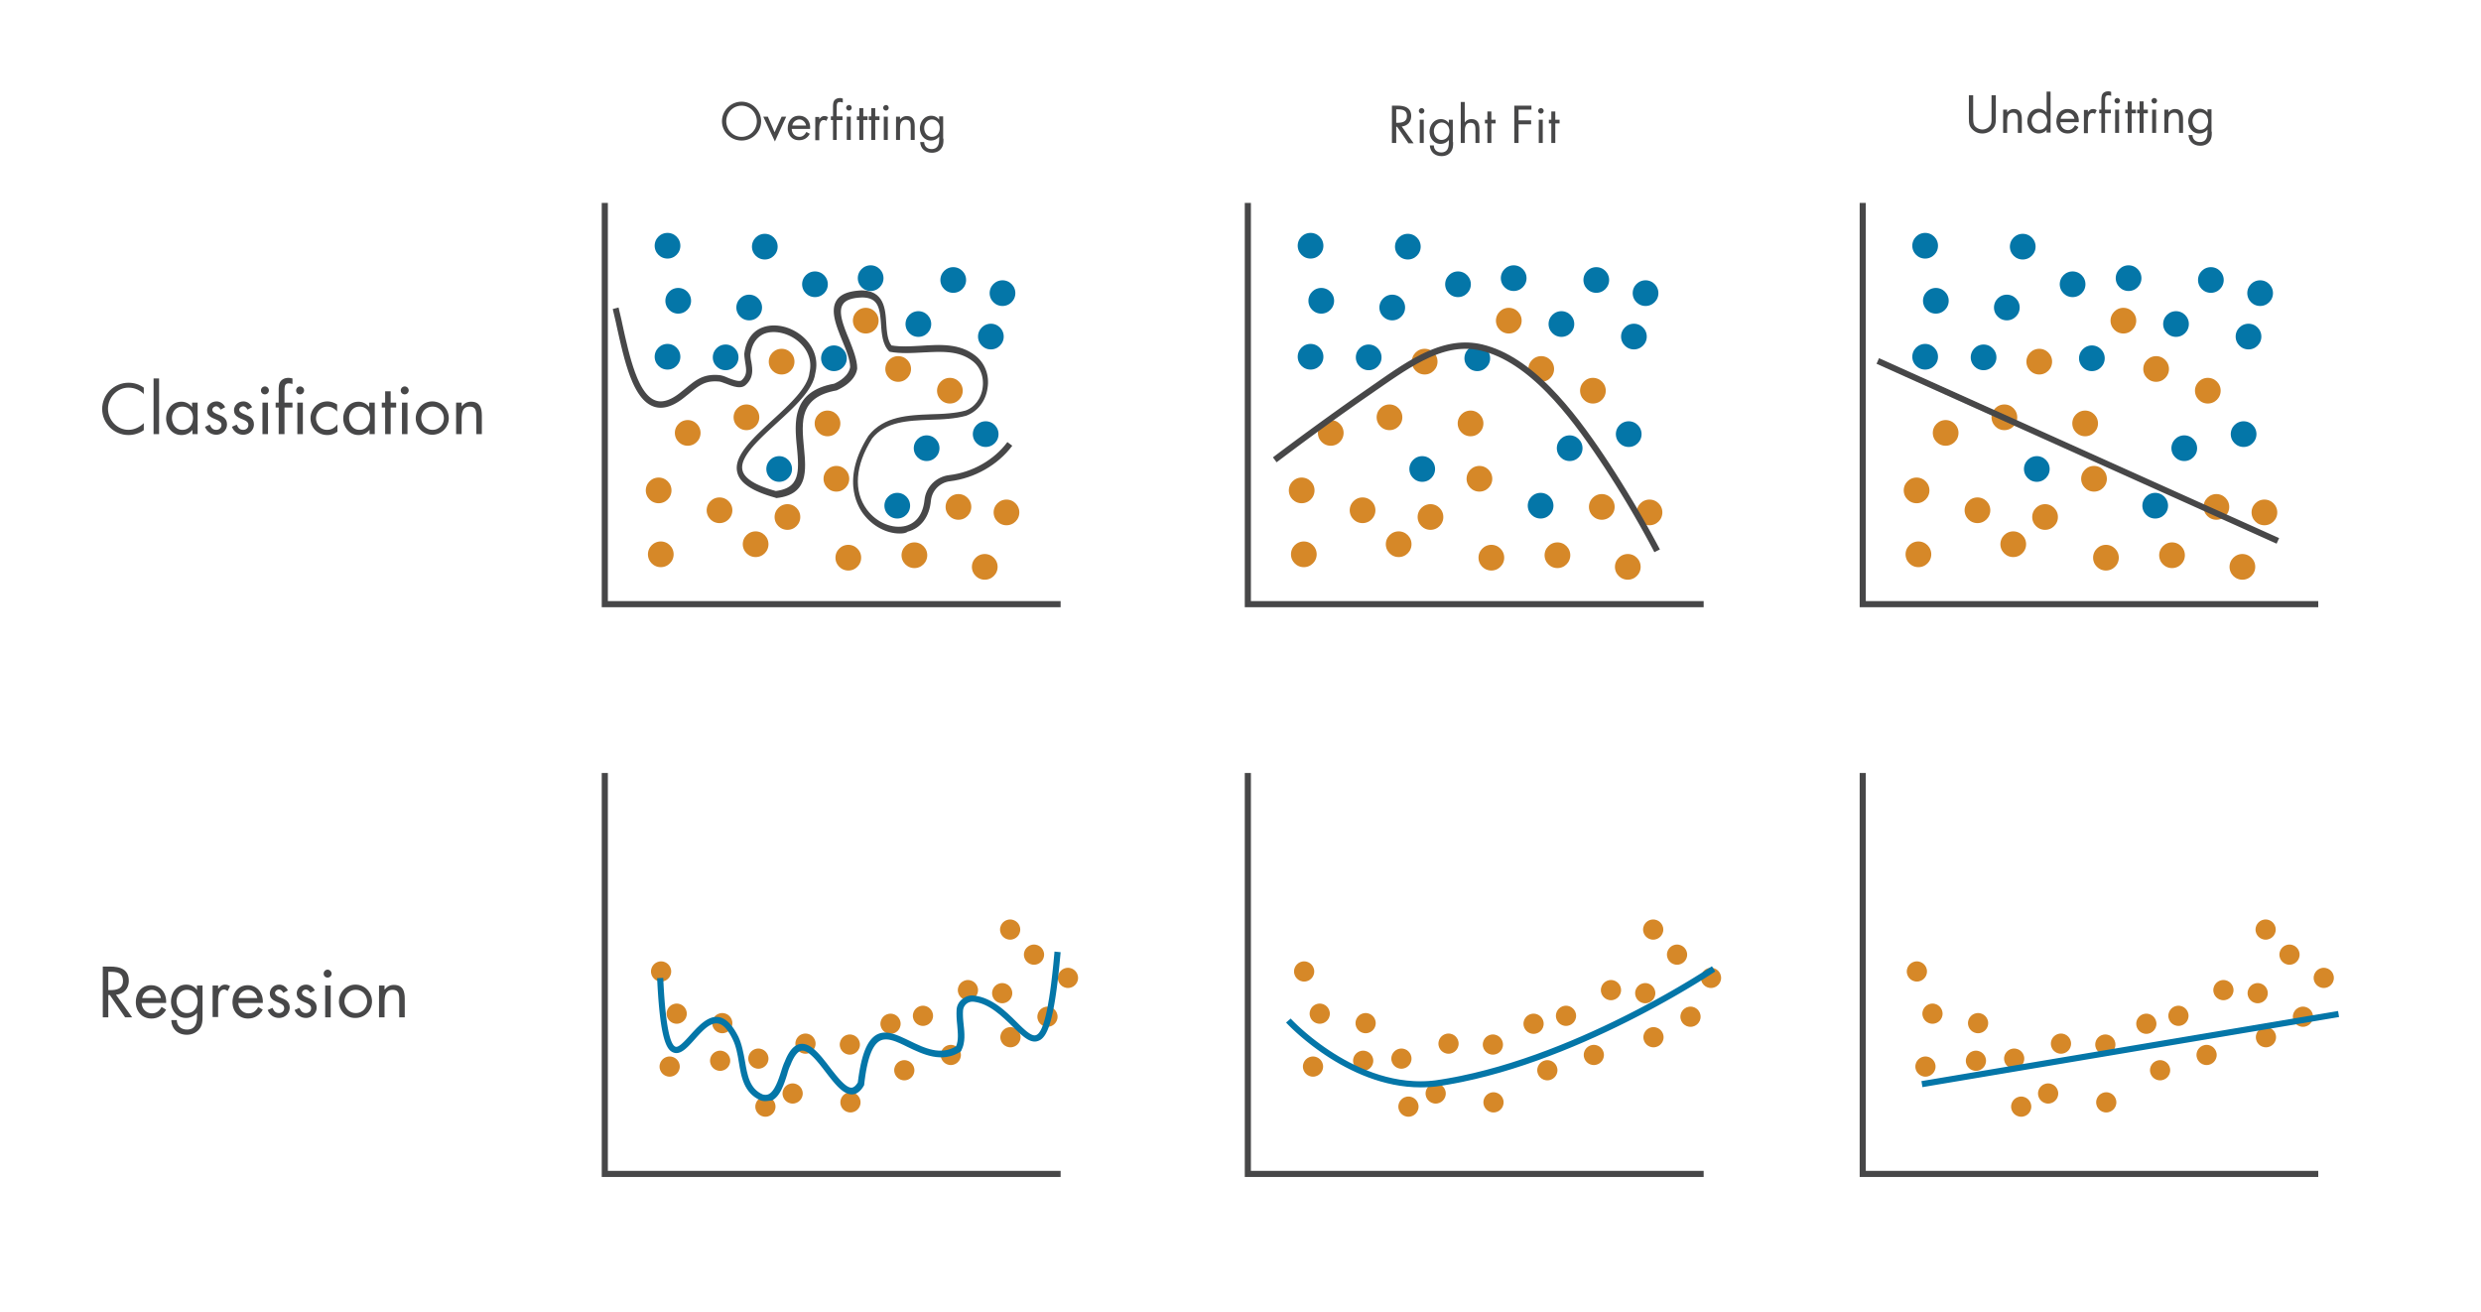
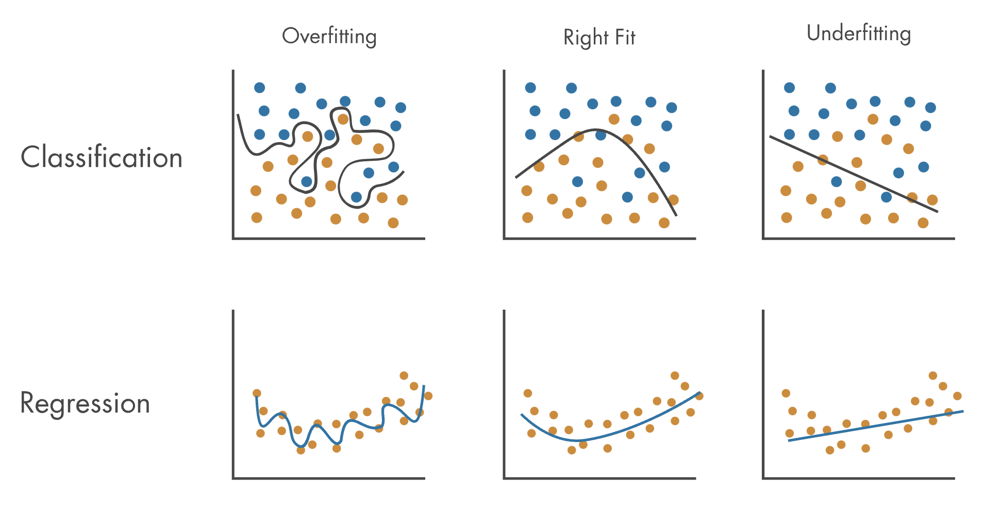
Regularization with Dropout

Slide 10
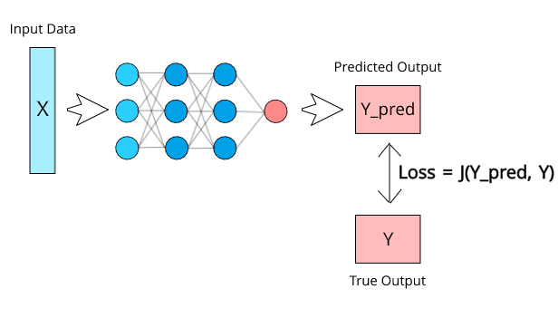
Thread #1: DLITE Loss
Loss functions:
Errors, Cross-Entropy, KL Divergence
How about DLITE?
A loss function based on DLITE.
1. Implement a custom loss function based on DLITE.
2. Use the loss function for transformer training, e.g. tinyshakespeare.
3. Train and monitor the convergence with DLITE, Cross-Entropy, and KL divergence scores: a) how fast does it converge, and b) the converged (lowest) scores.

Slide 11
Thread #2: GPT+IR
An information retrieval model integrated with LLMs:
1. Use the prompt (question/query) to retrieve documents.
2. Use the documents to enrich (as part of) the prompt.
3. Use the enriched prompt to get answer for the original question/prompt.
Note:
* Assume existing (pre-trained) LLM and (indexed) IR systems.
* May access them via APIs, e.g. OpenAI APIs, Elastic APIs.

Slide 12
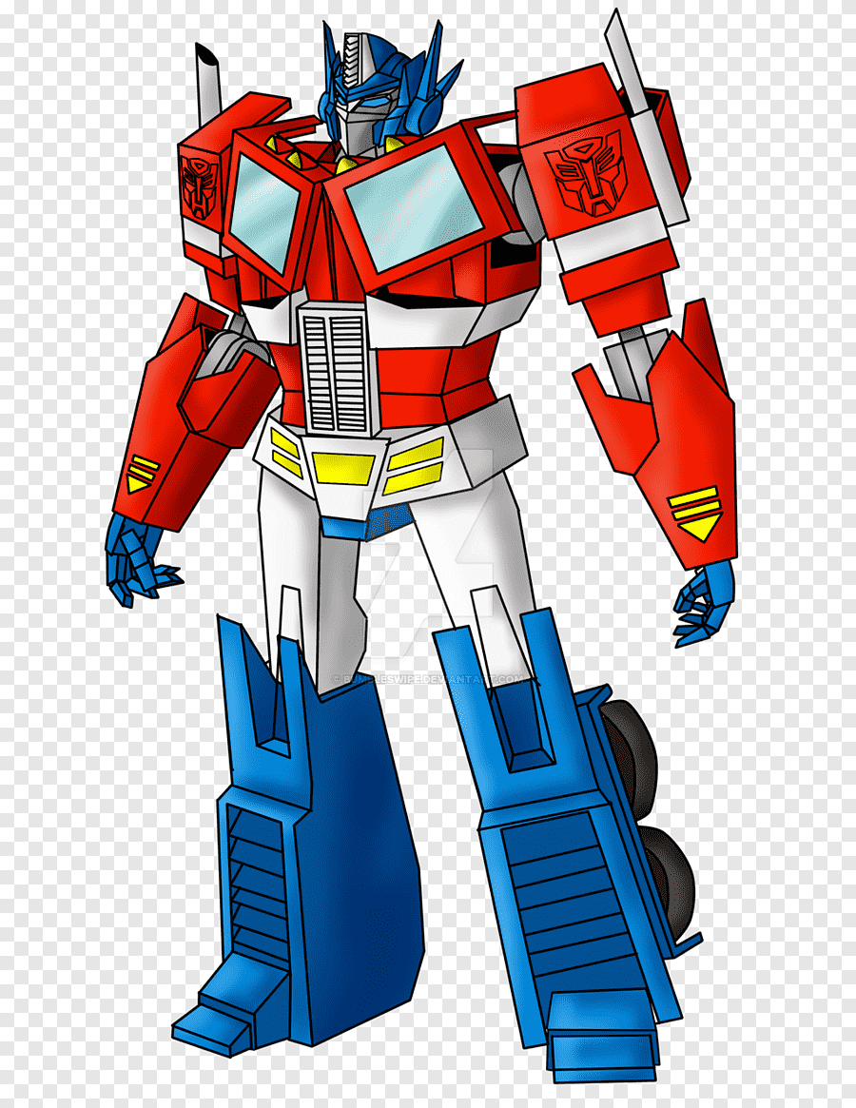

Thread #3: GPT+GPT
Transformers (agents) trained on local personal data.
1. Train mini-GPT on local personal data (e.g. for Bob).
2. Or fine-tune large pre-trained models, e.g. with Alpaca.
3. Answer questions about local personal data.
4. Interact with another mini-GPT, e.g. for Alice.
5. (Future) Form a network of mini-GPT for large capacity.

Slide 13
Thread #4: GPT4NER
Predictions
Training
Fine-tuning
Pre-trained
BERT
Train GPT to generate (recognize) name entities.
1. Train transformer (decoder) for embedding.
2. Or use existing embedding, e.g. BERT.
3. Train and fine-tune on New York Times annotated data.
4. Test and evaluate predictions for NER.

Slide 14
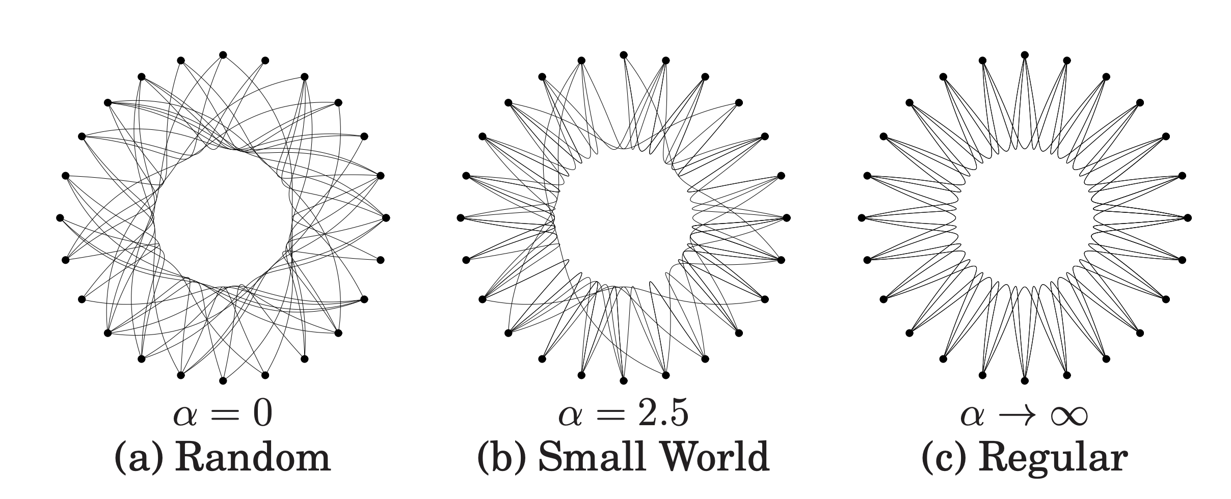
Thread #5: NET4GPT
Core question of how to construct and optimize residual connection for faster and robust learning?
1. Test different combinations of layer-to-layer vs. residual (skip) connections.
2. What is the optimal connections for: * fastest convergence, and * best performance (min loss).
3. Inspirations: Weimao Ke's extensive research on network connections and the "Clustering Paradox" in distributed search and retrieval.

