Slide 1
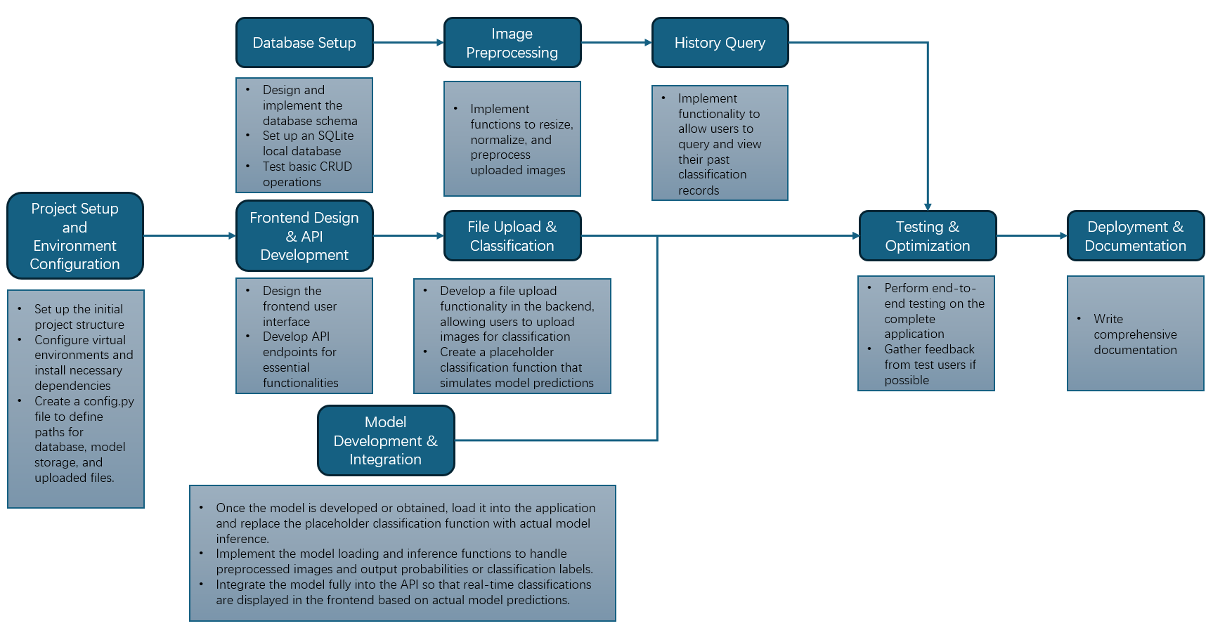
Workflow Overview
Explanation:
The workflow is divided into key stages.
Arrows indicate dependencies and the flow of tasks.
Key Stages:
Setup, backend and frontend development, file handling, model integration, testing, and deployment.

Slide 2
Project Setup and Environment Configuration
Set up the Initial Project Structure
Organized directories for backend, frontend, and model components.
Created a clean, modular layout for scalability and easier collaboration.
Configure Virtual Environments and Install Dependencies
Used venv or conda to isolate the project environment.
Installed key libraries like Flask for API development and TensorFlow for model integration.
Create config.py
Centralized paths for database, model storage, and uploaded files.
Simplified configuration updates for future scalability.

Slide 3
Database Setup
Design and Implement the Database Schema
Created tables for storing user-uploaded image data and classification results.
Focused on scalability to accommodate future functionalities like user accounts and metadata storage.
Set Up an SQLite Local Database
Configured a lightweight database suitable for prototyping and testing.
Ensured ease of deployment and compatibility with other components.
Test Basic CRUD Operations
Validated the database's ability to Create, Read, Update, and Delete records.
Ensured reliability and accuracy for data storage and retrieval processes.

Slide 4
Frontend Design & API Development
Design and Implement the Database Schema
Created tables for storing user-uploaded image data and classification results.
Focused on scalability to accommodate future functionalities like user accounts and metadata storage.
Set Up an SQLite Local Database
Configured a lightweight database suitable for prototyping and testing.
Ensured ease of deployment and compatibility with other components.
Test Basic CRUD Operations
Validated the database's ability to Create, Read, Update, and Delete records.
Ensured reliability and accuracy for data storage and retrieval processes.

Slide 5
Model Development & Integration
Load Model and Replace Placeholder
Replace the placeholder classification function with the actual trained model.
Ensure the model is properly loaded into the application for real-time inference.
Implement Model Inference
Develop functions to process preprocessed images and generate classification probabilities or labels.
Ensure smooth integration with existing workflows.
Integrate Model into the API
Fully integrate the model into the backend API.
Enable real-time predictions to be displayed seamlessly in the frontend for user interaction.

Slide 6
Testing & Optimization
Perform End-to-End Testing on the Complete Application
Tested the entire workflow to ensure seamless integration between frontend, backend, and database.
Validated functionality, including file uploads, preprocessing, and placeholder classification.
Gather Feedback from Test Users
Collected user input to identify usability issues and areas for improvement.
Incorporated suggestions to refine the interface and enhance overall performance.

