Slide 1
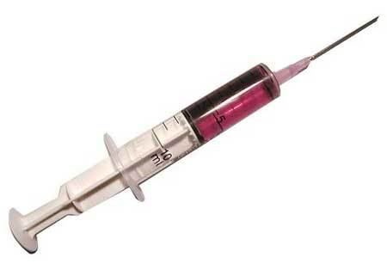
Process
main foo
5. Execute payload
1. Inject agent(manual)
Agent
Initialization
Instrumentation engine
Payload
Injector
3. Tell Agent about the call to foo
4. Propagate instrumentation to foo
2. Initial
Instrumentation
-------
-------
instrument()
foo()
-------
-------
-------
------
------
instrument()
connect()
-------
-------
-------
6. Call foo
Self propelled instrumentation user written code
Self propelled instrumentation library code
Steps in Self- propelled instrumentation
Normal control flow of the program

