Slide 1
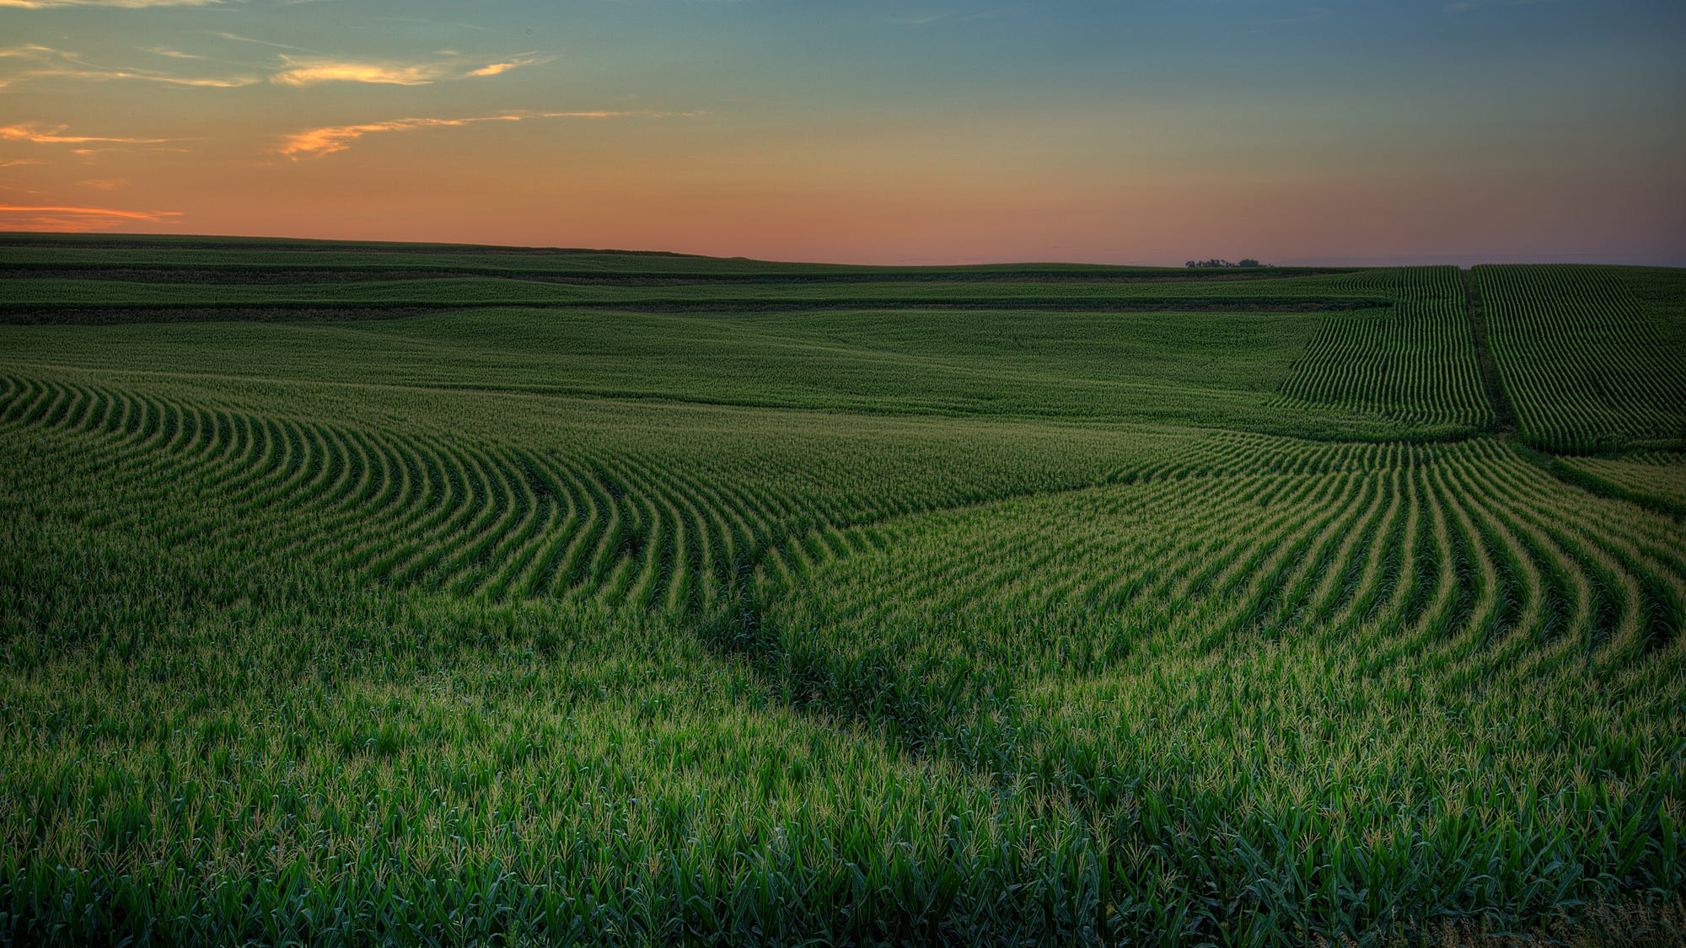

Slide 2
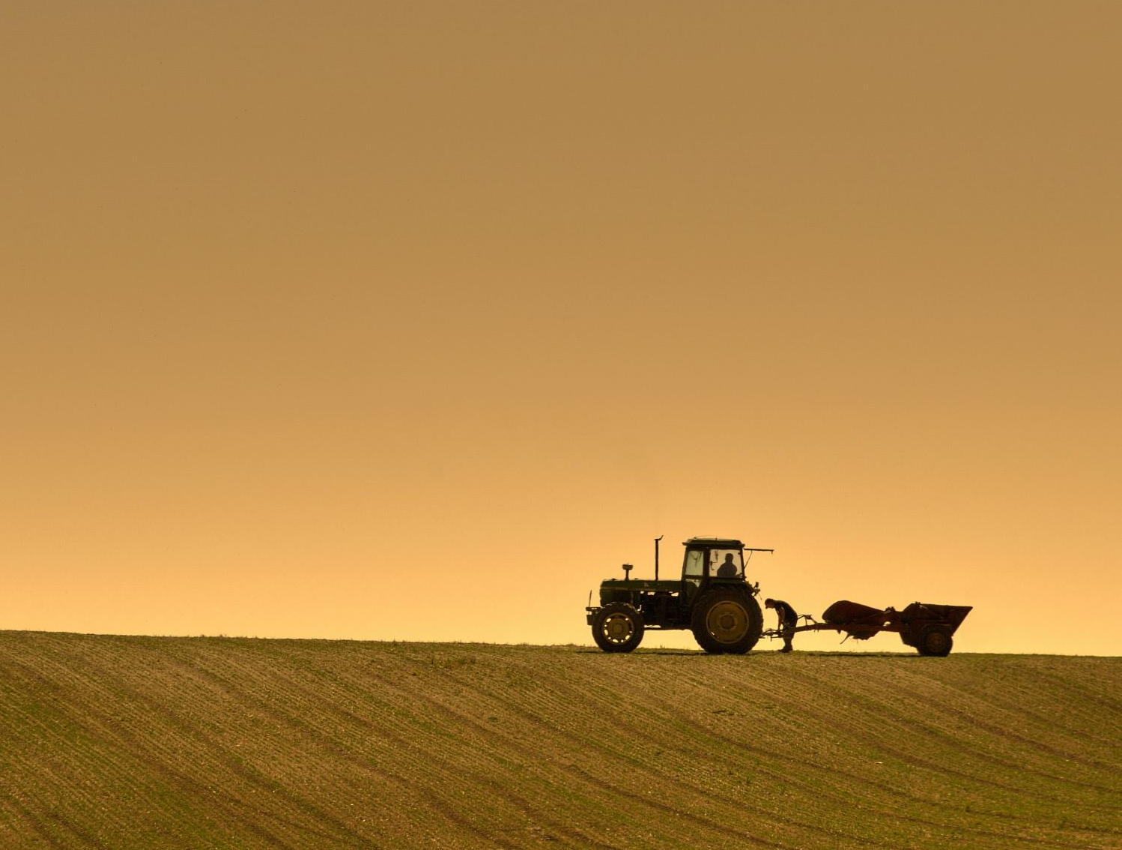
Group Intro
Carson, University of Minnesota Twin Cities, 2029
From North Dakota, where farming and Ag play major roles
Interested in seeing how ML is applied in those fields
Jerry, University of Minnesota Twin Cities, 2028
Previous experience preparing datasets for similar remote sensing projects.
Familiar with preprocessing but newer to model development
Cindy, Illinois Institute of Technology, 2027
No prior experience in agriculture
Interested in learning how AI models can combine multiple data sources for environmental applications. ​
Notes:
Jerry

Slide 3
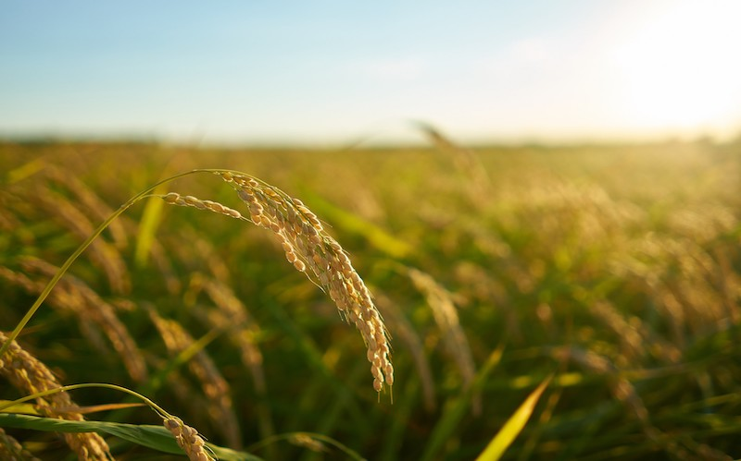
Project
Background
Why is crop mapping important?

Slide 4
Project
Reference:
https://www.ncsa.illinois.edu/2025/03/31/mapping-the-earths-crops/
https://www.arlula.com/news/why-satellite-imagery-is-a-game-changer-for-agriculture
Background
Production
Disease detection
Pest detection
Monitor plant nutrients
Precipitation Conditions
Plant Health
Monitor precipitation conditions
Rain, snow, sunny, sleet, hail, etc.
Soil moisture
Helps monitor agricultural production
Assists farmers and policymakers
How much food in total
Tracks the types of food being produced
Notes:
Accurate crop classification helps to monitor agriculture activities, allows us to make predictions on how much food is being produced, and identify the types of crops being grown in a large area.
This information can allow farmers to make better management decisions and help policy makers to monitor food supplies and plan agriculture activities.
We can also monitor precipitation conditions and plant health, allowing farmers to monitor soil moisture and take early actions in diseased crops to reduce economic loss.

Slide 5

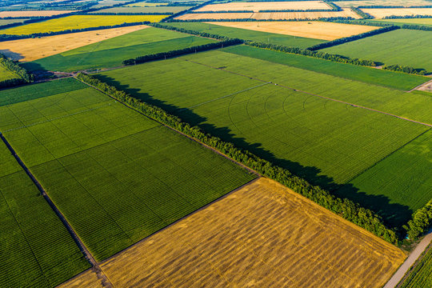


Current
challenge
Satellite imagery alone does not always distinguish crops accurately because many crops look similar during portions of the growing season (https://www.nature.com/articles/s41598-026-37806-2)
Notes:
Although satellite imagery provides many useful information, it has its limitations. Many crop types appear similar during parts of the growing season.
For example, corn and soybean look virtually identical during early spring emergence.
This challenge motivates the integration of additional information like weather data to improve crop classification accuracy.

Slide 6
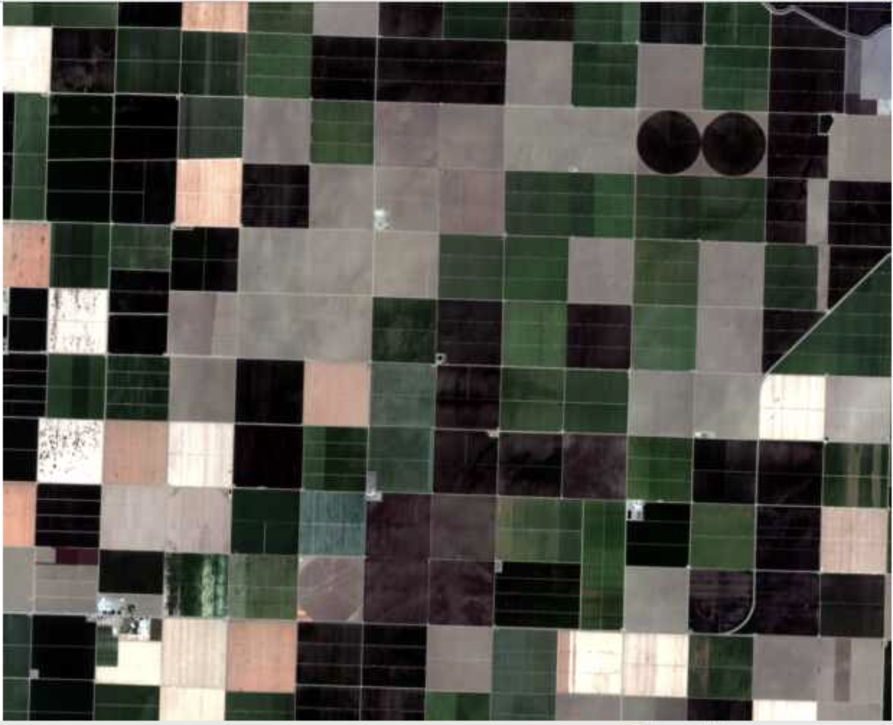
12 timestamps alternatives – Growth patterns of land cover
Reference: Jupyter Notebooks
Notes:
Here we show a series of satellite images of the same crop area over 12 timestamps. We can see how the area changes as crops are planted, grow, and harvest.

Slide 7
12 timestamps alternatives – Growth patterns of land cover
Reference: Jupyter Notebooks
Notes:
Here we show a series of satellite images of the same crop area over 12 timestamps. We can see how the area changes as crops are planted, grow, and harvest.

Slide 8
12 timestamps alternatives – Growth patterns of land cover
Reference: Jupyter Notebooks
Notes:
Here we show a series of satellite images of the same crop area over 12 timestamps. We can see how the area changes as crops are planted, grow, and harvest.

Slide 9
12 Timestamps
Reference: Jupyter Notebooks
Notes:
This is a blown up image of a single time stamp.

Slide 10
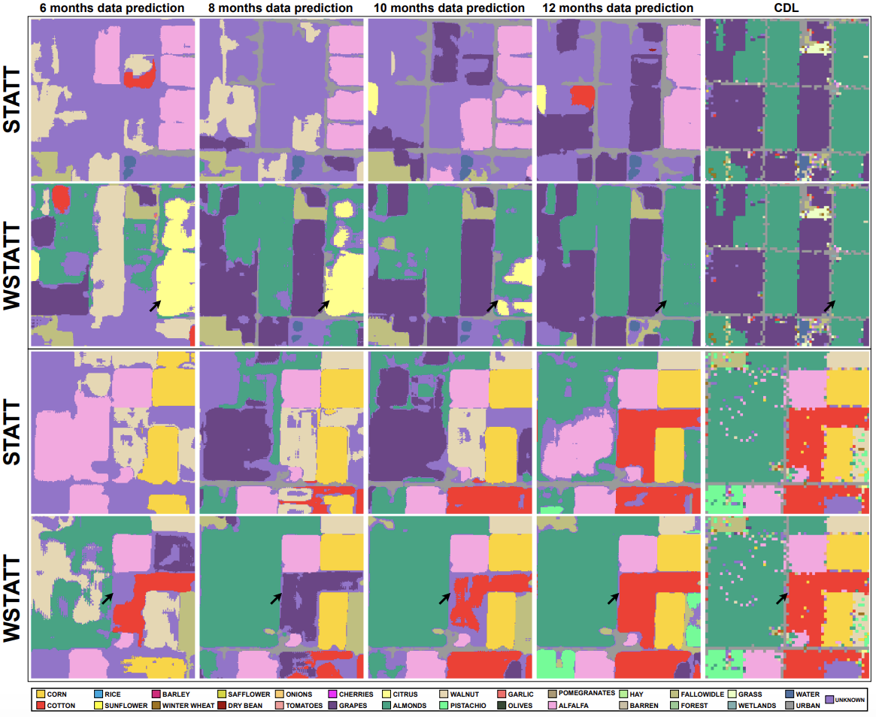
Technical Goal
Different combinations of timestamps and
weather variables
Develop a model that combines both satellite imagery and weather data to produce accurate crop classification maps.
1
2
Which weather variables contribute the most?
3
Can transformer-based models outperform traditional approaches (CNN)?
Reference: https://arxiv.org/pdf/2401.15875
Notes:
The main objective of this project is to develop a deep learning model that combines both satellite imagery and weather information to generate more accurate crop classification.

Slide 11
Technical Goal
But then we wanted to further investigate
1
Different combinations of timestamps and
weather variables
2
Which weather variables contribute the most?
Can transformer-based models outperform traditional approaches (CNN)?
3
Reference: https://arxiv.org/pdf/2401.15875
Notes:
Beyond building the model, we also wanted to answer some additional questions:
How do different combinations of time stamps and weather variables affect the result?
Which weather variables contribute the most?
And how the transformer base model compares to model based on CNN and LSTM in prediction at sparse time stamps.

Slide 12
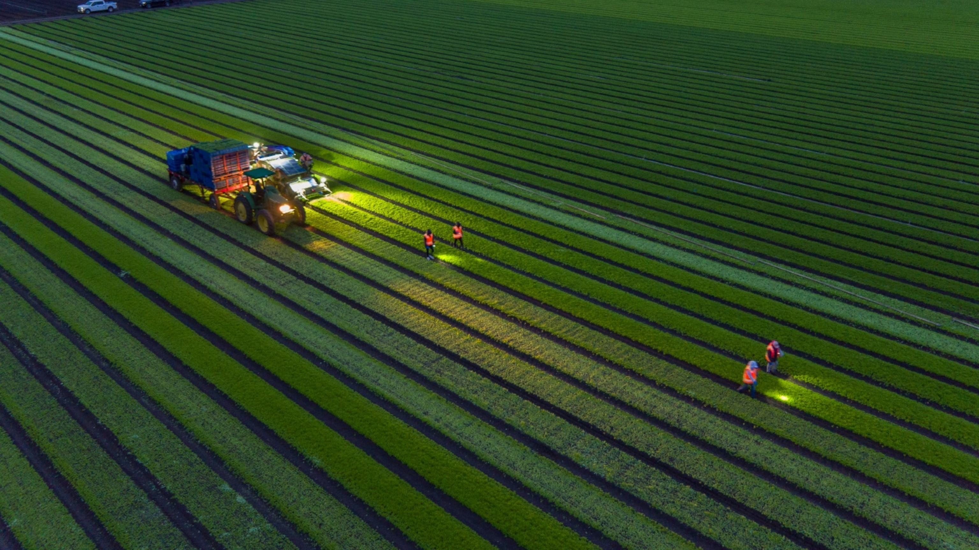
Dataset
Satellite
Weather + Satellite
Sentinel-2 (European satellite mission that regularly captures high-resolution images of Earth)
24 timestamps throughout the growing season
10 spectral bands
Spatial resolution: 1098 x 1098
Image split into patches of size 32 x 32
365 daily observations
Variables:
Dayl – Amount of Daylight
Prcp – Amount of Precipitation
Srad – Amount of Solar Radiation
Swe – Snow Water Equivalent
Tmax – Max. Temperature in a day
Tmin – Min. Temperature in a day
Vp – Vapor Pressure
Notes:
Cindy

Slide 13
Satellite
Weather + Satellite
365 daily observations
Variables:
Dayl – Amount of Daylight
Prcp – Amount of Precipitation
Srad – Amount of Solar Radiation
Swe – Snow Water Equivalent
Tmax – Max. Temperature in a day
Tmin – Min. Temperature in a day
Vp – Vapor Pressure
Sentinel-2 (European satellite mission that regularly captures high-resolution images of Earth)
24 timestamps throughout the growing season
10 spectral bands
Spatial resolution: 1098 x 1098
Image split into patches of size 32 x 32
13
Notes:
Our satellite imagery comes from the Sentinel-2 mission, which provides high-resolution multispectral images of the Earth's surface.
The dataset contains 24 timestamps captured throughout the year, allowing us to observe crop development over time.
Each image contains 10 spectral bands and has a spatial resolution of 1098 by 1098 pixels.
Alongside the satellite imagery, we use 365 daily measurements for seven weather variables, including daylight and precipitation, etc, providing environmental context that may explain crop growth patterns not directly visible in the imagery.

Slide 14
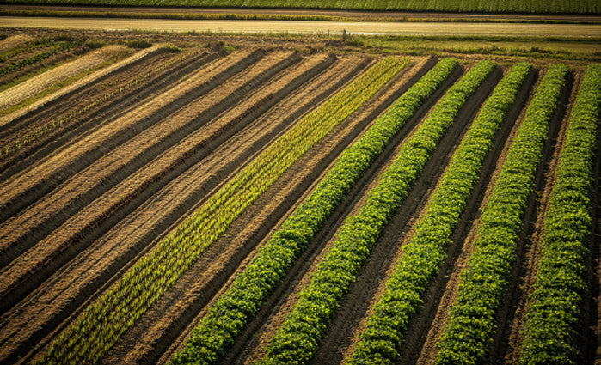
Labels

Slide 15
Combined
Original crop labels from the USDA Cropland Data Layer (CDL)
Every pixel is assigned a crop class (e.g., class 1 = corn, class 100 = unknown pixels)
Includes field boundaries, where neighboring crops meet
Contains approximately 200 crop classes, later reduced to 30 major classes for the purpose of this project
Eroded
Removes pixels along field boundaries
Keeps only the interior of each crop field
Reduces ambiguous/mixed pixels
Produces cleaner labels for training
Notes:
The crop labels originate from the USDA Cropland Data Layer.
There are 30 major crop classes, where each pixel is assigned one
The dataset also provides an eroded version of the labels, where it removes pixels located along field boundaries, where neighboring crop types often mix together, reducing ambiguity and noise.

Slide 16
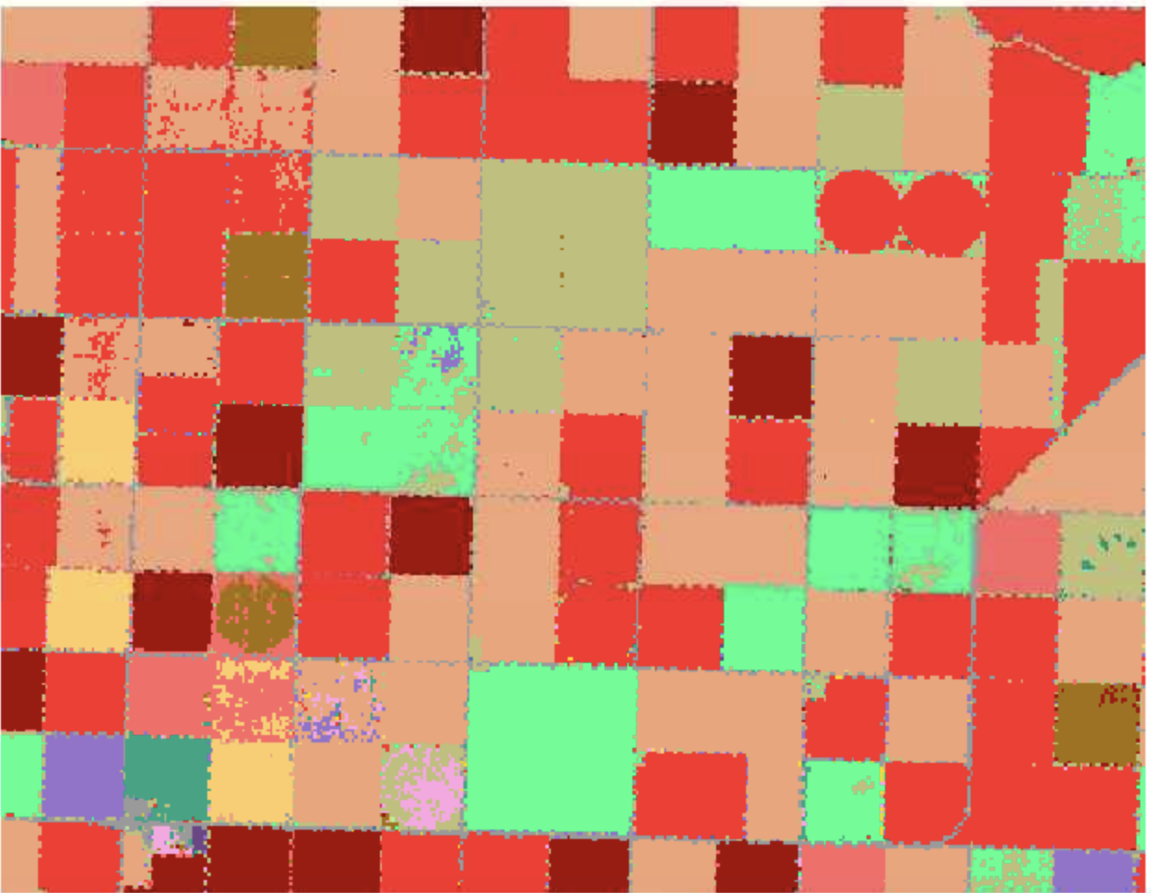
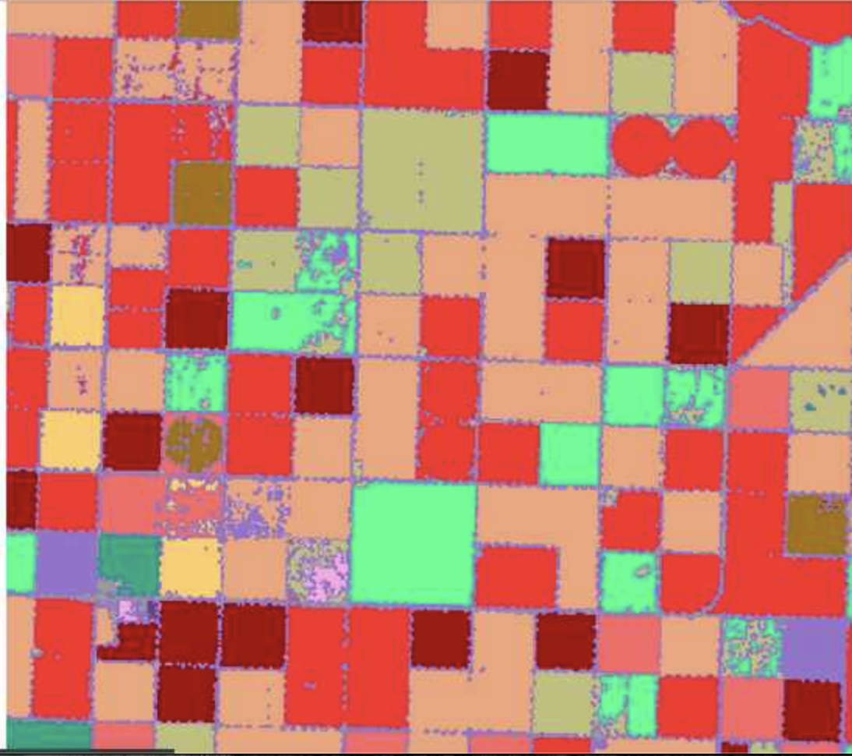
Combined vs Eroded Labels
Reference: Jupyter Notebooks
Notes:
The combined labels preserve the complete field boundaries, while the eroded labels intentionally remove edge pixels, allowing the model to learn from more reliable examples during training.

Slide 17
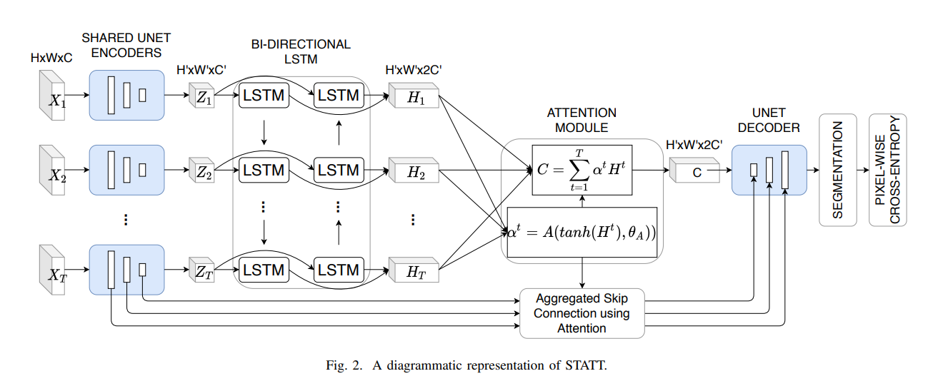
Methods
STATT Model
Reference: https://arxiv.org/pdf/2105.02963
Notes:
STATT serves as the baseline for this project.
It combines satellite imagery with temporal modeling by extracting spatial features and gathering temporal features from them across the timestamps.

Slide 18
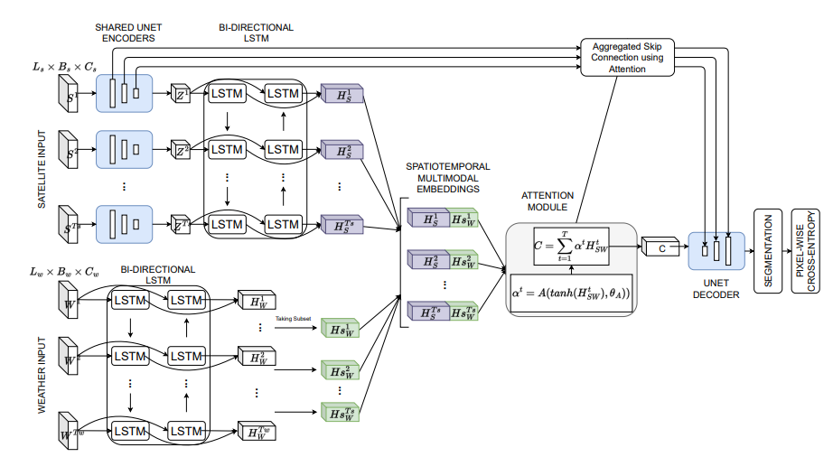
Methods
WSTATT Model
Reference: https://arxiv.org/pdf/2105.02963
Notes:
WSTATT extends the STATT architecture by incorporating weather information alongside the satellite imagery.

Slide 19
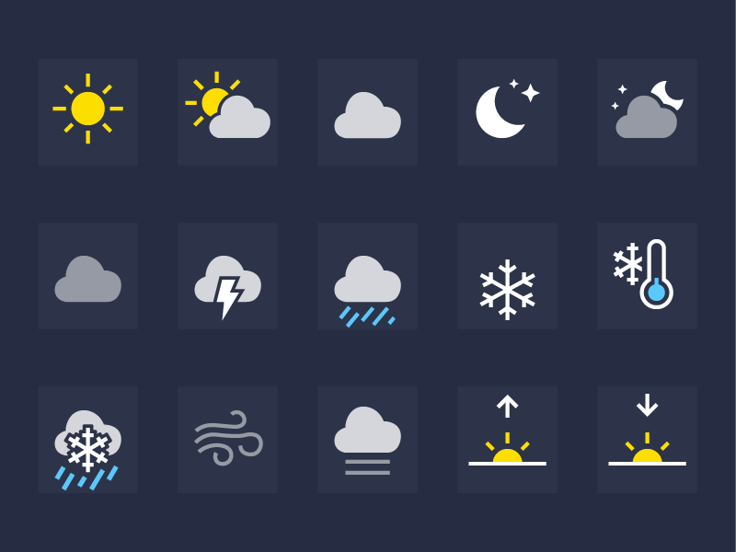
Methods
Satellite + Weather
Jupyter Notebook
Reference: https://metro.co.uk/2018/02/26/iphone-weather-symbols-mean-7343734/
Notes:
Our model combines both satellite imagery and weather data.

Slide 20
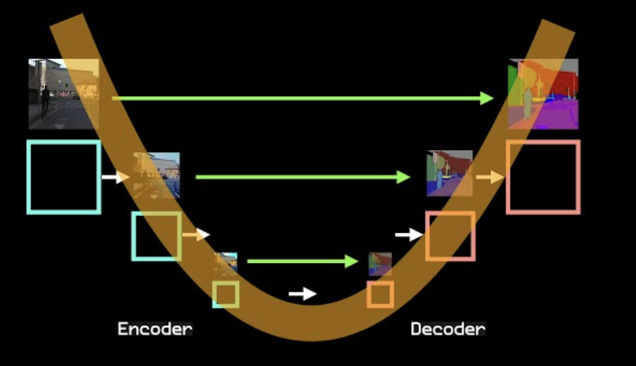
Methods
U-Net Encoder/Decoder
Purpose:
Extracts spatial features from each satellite image & learns patterns (field boundaries, crop textures, vegetation structures)
Reconstructs the spatial prediction from the encoded features
How it works:
Convolutional layers followed by down-sampling
Cross-Entropy Loss compares predicted class probabilities with the ground-truth labels during training.
Gradually up-samples the feature maps back to the original image resolution
Reference: https://youtu.be/NhdzGfB1q74?si=Gn2qlenZSNi-HfZI
Notes:
Encoder: Find spatial features at different resolutions by
progressively downsampling the input image.
Decoder: Follows a temporal module and reconstructs the segmentation mask using skip connections by progressively upsampling the learned feature maps.

Slide 21
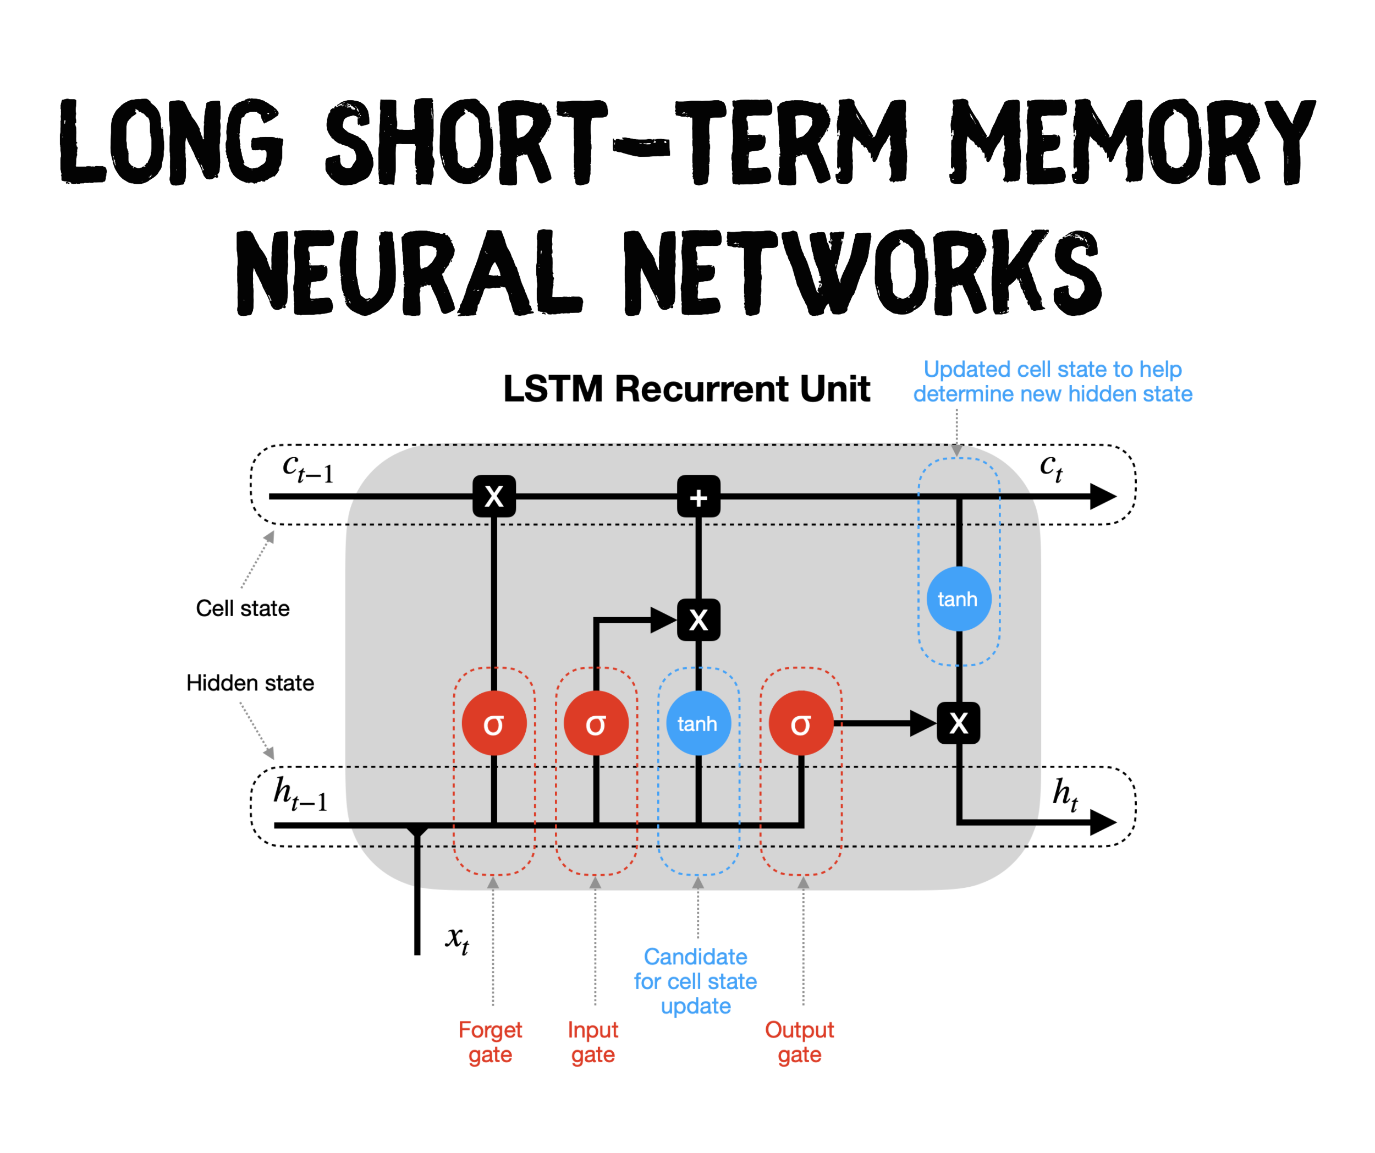
Methods
BI-Directional Long Short-Term Memory (BI-LSTM)
Purpose:
Model changes in crop appearance throughout the crop's lifecycle
How it works:
Processes the sequence of image features over multiple timestamps
Made of 2 LSTM structures:
Forward – manages the growing season
Backward – manages the harvesting season
Reference: https://towardsdatascience.com/lstm-recurrent-neural-networks-how-to-teach-a-network-to-remember-the-past-55e54c2ff22e/
Notes:
The LSTM processes the sequence of encoded satellite features across multiple timestamps, learning seasonal crop development patterns (planting, growth, and harvesting).
It’s made of 2 structures: forward, which manages the growing season, and backward, which manages the harvesting season

Slide 22
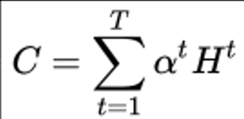
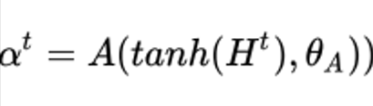
Methods
Purpose:
Identifies the most informative timestamps and weather conditions
Attention
How it works:
Computes importance weights for different temporal features
Influence the skip connections that are passed to the decoder
Reference: https://arxiv.org/pdf/2105.02963
Notes:
This attention module assigns higher importance to informative timestamps and weather conditions while reducing the influence of noisy observations, deciding which skip connections are the most important.
It also creates a hidden state that models different phenological patterns throughout the year.

Slide 23
Methods
Crop Classification Map
Reference: https://arxiv.org/pdf/2401.15875
Notes:
The final result is a segmentation mask where every pixel is assigned a predicted crop class.

Slide 24
Experimental Design
6, 12, 18, 24 timestamps
Satellite
Water Bands – prcrp, swe, vp
All 7 bands
Weather
Sun Bands – dayl, srad, tmax, tmin
Notes:
Cindy

Slide 25
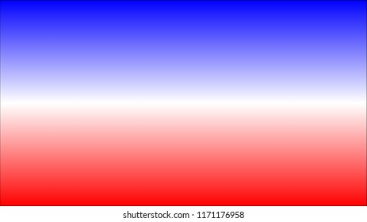
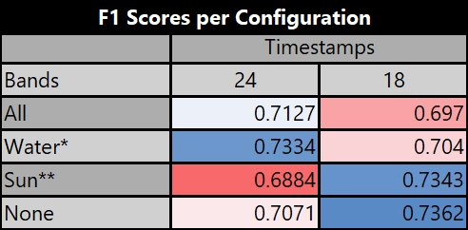
Results & Analysis – Original STATT & WSTATT Test
Key:
*Water bands (prcp, swe, vp)
**Sun bands (dayl, srad, tmax, tmin)
Blue -> Best Scores
White -> In Between
Red -> Worst Scores
Outcome: Results were not consistent across time stamps and weather bands
Notes:
Carson

Slide 26
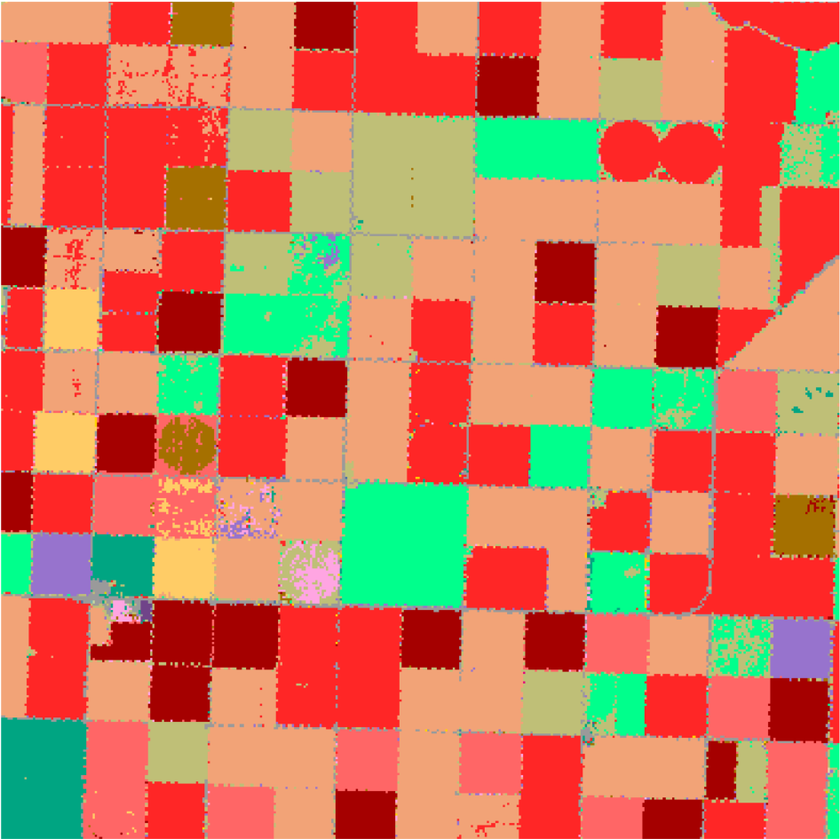
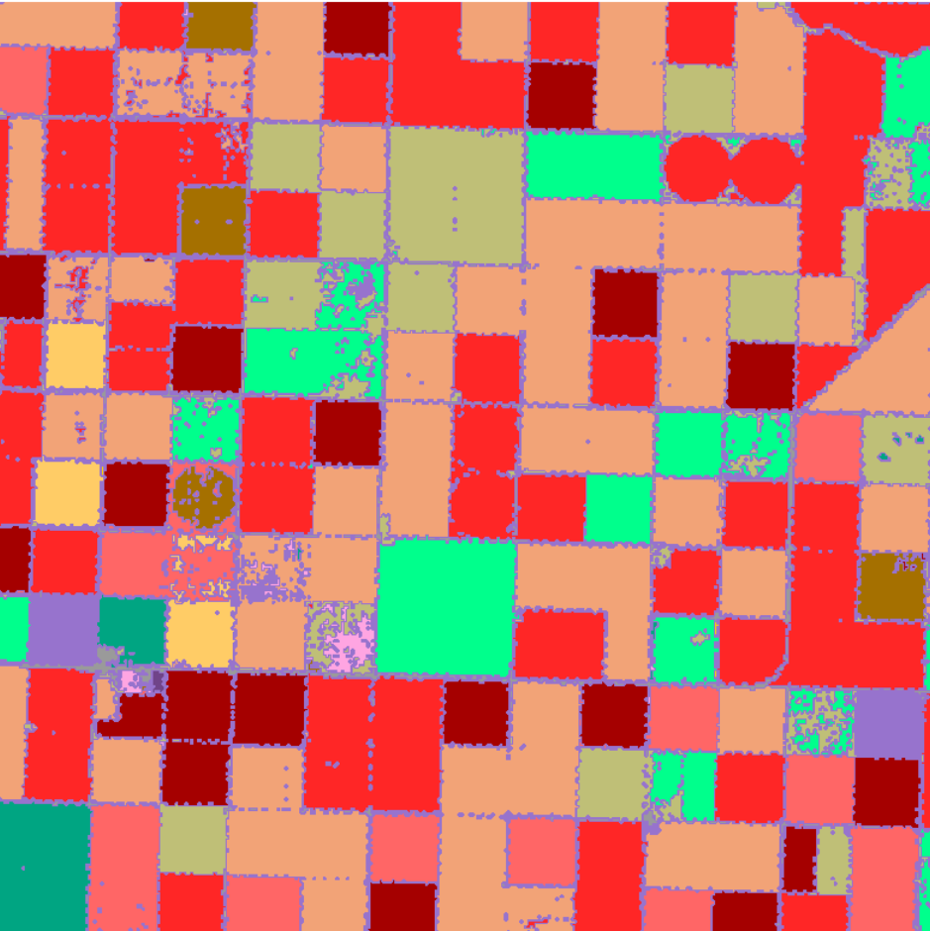
The Problem: Labels
We were training on Ground-Truth (combined)
Reference: Jupyter Notebooks

Slide 27
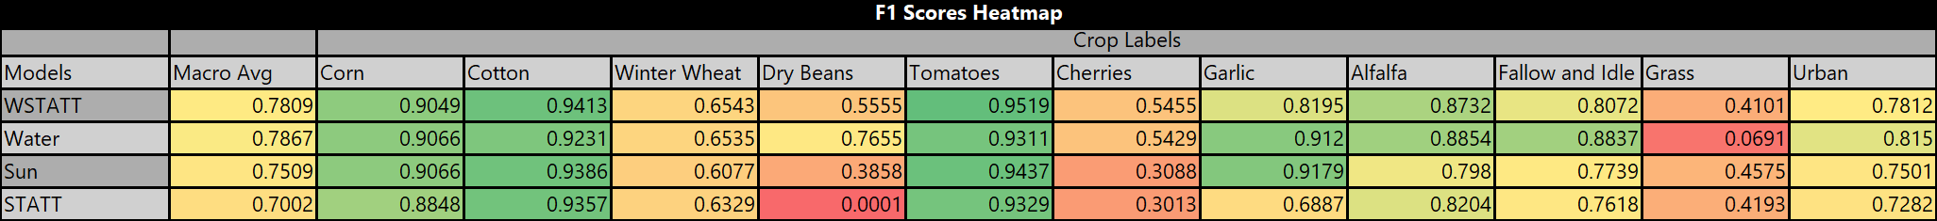
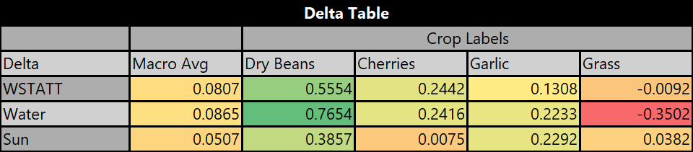
Results & Analysis – New STATT & WSTATT Test
Outcome
WSTATT showed clear improvement
The water-trained model showed consistently higher scores than the sun-trained model (Dry Beans, Cherries) or the same (Corn, Cotton, Garlic)
The water model's scores were very similar to WSTATT in full
*Shows direct improvements over STATT for each trained model

Slide 28
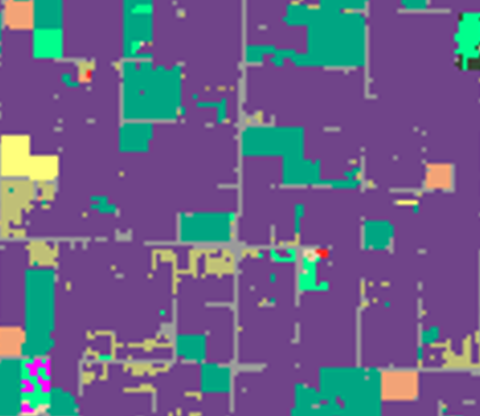
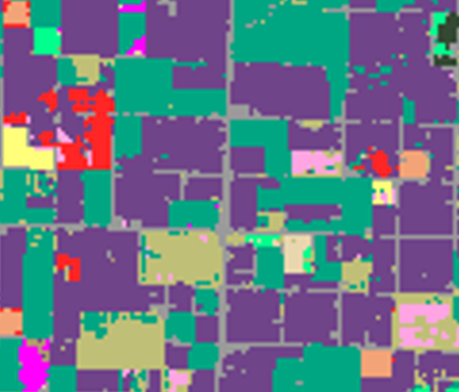
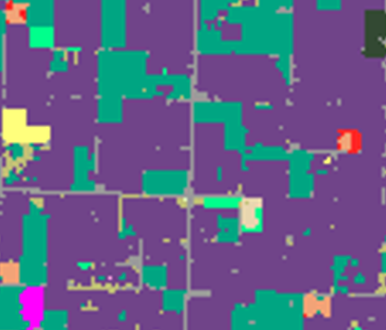
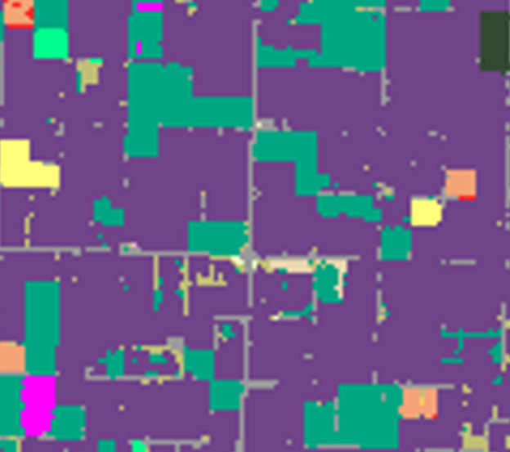
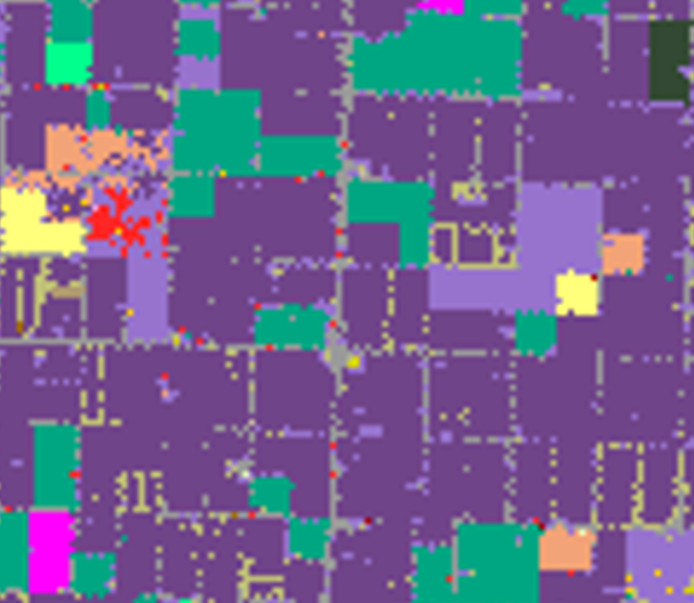
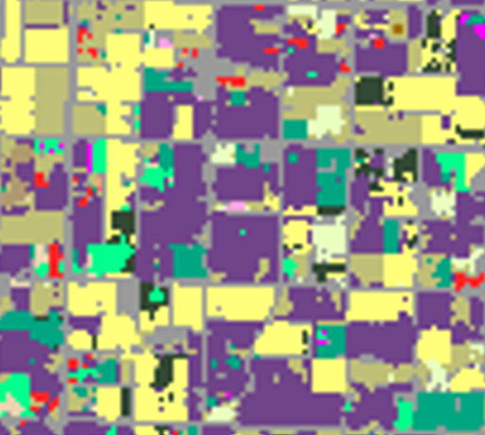
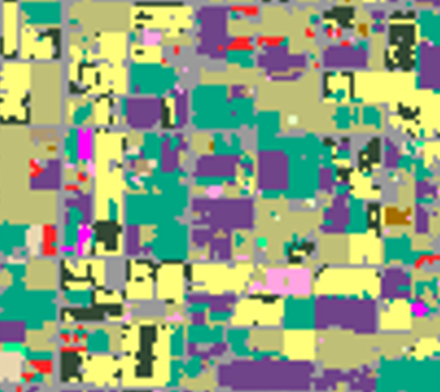
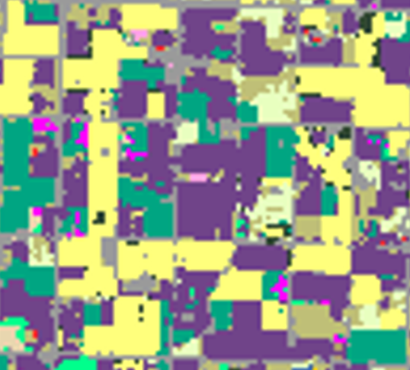
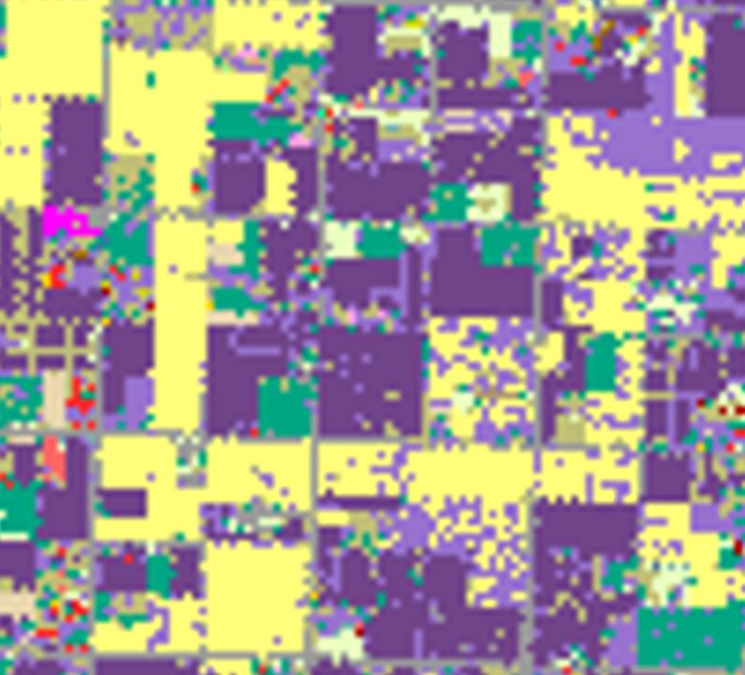
Direct Model Comparison
STATT
Sun-Trained Model
Water-Trained Model
WSTATT
CDL Ground-Truth
*Features predicted by the water-trained model are more represented in WSTATT's predictions than those predicted by the sun-trained model

Slide 29
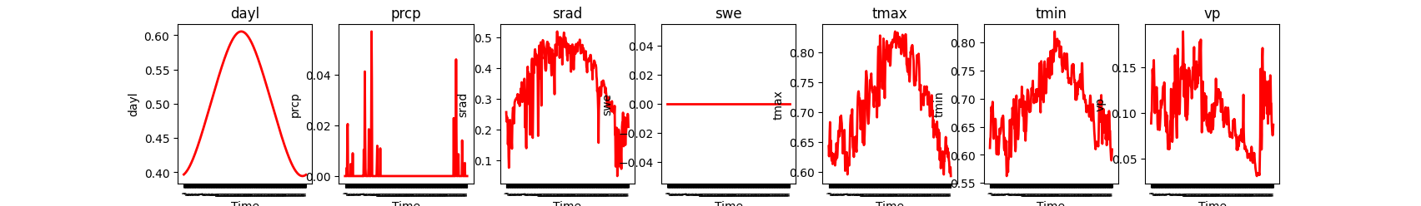
Crop vs. Sun Variables: Possible Explanation
Most sun variables are seasonal and demonstrate redundant trends, so there is less info for the model to gather
Crop phenology is directly influenced by water availability
*Most of WSTATT's predictive power comes from prcp and vp (swe doesn't provide a pattern in this region)
Reference: Jupyter Notebooks

Slide 30
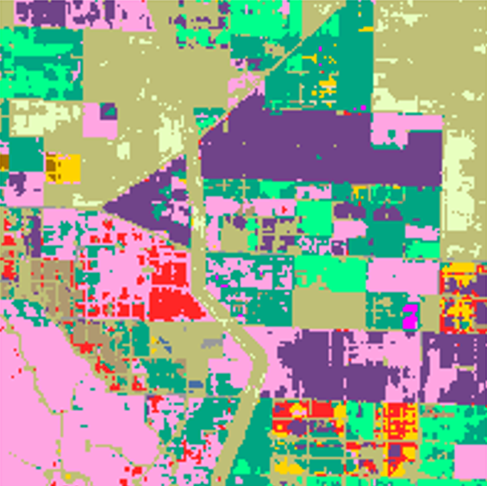
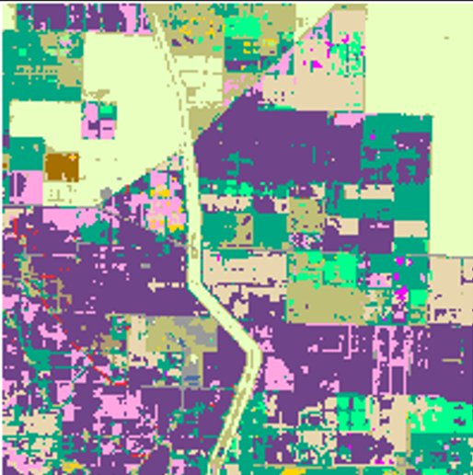
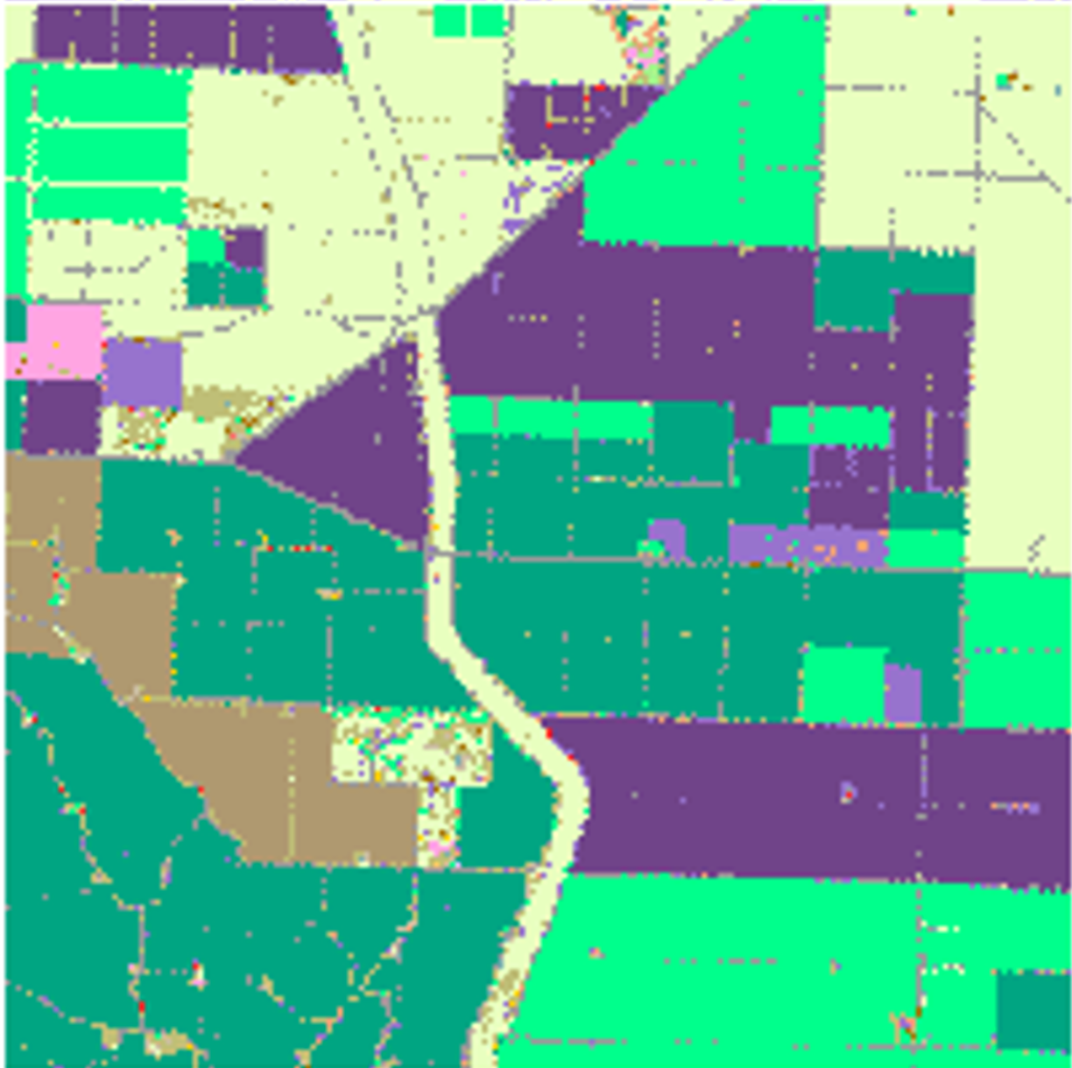
6 timestamps comparison
STATT
WSTATT
Ground-Truth

Slide 31
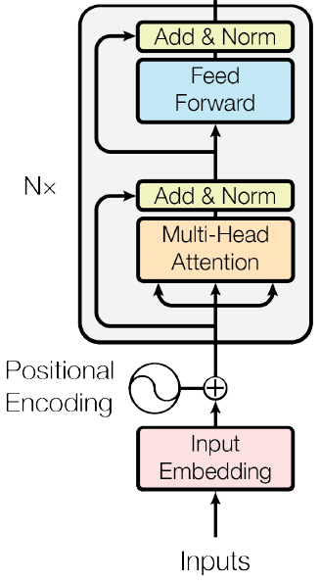
Can we build a good model with fewer timestamps?
Hypothesis: By utilizing transformers, we can more effectively use sparse temporal data to improve temporal feature representations in our predictions.

Slide 32
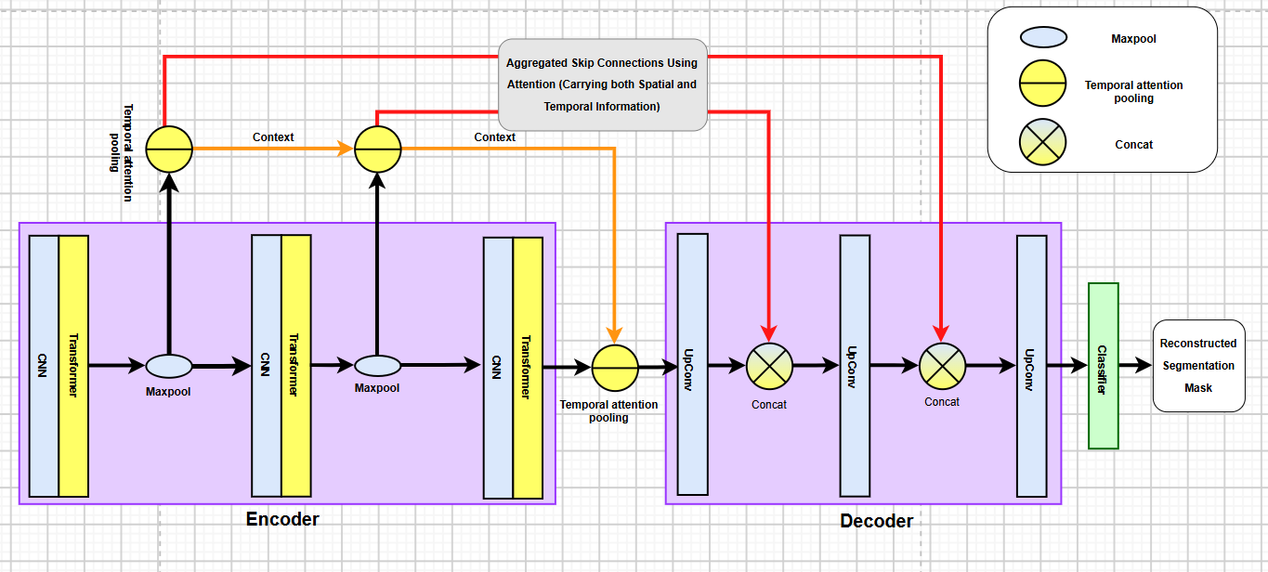
Transformer Model Pipeline
Reference: https://drive.google.com/file/d/10MdjF9_hlnFuo7ktOqXeHC5Ke7gM0u3M/view?usp=sharing

Slide 33
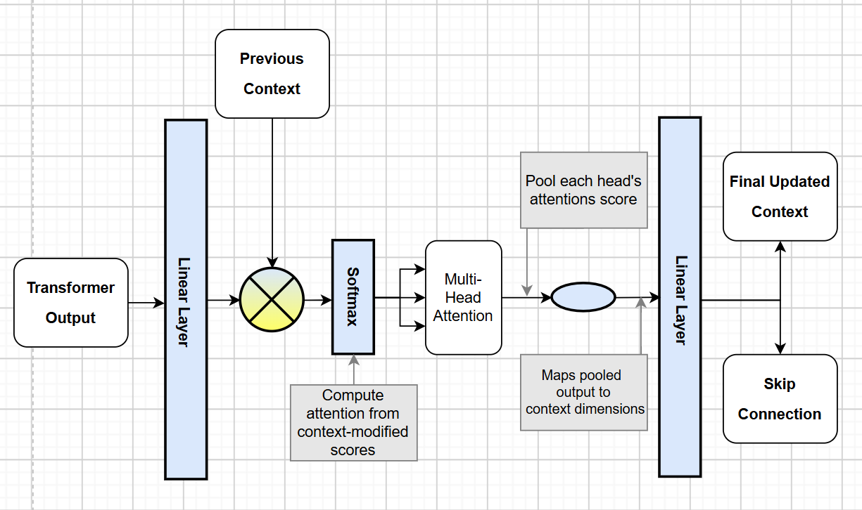
Temporal Pooling with Multi-Head Attention (MHA)
Pools the temporal dimension of transformers' outputs
Computes attention with MHA
Produces a context vector that affects the next temporal pooling layer
Final temporal pooling layer passes output to decoder
Reference: https://drive.google.com/file/d/10MdjF9_hlnFuo7ktOqXeHC5Ke7gM0u3M/view?usp=sharing

Slide 34
6 timestamps comparison
STATT
WSTATT
Ground-Truth

Slide 35
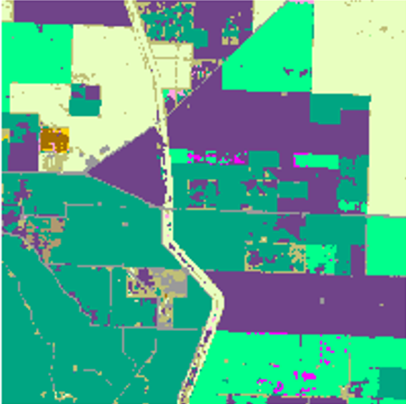
6 timestamps comparison
STATT
WSTATT
Transformer-Based
Ground-Truth
Transformer model performs much better with fewer timestamps than the STATT and WSTATT baselines

Slide 36
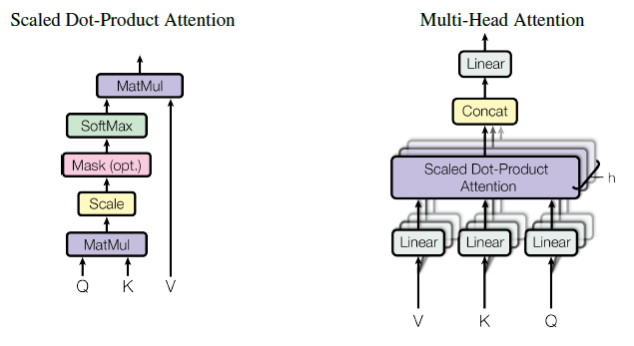
Why Is This?
- The hope is that multi-head attention allows our model to represent multiple phenological patterns, like different harvest and growth periods
- STATT originally compresses that into a single hidden state
- Applying temporal pooling to richer transformer features at different layers rather than 1 bottleneck
- Both spatial and temporal information are passed into the decoder with skip connections

Slide 37
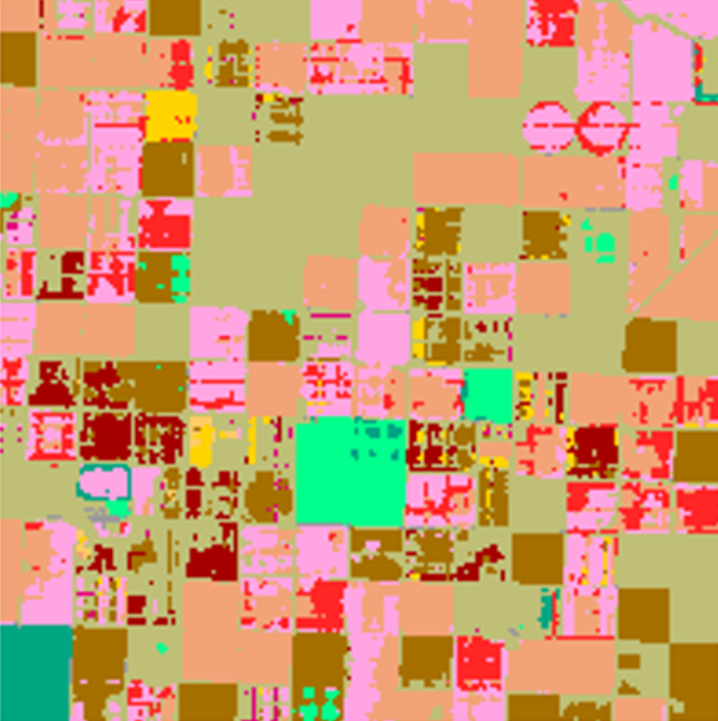
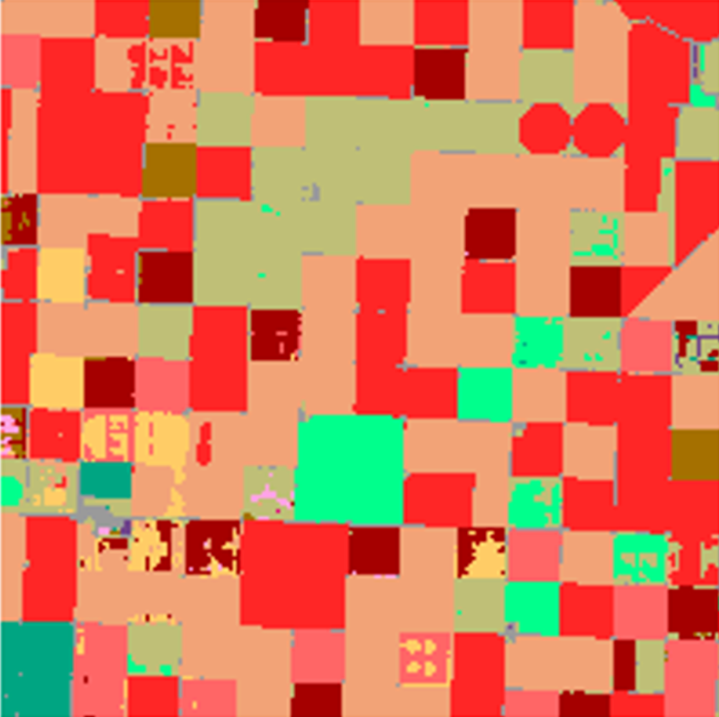
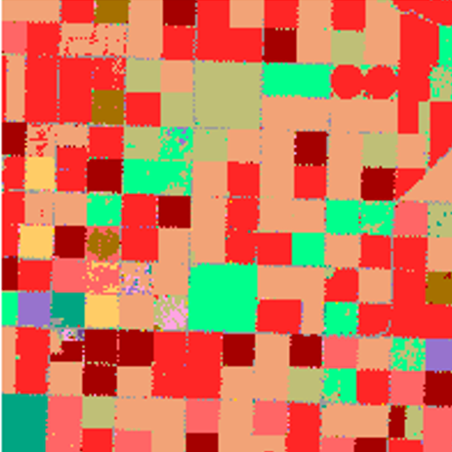
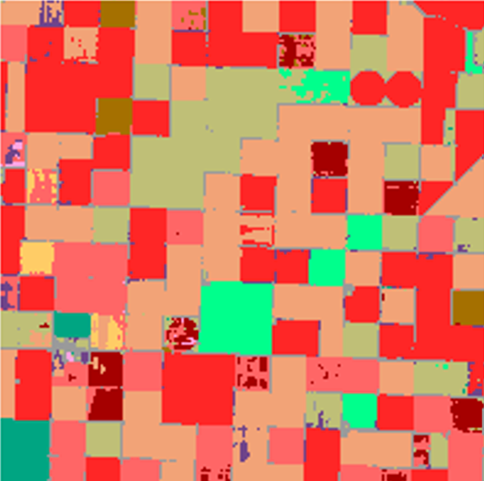
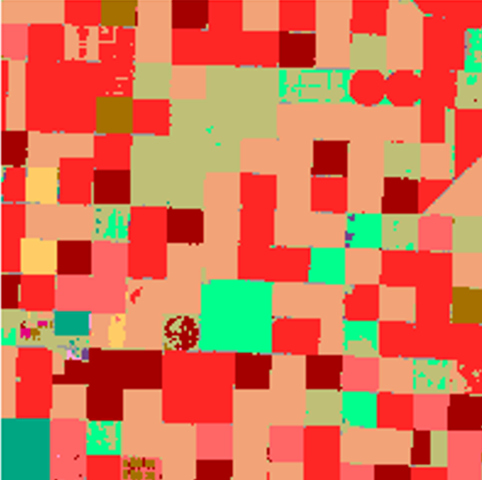
How Predictions Change 6 vs. 24 Timestamps
6 Timestamps
24 Timestamps
Ground-Truth
STATT
Transformer-Based Model

Slide 38
Summary & future expansion
Summary & future expansion
WSTATT performs better than or just as well as STATT in all categories
Water variables are more important to WSTATT's predictions than sun variables
Our transformer-based model was able to produce accurate crop maps with fewer timestamps, although its performance levels with STATT remain slightly higher (more training required) as timestamps increase
Incorporate weather data into our transformer-based model
WSTATT performs better than or just as well as STATT in all categories
Water variables are more important to WSTATT's predictions than sun variables
Our transformer-based model was able to produce accurate crop maps with fewer timestamps, although its performance levels with STATT remain slightly higher (more training required) as timestamps increase
Incorporate weather data into our transformer-based model

Slide 39
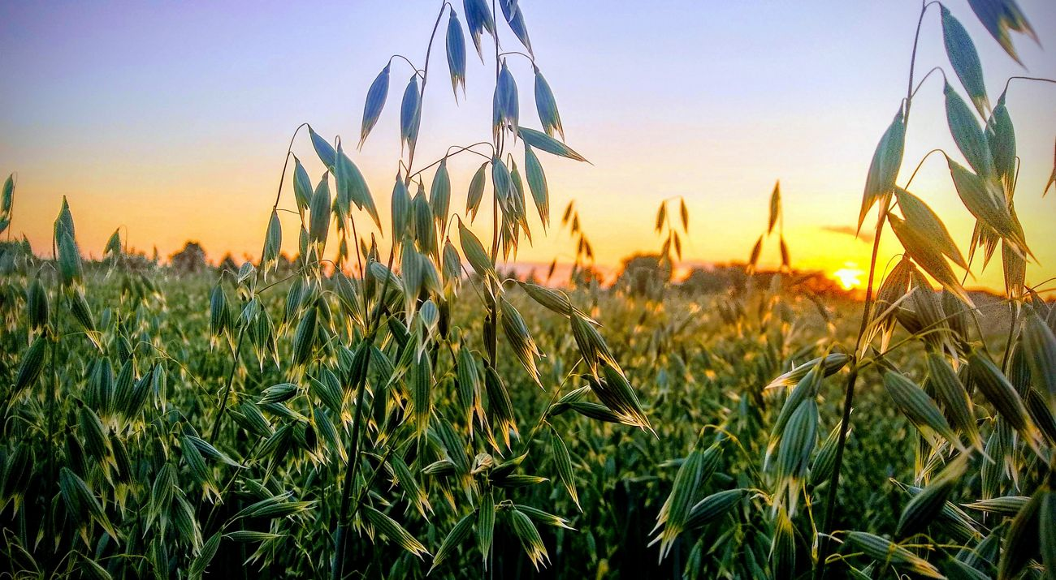
Learning Outcomes

Slide 40
Learning Outcomes
Carson
Carson
How to use spatial data and create ML models that use it to make predictions
Various components of segmentation models (U-Net)
How to develop a good workflow for model training, validation, testing, and gathering results
The roadblocks in those processes
Place Holder
Notes:
TODO: make them

Slide 41
Learning Outcomes
Carson
Jerry
Place Holder
How machine learning is utilized in agriculture.
How using different labeled data can affect the model results.
The general workflow of model training, validation, and testing.
Notes:
TODO: make them

Slide 42
Learning Outcomes
Carson
Cindy
Training deep learning models is far more time-intensive than expected
Label quality has a significant impact on model performance
Weather features influence both training behavior and model performance
Visualization is essential for diagnosing model performance
Small implementation bugs can produce misleading results
Learning new tools improves communication
Place Holder
Notes:
Training & validation loss

Slide 43
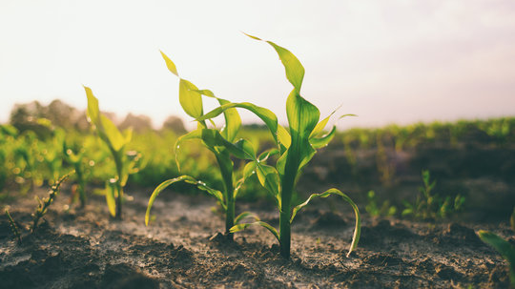
Q&A
Thank you

