Slide 1



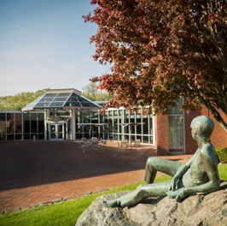
Brandeis Info
Jierui Peng, Xuxin Zhang, Jialin Zhou

Slide 2


01
02
03
04
APP GOAL
FUNCTIONS
NEXT GOAL
VOICE

Slide 3

01
APP GOAL
Overall Goal
Provide a platform for students to get all information with one click and connect each other

Slide 4
02
FUNCTIONS!
CLASS SECHEDULE
CLASS SEARCH
STUDENT MARKET

