Slide 1
Suggestion for presentation slide

Slide 2
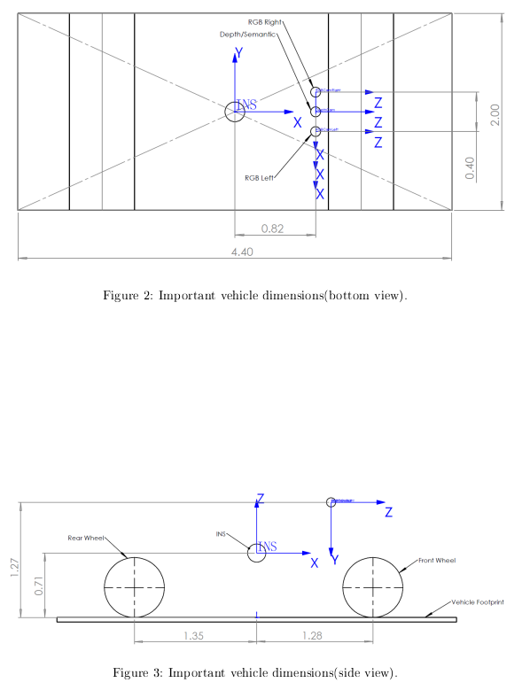
Traffic Light Detection
Setup:
  All Cameras are on the same height, the RGB cameras have each 1cm offset

Slide 3
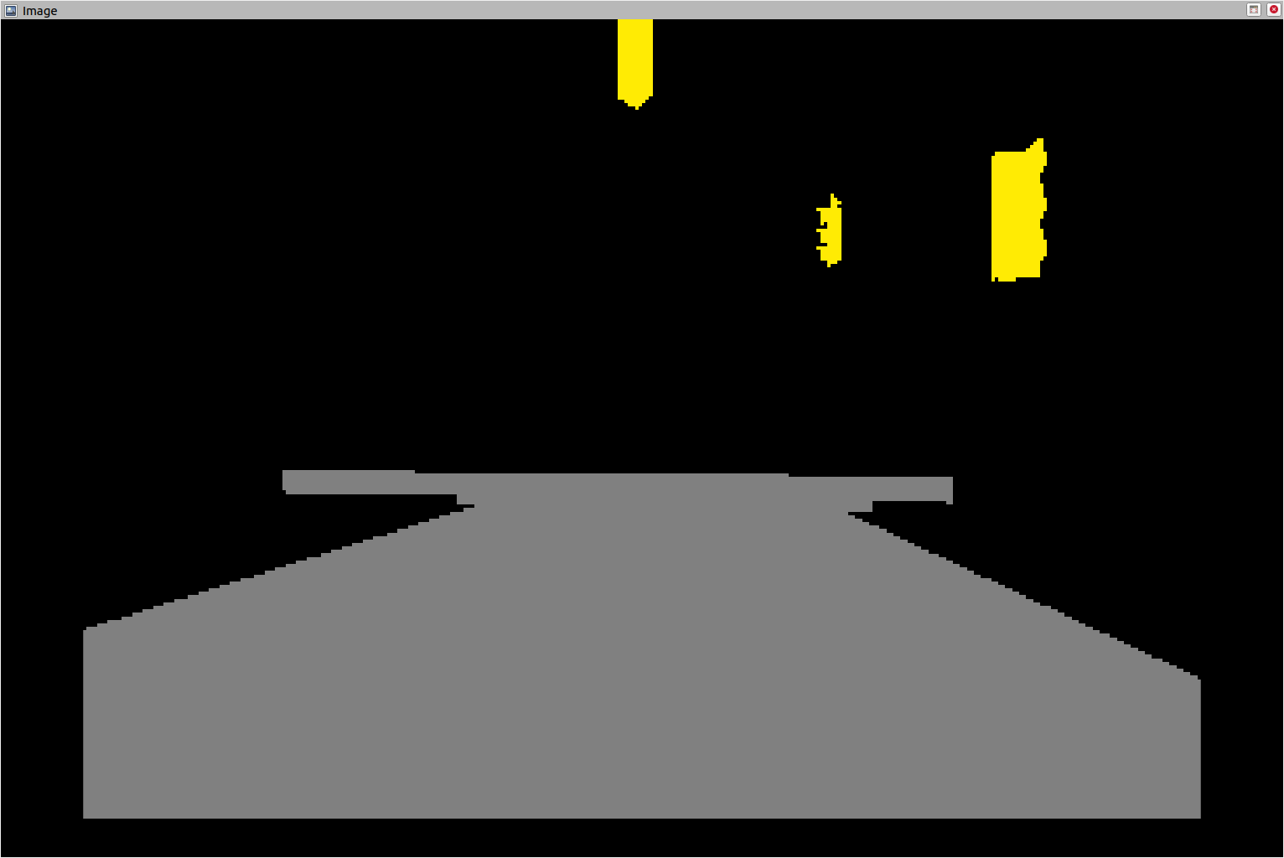
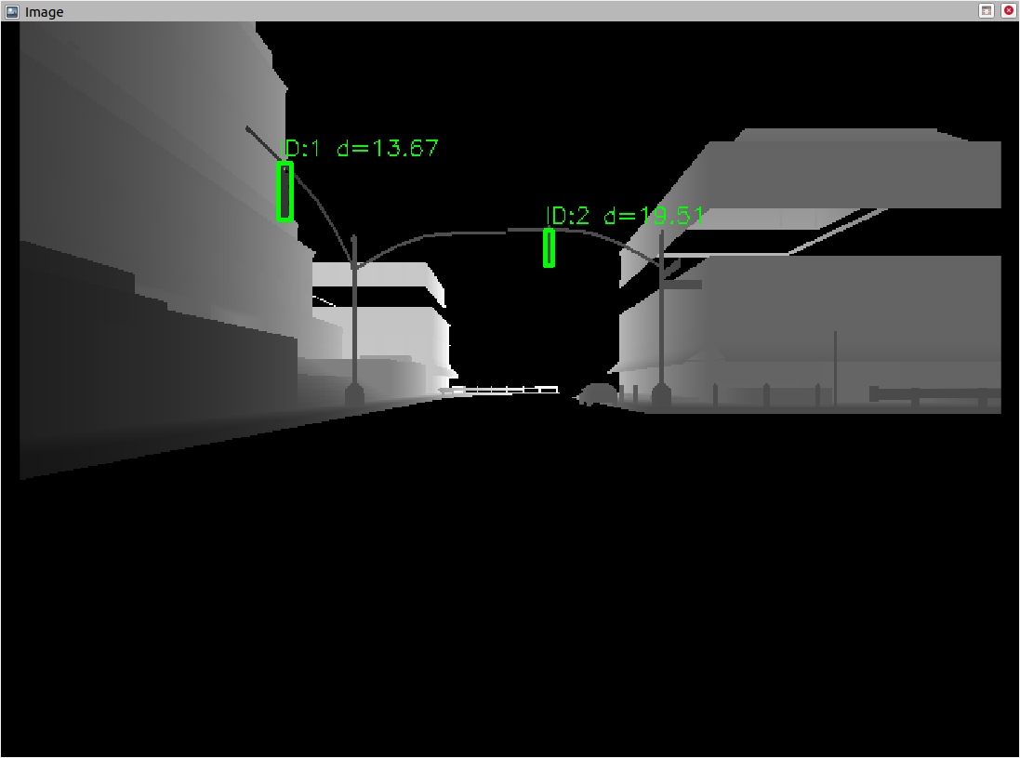
Traffic Light Detection
1st node:
Traffic Light pixel coordinates extracted from semantic camera
Depth camera has higher resolution
Node scales semantic camera into depth camera image size
Topic: traffic_lights_bbox
  Pixel coordinates depth image
  Distance to each traffic light object

Slide 4
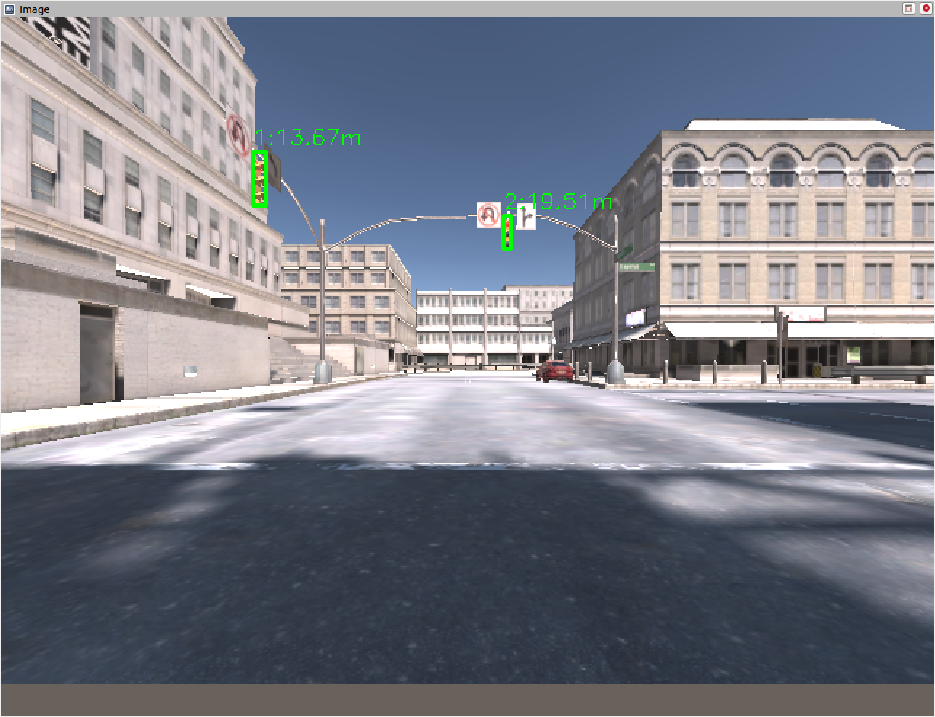
Traffic Light Detection
2nd node
With distance to Traffic Light, Pixel coordinates of depth image, camera intrinsic and offset of RGB camera
=> projection into RGB image
Topic: traffic_lights_bbox_rgb
  Pixel coordinates RGB image

Slide 5
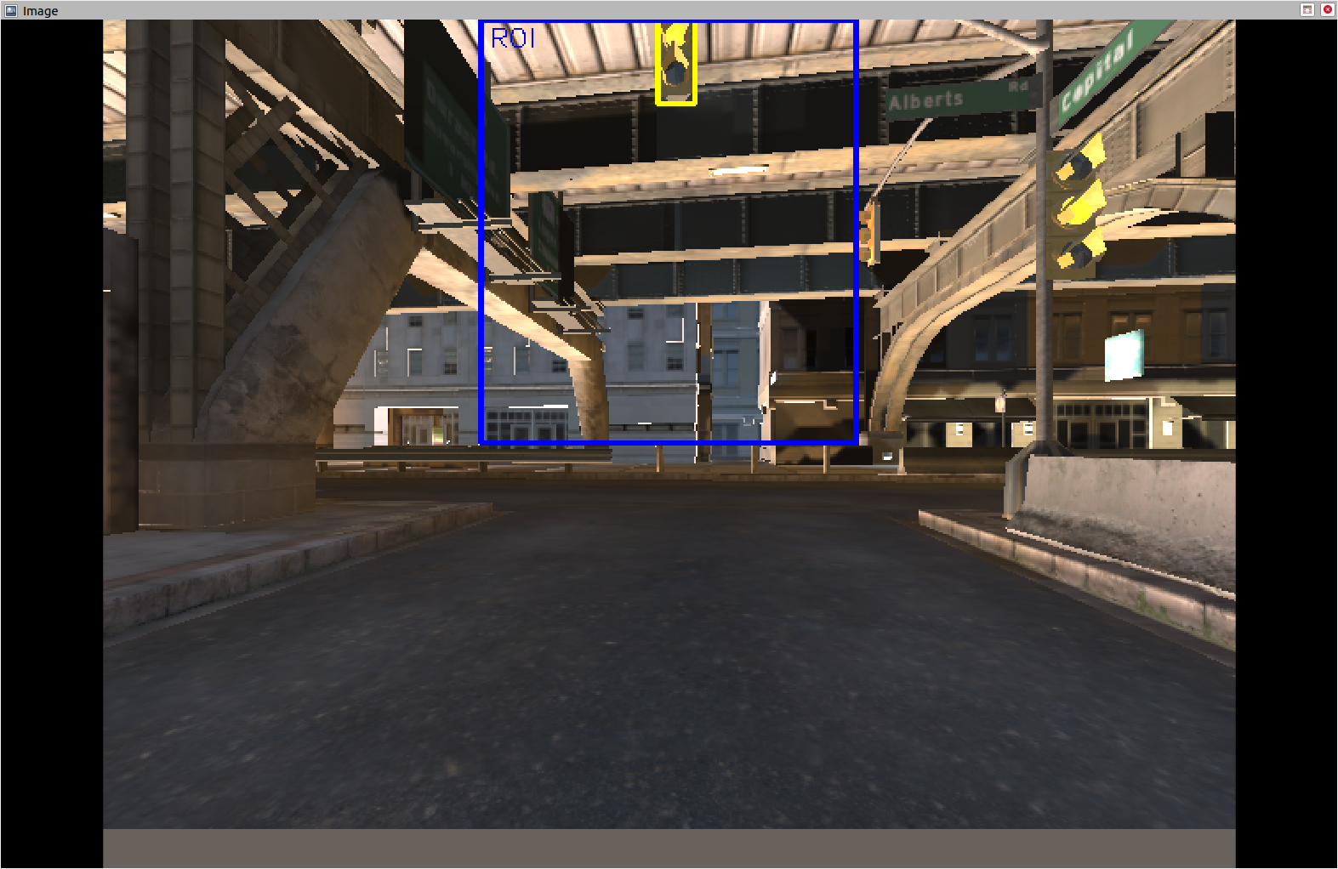
Traffic Light Detection
Check for any traffic lights for threshold distance (7m)
Crop image (blue frame)
Check color of traffic light within the frame
Topic: traffic_light_color
  Colors: red, yellow, green, none

Slide 6
Package: Traffic Light Detection
1. Node
Semantic Camera outputs segmentation of traffic lights
Pixel Coordinates are rescaled to the size of depth camera images
Topic: traffic_lights_bbox
  Pixel coordinates depth image
  Distance to each traffic light object
2. Node
The RGB camera has an offset to the depth and semantic camera
The location of the traffic lights in the RGB image can be calculated by projecting the pixel coordinates from the depth image to the RGB image. This is done with the distance and the camera intrinsic
Topic: traffic_lights_bbox_rgb
  Pixel coordinates RGB image
3. Node
The RGB image is cropped (middle third, upper half)
Within the cropped image, only the pixel within the traffic light pixels are considered for checking the color
The color is checked, by a HSV filter
If a intersection is in the region of 0-7m, the node publishes the traffic light state
Topic: traffic_light_color
  Colors: red, yellow, green

