Slide 1

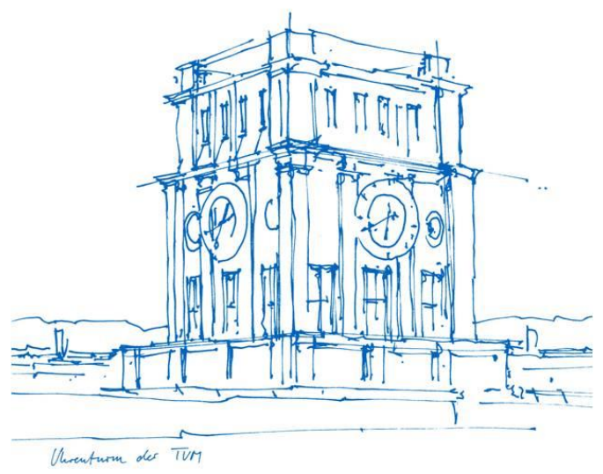
Introduction to ROS
Group Project: Autonomous Driving
Group 13: Progress Report
Shijie Zhou
Richard Viegener
Wenkai Xiao
Wenjin Zhang
Wenxuan Fu

Slide 2
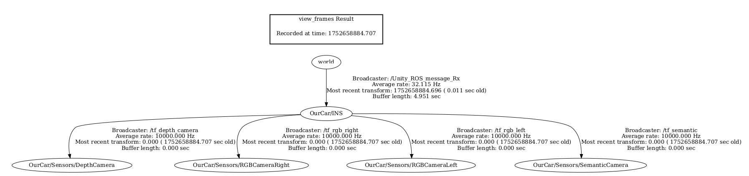
Perception
TF Tree Construction & Frame Alignment
1. The simulator continuously publishes the dynamic transform from the world frame to OurCar/INS.
2. Static transforms from OurCar/INS to each front-mounted sensor (depth, RGB left/right, semantic) are broadcast using tf2_ros/static_transform_publisher, ensuring valid timestamps and consistency.
3. Once initialized, all sensor frames remain fixed relative to the vehicle chassis, avoiding timestamp-related TF lookup errors during runtime.
Figure 1. TF Tree

Slide 3
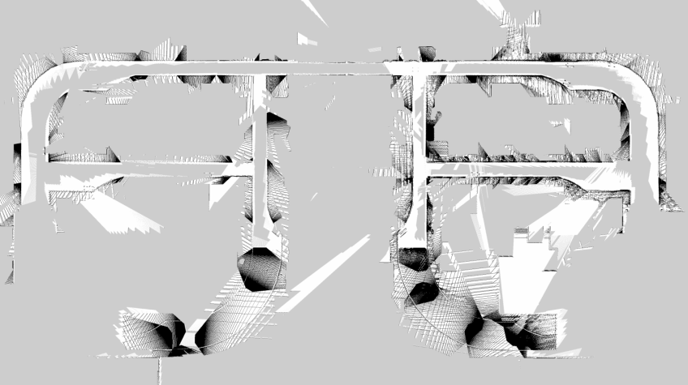
Perception
Map Generation Pipeline
1. Subscribe to simulated depth camera data and convert each depth image into a real-time point cloud using the depth_image_proc/point_cloud_xyz nodelet.
2. Feed the generated point cloud (/depth/points) into octomap_server to construct a 3D voxel-based OctoMap.
3. Apply height filtering (e.g., occupancy_min_z to occupancy_max_z) to exclude irrelevant voxels and focus on navigable space near ground level.
4. Project the filtered 3D map into a 2D occupancy grid centered on the vehicle and publish it on the /projected_map topic as a nav_msgs/OccupancyGrid.
Figure 2. 2D occupancy grid/Projected map

Slide 4
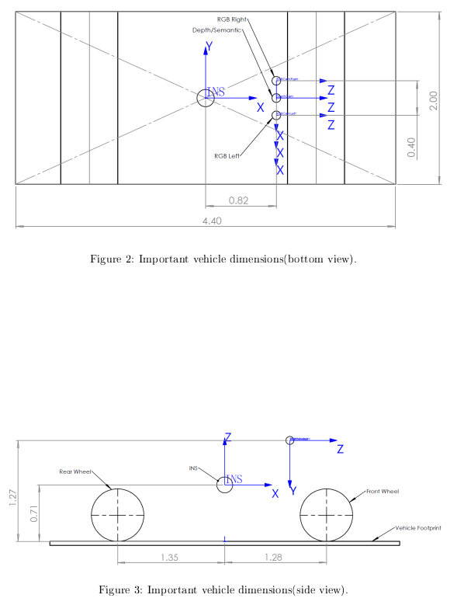
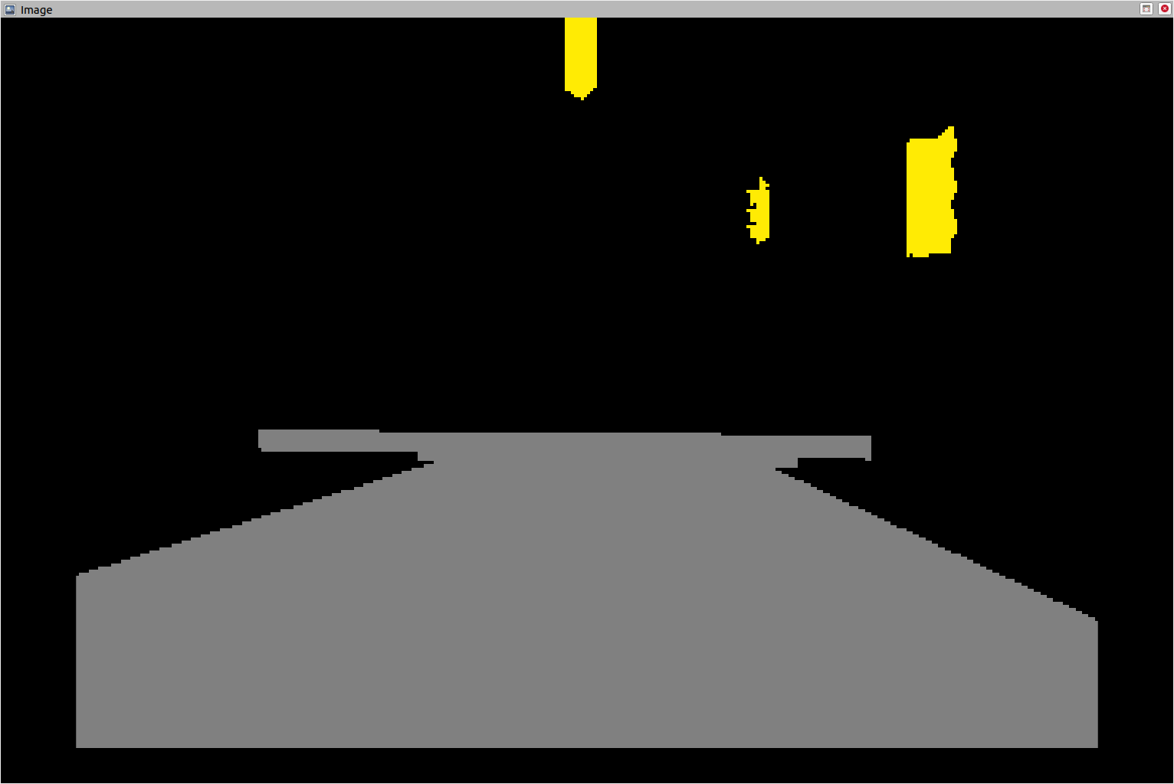
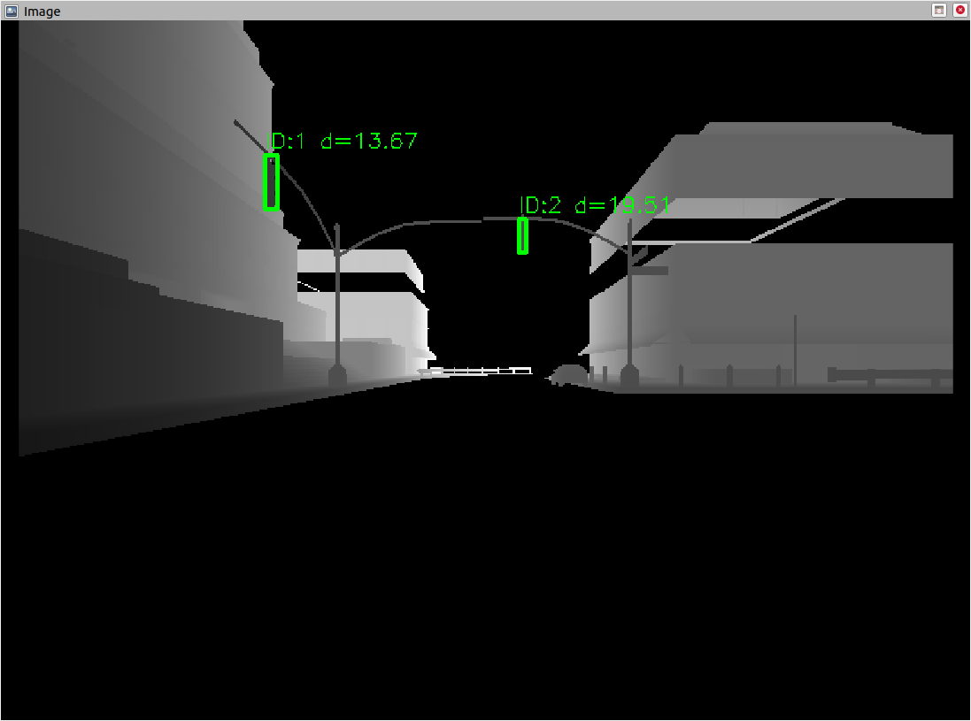
Traffic light detection
Setup:
- All Cameras are on the same height, the RGB cameras have each 1cm offset
1st node:
- Traffic Light pixel coordinates extracted from semantic camera
- Depth camera has higher resolution
- Node scales semantic camera into depth camera image size
Topic: traffic_lights_bbox
- Pixel coordinates depth image
- Distance to each traffic light object
Figure 3. Traffic Light pixel coordinates
Figure 4. Distance to each traffic light object

Slide 5
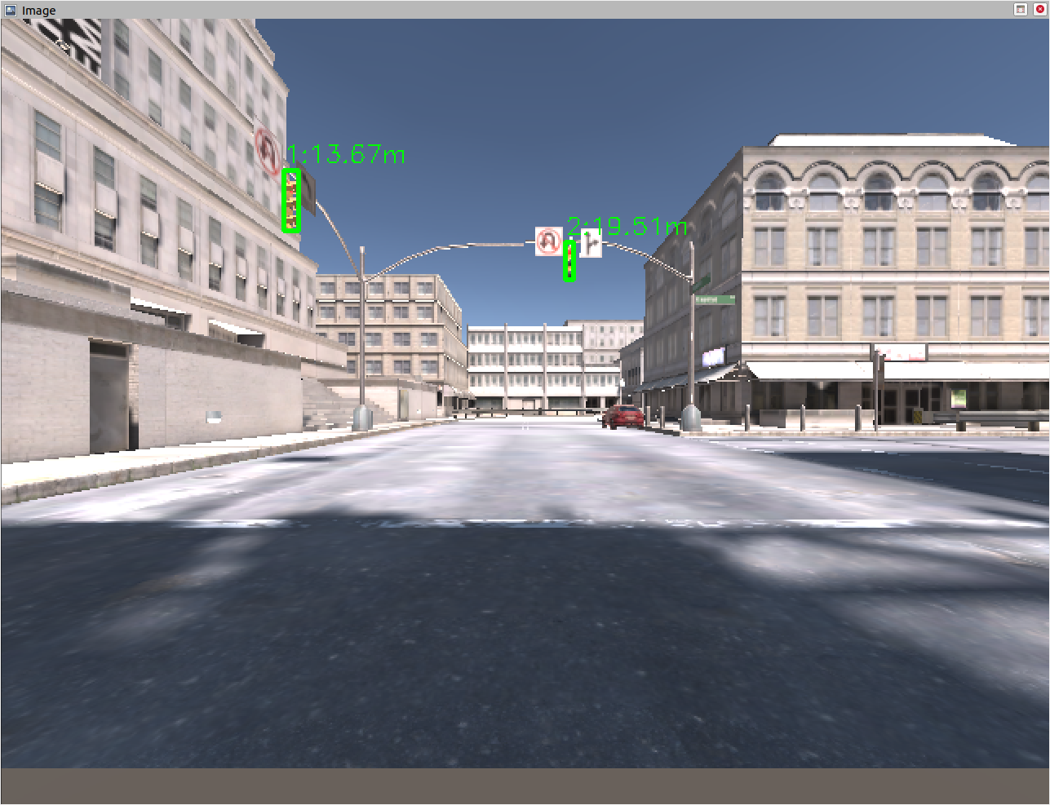
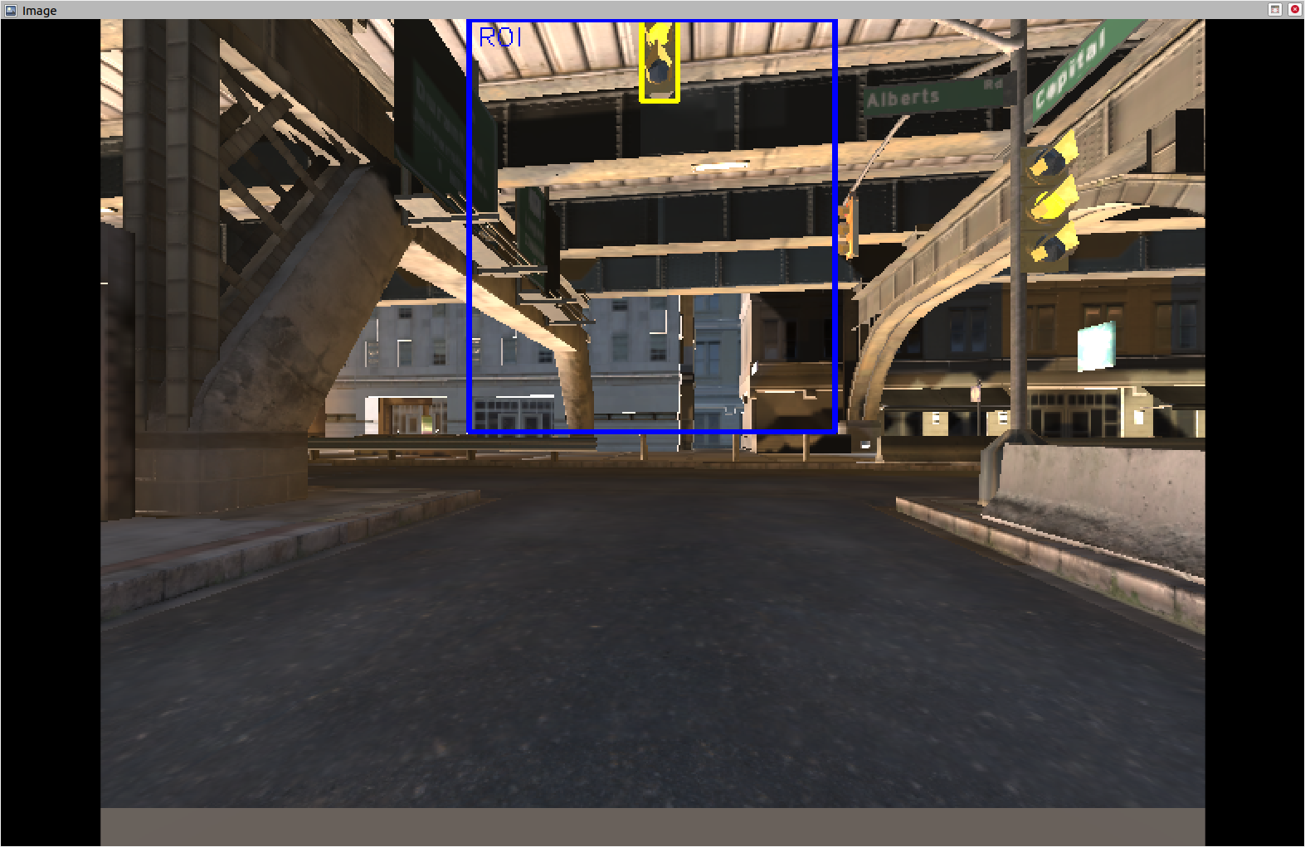
Traffic light detection
2nd node:
- With distance to Traffic Light, Pixel coordinates of depth image, camera intrinsic and offset of RGB camera => projection into RGB image
Topic: traffic_lights_bbox_rgb
- Pixel coordinates RGB image
Check for any traffic lights for threshold distance (70m)
Crop image (blue frame)
Check color of traffic light within the frame
Topic: traffic_light_color
Colors: red, yellow, green, none
Figure 5. Pixel coordinates RGB image
Figure 6. Check color of traffic light within the frame

Slide 6
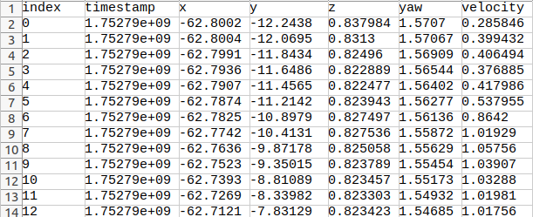
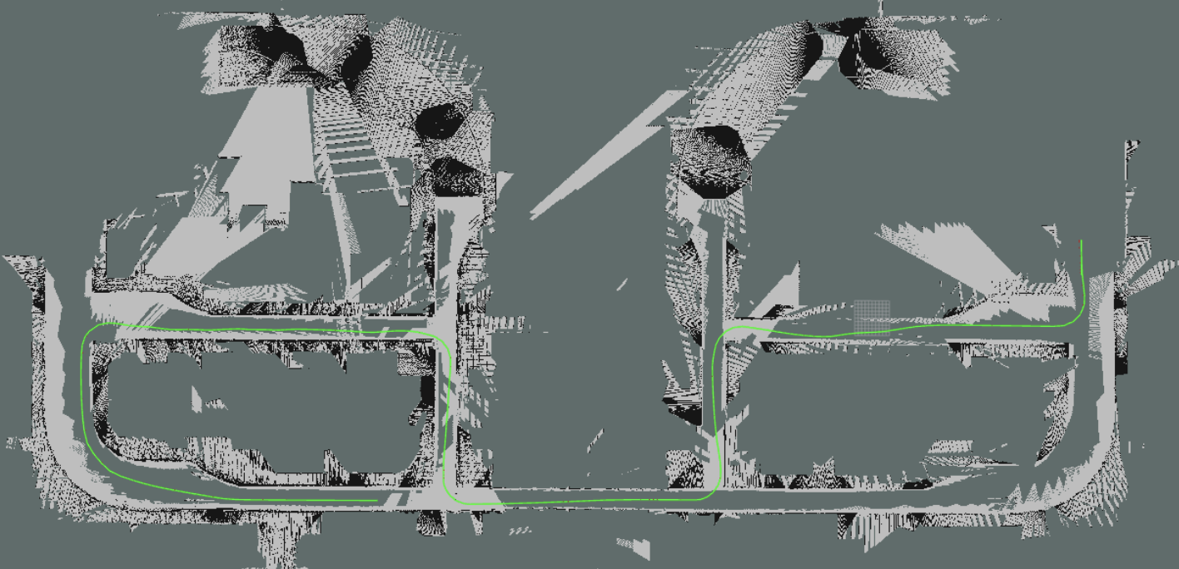
Trajectory Planning
Fixed-interval sampling
→ The system samples the robot’s state at a regular interval (e.g., every 0.5 seconds) to ensure consistent temporal resolution.
Log trajectory data
→ Each sampled point records key information: an auto-incremented index, timestamp, position (x, y, z), yaw angle, and velocity.
Figure 7. Path-Point record
Buffer points in order
→ All valid points are stored sequentially in memory (e.g., a list or queue), forming the full trajectory path.
Export to CSV on shutdown
→ When the node is terminated, the complete trajectory is automatically saved to a CSV file (e.g., recorded_path.csv) for analysis or replay.
Figure 8. Trajectory

Slide 7
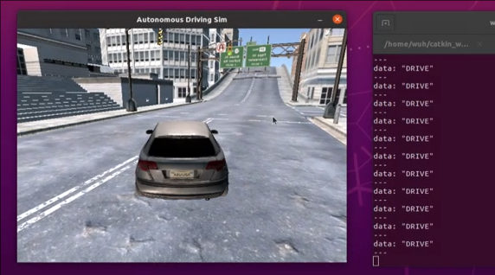
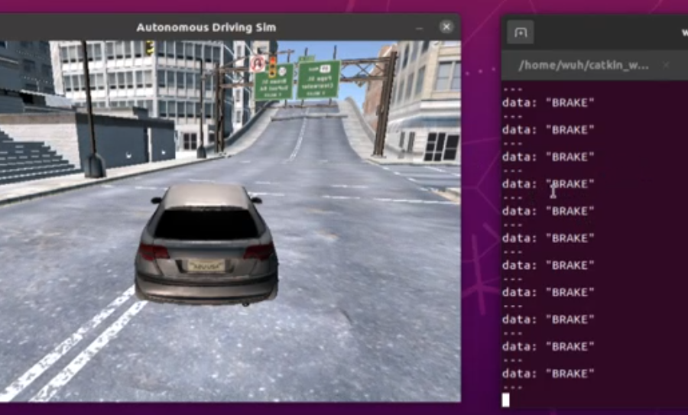
Decision Making
1. Node Initialization
Configure subscriber rate (20 Hz) and distance threshold (20 m).
Advertise the /traffic_decision publisher.
2. Subscribe to /traffic_light_color
Receive messages at 20 Hz in the format "id:state:confidence:distance" (or equivalent fields).
3. Parse Incoming Message
Split the payload to extract state (red/yellow/green/unknown) and distance.
4. Distance Check
If distance < 20 m, proceed to step 6.
Otherwise, skip to step 6.
5. State → Command Mapping
red → "BRAKE"; green → "DRIVE"
anything else → "UNKNOWN"
6. Publish Decision
Figure 9. Decision Making：Drive
Figure 10. Decision Making：Brake

Slide 8
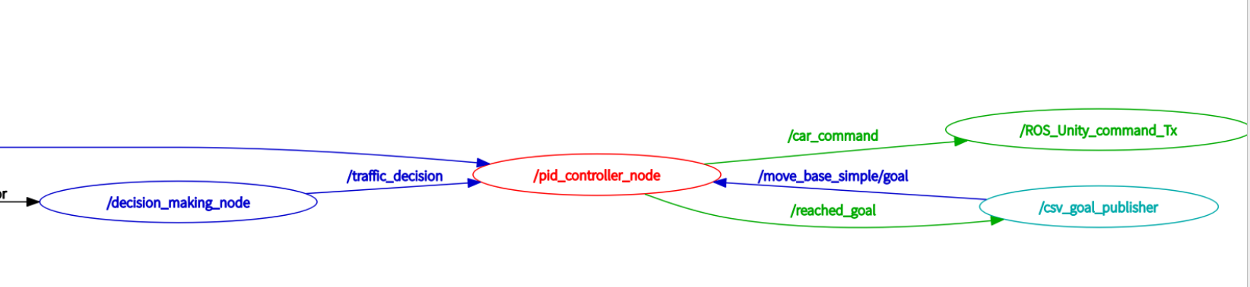
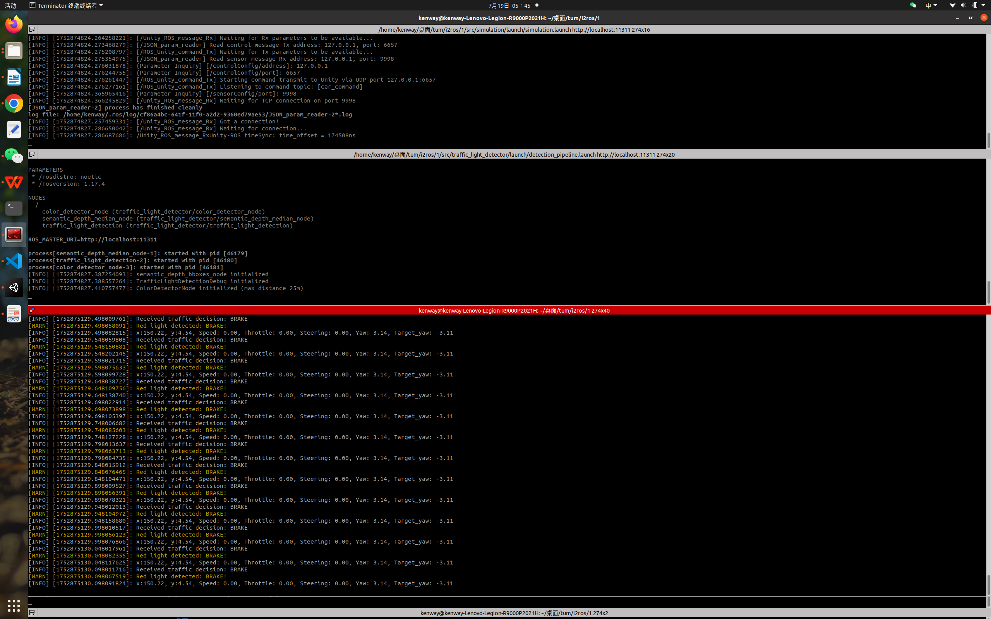
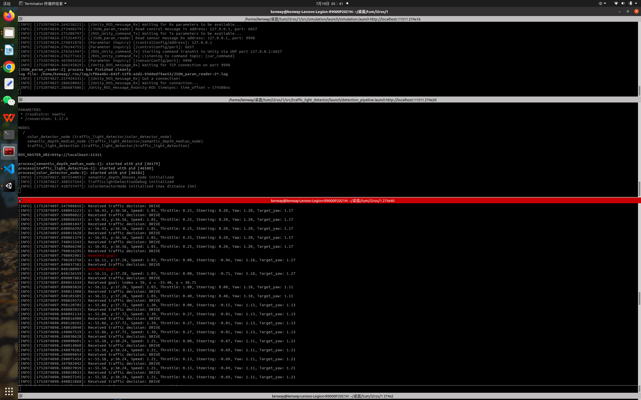
Controller
Two PID controllers are used to output throttle and steering control values to the actuator, while complying with the decisions from the decision-making module.
Node:
pid_controller_node
Subscribe:
/goal
Target points
/pose
Figure 11. Subscriptions and publications of the dummy_controller node
Current position of the car
/traffic_decision
Driving strategy
After receiving a target point, the system begins tracking it, and upon approaching the target, it publishes a “reached_goal” message to request the next target point.
Publish:
/car_command
command to throttel
/reached_goal
sign to require next target point

Slide 9
Result and Limitations
Result:
• Successfully generated map, driving path.
• Successfully detected the traffic light and responded correctly
• Drives around as fast as possible.
• The car can complete the task according to the path
Limitations:
• Fail to use algorithm to automatically generate trajectory
• Difficulty responding to yellow lights (speeding up or slowing down)
• Instability at high speeds

Slide 10

Thank you for your attention

