Slide 1
Features
Fingerprints: MACCS, ECFP6, RDKfingerprints,
TopologicalTorsionFingerprints,
CircularFP, PubChemFP
Chemical descriptors: Rdkit, Mordred
QM features (ML predicted):
HOMO, LUMO + reduction potential, oxidation potential
Create features as much as possible
(avoiding the omission of important information)
Pursue high-performance first
Not included for now
Notes:
Getting ECFP4 fingerprints successfully
Getting RDKfingerprints successfully
Getting TopologicalTorsionFingerprints successfully
Getting MACCS fingerprints successfully[167]
The redox potentials essentially represent the tendency of a molecule to accept or lose an electron and have turned out to be important properties for the discovery of new materials and screening databases of candidate organic molecules.
Redox potentials are experimentally determined using cyclic voltammetry measurements

Slide 2
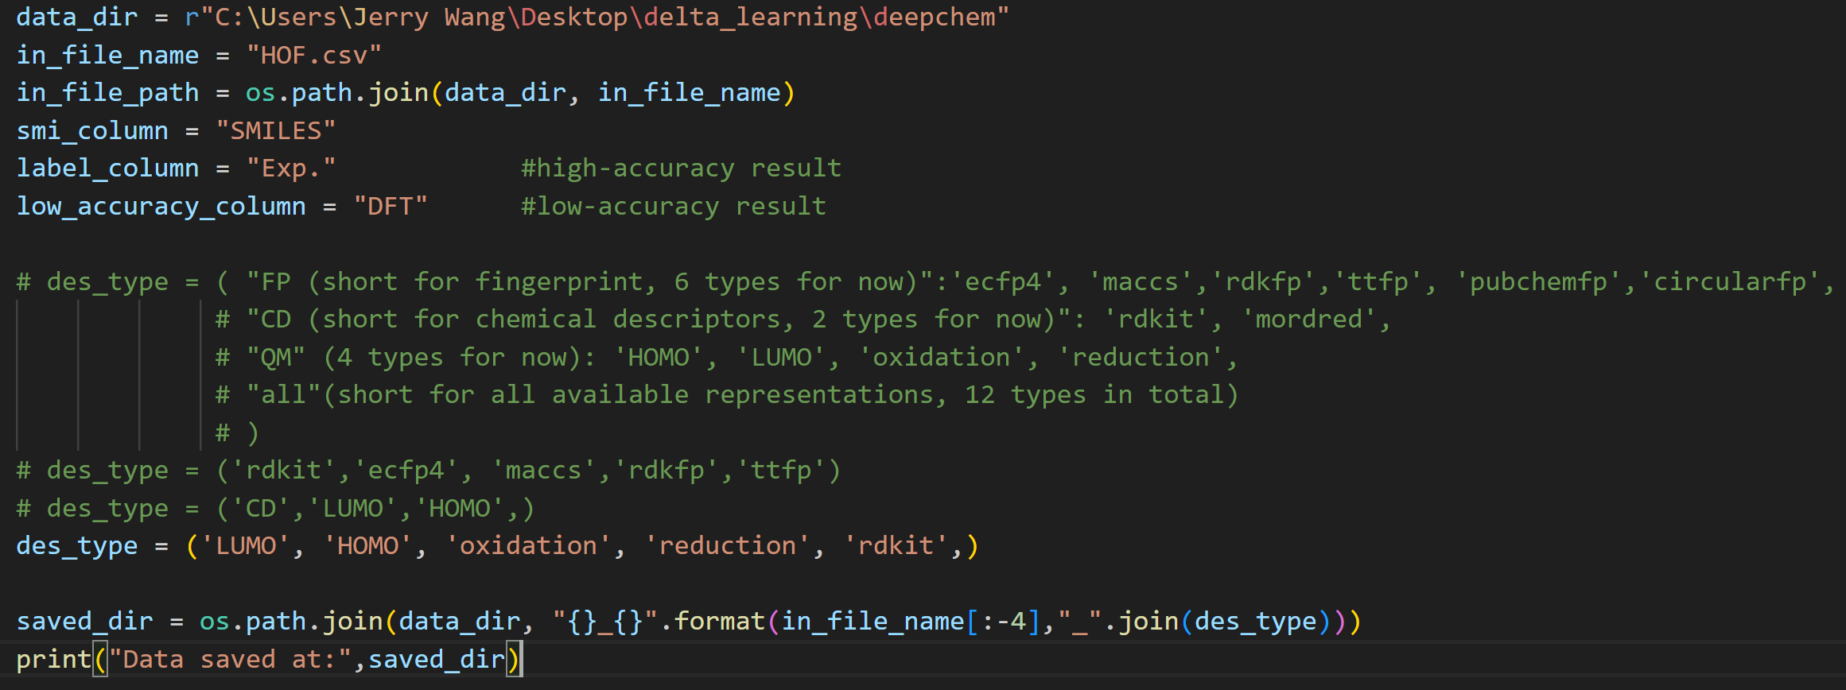

Slide 3
