Slide 1

Modern Agent: Training & Self-Evolving
Rui Shi
3/17/2026
Notes:
很开心great honor
介绍自己
在这一个小时内，我不会介绍非常详细的算法细节（won‘t introduce very detailed algorithm details），我希望可以快速带大家了解一下Agent领域在做些什么，并且如何让你们能快速上手。如果对某个技术很感兴趣，我也列出了references，在那里你会得到更多的信息。 I hope to quickly take you through what is being done in the Agent field and how to help you get started quickly. If you are very interested in a certain technology, I have also listed references, where you will get more information.

Slide 2
Outline
Overview
Post-training: How can we build a reliable Agentic System
Self-Evolving: How should we continue to raise the ceiling

Slide 3
Outline
Overview
Two Views
LLM Agent vs. Agentic System
2. Post-training: How can we build a reliable Agentic System
3. Self-Evolving: How should we continue to raise the ceiling

Slide 4
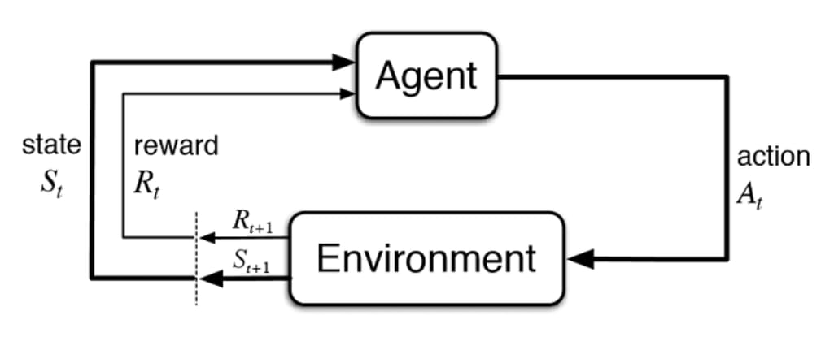
Moden Agent != LLM + external environment
LLM-first view
We make an LLM into an agent! ->-> LLM Agent
Implications: scaffold on top of LLMs, prompting-focused, heavy on engineering
Agent-first view
We integrate LLMs into AI agents so they can use language for reasoning and communication!
->-> Agentic System
Implications: All the same challenges faced by previous AI agents (e.g., perception, reasoning, world models, planning) still remain, but we need to (re)examine them through the new lens of LLMs and tackle new ones (e.g., synthetic data, self-reflection, internalized search)
Notes:
Scaffold on top of LLMs (搭建脚手架)： 写一堆外围代码（比如用 LangChain 这类框架）把大模型包装起来。
Prompting-focused (重度依赖提示词)： 靠写各种极其复杂的 Prompt 来逼迫大模型按照特定格式输出。
Heavy on engineering (重工程)： 遇到问题就加 if-else 代码，本质上是一种偏工程 Hack 的打法。【边界情况 boundary situation（cases）】
Agent 体系自古就有（右上角那个传统的经典控制图就是证明），经典问题依然存在（感知、推理、世界模型、规划）。
感知: 从复杂的外部环境（Environment）中接收原始信号，并把这些毫无意义的信号提取、转化为自己能理解的**“结构化信息（状态 State）
规划：policy \pi(a|s)
世界模型：Transition function P(s’|s,a) + Rewards r
但我们要 through the new lens of LLMs (通过大模型的新视角去重新审视它们)。
实现上可以看成是两个stages

Slide 5
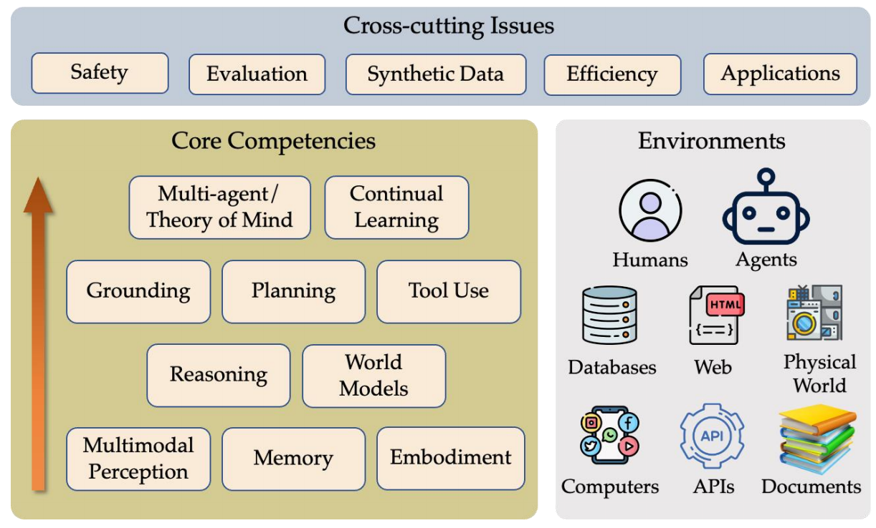
A conceptual framework you might know

Slide 6
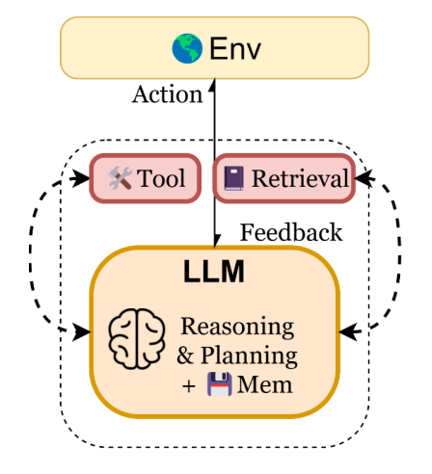
Stage 1: LLM Agent (LLM is the only brain)
Contemporary AI agents, with integrated LLM(s), can use language as a vehicle for reasoning and communication
Instruction following, in-context learning, output customization
Reasoning (for better acting): state inferences, self-reflection, replanning, etc.
• Reasoning by generating tokens is a new type of action (vs. actions in external environments)
• Internal environment: where reasoning takes place in an inner monologue fashion
• Self-reflection: a ‘meta’ reasoning action (i.e., reasoning over the reasoning process), akin to meta-cognitive functions
• Percept and external action spaces:
• Using language for communication and multimodal perception
Inner
Monologue
Notes:
LLM agent细节：
LLM Agent 就像是一个talented freelancer。你把任务外包给他，中间他什么时候起床、用什么工具、按什么顺序做，你完全不管，也没有固定的SOP（标准作业程序，Standard Operation Process），你只看最后结果。他确实能自己决定每一步，但有可能会搞砸。

Slide 7
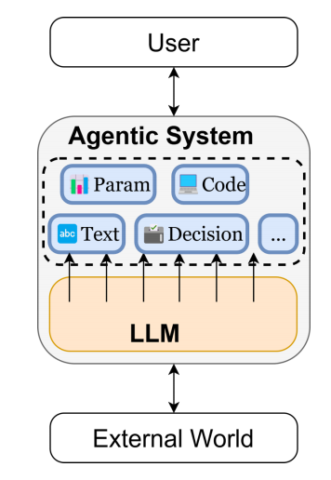
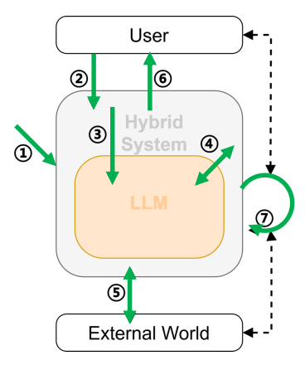
Stage 2: Agentic System (Hybrid System for production)
LLM != Omnipotence. LLM = an advanced reasoning function, supported by rigorous code logic, safety guardrails,
and with multi-module orchestration to ensure reliability.
- Hybrid Architecture: Integrates neural components (LLMs, green blocks) with symbolic components.
Production-Ready Engineering System: LLM serves as a core component or cognitive engine
1. Host: prepares the model(s) and deploys the system
2. User: send request to the system
3. System: process the request and invoke the model(s)
4. Model: interact with rest of the system
5. System: interact with the External World
6. System: respond to User
7. System: continuously running for long-term tasks
Ahead: A hybrid/agent system sometimes also interacts with another hybrid system, forming multi-LLM/multi-agent communications
Notes:
宏观上，它有固定的、由人类设计的 Workflow（工作流护栏）。 比如系统设定了必须先过“意图识别节点”，再过“数据检索节点”，最后过“总结输出节点”。
微观上，LLM 在特定节点内做决定。 比如到了“数据检索节点”，大模型才开始行使它的权力，自己决定是用关键词 A 还是关键词 B 去搜数据库。
很像是一种半固定/有约束的编排（Orchestration）。系统工程代码（粉色模块）负责兜底和流程流转，大模型（绿色模块）负责在关键卡点做复杂的逻辑推理。

Slide 8
Outline
Overview
Post-training: How can we build a reliable LLM Agent
SFT (data)
RL (data, grade & eval, etc.)
3. Self-Evolving: How should we continue to raise the ceiling
Notes:
聚焦LLM Agent；Agentic System更多的是系统设计、安全性保障，和根据领域特定的脚手架设定

Slide 9
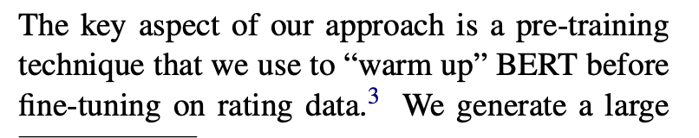
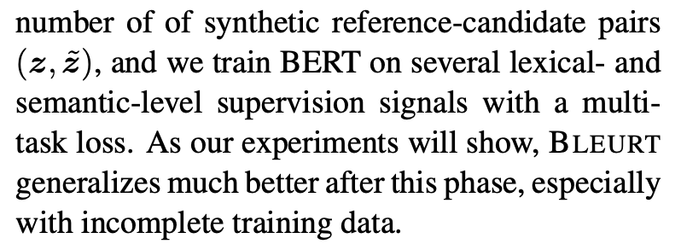
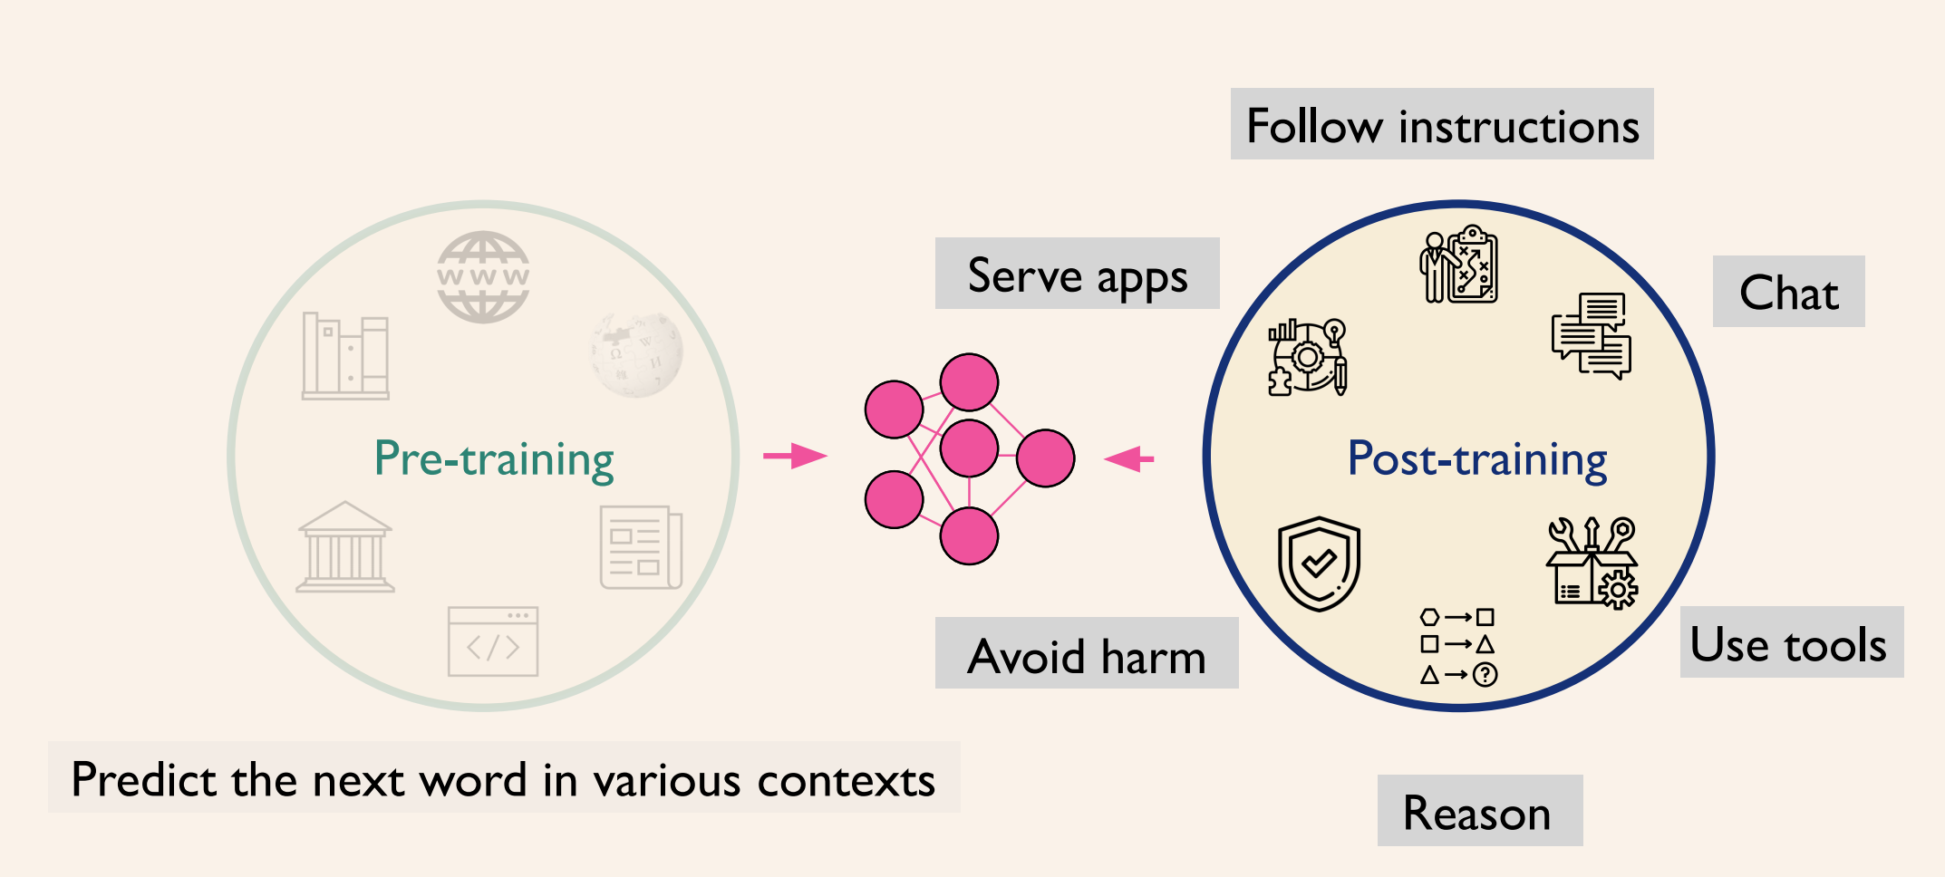
Mid-training/continual pre-training
BLEURT: Learning Robust Metrics for Text Generation
[Google Research, 2020]
Notes:
Mid-training：是一个pre-training technique（continual pre-training），用来在SFT前warm-up模型的；数据一定是精细化的、过滤掉大量垃圾数据，只包含高质量高密度的推理数据。蕴含了推理能力和逻辑思维的信息压缩和知识重组。包含了大量的各类专业领域的核心问题、规则、逻辑关系的高级别知识数据。
算力：照着pre-training来的
形式：文档 (Document-level)。给模型看的是完整的文章、代码库或长篇教材。比如：“第一章：线性代数基础...”
目的：让模型真正学会复杂的数学推理和代码逻辑 (暴力拉升模型的逻辑推理（Reasoning）、数学计算和代码编写能力)。增强模型的泛化能力

Slide 10
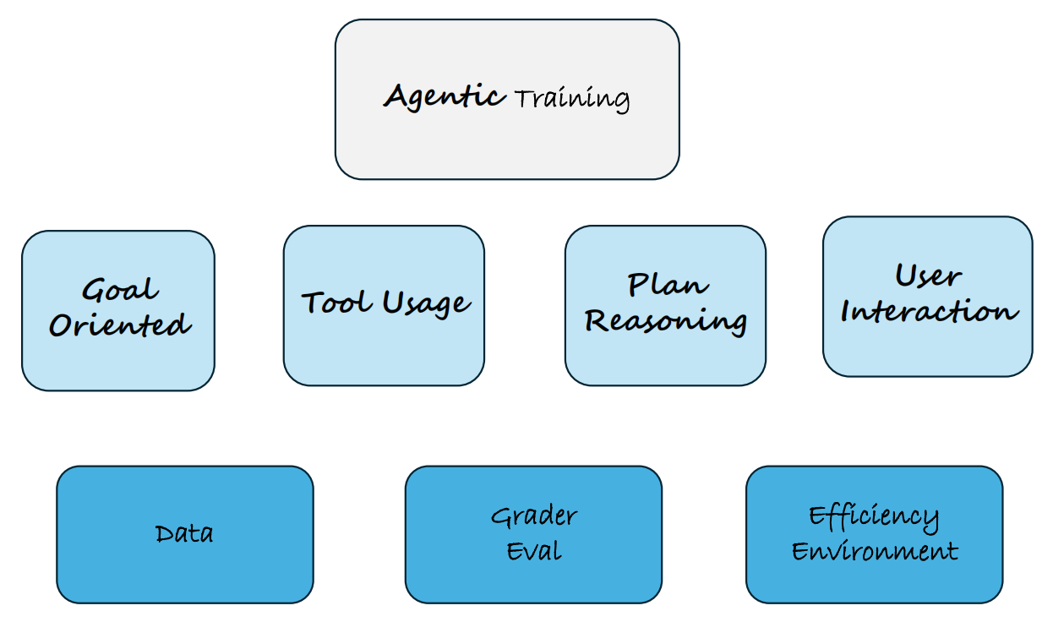
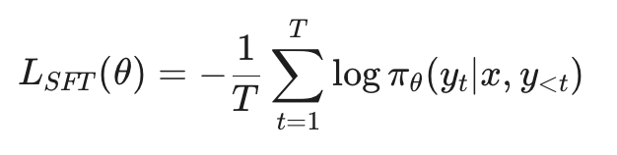
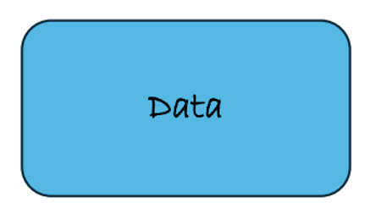
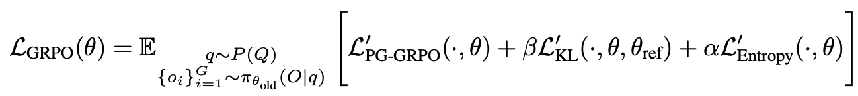
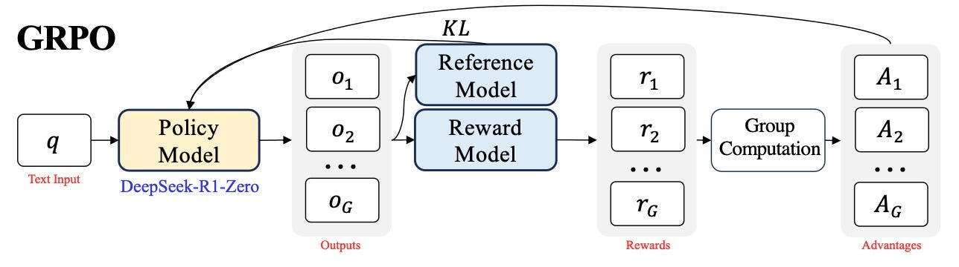
Post-training
Goal
Supervise finetuning (SFT)
(Cold Start)
Reinforcement Learning (RL)
DeepSeek-Math
[DeepSeek-AI, 2024]

Slide 11
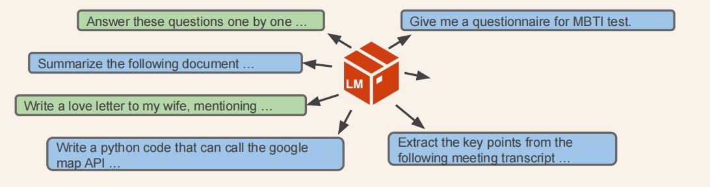
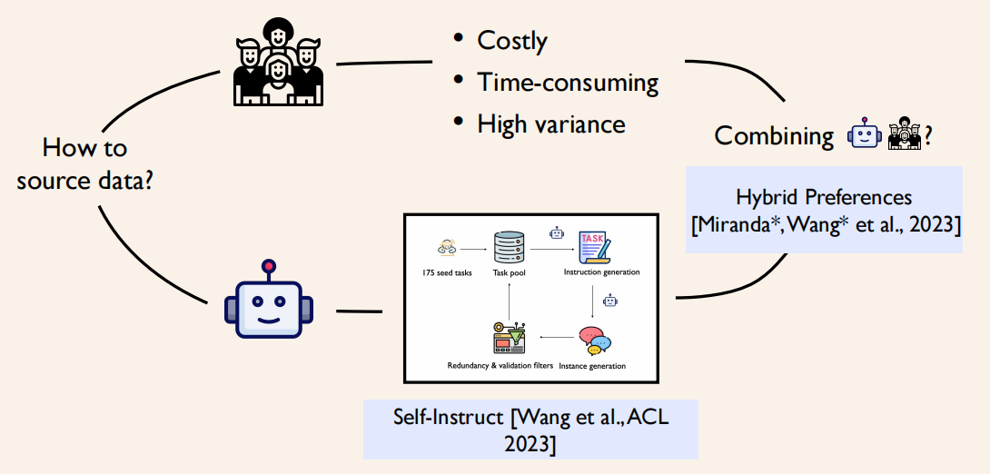
SFT: Trajectory Curation
SFT Goal:
• Not Knowledge
• We want LLM follows user instructions and designer’s desires (length, bullet points; not knowledge.)
• Be aware of & Learn how to use special tokens: system/user/assistant prompt; [EOS], …
Background:
• data of desired behaviors is what we want but scarce and expensive
• pretraining data scales but is not what we want
• Idea: finetune pretrained LLM on a little desired data => “post-”training
Two repeated and parallelizable tracks (both inputs and outputs):
1. Data curation: Curate data given targeted capabilities
2. Data mixing: Mix data across capabilities
a. Rejection Sampling: Filtering data while maintaining performance.
b. Start fully with mixing before curation.

Slide 12
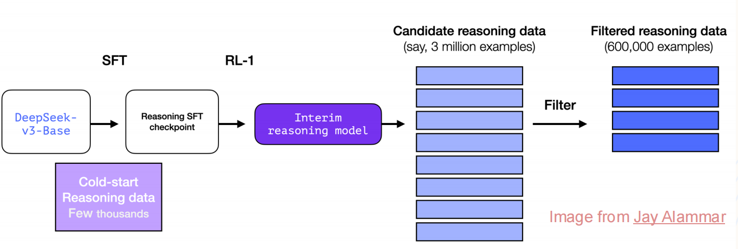
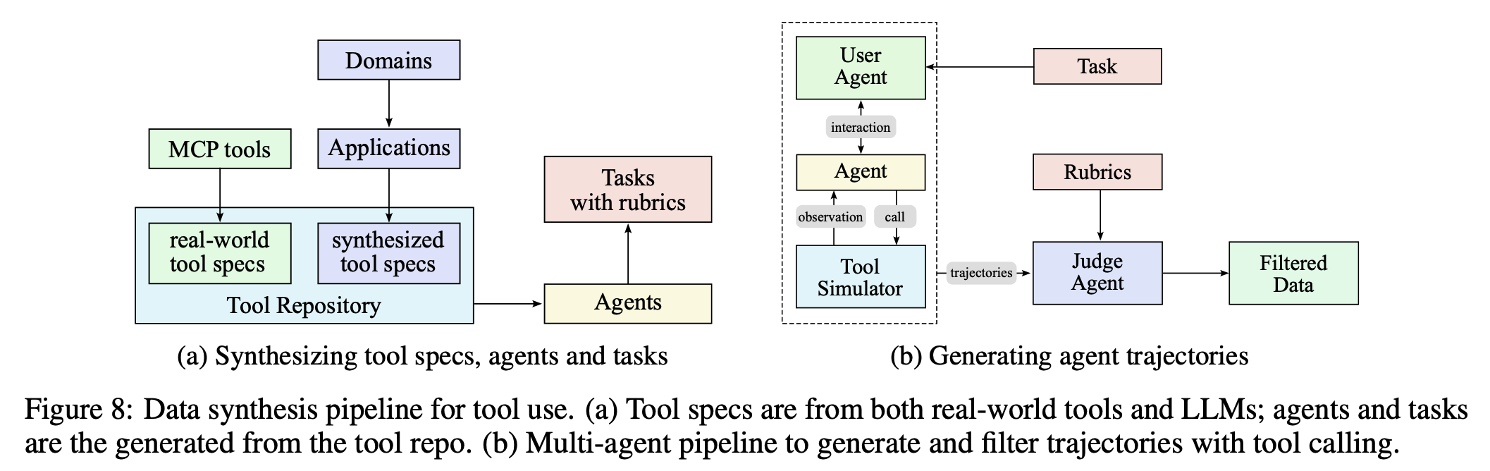
SFT: Data Synthesis Pipeline
DeepSeek-R1
Uses rejection sampling based on verifiers
1. Temporary LLM generates many answers
2. Keep answer if it’s correct (eg, passes test case), or preferred over others
DeepSeek-R1
[DeepSeek-AI, 2025]
Kimi-K2
Uses LLM simulated user & tools, and rubric based rejection sampling to
build data for agentic tool use
Kimi K2
[Kimi team, 2025]
Takeaway:
1. Quality Matters: curating high quality data often outperforms alchemy in parameter tuning for the training.
2. Hard problem are usually more useful for powerful models.
3. The goodness of data is also model dependent.
4. Combine the use of real data and synthetic data.
Notes:
DeepSeek-R1: 客观验证器 Objective verifier
1. 过渡期的语言模型 (Temporary LLM) 对着问题生成海量的解答路径【3 million cases】
2.随后，这些答案会被送入校验器。如果答案是正确的（比如通过了测试用例），或者在对比中显著优于其他答案，它就会被保留下来
3. 60 万条极其高质量的推理数据 (Filtered reasoning data)
Kimi-K2: 训练模型使用工具 (build data for agentic tool use)。
Kimi 首先构建了一个庞大的工具库 (Tool Repository)，里面既有真实世界的工具配置 (real-world tool specs)，也有合成的工具配置 (synthesized tool specs)。同时，系统会合成各种各样的任务 (Tasks with rubrics) 和对应的智能体 (Agents)。
User Agent：系统让一个由 LLM 扮演的“用户 (User Agent)”向被训练的“智能体 (Agent)”下达指令。该 Agent 在一个“工具模拟器 (Tool Simulator)”中不断尝试调用工具、观察结果。这个过程会产生大量完整的行为轨迹 (trajectories)。
3.一个专门负责当裁判的模型 (Judge Agent) 会拿着评分标准 (Rubrics) 对这些行为轨迹进行审核。
Rubrics：
Rubrics说明什么是好的，Data Synthesis生成好数据
Rubrics are design to be
• highly detailed and interpretable,
• Structured and enable precise grading
Tackling open-domain and complex tasks
• Spanning hours, days, or even months

Slide 13
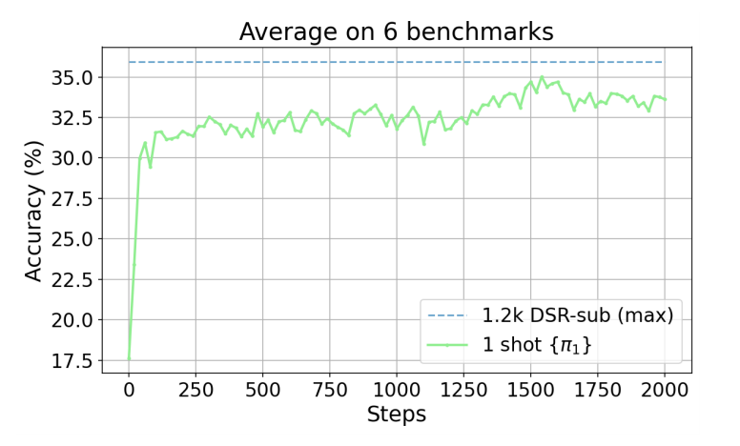

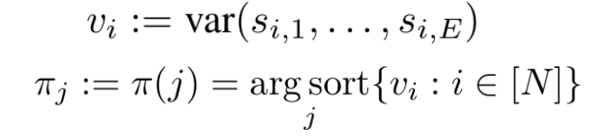
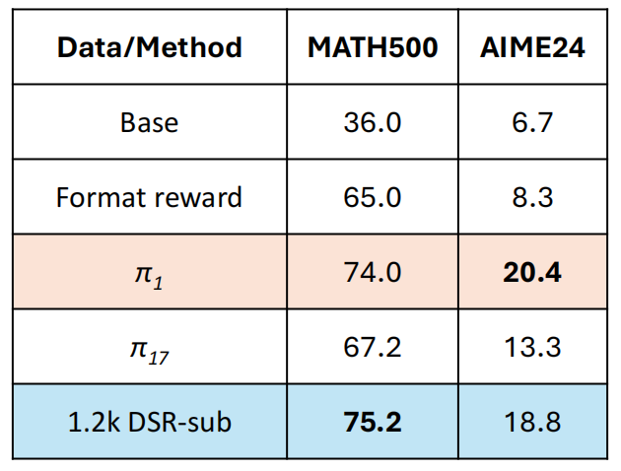
RL: Data
RL Goal:
• Not just memorization.
• It is all about the power of exploration.
Data Types:
• Verifiable (close-ended): Math, Code, etc. -> Great!
• Non-Verifiable (open-ended) : Style, Writing, Safety, etc. -> Rubrics & Data Synthesis
Takeaway:
1. Extremely high data efficiency
• 1 sample to figure out most math building blocks
2. Quality matter – requires rejection sampling too
• High entropy to encourage exploration
• Can’t be too hard (pass-rate = 0), or too easy (without negative feedback)
Ranking the training data by the variance of historical training accuracy si.
RL for RLM with one training example
[Wang et. al, 2025]

Slide 14
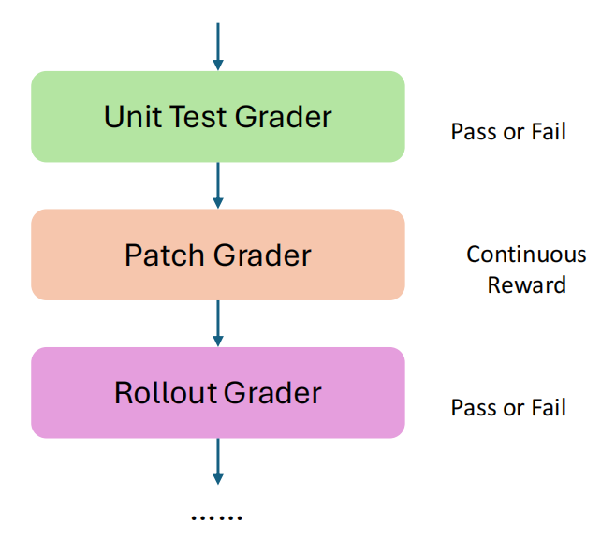
RL: Grade for the reward(signal)
Grading:
• figure out what to grade,
• build up a new grader (update rubrics) to combine with current graders
• prepare the data to be graded and trained (continually evolve, more harder)
Many different graders from (for general Agent)
• Different domains: finance, medical, coding, consultant, Stem, law, etc
• Different problems for each domain
• Different application/product constraints
Other Things important for (Asynchronous) Agentic RL Training:
Efficiency:
- Encourage policy exploration: [Agent Training often encounters entropy collapse – void turns & echo trap]
- Control sampling cost
Infra for asynchronous Agentic RL
Environment
Evaluation under open-ended setting
…
Notes:
Grading:
New grader: 随着 Agent 能力的提升，老的裁判可能不够用了，你需要不断开发新的裁判，并和老裁判组合起来使用。
Other things:
High Entropy：
空转（void turns）: 不推动任务进展的反应，如文本碎片化、内容重复或提前终止; 一旦产生，它们会在后续回合中传播，形成有害的反馈循环。这些误差主要源于预训练推断与多回合推断之间的分布偏移，模型必须处理预训练期间未存在的外部工具输出或中间信号，增加了生成畸形的（malformed） generation的可能性
echo trap 多匝强化学习: 原因是系数的二元奖励和高指令推理之间不match -> reward hacking -> 幻觉 or 跳过关键推理步骤

Slide 15

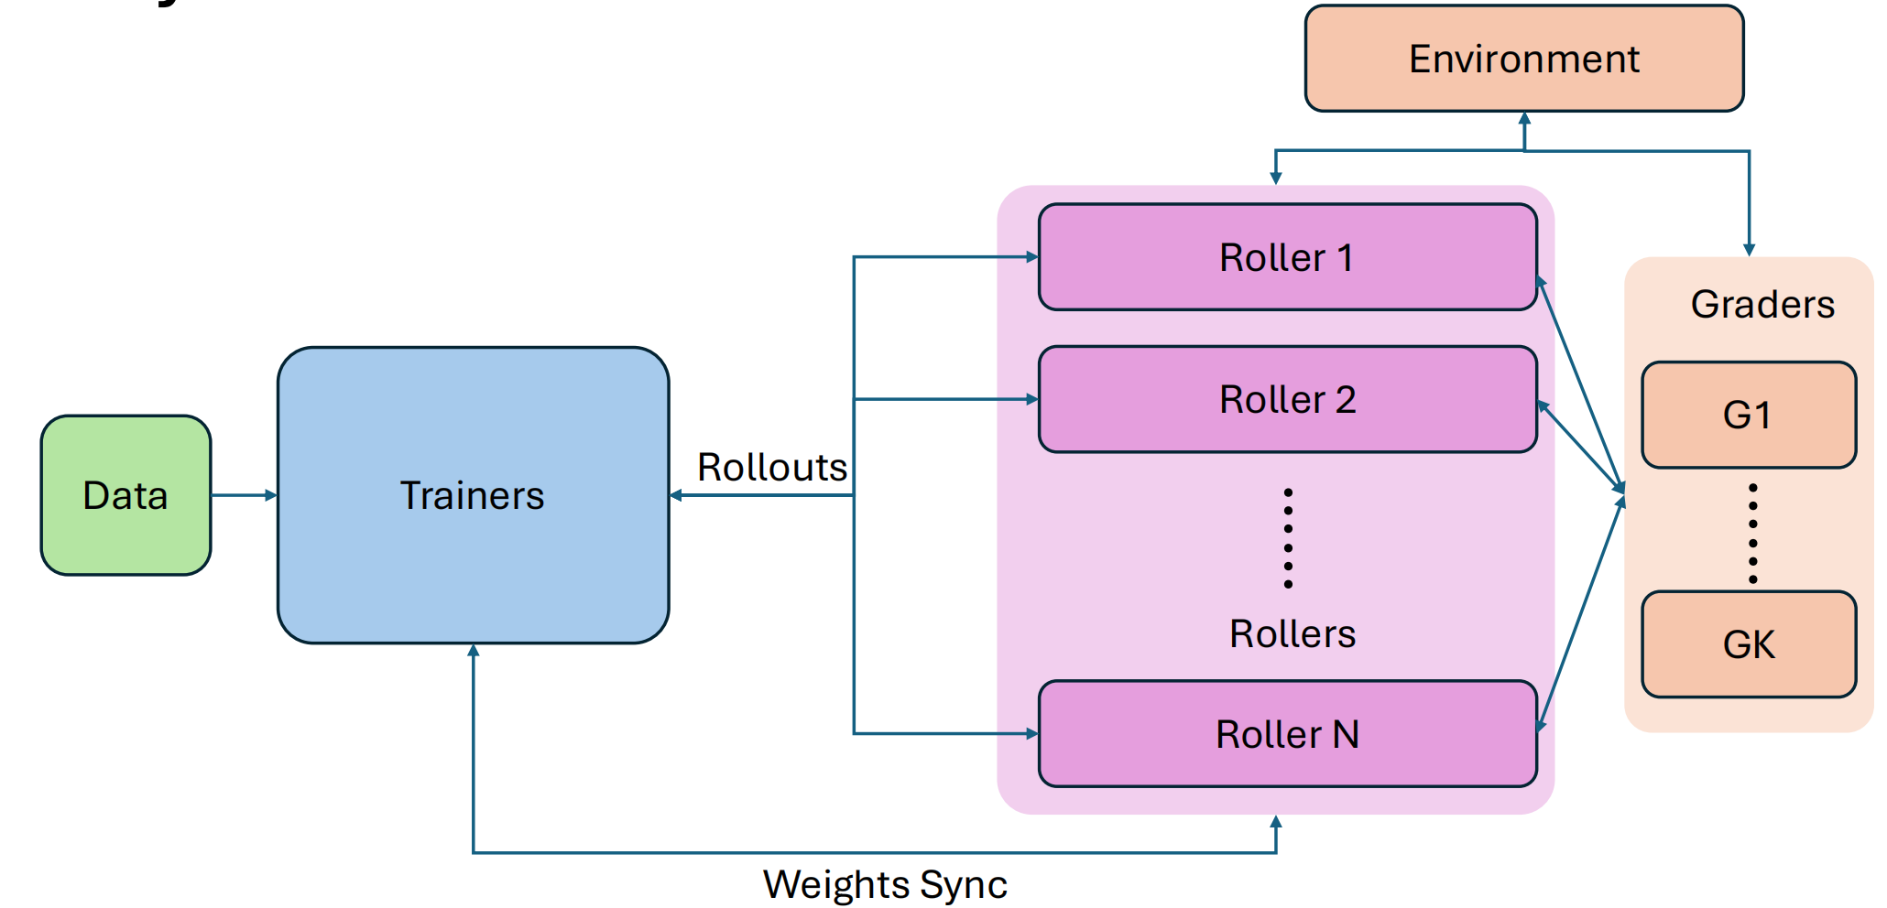
RL: Asynchronous Infra
Verl, Slime, AReal, Seer…
Scale environments
Long tails tasks -> unpredictable & heterogeneous
…
Notes:
当LLM处理推理时，代理的“手”涉及外部环境、API或计算资源。每个环境都可能强加繁重和异质的要求：
- 编码代理需要一个带有特定文件系统和依赖项的Isolated Docker container来安全地执行代码。
- ML工程代理可能需要专用的GPU访问并运行长期运行的实验。
- 网络搜索代理 ...
有些任务很快就能完成，而另一些则需要数十个步骤和大量的交互。这种差异性造成了“长尾”问题，即少数耗时极长的任务可能会阻塞整个训练过程，导致昂贵的GPU闲置，等待最慢的任务完成。

Slide 16
Outline
Overview
Post-training: How can we build a reliable LLM Agent
Self-Evolving: How should we continue to raise the ceiling of LLM Agent
Why Self-evolving & What is Self-evolving
Two perspectives and their developments
Notes:
之前的重点都在Data -> Self-evolving 更多的也是data层面的（weight-level self-improving）-- data matters most
Self-evolve: Get rid of human bias

Slide 17
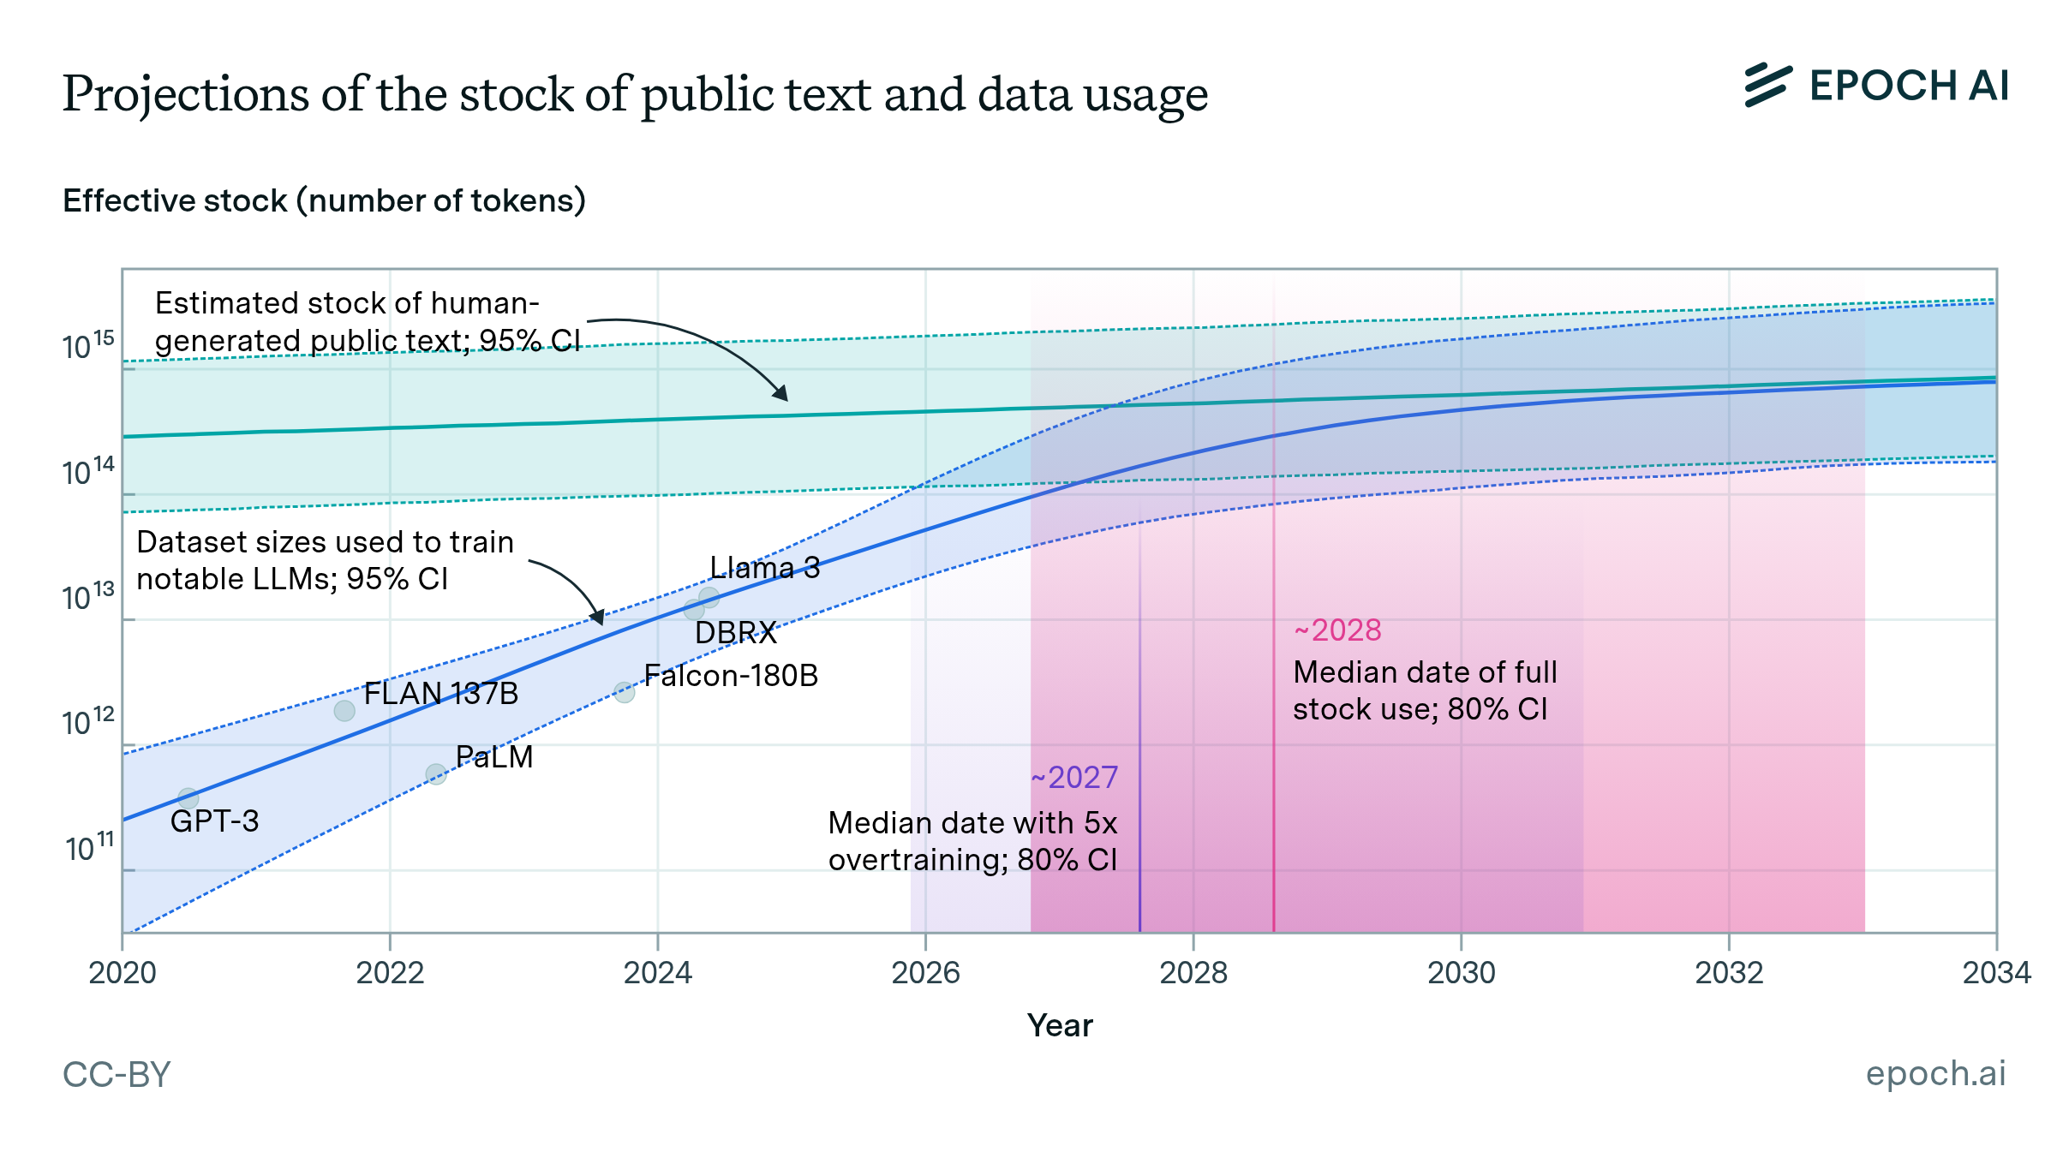
Why Self-evolving AI
Will we run out of data? Limits of LLM scaling based on human-generated data
[Epoch-AI, 2024]
1. Scaling under finite human data
Notes:
Epoch AI 的预测：随着时间的推移，前沿语言模型所使用的 token 数量正迅速逼近互联网上公开可用的 token 总量。
纵轴：vertical axis：Dataset sizes used to train notable LLMs
左侧：Scaling Laws (多数据，大参数 -> better performance) still work - Great power creates miracles.
右侧：slope decreases & green curve and blue curve will intersect

Slide 18
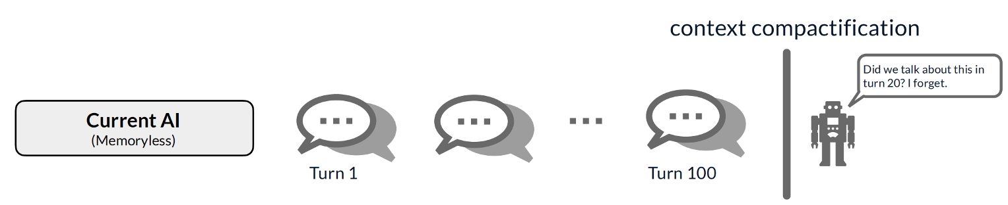
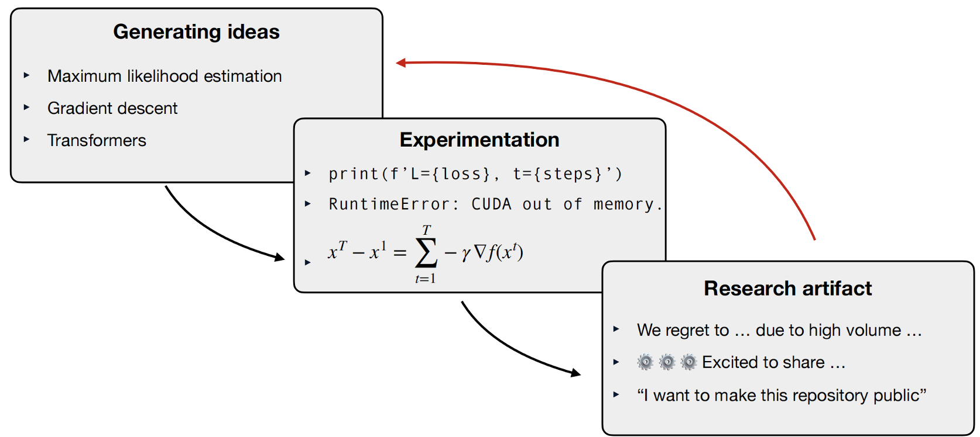
Why Self-evolving AI
2. Static weights after human creation
3. Limited by algorithms human can find
Notes:
2. 在与 ChatGPT 或 Claude 的典型对话中，一开始你可能有 100 轮对话，然后你会经历一个上下文压缩阶段 (context conpactification)，试图总结到目前为止的对话。在这之后，如果你试图问 AI 之前发生过什么，它不会有完美的记忆，因为随着上下文变长，压缩是一个非常容易丢失信息的有损过程。但对于人类记忆来说，也许你在前 100 轮对话后睡了一觉，你的记忆转移到了大脑的其他部分，然后你还能隐约记得你之前谈论过的一些事情。
3. 如果我们思考一下人类是如何提出算法的：它经历了一个产生想法的过程（例如最大似然估计），然后进行实验（这可能是编写代码或进行数学推导），最终你得到一些研究成果；随后其他人在此基础上继续研究，这个循环再次开始。这个过程极其依赖人力，并且成本非常高昂。因此，我们发现的仅仅是所有可能算法中的一个子集（subset），而我们希望利用 AI 本身来使这个过程自动化。

Slide 19
What is Self-evolving AI - Definition
A continually self-evolving AI is one that, once created, can autonomously and continually improve itself better than its human creators can improve it.

Slide 20
What is Self-evolving AI - Characteristics
Three characteristics of self-evolving AI under parametric and pretrained assumption:
After the initial pretraining phase, the system continues to acquire new knowledge into its parametric weights without catastrophically forgetting existing capabilities.
The system generates its own training_signal, and learning from these self-generated signals yields improvement beyond what human-generated signals provide.
The system can autonomously design what learning_algorithm to use to learn from its training signals.
Notes:
根据这个knowledge可以分成两种观点，分别对应不同的训练阶段

Slide 21
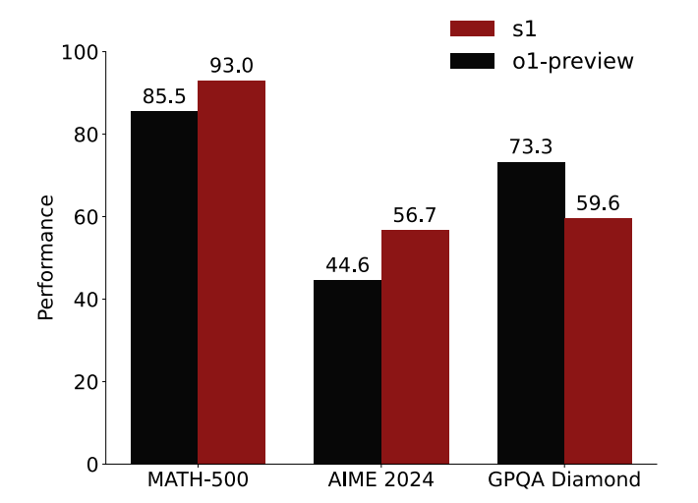
S1: Simple test-time scaling
[Muennighoff et. al, 2025]
Mid-training
Notes:
补充pre-train视角和post-train视角的不同：【no-conflict, but the key points are different】
pre-train：
Supervised finetuning on 1,000 chains-of-thoughts delivers o1-preview level capability 【Post-training capabilities are generalizations from pretraining knowledge】
S1是基于Qwen 2.5-32-Instruct来做的
核心：
困惑度揭示了模型能力的核心，它通常与预训练的数据规模和模型规模有更大的相关性。
因此，为了见证真正的自我改进，你必须看到在训练层面上的自我改进，而不仅仅是我们之前项目中看到的中期训练或后训练层面的改进

Slide 22
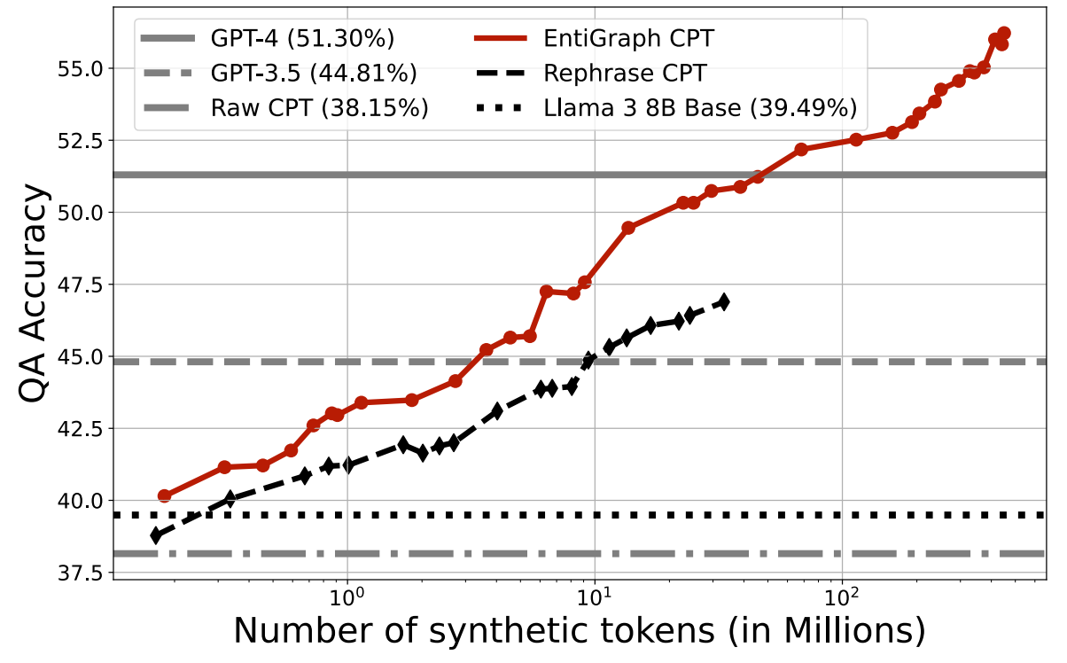
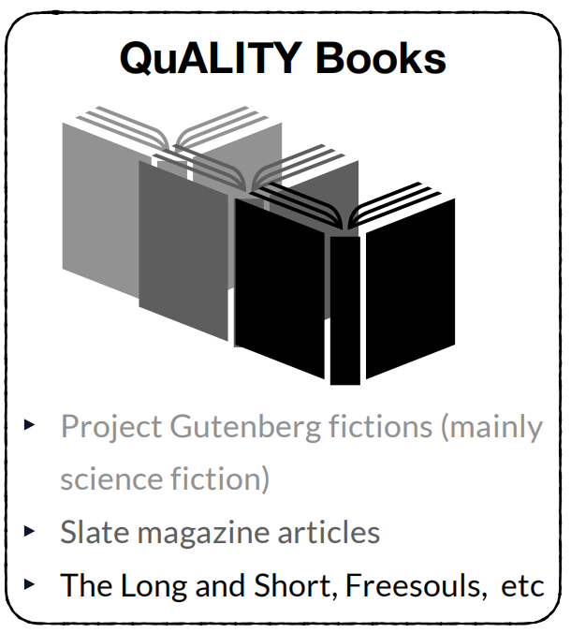
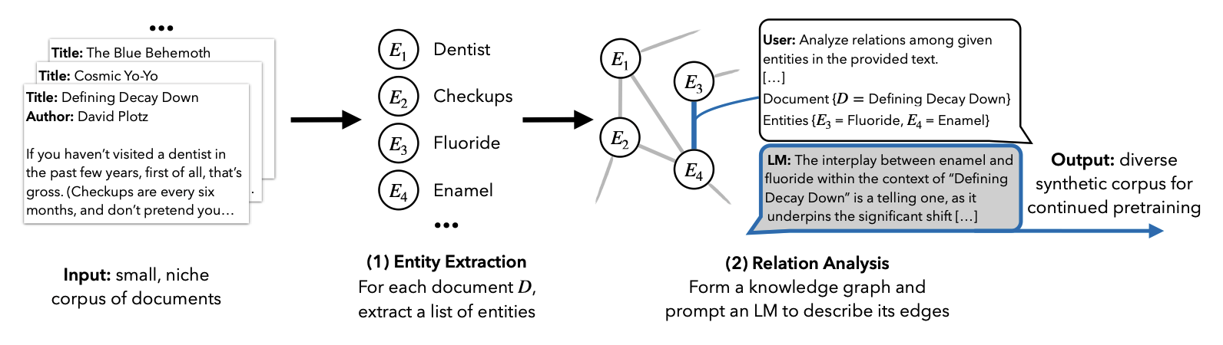
Perspective 1: pre-training is the core
Continual Knowledge acquisition for continual pre-training
Goal: teach model the knowledge from a niche domain consisted of a few “source documents”.
Step 1: Generate synthetic text based on the source documents
Step 2: Continually pretrain (finetune) the model on generated text
265 specialized books (~1.8M tokens);
High-quality multiple-choice Q&As
QuALITY
[Pang et. al, 2022]
Synthetic Continued Pretraining
[Yang et. al, 2024]
Notes:
目标：在训练后不断获得新知识
Where does the knowledge come from in pre-training? 【structural correlation enables learning】
Statistical view：Natural language tokens has statistical correlations
Computational view（theory of information）：Natural language has compressible patterns, 而下一个 token 预测本质上是在进行信源编码以压缩文本。
Why Synthetic data:
如果没有合成数据，知识可能是稀疏的. 我们需要多样化的表征 – 也就是多样化的structural correlation来强化知识学习
现状：
基于entity + knowledge graph 【可以被认为是某种的rewrite策略】的数据合成在如今agent中被广泛使用，deep research agent -> multi-hop reasoning data

Slide 23

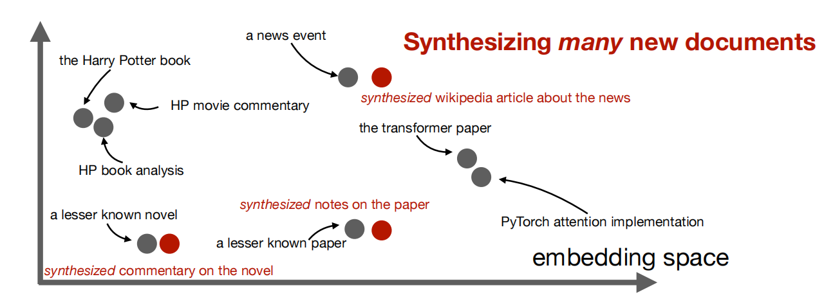




Perspective 1: pre-training is the core
Self-improving pretraining capability – Learn structural correlation from scratch
Goal: Self-improving with no distillation from teacher model
Step 1: Nearest-neighbor pairing: Use DCLM subset and Qwen-0.6B-Embedding
Step 2: Synthesizer tuning: SFT-like objective initialized at pretrained checkpoint
Step 3: Synthesis at scale: Temperature=1 allows each document to have varied synthesis
Synthetic bootstrapped pretraining
[Yang et. al, 2025]
Notes:
他们做了几件事：
Pre-train a model from scratch
Fine-tune the model -> synthetic data generator【without now data】
- Combine real & synthesis data -> continual pre-train the model
1.词向量会对相似度进行编码
2.将这些相邻的文档连接成图，并执行合成微调。
合成微调的具体做法是：把一个经过预训练的检查点作为语言模型的初始化状态（这里的预训练检查点指的是已经在所有真实数据上训练过的模型）；然后通过类似 SFT （监督微调）的目标对模型进行微调。
3. Temperature = 1的原因；这里需要说明的是，每一个源文档（d1）可能对应多个目标文档（d2）。这个过程会极大程度地增加模型的熵，例如，如果每个 d1 对应 20 个 d2，那么在逻辑回归下，将均匀的概率质量分配给每一个文档。因此，经过这种微调后，你的模型会处于极高熵的状态。

Slide 24
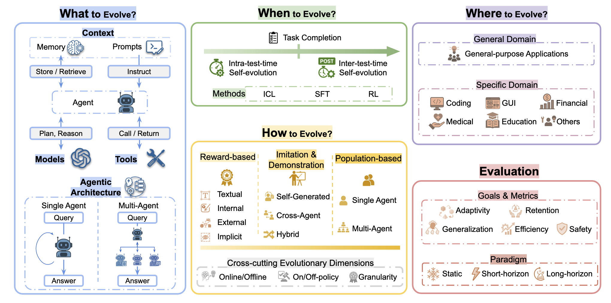
Perspective 2: mid and post-training & Agent scaffold components for adaptation
A SURVEY OF SELF-EVOLVING AGENTS: ON PATH TO ARTIFICIAL SUPER INTELLIGENCE
[Gao et. al, 2025]

Slide 25
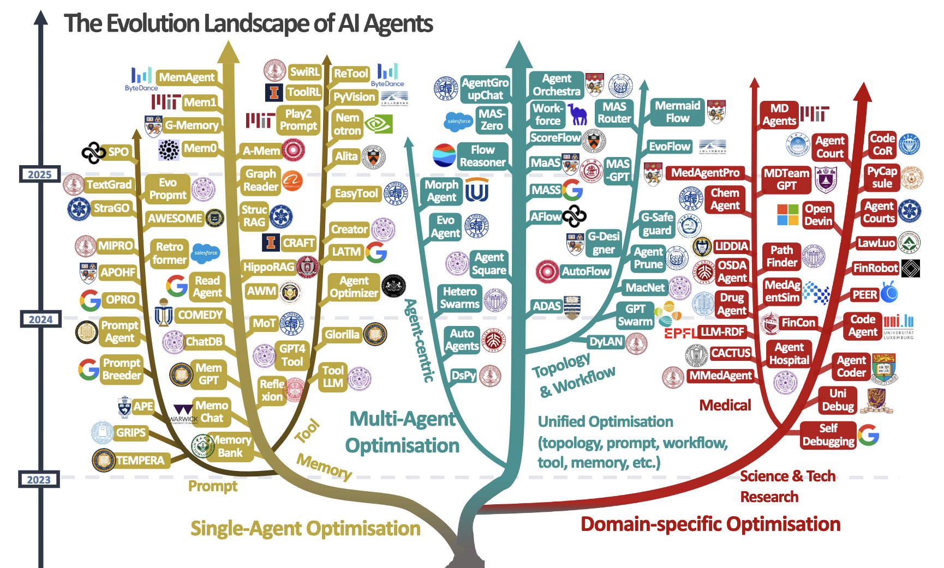
Perspective 2: mid and post-training & Agent scaffold components for adaptation
A Comprehensive Survey of Self-Evolving AI Agents
[Fang et. al, 2025]
Notes:
Tool:
Memory:
Prompt:
Domain:

Slide 26

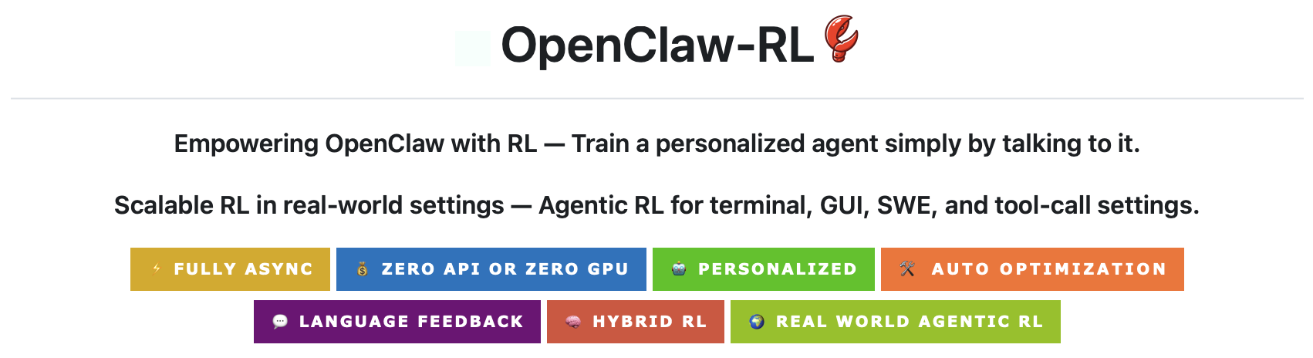
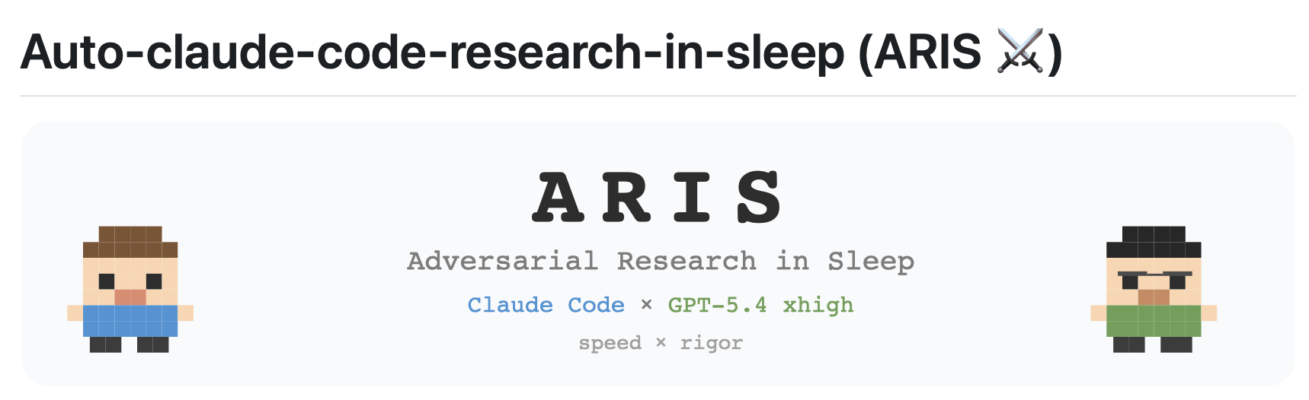


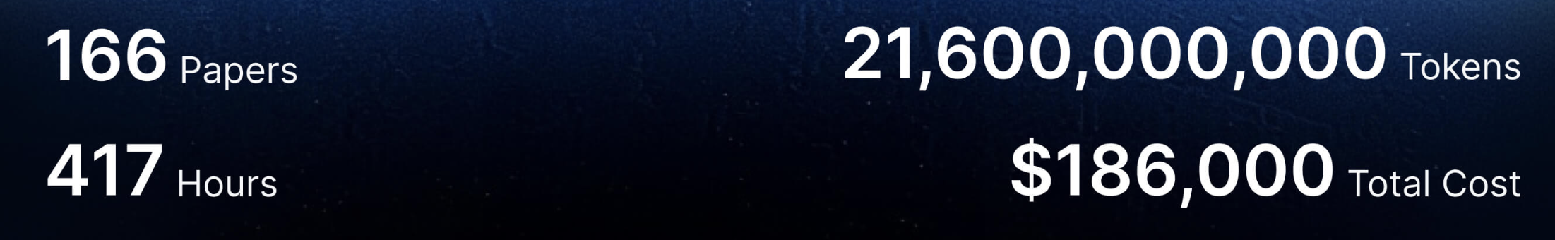
Look Ahead: Can AI self-evolve to be really stronger than its creator?

Slide 27
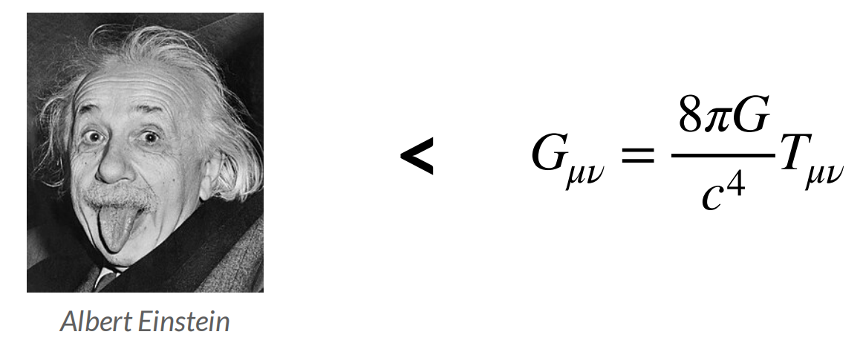
Look Ahead: Can AI self-evolve to be really stronger than its creator?
At present, the underlying technologies for neither perspective have completely hit the mark.
A theory can evolve and can mutate. It has a life of their own.
Einstein created the field equations that is smarter than himself.
By analogy, humans can create AI that is smarter than humans themselves.
The moment the theory is created, it is above its creator.
Think Boldly, Act Bravely
Notes:
我想向你们展示爱因斯坦是如何以一种安静而精确的方式，创造了一个超越他自身认知的理论的。
【过去式】
起初，爱因斯坦提出了广义相对论的场方程，这个方程在未经修改的状态下，已经精准地预言了宇宙正在膨胀。然而在 1910 年代，当时的科学界普遍笃信宇宙是静止且永恒的（static & eternal）。为了迎合（to cater to）这种时代观念，爱因斯坦在 1917 年主动修改了自己的方程，硬生生地让它计算出一个静止的宇宙(Einstein deliberately modified his equations in 1917, forcing them to yield a static universe)。直到 1929 年，哈勃通过天文观测证实了宇宙确实在膨胀，而且其规律与爱因斯坦最初那版未修改的方程所预测的一模一样。爱因斯坦后来坦言，那次修改是他一生中「最大的错误」
也就是说，当一个理论被创造出来的那一刻，它就拥有了生命并开始演化。就像当爱因斯坦写下那个场方程的那一刻，该方程就已经编码了一个当时没有任何人类能够理解的真理。

Slide 28
References:
Agentic AI, UC Berkeley, https://agenticai-learning.org/f25
Advanced Large Language Model Agents, UC Berkeley, https://agenticai-learning.org/sp25
Continually self-improving AI, Zitong Yang, Stanford University
Lambert, Nathan, et al. "Tulu 3: Pushing frontiers in open language model post-training." arXiv preprint arXiv:2411.15124 (2024).
Guo, Daya, et al. "Deepseek-r1: Incentivizing reasoning capability in llms via reinforcement learning." arXiv preprint arXiv:2501.12948 (2025).
Team, Kimi, et al. "Kimi k2: Open agentic intelligence." arXiv preprint arXiv:2507.20534 (2025).
Wang, Yiping, et al. "Reinforcement learning for reasoning in large language models with one training example." arXiv preprint arXiv:2504.20571 (2025).
Villalobos, Pablo, et al. "Position: Will we run out of data? Limits of LLM scaling based on human-generated data." Forty-first International Conference on Machine Learning. 2024.
Muennighoff, Niklas, et al. "s1: Simple test-time scaling." Proceedings of the 2025 Conference on Empirical Methods in Natural Language Processing. 2025.
Pang, Richard Yuanzhe, et al. "QuALITY: Question answering with long input texts, yes!." Proceedings of the 2022 Conference of the North American Chapter of the Association for Computational Linguistics: Human Language Technologies. 2022.
Yang, Zitong, et al. "Synthetic continued pretraining." arXiv preprint arXiv:2409.07431 (2024).
Yang, Zitong, et al. "Synthetic bootstrapped pretraining." arXiv preprint arXiv:2509.15248 (2025).
Gao, Huan-ang, et al. "A survey of self-evolving agents: On path to artificial super intelligence." arXiv preprint arXiv:2507.21046 1 (2025).
Fang, Jinyuan, et al. "A comprehensive survey of self-evolving ai agents: A new paradigm bridging foundation models and lifelong agentic systems." arXiv preprint arXiv:2508.07407(2025).

Slide 29
Hope you enjoyed the lecture!
Question?

