Slide 1
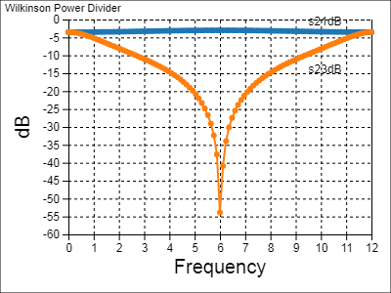
tee
3
1
2
1 2
3
3
t70
5
7
9
1
1
3
1
2
tee
r100
2
1
3
wilkinson
8
2
t70
4
6
2
3
1
2
1 2
tee

Slide 2
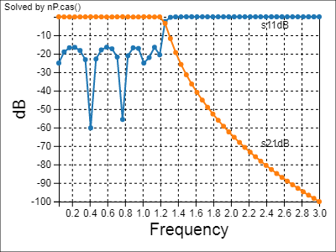
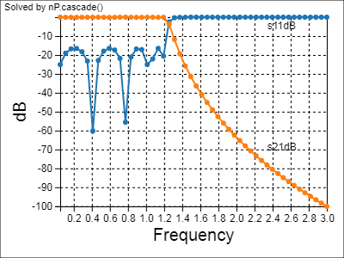
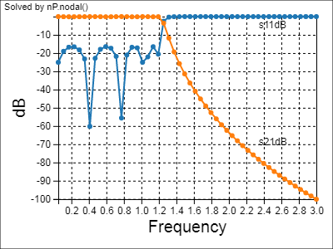
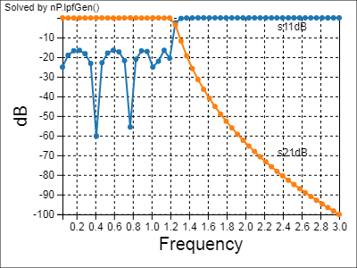
L1 = 9.56nH
L2 = 10.72nH
L3 = 10.72nH
L4 = 9.56nH
1
2
3
4
5
6
7
8
9
10
C1= 3.17pF
C2= 5.66pF
C3= 5.84pF
C4= 5.66pF
C5= 3.17pF

Slide 3
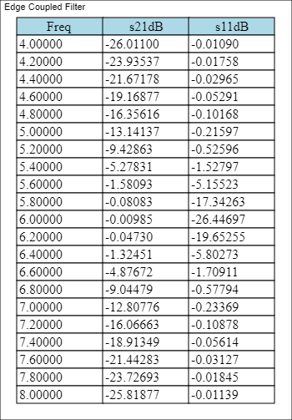
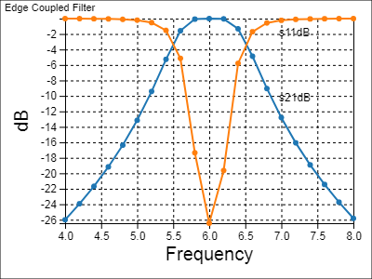
Zoe = 79.67
Zoo = 37.83
Zoe = 79.67
Zoo = 37.83
Zoe = 79.67
Zoo = 37.83
1
2
open
1 tclin1 2
open
4
4 tclin1 3
3
1 tclin2 2
5
open
open
7
6
8
4 tclin2 3
1 tclin3 2
open
10
9
4 tclin3 3
open

Slide 4
seSeRL and paSeRL
nP.seSeRL
nP.paSeRL()
R = 75
L = 5e-9
R = 75
L = 5e-9

Slide 5
Figure 1-4
V₁= 1.2 * 12.23/(4.549 + 12.230) = 0.874
1
4
1.2
Volts
2
5
+
DC
3
6
7
Fig 1-4
R_{equivalent}
4.549
Ohms
3.549
Ohms
12.230
Ohms
3.230
Ohms
DC

Slide 6
Figure 1-5
1 Volt
+
R_{source} = 50
DC
R_{Load}

Slide 7
Figures 1-6 to 1-7
1 Volt
+
R_{Source} = 50
DC
Through 2-Port
R_{Load} = 50
Fig 1-6
V₁ = 0.499
V₂ = 0.354
+
R_{Source} = 50
R₂ = 17.6
DC
R_{Load} = 50
Fig 1-7
R₁ =
292.4
R₃ =
292.4
R_{V1} = 49.98
R_{V2} = 42.69

Slide 8
Interlude Decibel Table

Slide 9
Figures 1-8 to 1-9
V
R
1 Volt
I
1 Ohm
+
DC
1 Amp
Fig 1-8
V – I * R = 0
R_{Source} = 50
R₂ = 17.6
V₁
V₂
+
DC
R_{Load} = 50
I₁
I₂
I₃
Fig 1-9
R₁ = 292.4
R₃ = 292.4

Slide 10
Figure 1-10
R_{Source} = 50
R₂ = 17.6
V₁
V₂
1V
+
DC
R_{Load} = 50
I₁
I₂
I₃
R₁ = 292.4
R₃ = 292.4
(a)
R_{Source} = 50
V₁
V₂
1V
I₁
R₂ = 17.6
+
I₂
DC
a₁
a₂
R_{Load} = 50
Fig 1-10
b₁
R₁ =
292.4
R₃ =
292.4
b₂
Port 1
Port 2
(b)

Slide 11
Figures 1-11 to 1-12
R_{Source} = 50
V₁
V₂
1V
I₁
R₁ = 75
+
I₂
DC
a₁
a₂
Fig 1-11
R_{Load} = 50
b₁
b₂
Port 1
Port 2
R_{Source} = 50
R_{Load} = 50
V₁
V₂
I₁
R₁ = 75
1V
I₂
+
a₁
a₂
DC
Fig 1-12
b₁
b₂
Port 1
Port 2

Slide 12
Figures 1-13 to 1-14
R_{Source} = 50
V₁
V₂
1V
I₁
+
I₂
DC
a₁
R₁ =
75
a₂
Fig 1-13
R_{Load} = 50
b₁
b₂
Port 1
Port 2
R_{Source} = 50
R₁ = 292.4
R₂ = 17.6
R₃ = 292.4
R_{Load} = 50
1V
+
DC
Fig 1-14

Slide 13
Figures 1-15 to 17
R_{Source} = 50
V₁
1V
I₁
+
DC
a₁
Fig 1-15
b₁
Port 1
R_{Source} = 50
R_{Source} = 50
V₁
V₁
1V
I₁
1V
I₁
+
+
DC
a₁
Fig 1-16
DC
a₁
Fig 1-17
50
b₁
b₁
Port 1
Port 1

Slide 14
Figures 1-18
R_{Source} = 50
V₁
V₂
1V
I₁
+
I₂
DC
a₁
a₂
Fig 1-18
R_{Load} = 50
b₁
b₂
Port 1
Port 2
R_{Source} = 50
V₁
50
V₂
1V
1V
I₁
10*V₁
+
I₂
+
+
50
+
DC
a₁
a₂
DC
DC
DC
R_{Load} = 50
Fig 1-19
b₁
b₂
Port 1
Port 2
(b)

Slide 15
Figure 1p2
59.76
+
5670
DC
I₃
42.1
842
5732
+
DC
I₂
4821
I₄
986
38.9
1017
847
+
DC
I₁
I₅
3492
949
Fig 1p2

Slide 16

Figures 2-1
120V_{DC}
Water Boiler Element @ 200 °F
+
DC
10A
Fig 2-1
120V_{RMS}
@60Hz
Water Boiler Element @ 200 °F
+
AC
10A_{RMS}

Slide 17
Figure 2-2
R_{Source} = 50
L = 45.65nH
V₁
V₂
1V_{RMS}
@2GHz
+
AC
Fig 2-2
I₁
I₂
I₃
R_{Load} = 50
C= 16.42pF
C= 16.42pF
1.642e-11
4.565e-8
1.642e-11
(a)

Slide 18
Figures 2-3
R_{Source} = 50
1V_{RMS}
@2GHz
V₁
V₂
+
I₁
I₂
AC
a₁
a₂
Fig 2-3
R_{Load} = 50
b₁
b₂
Port 1
C= 16.42pF
Port 2
R_{Source} = 50
1V_{RMS}
@2GHz
V₁
V₂
I₁
L= 45.65nH
I₂
+
AC
a₁
a₂
R_{Load} = 50
Fig 2-4
b₁
b₂
Port 1
Port 2

Slide 19
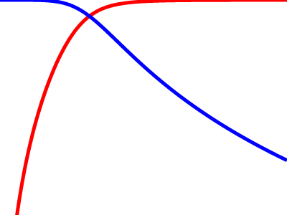
Figures 2-5

