Slide 1
IND5003 PG04 Q&A Session Green Taxi in NYC
WU QILONG, XIANG XIAONENG, JIN YIXUAN, DONG XINYUE, QI SHUOLI

Slide 2
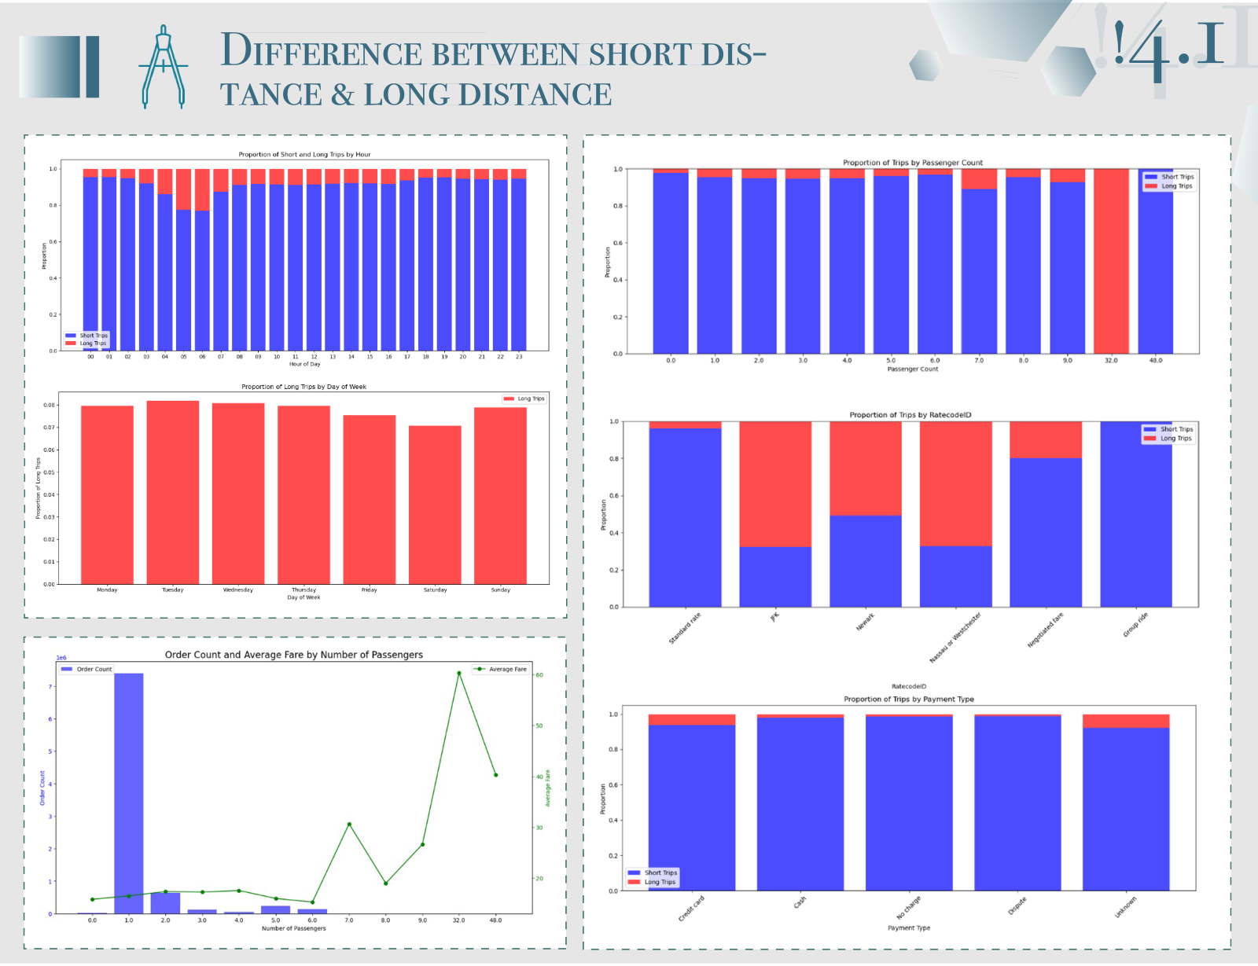
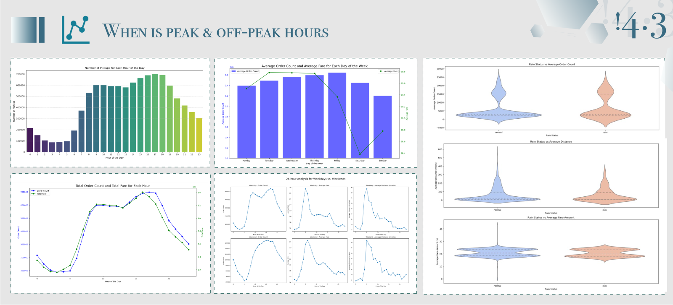
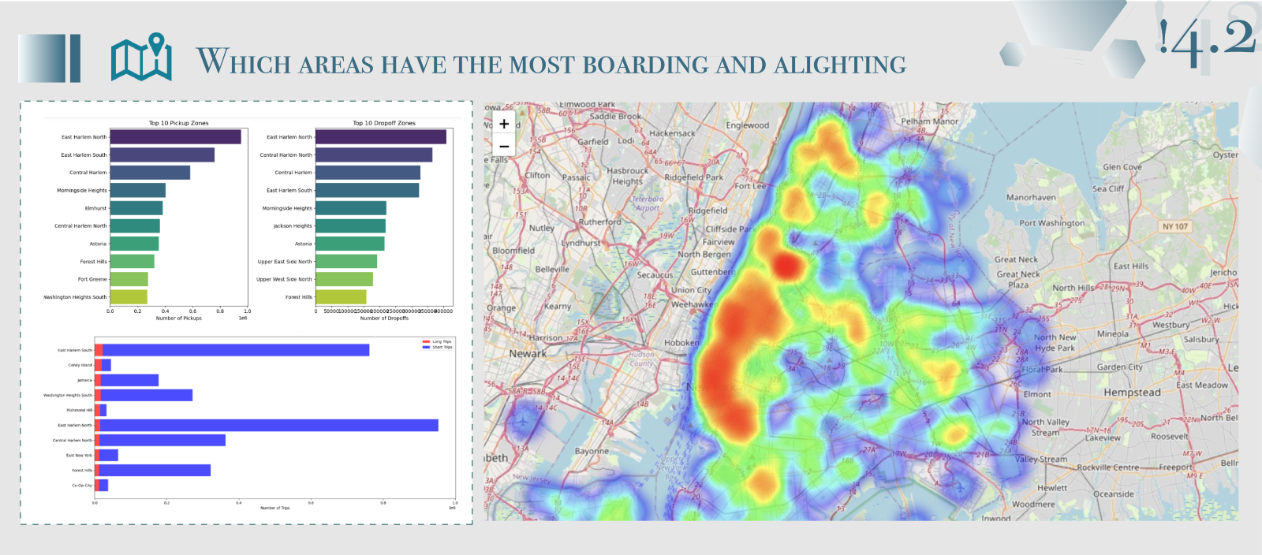
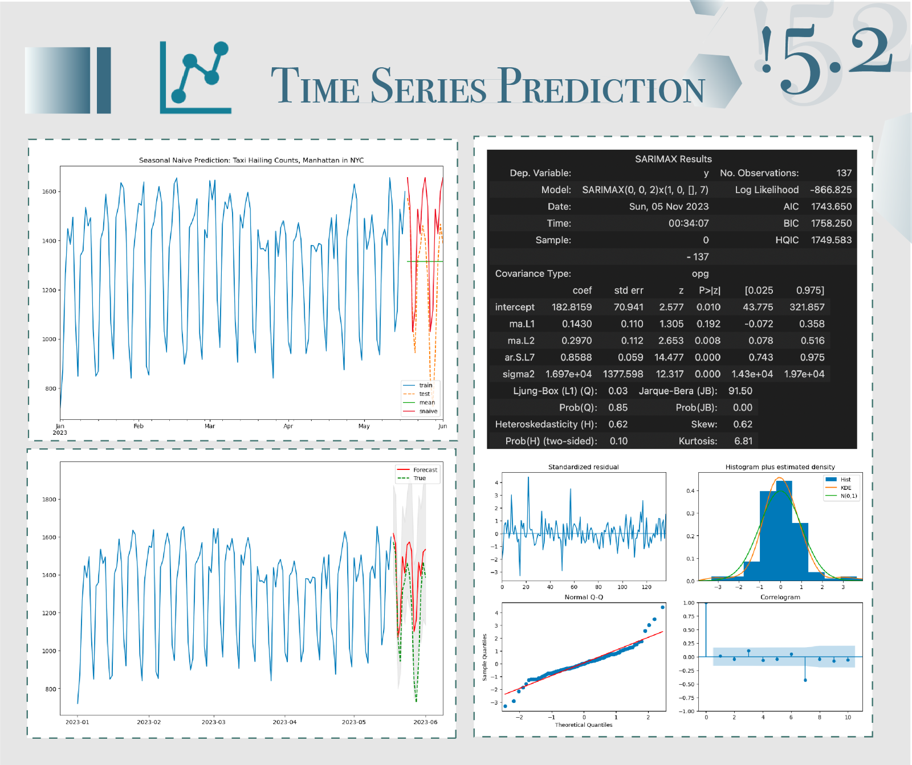

Slide 3

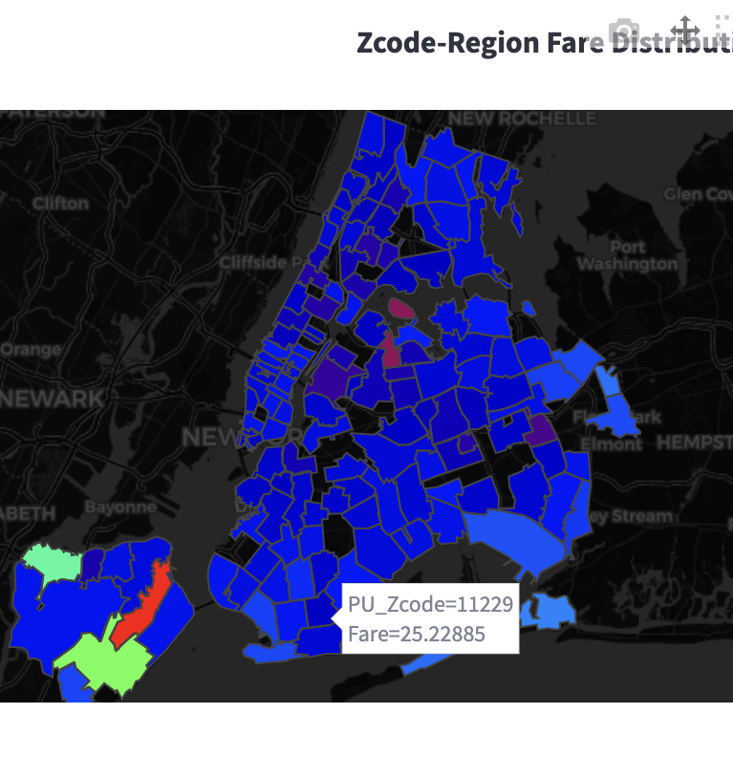

Scan this QR-Code to visit our Website!
GitHub
Website

Slide 4
Q1 Project Target
1. Do you have some ideas to provide the taxis company with specific strategies? Considering many conditions such as weather, time, frequency, etc.
2. Did the study consider the shifts in transportation patterns?
3. Considering the correlation between cost and distance, are there other factors that influence the overall cost increase, such as what is the average unit price per kilometer between short and long trips?

Slide 5
Q1 Project Target
Target: Provide analysis services for Green Taxi Company, not for customers. Increase revenue & Reduce costs, downtime.
History & Real-time Visualization Monitoring: Create a dashboard which analyze any time-period.
Prediction: To get future insights for decision-making and modification in advance.
Regression:
Validate if the intuitive regularity of pricing strategy ~ distance.
Further explore the hidden patterns of other variables to improve the pricing strategy(reset the goal to price/mile to remove the distance effects).

Slide 6
Q2 Time Series
1. Is there a significant difference between pre- and post-epidemic data? Did you analyze the data for 2020 as it may be disruptive due to big shift of pandemic?
2. Did you considered ARIMA model differencing given that the time series exhibits some trends?

Slide 7
Q2 Time Series
Yes. There is a significance difference between pre- and post-epidemic data. For more special analysis need in specific time-period, you could explore yourself on our website.
Actually, we DO use ARIMA differencing, and we set it without differencing by default, if you want you could change the parameters in our code to implement that.

Slide 8
Q3 Clarification for Regression
1. I saw that you used feature importance to check the importance of features, however, there is no way to check the p-value of these models, how you manage the features multicollinearity?
2. The weightage of distance outweighs all other variables. Does this affect your regression model's usefulness? Perhaps instead of using total price as your target variable, would price per distance be more useful to the taxi company?

Slide 9
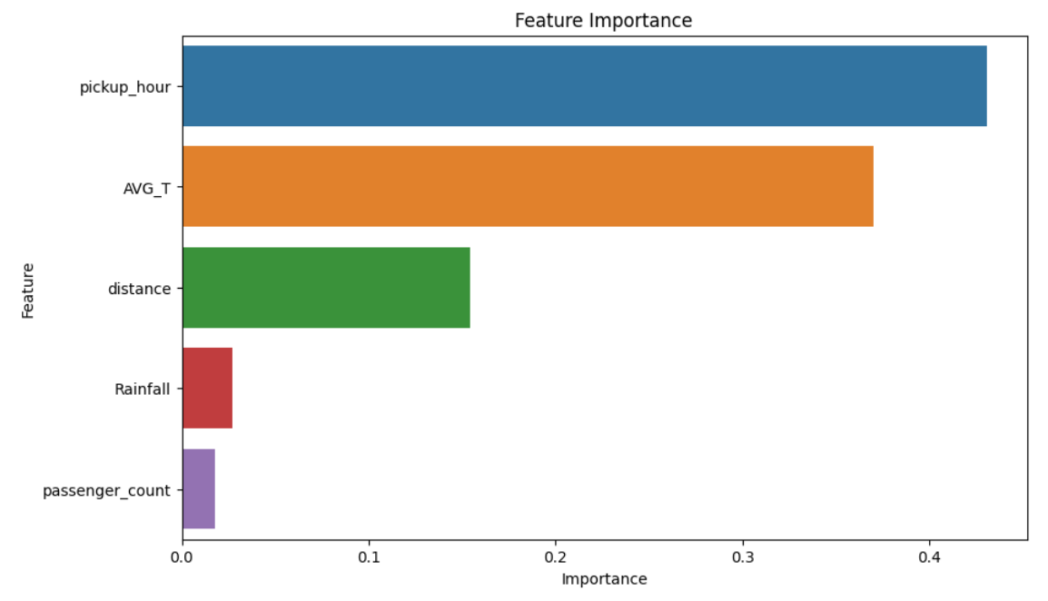
Q3 Regression Clarification
As mentioned before, our regression analysis is not primarily aimed at prediction but to analyze the impact of different features on the price of taxi trips. Therefore, feature importance is more significant for us in analyzing the pricing strategy of taxi companies.
In recommendations for analyzing the unit price per mile, we have not only observed factors affecting the total price but also conducted regression analysis with multiple models on the price per mile, using the GBM model to obtain the 5 most influential factors shown in the figure.
Hypothesis testing isn't directly applicable to non-parametric machine learning models. Traditional models might not capture non-linear relationships. Therefore, we us e cross-validation to confirm the stability and credibility of feature importance, as validated and shown in the figure.

Slide 10
Q4 Improvement
1. What are the limitations you have that can be further improved?
2. Could you explore how these patterns might change if new transportation options, such as expanded public transit or ride-sharing services, are introduced in the city?

Slide 11
Q4 Improvement
Already built the whole pipeline from data collection to results automatically, so only need to improve some links.
Cross-Validation or Optimization Algorithms(like Genetic Algo/Momentum Algo/…) for Hyperparameters Tuning.
Need other new data describing the extra conditions to do A-B Test to find out how the former patterns will change.

Slide 12
Thanks for Listening!

