Slide 1


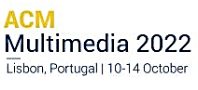

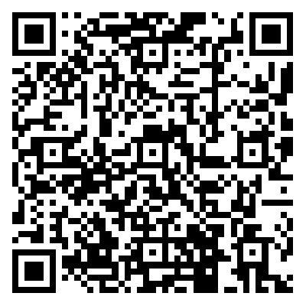

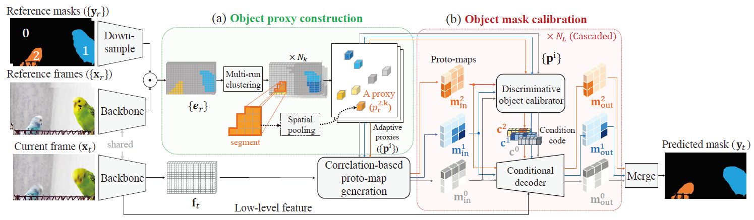
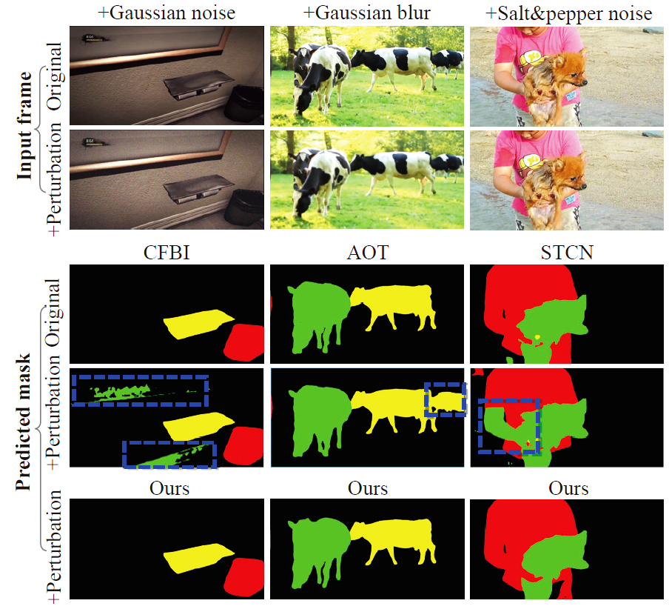
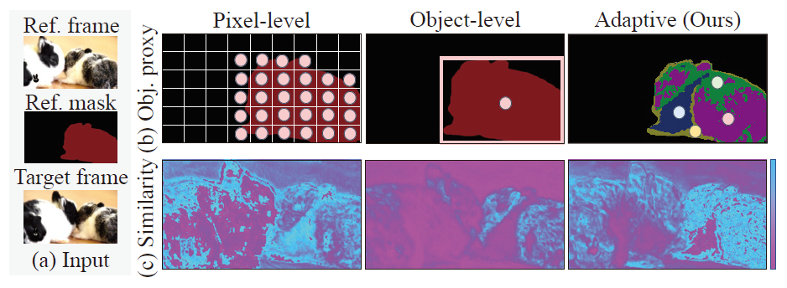
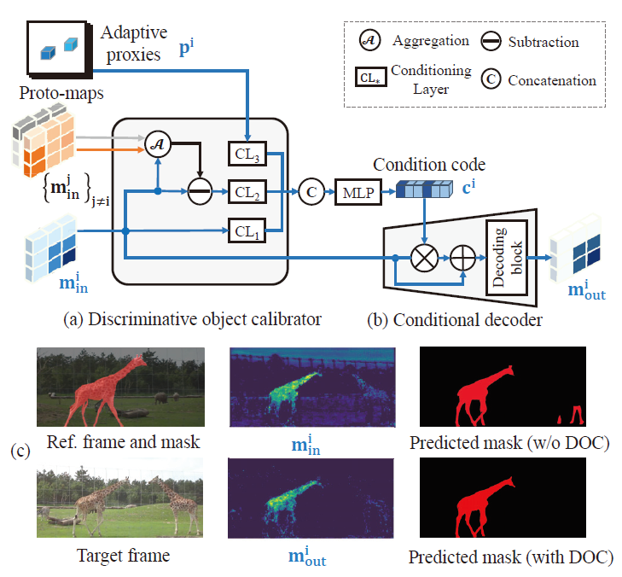
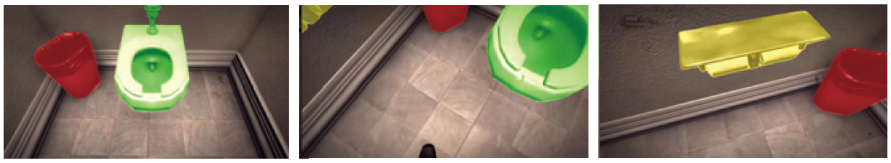
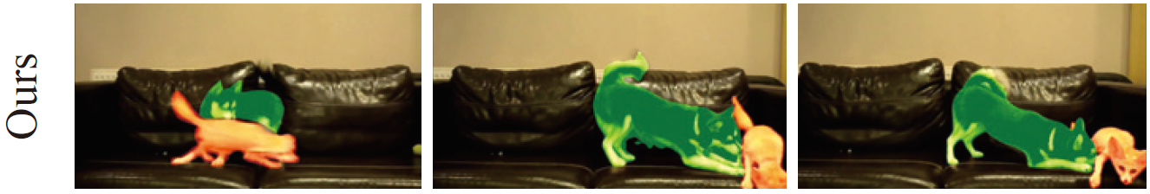
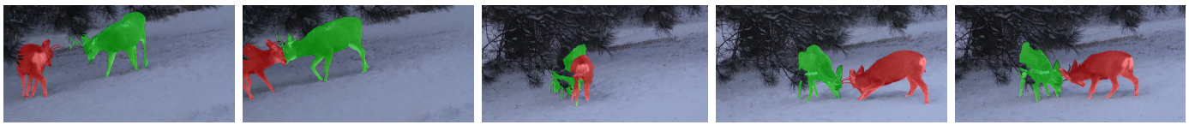
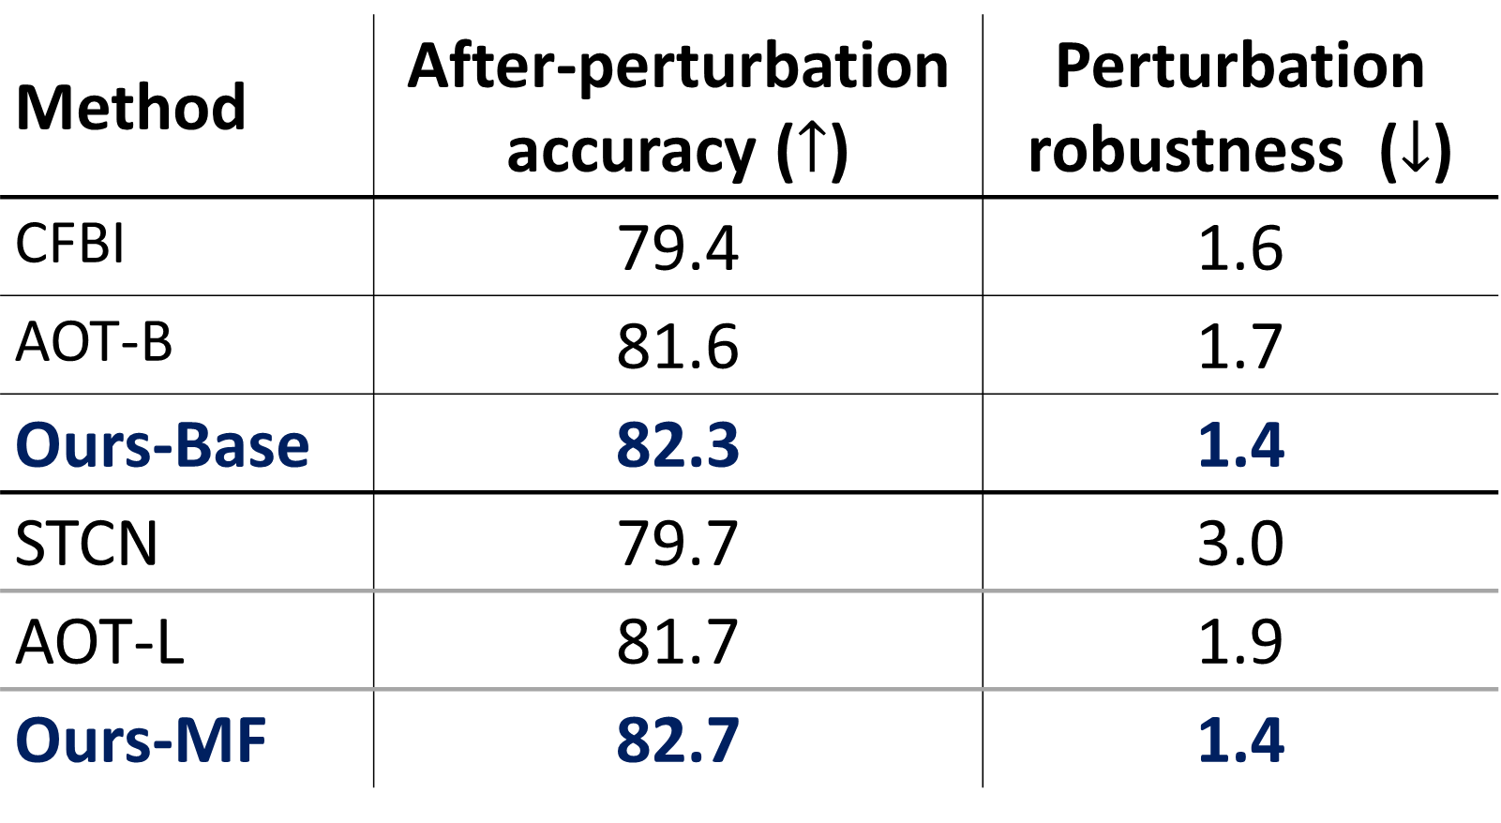
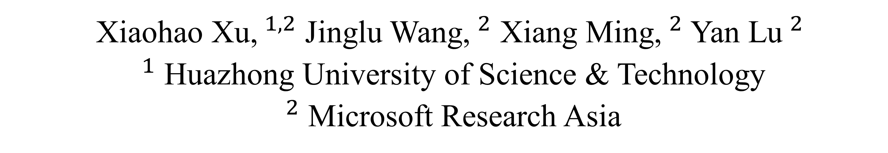
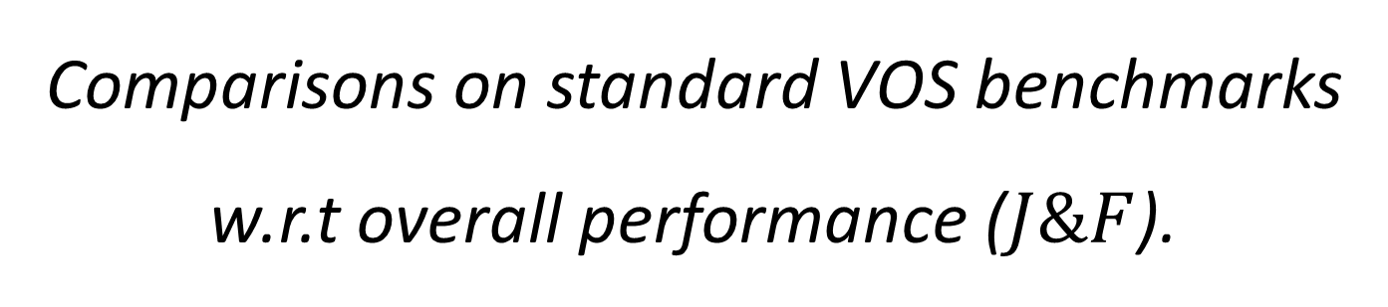

Towards Robust Video Object Segmentation
with Adaptive Object Calibration
Xiaohao Xu,$^{1,2}$ Jinglu Wang,$^{2}$ Xiang Ming,$^{2}$ Yan Lu$^{2}$
$^{1}$ Huazhong University of Science & Technology
$^{2}$ Microsoft Research Asia
Introduction
Method
paper
repo
Results
Task: Video Object Segmentation (VOS) aims at segmenting target objects in a video clip given the ground truth mask at the reference frame.
Motivation: Our finding indicates that existing VOS models are fragile to natural perturbations.
Solution: The key insight is to:
introduce an adaptive object proxy representation for referenced objects robustly, which reduces errors incurred by unstable pixel-level matching.
calibrate the object masks by updating object representation and masks in an interleaving manner progressively, achieving discrimination among co-existing objects.
Robust VOS Framework = Robust object representation + Robust mask decoding
Method | YouTube- VOS18 | DAVIS17 Valid | DAVIS17 Test-dev
STM | 79.4 | 81.8 | 72.3
CFBI | 81.4 | 81.9 | 74.8
AOT-B | 83.2 | 82.1 | 75.5
Ours-Base | 83.6 | 83.1 | 76.5
STCN | 83.0 | 85.4 | 76.1
AOT-L | 83.7 | 83.8 | 78.3
Ours-MF | 84.0 | 83.8 | 79.3
Comparisons on standard VOS benchmarks
w.r.t overall performance ($J\&F$).
Adaptive Object Proxy (AOP) for Robust Object Representation
Ref. pixel
proxy
Method | After-perturbation accuracy ($↑$) | Perturbation robustness ($↓$)
CFBI | 79.4 | 1.6
AOT-B | 81.6 | 1.7
Ours-Base | 82.3 | 1.4
STCN | 79.7 | 3.0
AOT-L | 81.7 | 1.9
Ours-MF | 82.7 | 1.4
Target embedding
Global average pooling
Traditional pixel-wise matching
Cluster-based average pooling
Target embedding
Ref. adaptive
proxy
Pilot study of perturbation robustness for VOS models on the perturbed dataset YouTube-VOS-P.
Our model with adaptive object calibration shows superior robustness against perturbations.
Sensitive to
pixel-level noises
Lose too
much details
Robust to noises &
preserve details adaptively
Matching with adaptive proxies (Ours)
Discriminative Object Calibration (DOC) for Robust Mask Decoding
$$0$$
$$t$$
Other
objects
Target
object
incorporate discrepancy
between different objects
for inter-object discrimination
Qualitative results of our model.

