Slide 1
Understanding the size effect, value effect, and momentum effect

Slide 2
Value and Size
Fama and French interpret the small stock effect and the value effect as being systematic factors
Are the value and size effect capturing risks investors care about?
Are they due to systematic mispricing?
Are they due to data mining?

Slide 3
Rational Theories of Value

Slide 4
Risk and Return
To summarize, if the payoff of an asset tends to be
High in bad times => valuable asset to hold => low returns
Low in bad times => high returns
Any rational story of a strategy having unconditionally high expected returns is those high expected returns compensate the investor for losing money during bad times.
Applied to value investing:
Value stocks have high expected returns because they are risky during bad times. Value stocks tend to lose money during bad times and require high risk premia to induce investors to hold these stocks.
Growth stocks have low returns because they tend to pay off during bad times and are less risky.

Slide 5
Rational Theories of Value
Time-Varying Betas
Long-run risk
Real investment risk

Slide 6
Time-Varying Betas
Lettau and Ludvigson (2001) advocate a conditional CAPM, where value stocks’ CAPM-betas become higher during “bad times” when expected returns on the market are high and prices are low
As betas are high, there are potentially more losses holding value stocks during bad times
Significant time variation of value firm betas

Slide 7
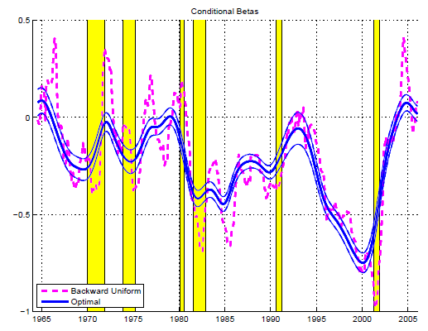
Time-Varying Betas
Value-Growth Betas from Ang and Kristensen (2012)

Slide 8
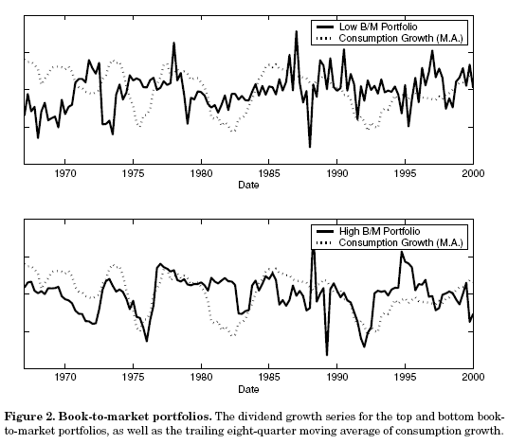
Long-Run Risk
Bansal et al. (2005) measure bad times using long-run (backward-looking) averages of consumption growth. This is “long run” consumption risk.
Value stocks have higher betas with respect to long-run consumption growth than higher frequency consumption growth
Implication: when long-run consumption growth falls (bad times), value stocks are more likely to have lower returns

Slide 9
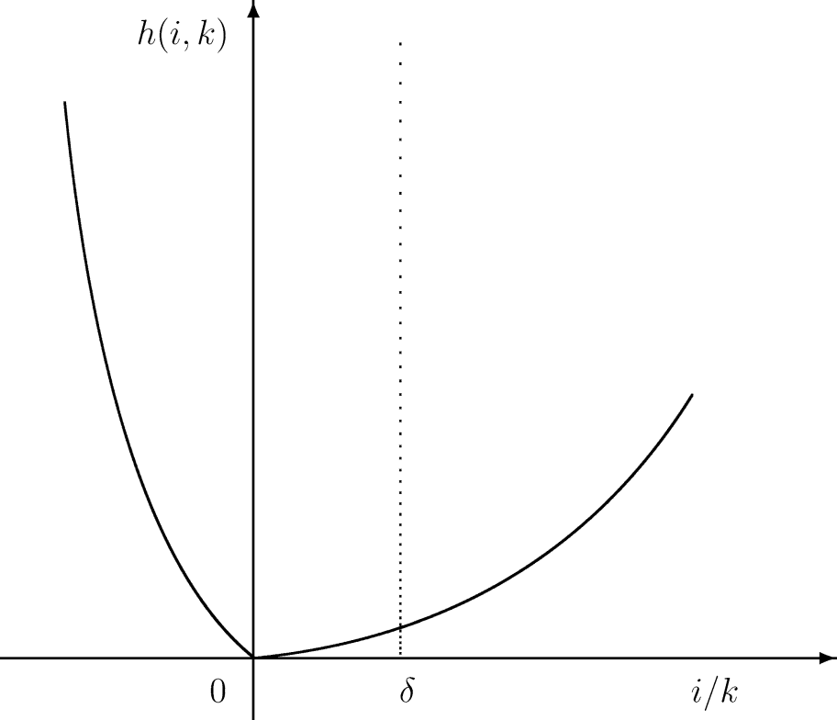
Real Investment Risk
Value stocks: firm value derived mainly from assets in place
Growth stocks: firm value derived mainly from growth opportunities
In Zhang (2005), adjustment costs are asymmetric and firms face higher costs in adjusting capital stocks downward
E.g., may have to sell PP&E at a relatively large discount to transition to producing more profitable output
Value firms are risky because during bad times (like recessions):
They are burdened with more unproductive capital (they cannot disinvest as easily as growth firms because they hold stodgy PP&E).
They want to cut back on capital, face higher adjustment costs
Implication: lower returns in bad times, thus they are riskier than growth firms
Growth firms can better deal with a downturn by deferring investment
Figure 1 from Zhang (2005)

Slide 10
Behavioral Theories of Value (potential mispricing)

Slide 11
Behavioral Theories: Over-Extrapolation
Most behavioral explanations of value center around over-reaction/over-extrapolation
Investors over-extrapolate past growth rates into the future.
Growth firms have had high past growth rates. Prices of these firms are bid up too high reflecting excessive optimism.
When growth does not materialize, prices fall so returns are low relative to value firms
Value stocks are NOT fundamentally riskier
Story first put forward by Lakonishok, Shleifer and Vishny (1994)
Crucial assumption: naïve investors over-extrapolate and prices reflect the over-reaction. Contrarian (value) investors outperform by taking the opposite side.
Why don’t more value investors enter the market and bid up the prices of value stocks removing the value premium?

Slide 12
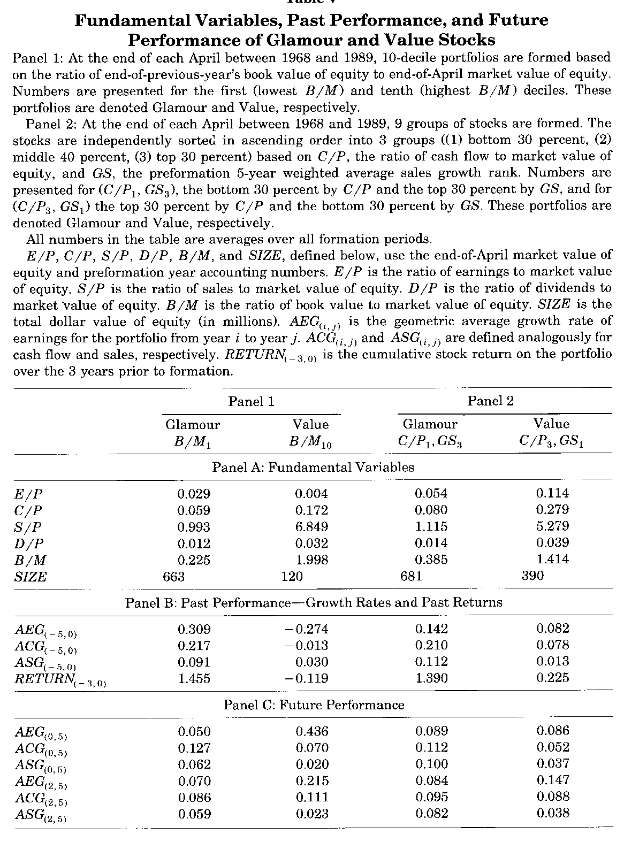
LSV compare actual growth rates to past growth rates and to expected growth rates implied by firm multiples
Panel A: value portfolios have higher fundamentals to price ratios
Panel B: growth stocks grew substantially faster than value stocks 5 years prior to portfolio formation
Panel C: In the 5 years post formation, growth rate for growth stocks are lower than 5 years previously, and lower than value stocks. Especially low growth over years +2 to +5.

Slide 13
Size

Slide 14
Size

Slide 15
Small-Large
Was it spurious?
Consistent with the actions of a near-efficient market

Slide 16
Momentum

Slide 17
Winners vs Losers

Slide 18
Origins of Momentum Matter
Rational Theories
The payoff to momentum is a payoff for bearing systematic risk Implication: Eventually the risk will materialize
Momentum contains information generated by hard-working investors that is not yet fully discounted by market prices Implication: If the information is correct, momentum investing will yield positive returns
Behavioral Theories
Investors make systematically irrational decisions by over-extrapolating price movements Implication: Invest in momentum, but jump off at the right time
They under-react to important information Implication: If so, buy past winners and sell past losers. As investors adjust to the information, you will profit

Slide 19
Risk Theories
Momentum is hard to explain with a risk story. But, there seem to be some risk components of momentum profits
Momentum profitability varies over the business cycle
Momentum strongest during bull markets (this is also consistent with over-reaction)
There are downside risk components to momentum profits
Links to liquidity risk

Slide 20
Jegadeesh-Titman (1993) Momentum

Slide 21
Behavioral Theories
Behavioral explanations of momentum come in two main flavors:
Under-reaction: good news comes out but investors under-react. Then, prices slowly drift upwards to the rational price.
Over-reaction: irrational investors over-react to positive news. This over-reaction is gradual, so stock prices display momentum for a period of time but then eventually reverse and return to fundamental value.
Most combine elements of under- and over-reaction
The under-reaction captures momentum, while the over-reaction captures long-term mean reversion

Slide 22
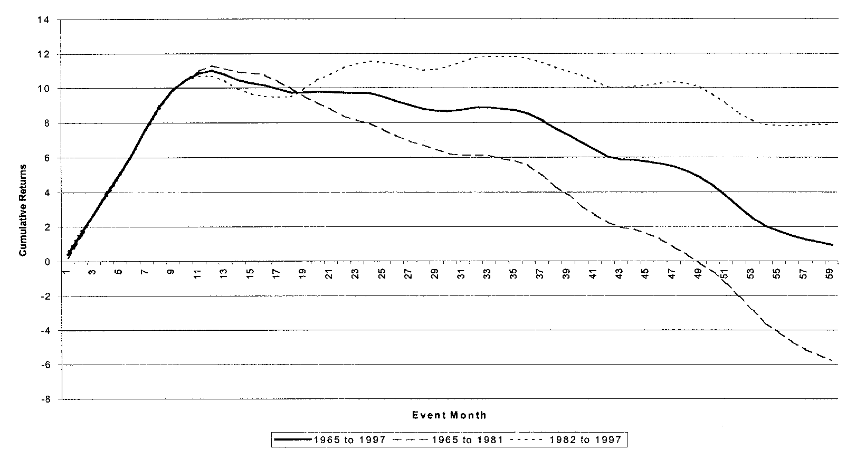
Momentum Reversals
Jegadeesh and Titman (2001) track the returns of momentum portfolios up to 5 years post-formation
Momentum profits reverse in years 2-5.

Slide 23
Behavioral Theories
Barberis, Shleifer and Vishny (1998):
Uses two psychological biases
Conservatism: Investors underreact to information such as earnings announcements because they stick to their prior beliefs. This causes momentum.
Representative heuristic: investors mistakenly conclude that firms with high earnings growth in the past continue to experience high earnings growth in the future.
Representativeness causes investors to assume commonality between similar objects (here past and future growth rates).
This leads to overreaction of asset prices to a series of good or bad news
Representativeness leads to long-term mean reversion.
No role for rational investors

Slide 24
Behavioral Theories
Hong and Stein (1999):
No behavioral biases
Two groups of investors, both rational but have limited information sets (“bounded rationality”)
Informed investors (“news watchers”) receive signals of firm value but ignore information in the past history of prices
If information diffuses gradually -> momentum in prices
Uninformed investors (“momentum traders”) do not receive signals but trade based only on past prices. Momentum traders jump on the train. This leads to overreaction and price reversals in the long-run.

Slide 25
Interpreting the Evidence

Slide 26
Summary: Rational vs. Behavioral
Various anomalies (relative to the CAPM) have explanations that arise from a rational risk-based story or a behavioral story
Rational: high expected returns compensate for negative returns during certain periods. The key is defining what those bad times are.
Behavioral: high expected returns result from agents’ under- or over-reaction to news and/or the inefficient updating of beliefs. Behavioral biases persist because there are barriers to the entry of capital.
For some anomalies, the explanations are largely rational, for others, mostly behavioral
Value/growth: rational and behavioral
Momentum: behavioral, mostly
High returns on selling volatility in option markets: rational, mostly

Slide 27
Joint Hypothesis Problem
If we find a strategy that earns “abnormal” returns, can we conclude we are exploiting market inefficiencies?
Abnormal return: return not explained by exposure to a set of risk factors
Joint hypothesis problem:
We cannot disentangle whether or not “abnormal” returns to a strategy are due to market inefficiencies or are compensation for a risk we haven’t considered
I.e., either we have found a pocket of market inefficiency or our asset pricing model is wrong
Example: a trading strategy has positive alpha after controlling for exposure to the Fama-French 3 factors. Maybe there is an important 4th risk factor that the strategy is exposed to that we haven’t included in our model.
We need to use our best judgment when we find “anomalies”

Slide 28
Other issue: Data mining
Over 300 factors have been “discovered” and published in top finance journals (Harvey, Liu and Zhu (2016))
It is highly unlikely that there are 300 systematic risk factors
Most likely, a majority are the result of data mining
Recent wave of research:
Using LASSO and other techniques to determine the “important” factors

Slide 29
Portfolio Decisions
For an individual investor, deciphering the correct explanation for a factor doesn’t matter as much as determining how the factor covaries with your good and bad times
Does the factor have low payoffs during your bad times? Are you willing to bear the risks associated with the factor to earn the premium?
Also, do we expect the premium to persist?

Slide 30
Summary

Slide 31
Summary
In multifactor models, there are multiple definitions of bad times.
Each factor defines a new set of bad times.
Factors can be both fundamental, macro factors like economic growth and inflation, and investment (or style) factors, like value-growth, size, and momentum
Factors can have both rational (risk-based) or behavioral foundations. Many factors, such as value-growth, can have both explanations.
Markets are “near” efficient, it is impossible for markets to be truly efficient in the classical sense

