Slide 1
Arbitrage Pricing Theory (APT)

Slide 2
Bag of Candy Arbitrage Example
Bag costs $50
20 milky way, 20 Twix and 10 snickers
Individually:
Milky Ways cost $0.50, Twix cost $1.25 and Snickers cost $1 individually.
Buy the bag or the individual bars?
Buy 20 MW for $.50 = $10
Buy 20 Twix for $1.25 = $25
Buy 10 snickers for $1 = $10
$45 to replicate the bag of candy
Arbitrageur: buy the underpriced individual candy bars and sell (short) the overpriced bag

Slide 3
Arbitrage
The act of exploiting mispricing to achieve risk-free profits
Investors make money without putting capital at stake and without taking risk
Example:
Microsoft is trading at $10 on BATS and $12 on NASDAQ.
Arbitrage strategy: short at the NASDAQ exchange price, use proceeds to buy on the BATS exchange and close short.
In competitive and efficient markets, profitable arbitrage opportunities like these will quickly disappear

Slide 4
Pure vs. Risk Arbitrage
Pure arbitrage: creation of riskless profits made possible by relative mispricing among securities. No investment required.
Risk “arbitrage”: creation of risky profits made possible by relative mispricing among securities. No investment required.
E.g., an acquirer offers to buy shares in a target company for a price of $420 per share. Current share price is $380/share.
You buy shares in the target company and fund the purchase by shorting the acquirer.
You plan to sell at $420 to earn 10% on your long position.
There is no guarantee the offer will be approved
Most arbitrage strategies are really risk arbitrage strategies

Slide 5
One Factor Portfolio Arbitrage Example

Slide 6
Returns
Assume a large number (say 500) assets have returns that are driven by one systematic risk factor and they each have idiosyncratic risk.
Also assume that a majority have positive alpha.
How can an arbitrageur take advantage of the alphas?
First eliminate idiosyncratic risk, then eliminate systematic risk

Slide 7
Eliminate Idiosyncratic Risk
Combine the assets into a portfolio
A well-diversified portfolio will only be exposed to systematic risk
Expected return:

Slide 8
Eliminate Systematic Risk
To eliminate the systematic risk, we need to create a portfolio to hedge the market
First, create a portfolio that mimics the risk in portfolio P
Mimicking portfolio:
w_{m} in the market portfolio
w_{f} in the risk-free asset
r_{mimic} = w_{m} (r_{m}) + w_{f} (r_{f})
What weights give us a return that mimics the return on portfolio P?

Slide 9
Eliminate Systematic Risk
Solve for weights in the short portfolio, to mimic the returns of Portfolio P
Go long portfolio P (100%) and short the mimicking portfolio (-100%).

Slide 10
Combined portfolio
The return on the combined portfolio:
Weights sum to zero because there’s no investment
And there’s no risk in the portfolio.
We eliminated:
Idiosyncratic risk through diversification
Systematic risk by hedging using the market index

Slide 11
Zero Net Investment Portfolios
Zero net investment portfolio:
Investor does not contribute their own wealth to the portfolio
Sum of portfolio weights equals zero
Long and short the same amount of dollars
100% long = 100%
100% short = -100%
Sum = 100% + (-100%) = 0%

Slide 12
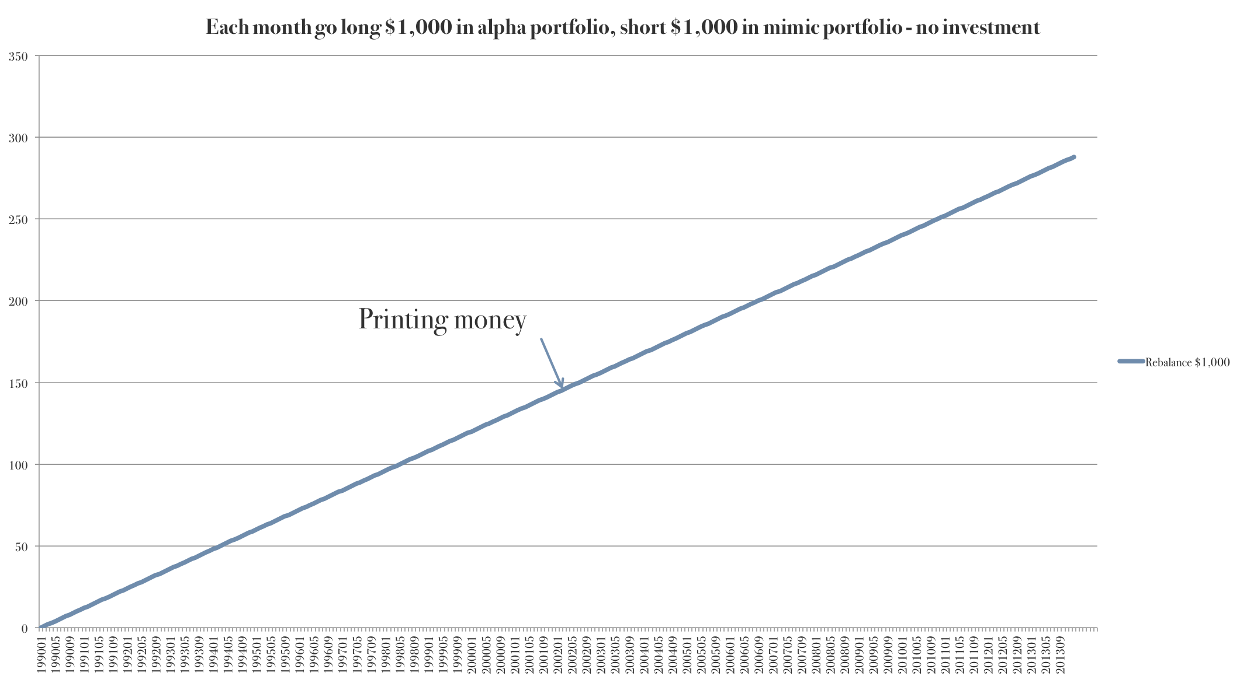
Rebalance Each Period

Slide 13
Efficient markets
We constructed a pure arbitrage
In a competitive and efficient market, arbitrage opportunities like this shouldn’t exist
Therefore, the alpha should be zero on this well-diversified portfolio:
This is the same as the SML

Slide 14
Multi-Factor Example

Slide 15
Multi-Factor Example
Assume there is an “alpha” portfolio with returns:
Where r_{E} is the return on a US Equity index and r_{C} is the return on a commodity index

Slide 16
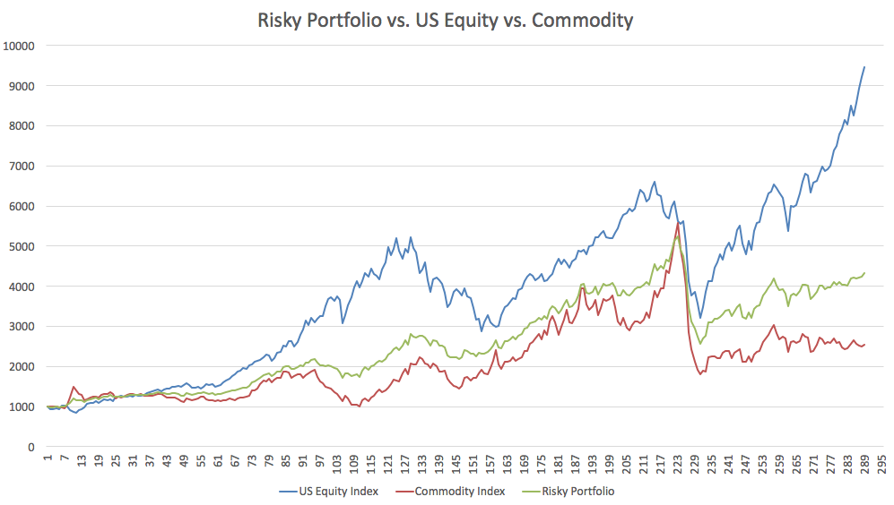
Portfolio and Indices Growth
Notes:
I am using the same data as in the efficient frontier homework

Slide 17
Arbitrage
Can we create a pure arbitrage strategy to take advantage of the alpha?
Create a mimicking portfolio using the US equity index, commodity index and risk-free asset that “mimics” the returns on A (except for the alpha):
What should be the weights?

Slide 18
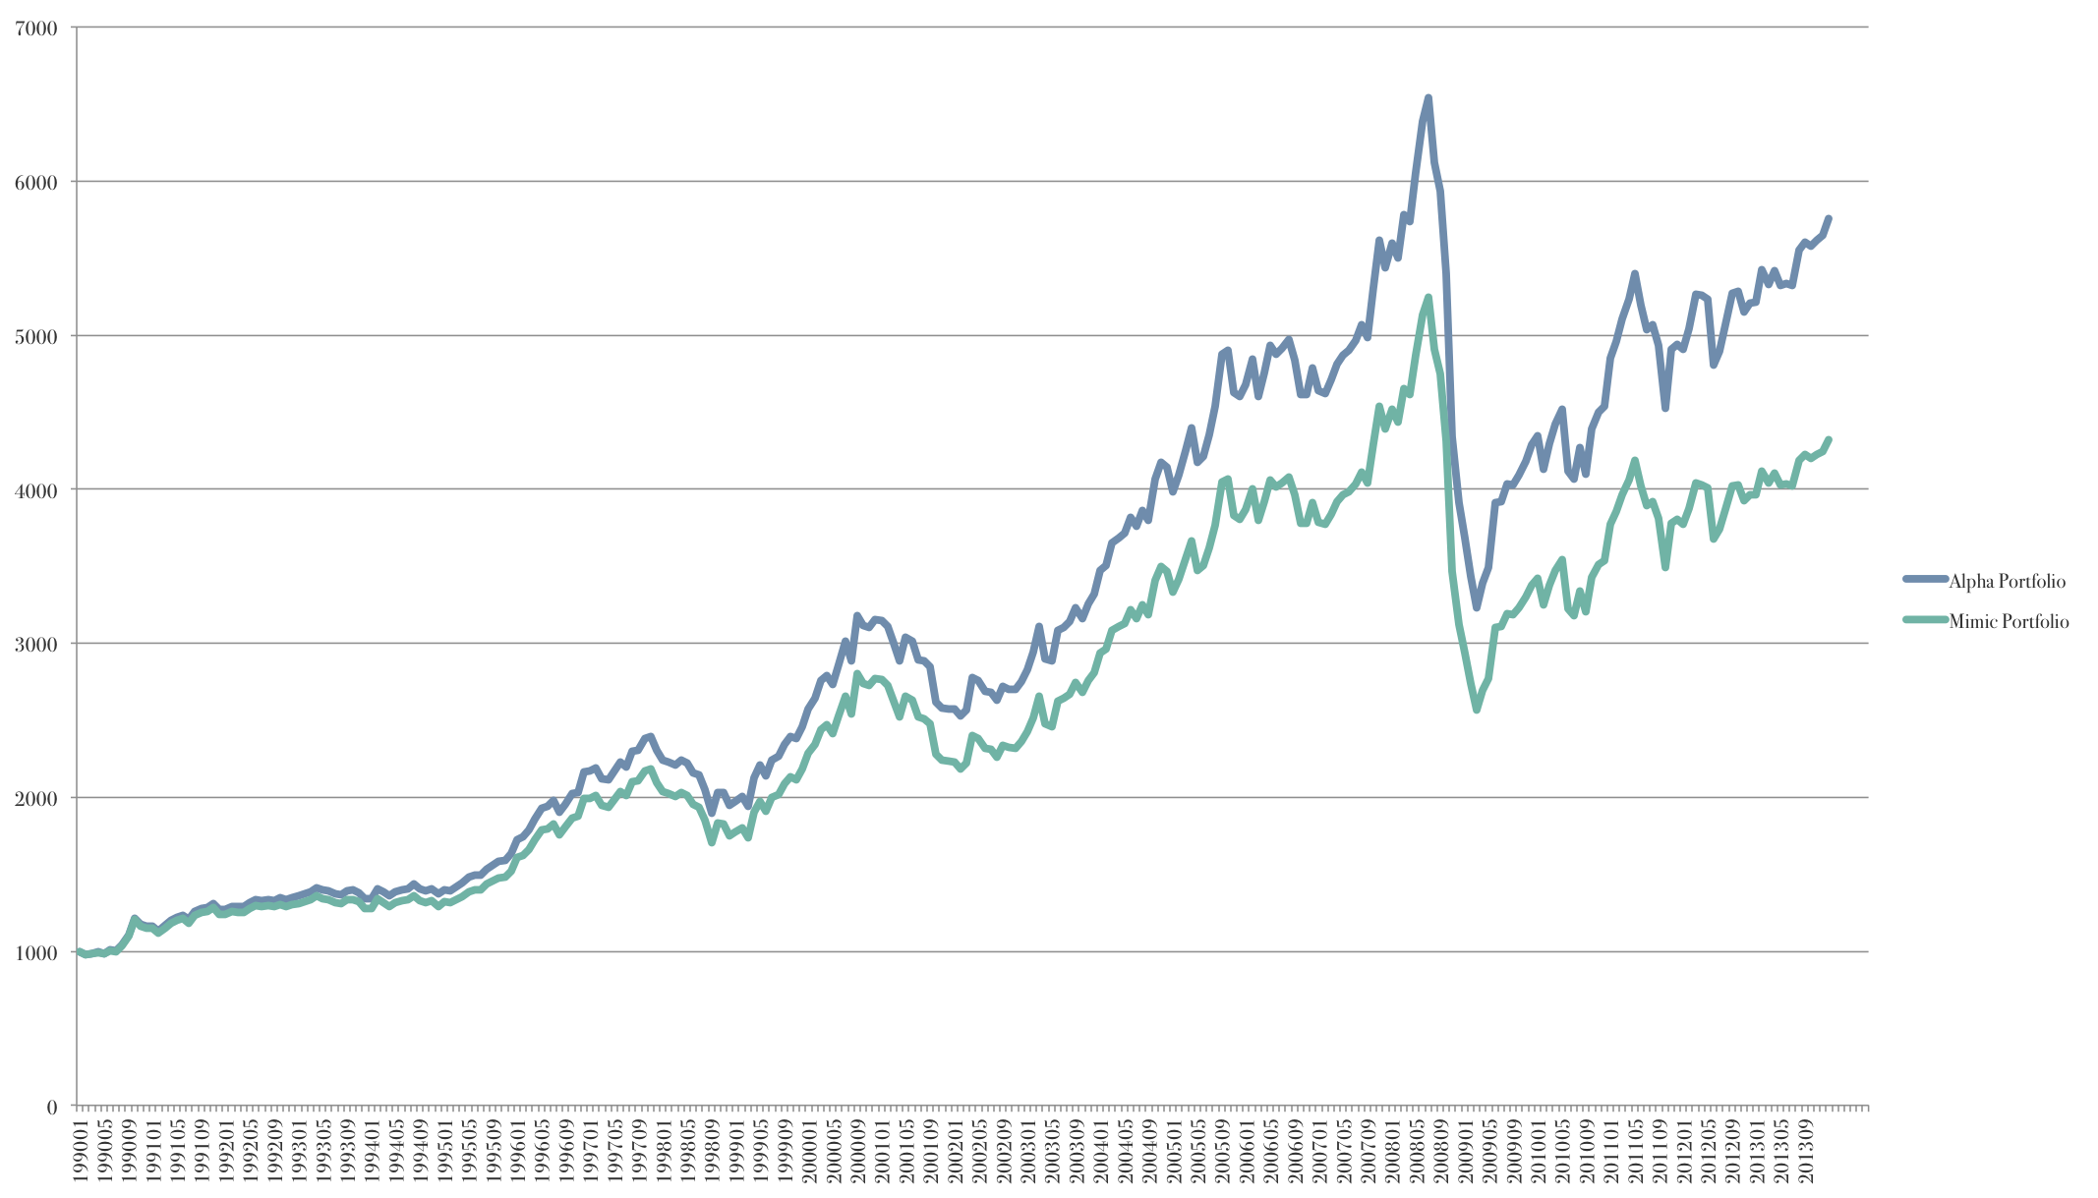
Alpha vs. Mimicking

Slide 19
Arbitrage
Alpha portfolio returns:
Mimicking portfolio returns:
Zero net investment portfolio:
Long Portfolio A (weight=100%), short mimicking (weight=-100%):
With long $X in the alpha portfolio and short $X in the mimicking portfolio:

Slide 20
Arbitrage
Let’s look at 2 strategies:
Go long/short $1,000 each month (rebalance)
Go long/short $1,000 at beginning and do not rebalance

Slide 21
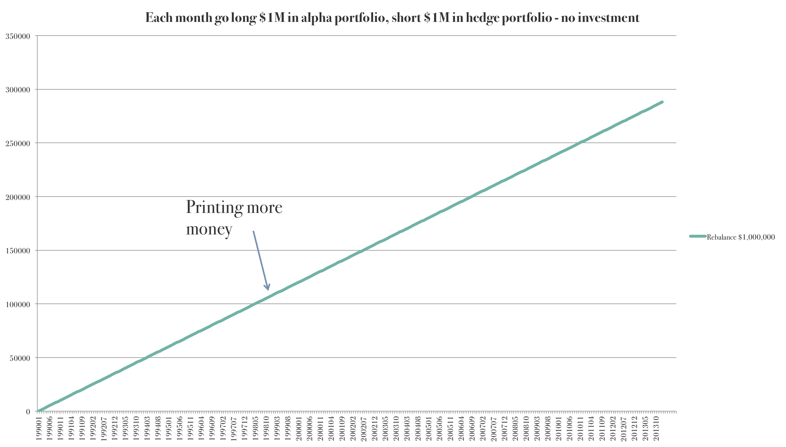
Up the stakes ($1M long/short)

Slide 22
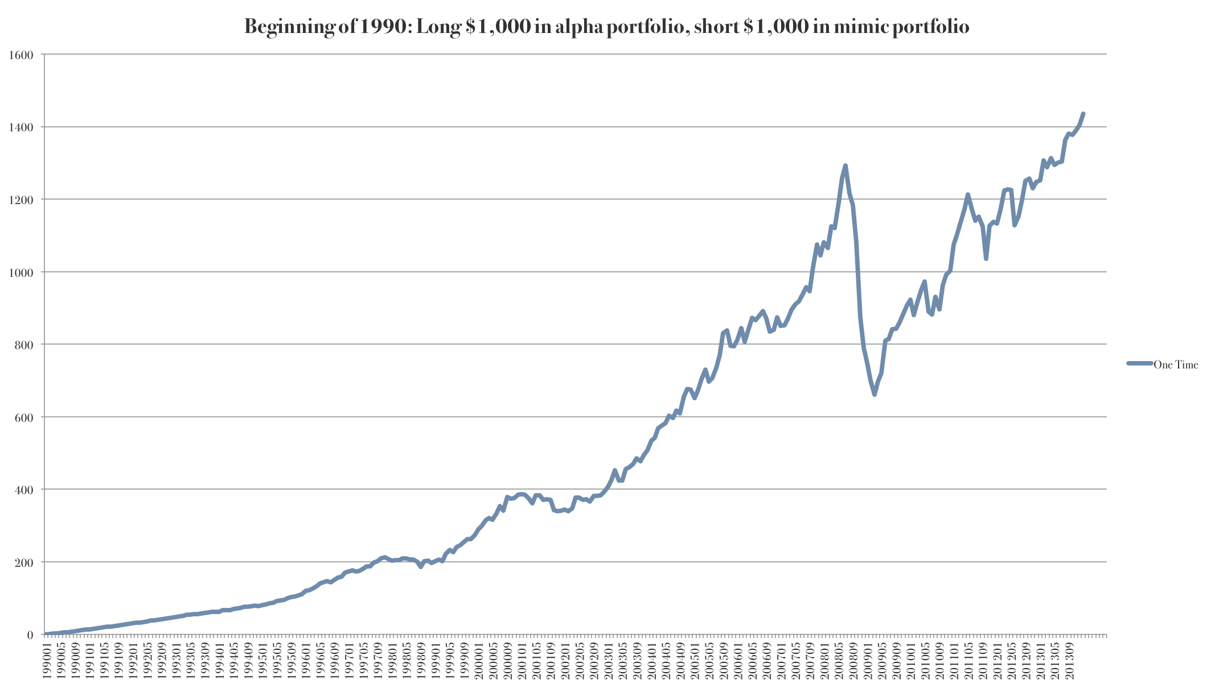
No Rebalancing
Long outperforms short. Over time, the long side grows more and more.
Greater relative exposure to long than short. This creates risk and is not a pure arbitrage strategy

Slide 23
Idiosyncratic Risk

Slide 24
Idiosyncratic Risk
Now, assume there is some residual risk in the alpha portfolio
How does this affect our arbitrage strategy?

Slide 25
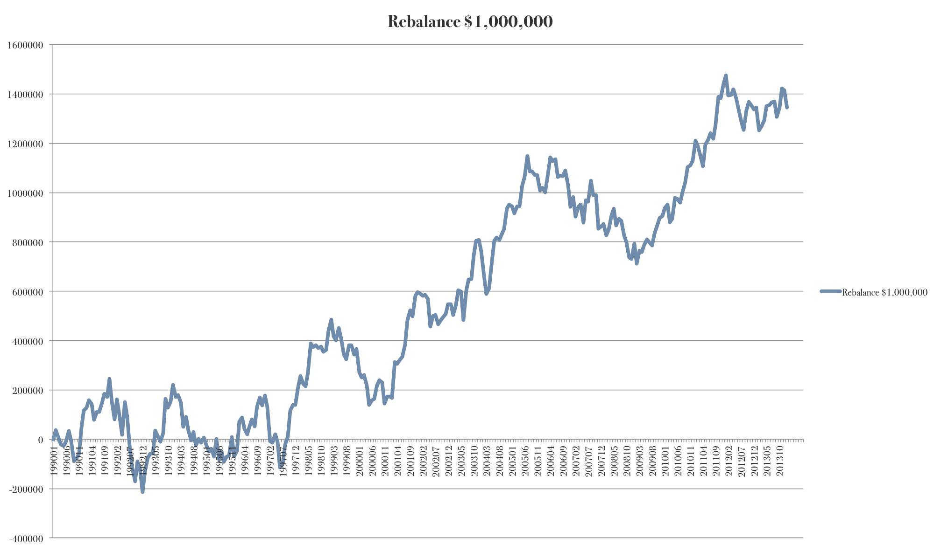
$1M Rebalancing (Example 1)

Slide 26
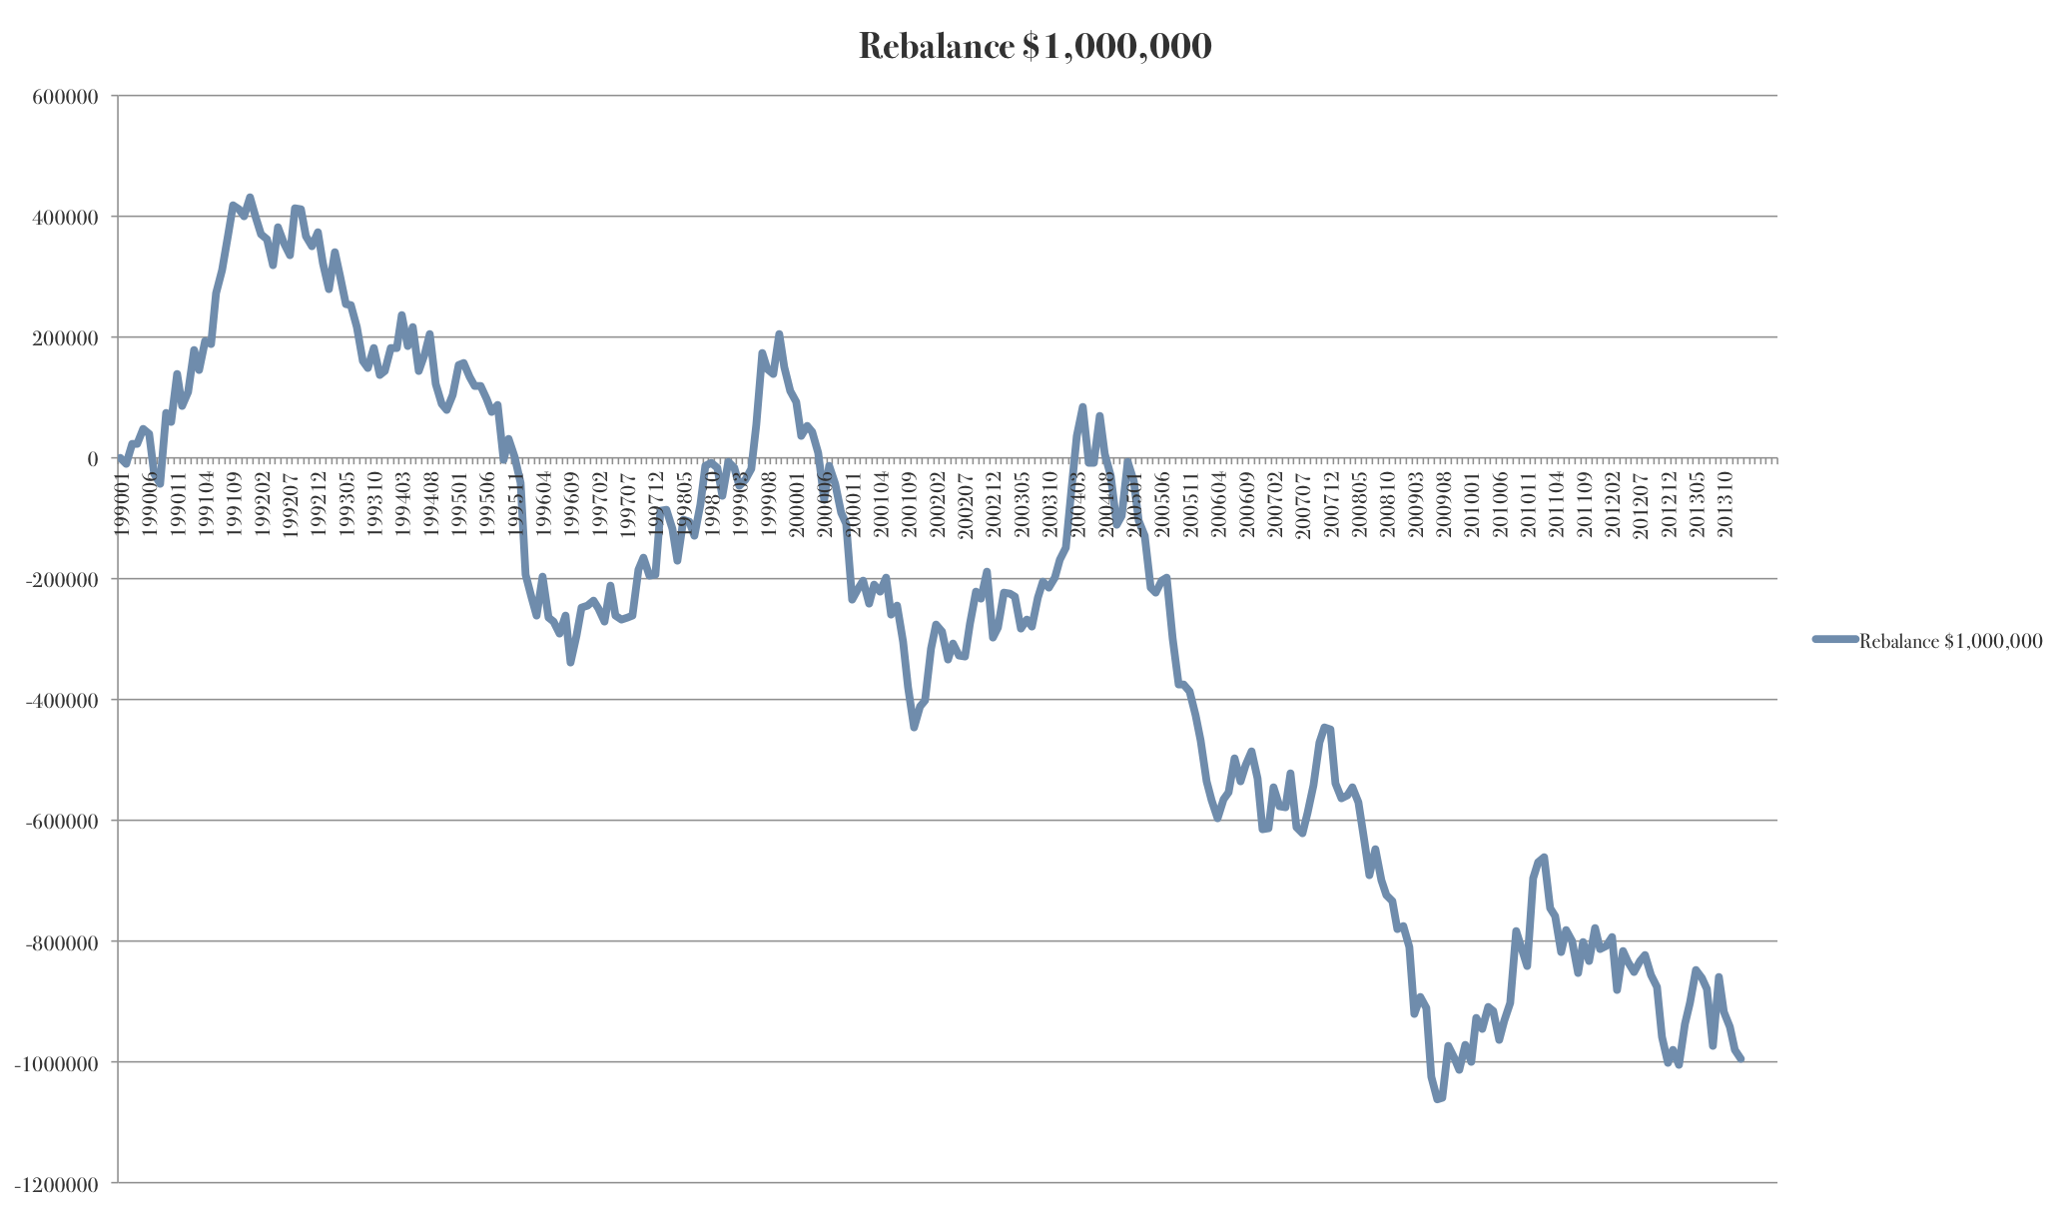
$1M Rebalancing (Example 2)

Slide 27
Idiosyncratic Risk
Arbitrage strategy is no longer riskless (pure)
If we cannot hedge the residual risk, then arbitrageurs may not be willing to conduct an arbitrage trade
Alpha can persist

Slide 28
Multi-Factor Example 2

Slide 29
Example
A portfolio of stocks has the following return which is exposed to Chinese and Australian market movements.
The Chinese factor is captured by the Shanghai Composite Index and the Australian exposure is captured by the Australian All Ordinaries Index
Create a strategy to take advantage of this alpha

Slide 30
Arbitrage Strategy
Mimicking portfolio
Weight in Shanghai= 1.2
Weight in Aussie = 4
Weight in risk-free = 1 – 1.2 – 4 = - 4.2

Slide 31
Arbitrage
Short portfolio A (weight = -100%)
Long mimicking (weight = 100%)
Overall weights:
China: (100% x 1.2) = 120%
Aussie: (100% x 4) = 400%
Risk-free: (100% x -4.2) = -420%
Portfolio A: -100%
Sums to zero

Slide 32
Arbitrage Pricing Theory

Slide 33
Arbitrage Pricing Theory
The arbitrage pricing theory is a theoretical model for expected returns
The arbitrage pricing theory makes three assumptions:
1. Security returns can be described by a factor model
2. There are sufficient securities to diversify away idiosyncratic risk
3. No arbitrage

Slide 34
Law of One Price/APT
Under these assumptions, then the expected return on a well-diversified portfolio should only be determined by the beta on each factor and the price of risk for each factor
Where π_{n} is the risk premium (price of risk) for factor n
Example: π_{m} = E[r_{m}-r_{f}] for the market portfolio
This is the expected return on the factor mimicking portfolio
β_{n} is the factor loading or amount of risk or sensitivity to risk factor n

Slide 35
Risk Premium
The size of the risk premium will depend on investors preferences for that risk
Examples:
The risk premium on inflation innovations may be negative
Assets with returns positively correlated with inflation innovations should have lower expected returns because they have higher returns in bad times (periods of high inflation)
The risk premium on the market is positive
Assets with returns positively correlated with the market should have higher expected returns because they have low returns in bad times (low market returns)

Slide 36
APT Implication
All well-diversified portfolios with the same loading (beta) on the systematic risk factor should have the same expected return
Expected returns must be proportional to the loadings (beta) on the systematic risk factor
Individual securities or undiversified portfolios may or may not have alpha
Alphas will center around zero
Alphas should be uncorrelated with beta and residual risk

Slide 37
APT
APT holds for well-diversified portfolios because idiosyncratic risk is eliminated through diversification
APT cannot guarantee individual assets will have zero alpha
The average alpha across a large set of securities should be zero though
Alpha should be near zero for assets with low residual risk
For very high risk assets, APT may not hold

Slide 38
APT vs. CAPM
APT: CAPM:
Assumes a well-diversified portfolio, but residual risk is still an issue.
Does not assume investors are mean-variance optimizers.
Uses tradable factor portfolios like a market index
Reveals arbitrage opportunities
Allows for many possible factors
Model is based on an inherently unobservable “market” portfolio.
Rests on mean-variance efficiency.
The actions of many small investors restore CAPM equilibrium.

Slide 39
Testing APT

Slide 40
Testing APT
How should we test if APT holds in reality?
First, we choose a factor model (i.e., a set of factors) to test like the Fama-French 3 Factor Model
Second, we select a set of test assets (usually well-diversified portfolios). Typically, we sort assets into portfolios based on characteristics (like past beta, value, size, investment rates, etc.).
Third, run regressions of test asset returns on the set of factors in the factor model
If the factor model “prices” the test assets, then alphas should be (statistically insignificantly different from) zero. We cannot reject the APT null hypothesis of zero alpha.
If the portfolios have non-zero alpha, what does this mean?
Are there arbitrage opportunities?
Or do we not have the right factors? Is there another factor we should consider?
Joint Hypothesis Problem
Is our model wrong or are assets mispriced?
Even if we find that certain factors explain average returns, there will be debate about whether the factors actually capture risks investors should care about

Slide 41
GRS test
To test if a factor model “prices” a set of test assets (e.g., 10 portfolios sorted on a characteristic), we regress each test asset’s returns on the factor returns and examine the intercept
We do not want to use the intercept’s t-statistic from each individual regression as our criteria to reject or fail to reject the null
Why? If we run 10 regressions using 10 different test assets, then on we should expect about 1 will have a statistically significant alpha at the 10% level even if the null is true
GRS test: tests the joint significance of the estimated intercept values
Cite: Gibbons, Ross and Shanken (1989)

Slide 42
Arbitrage opportunities or is FF3 the wrong model?
There are a number of trading strategies related to stock characteristics that have Fama-French 3-Factor model alphas:
Momentum strategies [buy past winners, short past losers]
Firms with high investment rates underperform firms with low investment rates (Titman, Wei and Xie (2003))
Firms that issue new shares underperform those that do not (Loughran and Ritter (1995))
Firms with high idiosyncratic volatility underperform firms with low idiosyncratic volatility (Ang, Hodrick, Xing and Zhang (2009))
More profitable firms have abnormally high returns (Fama and French (2006,2008))

Slide 43
Summary
Arbitrage pricing theory shows that returns on well-diversified portfolios should be a linear function of risk factors
Assumes:
Security returns can be described by a factor model
There are sufficient securities to diversify away idiosyncratic risk
Investors exposed to systematic risk factors after diversification
No arbitrage
No alpha on well-diversified portfolios
Possible to have alpha on individual securities or portfolios with idiosyncratic risk (underdiversified portfolios)

Slide 44
Next Class/Week
Thursday:
Time to work on “Testing Multifactor Models” Assignment
Read APT Notes
Next week:
Investment performance evaluation

